Slide 1


Slide 2
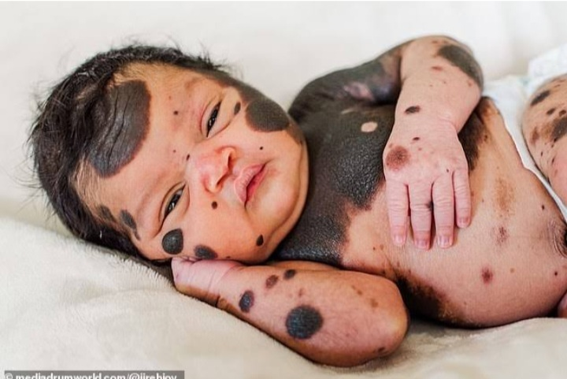
Congenital Naevi and Other Developmental
Abnormalities Affecting the Skin
DR.KHADIJA
FCPS RESIDENT OF DERMATOLOGY
JPMC,KARACHI.

Slide 3


Slide 4
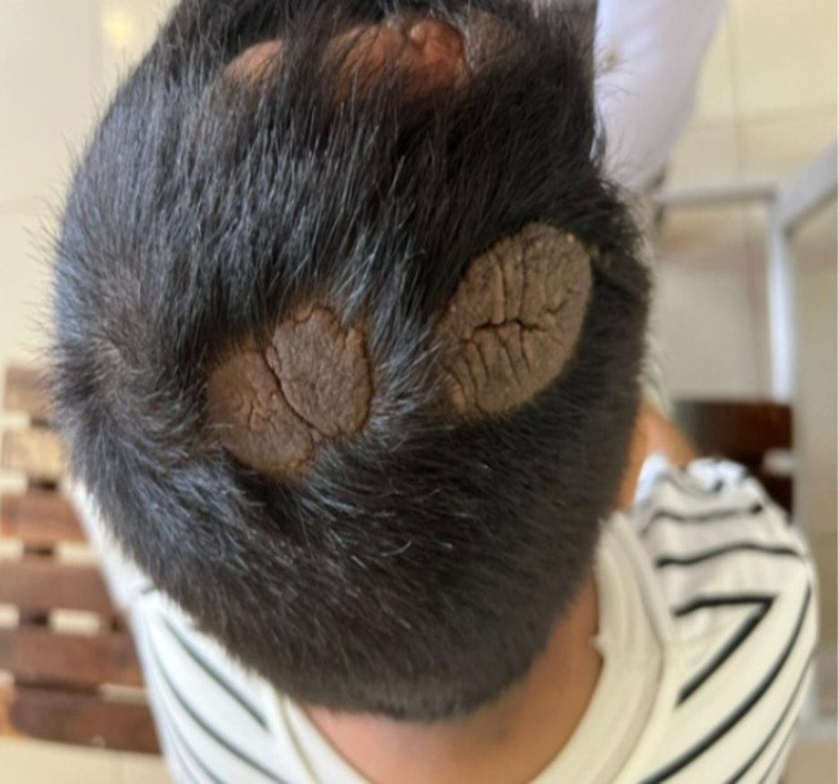

Slide 5
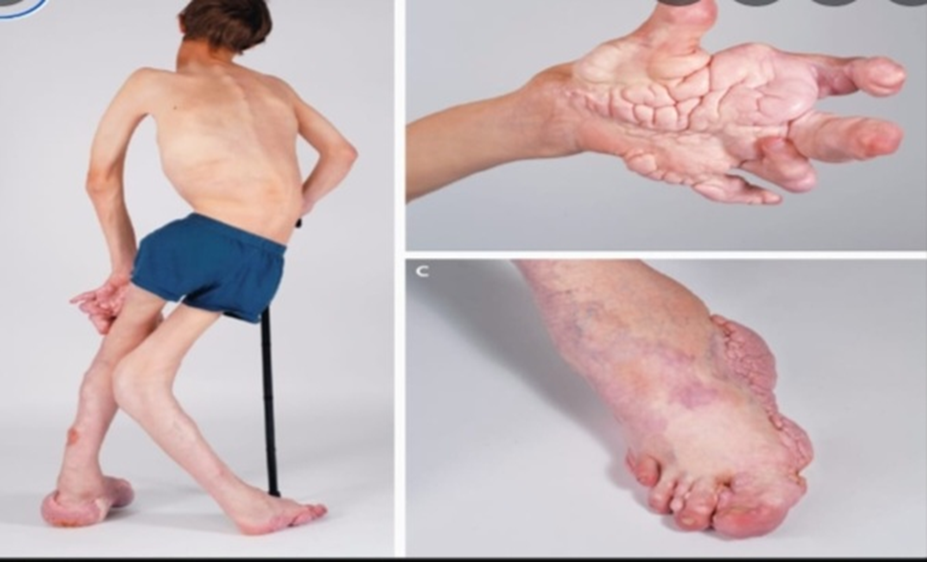

Slide 6
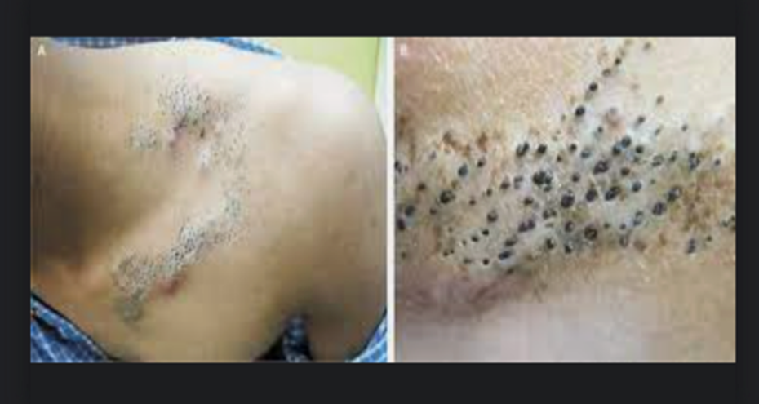

Slide 7
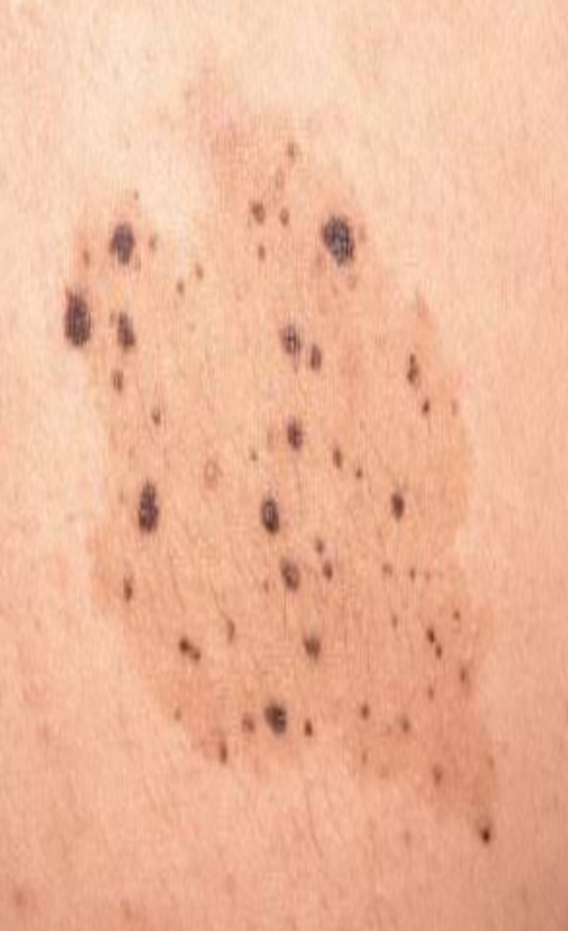

Slide 8
CONGENITAL NAEVI:
Also known as Birthmarks,results from disordered/abnormal proliferations of cells within the tissue of origin,due to developmental error.
Present at birth OR shortly after birth.
Usually caused by somatic mutation in a cell that resides in skin.
Only some part of skin is affected and rest of the skin appear entirely normal macroscopically.

Slide 9
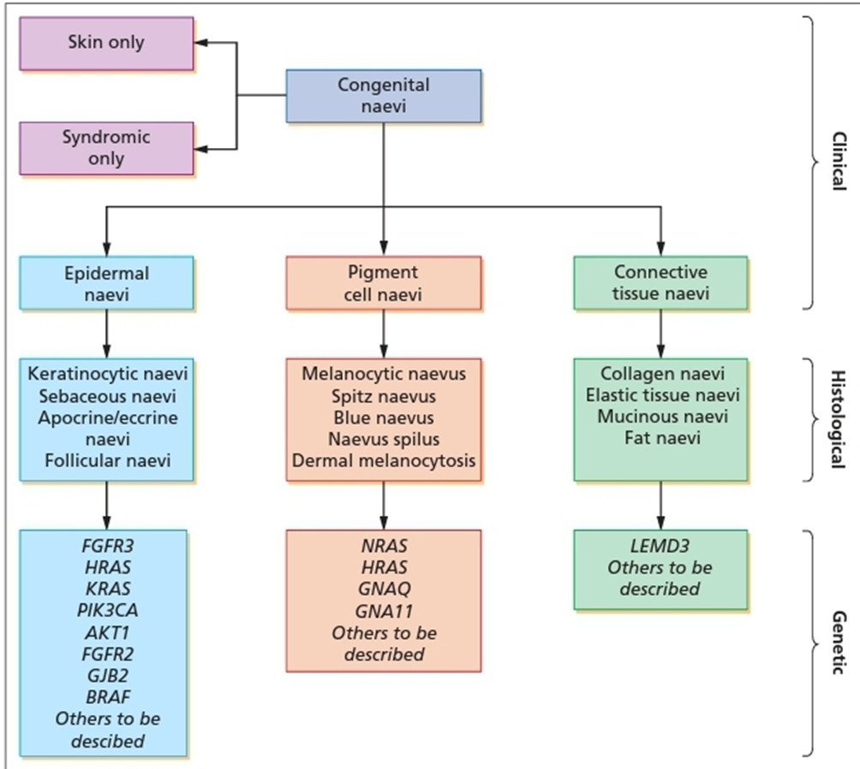

Slide 10
Clinical features:
History:
at birth
or become apparent in the first years of life,
in a characteristic developmental pattern.
become more pronounced with age.

Slide 11
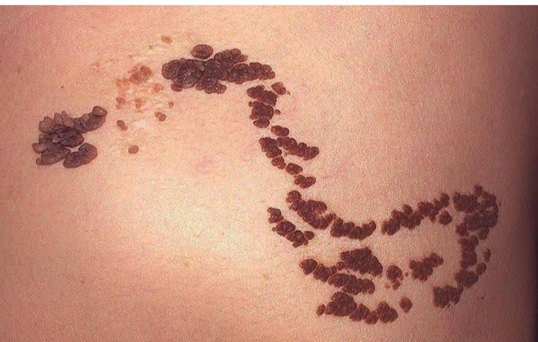
CONGENITAL EPIDERMAL NAEVI:
Usually benign.
Isolated cutaneous lesions
OR
in association with extracutaneous
features as part of diverse syndromes,
Extracutaneous features:including neurological,
ophthalmological,skeletal and endocrinological
abnormalities.
Commonest CEN,sebaceous naevi(prevalence of 1-3
in 1000)

Slide 12
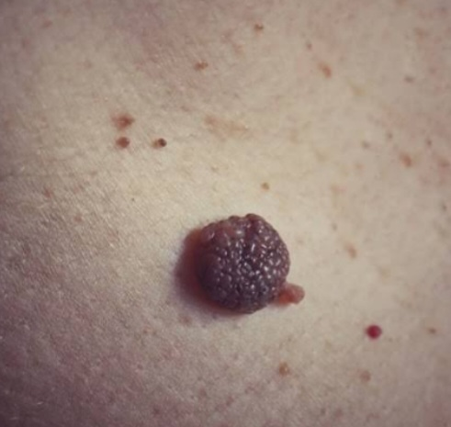
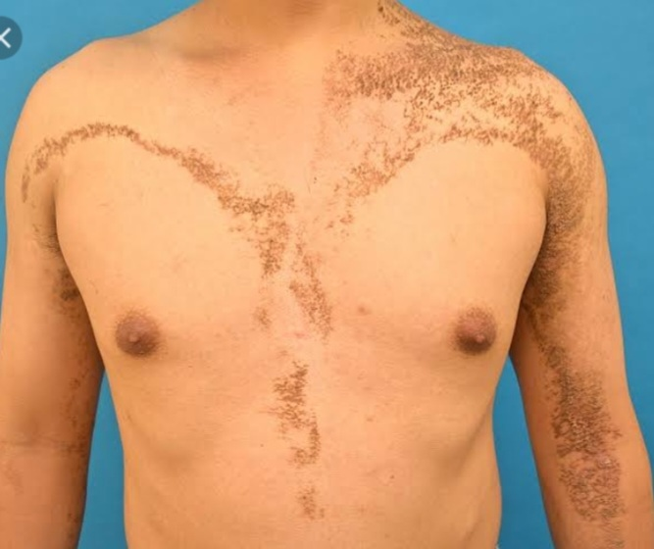
Single CEN may be round or linear.
Larger and multiple lesions are Blaschko linear in distribution.
Epidermal naevi are very superficial and raised ,
giving a ‘Stuck On’ appearance on skin surface.
No role of Environmental factors in CEN.

Slide 13
Genetics:
Most CEN are caused by single postzygotic mutations in an epidermal precursor cell, leading to epidermal mosaicism, with or without mosaicism in other organs.
Keratinocytic CEN:(FGFR3,PIK3CA,HRAS,KRAS,AKT1,KRT1,KRT10)
Sebaceous Naevi:(HRAS,KRAS)
Follicular Naevi(FGFR2)
Porokeratotic Eccrine Naevi(GJB2)

Slide 14
H/P:Epidermal naevi
Localized Hamartomatous processes characterized by Hyperkeratosis,Thickened Epidermis and papillomatosis.
Histologically classified based on predominant epidermal component
(Sebaceous,kerationcytic ,follicular,eccrine/apocrine).
Whether inflammatory component present(ILVEN) or not.

Slide 15
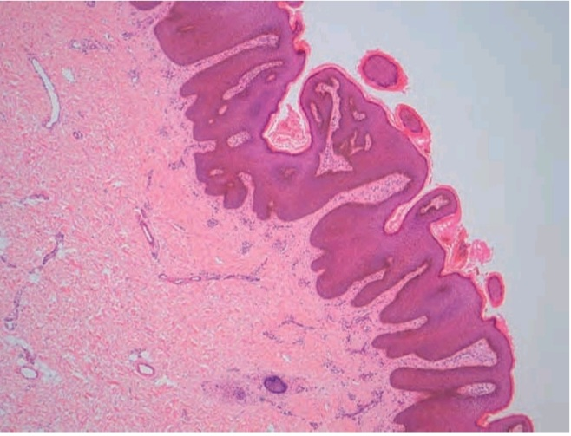
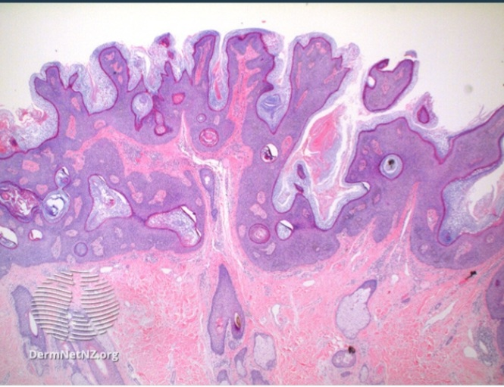

Slide 16
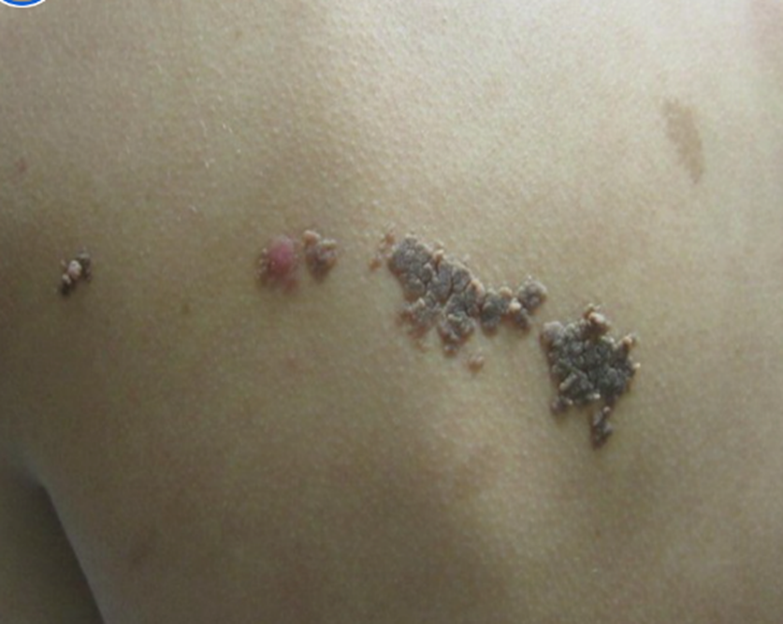
1:Keratinocytic Naevi :
Vary from pale brown to red, and
nearly macular,with a soft velvety feel,
verrucous or hyperkeratotic, and can have
a prominent inflammatory component.

Slide 17
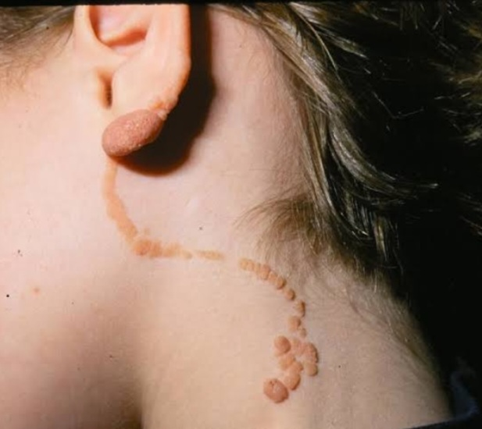
ILVEN:

Slide 18
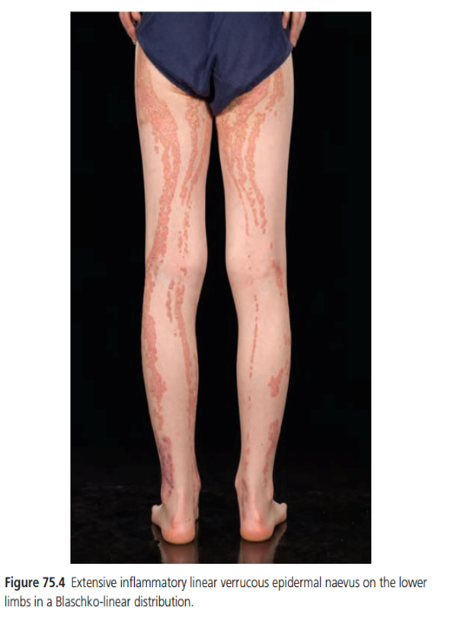
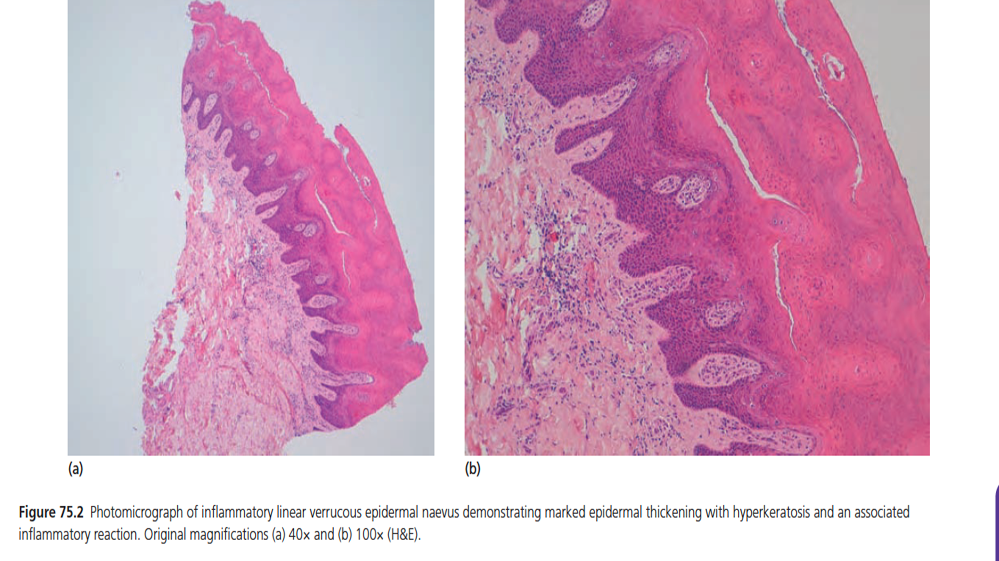
HISTOLOGY:
Marked inflammatory component, including a psoriasiform appearance with epidermal hyperplasia and a dense associated superficial dermal inflammatory infiltrate.

Slide 19
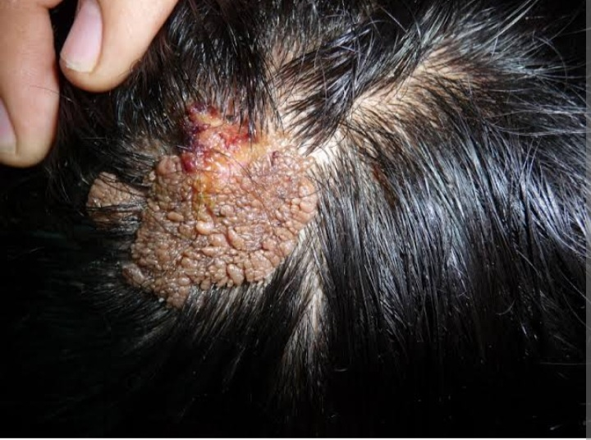
2:Sebaceous Naevi:
Greasy feel and appearance,
are often yellowish or pink but
can sometimes be deeply pigmented.

Slide 20
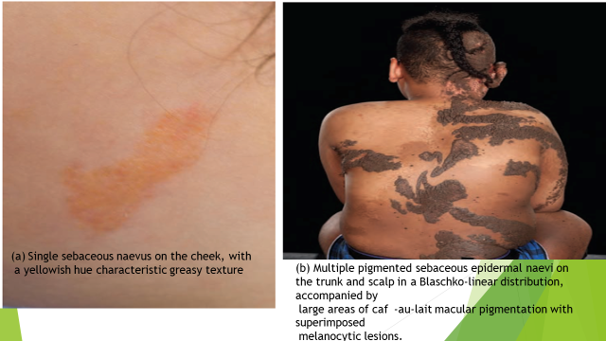

Slide 21
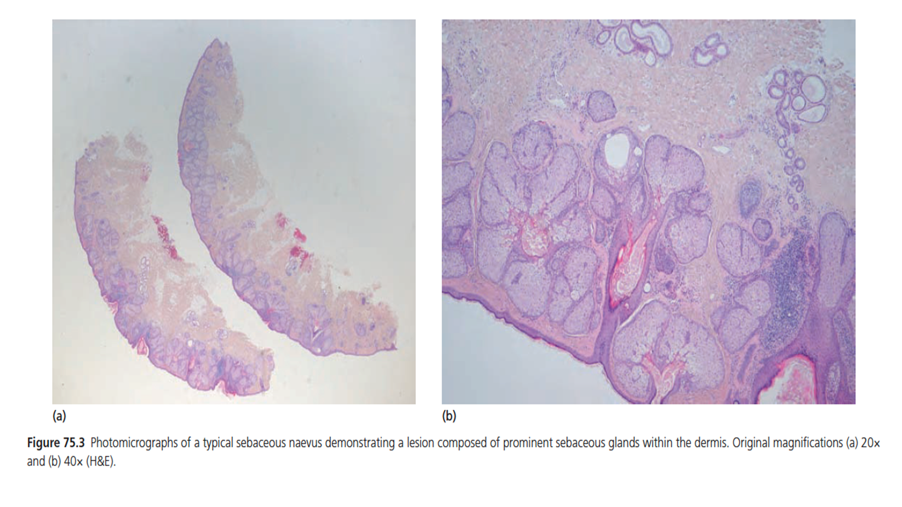

Slide 22
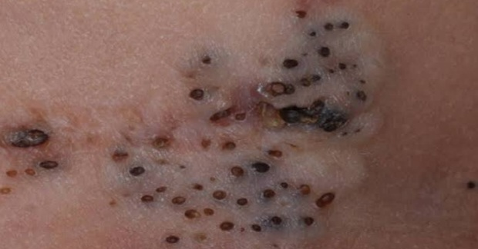

3:Follicular naevi (naevus comedonicus or acne naevus).
Very characteristic in appearance,
skin coloured with a high density of multiple,
comedo‐like lesions.

Slide 23
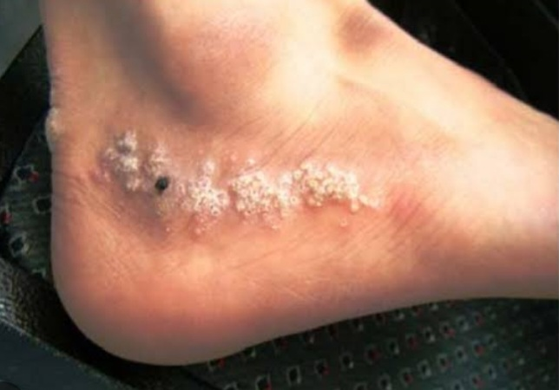
4:Congenital eccrine or apocrine naevi:
.Localized hyperhidrosis, with porokeratotic variants of eccrine naevi exhibiting the classic signs of porokeratosis.

Slide 24
Clinical variants
Schimmelpenning–Feuerstein–Mims syndrome and phakomatosis pigmentokeratotica:
HRAS mosaicism
Clinical features of Schimmelpenning syndrome are linear sebaceous epidermal naevi with or without the following: areas of keratinocytic epidermal naevus, naevus spilus (synonym: speckled lentiginous naevus) or areas of caf ‐au‐lait macular pigmentation, neurological abnormalities, ocular abnormalities, developmental skeletal abnormalities and hypophosphataemia leading to rickets.

Slide 25
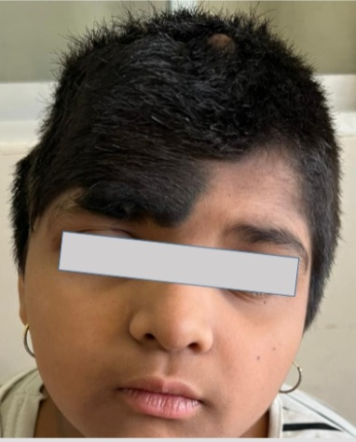

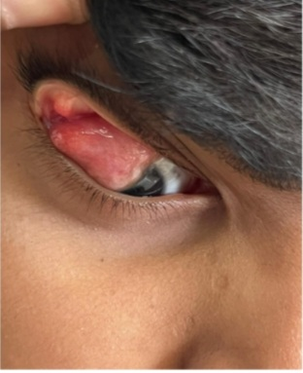
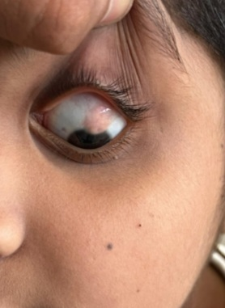
Schimmelpenning/Linear Naevus sebaceous syndrome:

Slide 26
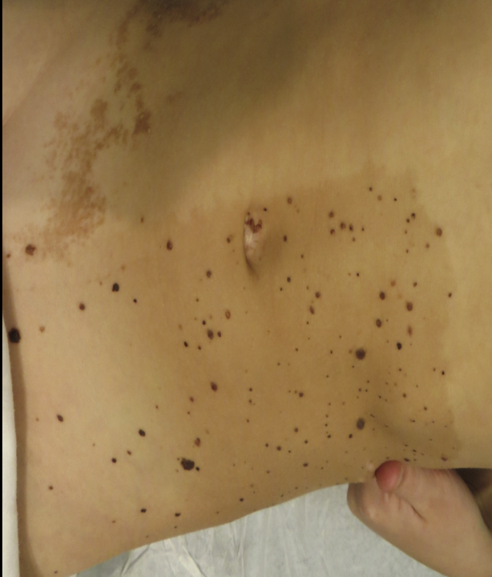
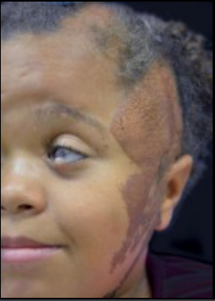
Schimmelpenning–Feuerstein–Mims syndrome
phakomatosis pigmentokeratotica:

Slide 27
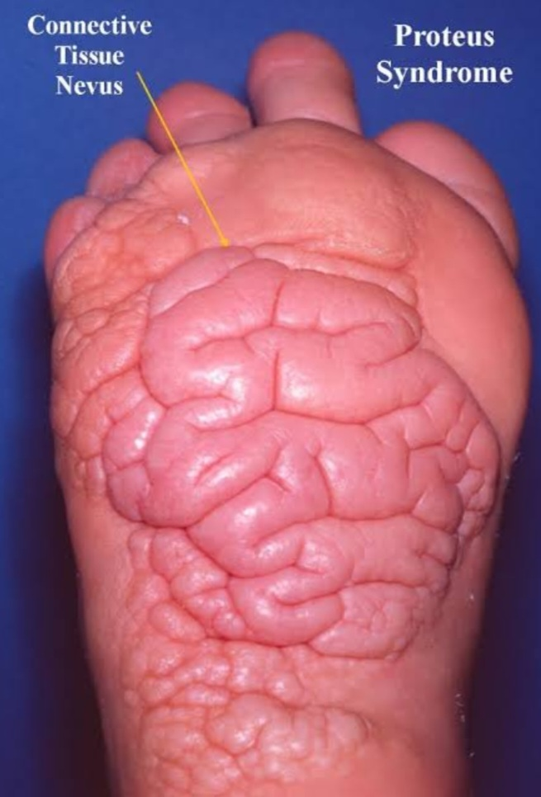
Proteus syndrome:
Mosaic disorder of overgrowth.
Cutaneous lesions include keratinocytic epidermal naevi,
connective tissue naevi,(cerebriform thickening
mainly over palms and soles), lipomas, vascular naevi
and patchy lipohypoplasia or dermal hypoplasia.
The number of skin lesions correlates to some degree
with the severity of the phenotype in an affected individual and can progress over time.
Somatic mosaicism for AKT1 mutations.

Slide 28


Slide 29
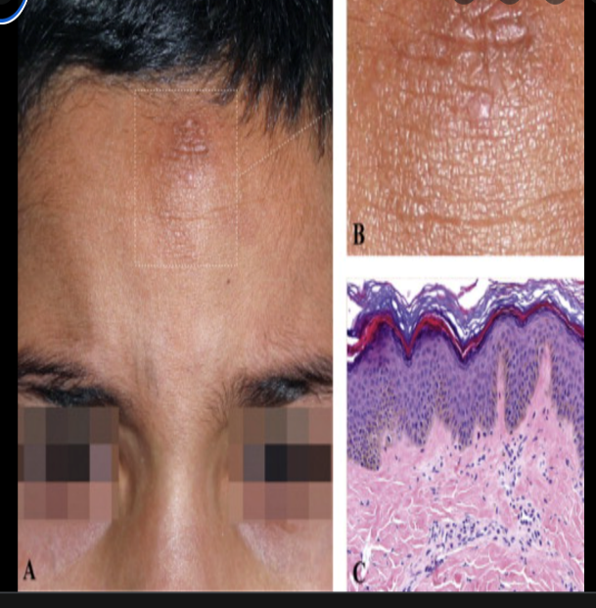
PENS syndrome
This newly delineated familial or sporadic syndrome
Characterized by multiple, round/ovoid, papular, white/ yellowish, keratotic lesions of 0.1–1.5 cm diameter.
At birth or develop shortly after.
Have a characteristic histological appearance of a ‘skyline’ basal cell layer
Many of the cases described have had mild neurodevelopmental delay and/or epilepsy.
Notes:
Papular epidermal nevus.

Slide 30
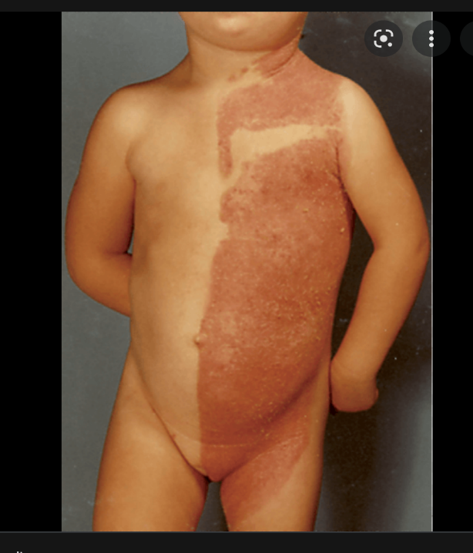

CHILD syndrome:
Striking condition affecting either the right or left of the body with a sharp midline cut‐off.
Genetic defect is known to be germline loss‐of‐function mutations in NSDHL which encodes an enzyme involved in cholesterol metabolism, with X‐inactivation postulated to be responsible for the hemi-dysplasia phenotype.
The inheritance is X‐linked dominant.
Lethal in males.

Slide 31
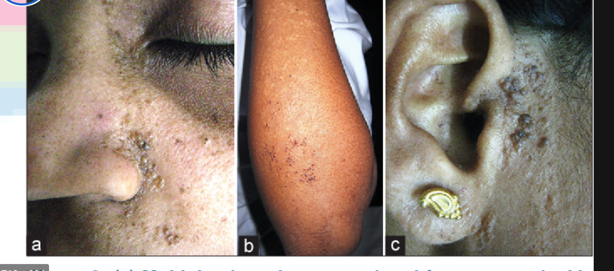
Happle–Tinschert syndrome:
This is the rare association of segmental
basaloid follicular hamartomas with
extracutaneous abnormalities, most notably
in the dental, osseous and neurological system.
Follicular naevus/naevus comedonicus syndrome. Naevus comedonicus associated with cataracts,skeletal and neurological abnormalities.
The genetic basis of isolated naevus comedonicus is known to be mutations in FGFR2.
Becker Naevus Syndrome:

Slide 32
COMPLICATIONS:
Increased risk of superimposed benign tumour development.
Very low risk of malignant transformation including syringocystadenoma
papilliferum(1%),BCC(less than 1%) and SCC is rarer.
Experience of HRAS mosaicism with extensive sebaceous naevi.
Melanoma has been described in Becker naevus .
Hypophosphataemic rickets and osteomalacia →RAS gene mosaicism.
Neurological abnormalities associated with CEN→ neurodevelopmental delay and/or seizures.

Slide 33
Disease course and prognosis:
At the present time all postzygotic mosaic CEN are permanent if not surgically removed.
The prognosis for CEN without extracutaneous involvement is excellent.
patients with CEN syndrome remains guarded with respect to neurological, ophthalmological, skeletal and other organ system abnormalities and should be assessed on an individual basis.

Slide 34
MANAGEMENT
Biopsy of the epidermal naevus is required to make an exact diagnosis particularly for keratinocytic CEN of any size, to look for epidermolysis.
EPIDERMOLYTIC CEN → clinical geneticist for counselling at an appropriate age as there is a possibility of transmitting the trait as a germline heterozygous dominant mutation if there is gonosomal mosaicism.
CEN WITH inherited dimension (e.g. CHILD syndrome, Cowden syndrome) →clinical genetics.

Slide 35
Dental, ophthalmological, neurological, orthopaedic or metabolic assessment
Baseline electrolyte and calcium/phosphate/alkaline phosphatase measurement
MRI/CT SCAN.
SURGICAL EXCISION OF SMALL EPIDERMAL NEVUS
Keratinocytic and sebaceous naevi are →Ablative laser therapy to reduce thickness and/or hyperkeratosis of the lesion, and smaller verrucous lesions have been treated successfully with cryotherapy.
ILVEN AND CHILD → CO2 laser therapy, topical calcipotriol, etanercept and oral retinoids.

Slide 36
CONGENITAL PIGMENT CELL NAEVI:
Benign, pigmented, melanocytic naevi present at birth ,first year of life
Or in minority of cases may become clinically apparent in first 2 years
of life termed as ‘Congenital naevus Tardive’.
Enviromental Factors:
Smoking during Pregnancy associated with small risk.
Mothers of child born with CMN significantly suffered from
threatened miscarriage,
severe nausea/ vomiting or raised blood pressure.

Slide 37
Gender:Slight predominance of females to male of 1.2 :1.
Genetics:Somatic mutation in NRAS or BRAF gene,
Germline variant gene i.e:melanocortin-1-receptor gene(MC1R) in one study.
Associated Diseases:Neurofibromatosis 1(esp if Multiple)

Slide 38
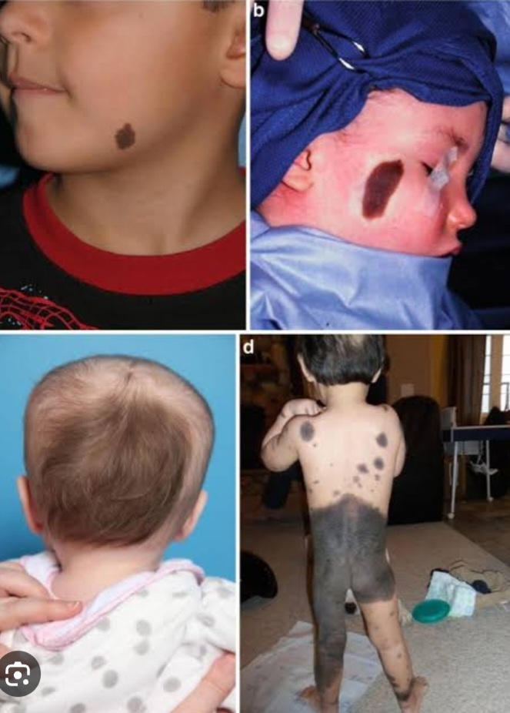
History and Presentation:
Brown or black.
Purplish or red, particularly at birth .
Palpable with increased surface markings.
Darkest at birth and lighten to some degree
over the first few years of life.
If CMN present on scalp,overlying hairs are
thick luxuriant or wiry at birth,grows greater
than surrounding hairs.
.Single or Multiple CMN
.Multiple → ‘satellite’ lesions

Slide 39
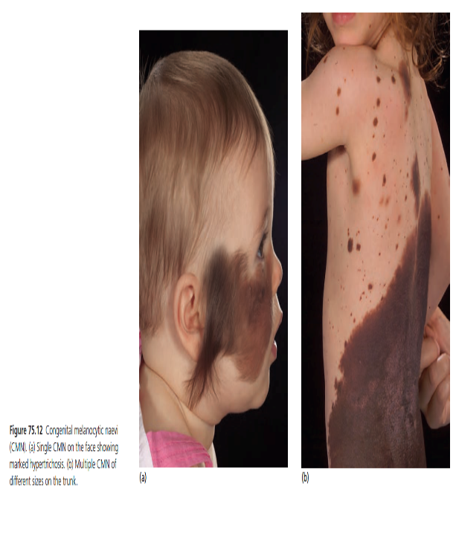
.Two commonly arising proliferating lesions:
A)Classic proliferative nodules:
Present at birth, are well circumscribed, symmetrical, round or oval, soft to firm and of any uniform colour.
.Half to a few centimetres in diameter.
.Easily resected
B)Diffuse neuroid proliferations:
Not present at birth, but can develop at any point during childhood, and often continue to grow slowly over time.
Become more active around puberty. They have less well‐defined edges .
Few centimetres to many centimetres in diameter, are firm, and often become pendulous when larger.
Difficult to resect, as they tend to recur, sometimes quickly.

Slide 40
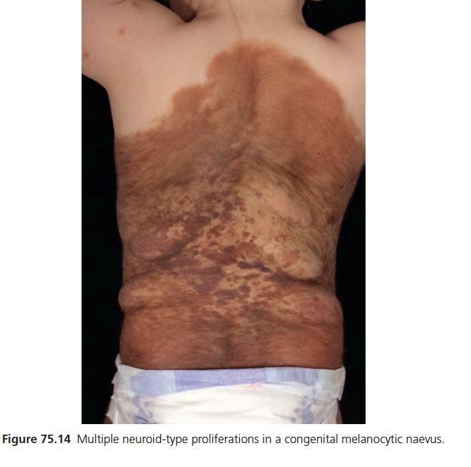
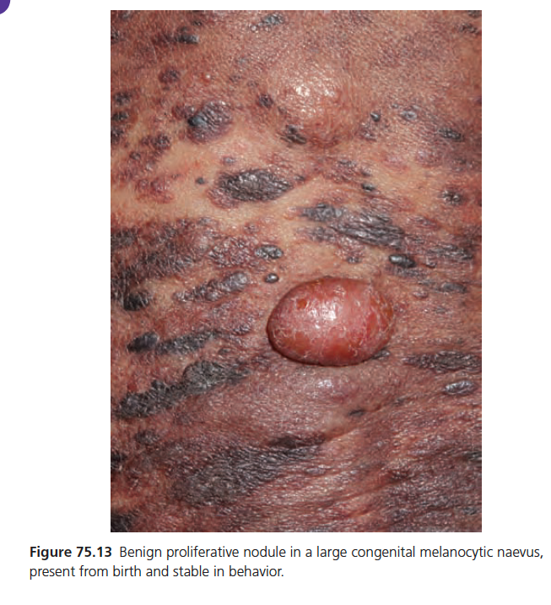

Slide 41
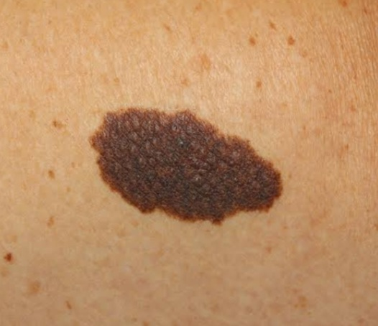
Classification of CMN:
Small CMN: less than 1.5cm.
Medium CMN:1.5-19.9 cm.
Large or Giant CMN:more than 20 cm in diameter.

Slide 42
Pathology:
Compound naevi with junctional and predominant dermal components.
Bland melanocytes that extend around adnexal structures and often into the underlying muscle and fat.
No cytological atypia.
Rarely melanoma may arise within CMN But Differentiating Features of Melanoma are:poorly circumscribed,infiltrating proliferation of cells often with focal necrosis,marked cytological atypia and mitotic activity.

Slide 43
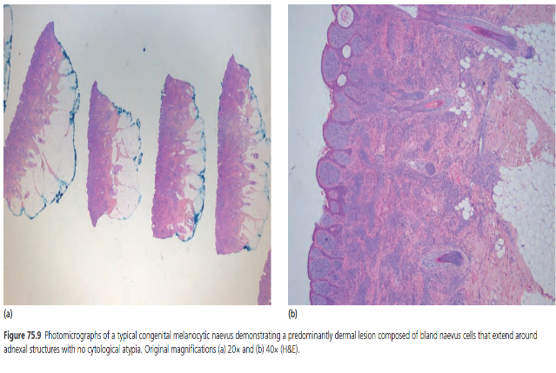
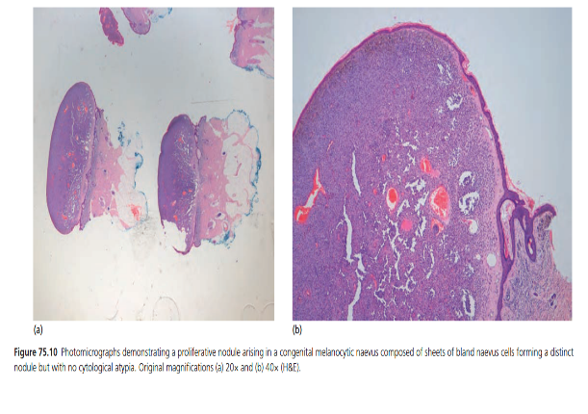
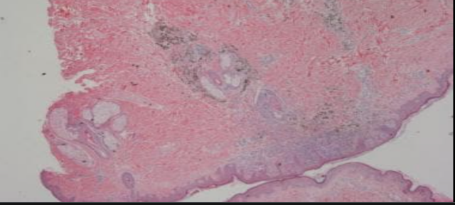
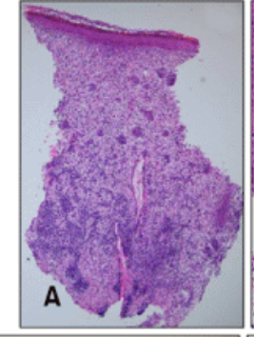

Slide 44
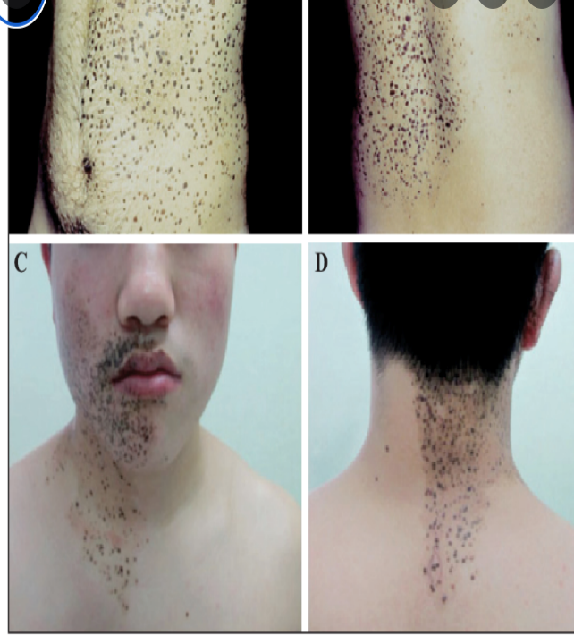
Clinical variants:
Naevus spilus‐type CMN
Cafe ‐au‐lait macule background, onto which are
superimposed multiple, raised CMN of different sizes
and colours .

Slide 45
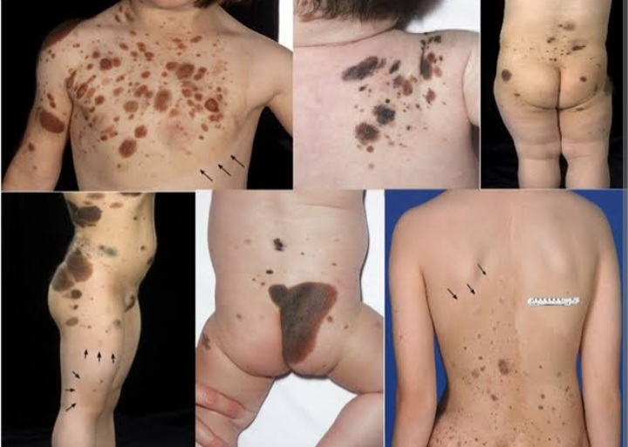

Slide 46
Classification of severity
Depends on number of lesions i.e:If the patient has more than one CMN there is some degree of risk of neurological and malignant complications.
Presence of Neurological lesions on MRI,Clinical neurological abnormalities,Characteristic fascial features,Presence of malignancy.
Projected Adult Size(PAS) of CMN statistically correlated with Neurological outcomes.
Other Cutaneous Phenotypes includes Rugosity and Colour.

Slide 47
Complications and co‐morbidities
NEUROLOGICAL ABNORMALITIES:
INTRA-PARENCHYMAL MELANOSIS is the commonest MRI findings in association with mulyiple CMN(most common site is amygdala) and Seizures are most commonly temporal lobe epilepsy.
50% of cases the lesions are asymptomatic
50% associated with neurodevelopmental delay, attention deficit hyperactivity disorder and autistic spectrum disorder, or seizures.
MELANOMA → Life time risk→ 0.1-2%(median age 7 yrs)
Risk increases if PAS of CMN is more than 60cm.
Primary Melanoma donot arise within affected skin but within CNS in atleast 50% of cases.
Other tumors:Rhabdomyosarcoma.(rare)

Slide 48
Characteristic Fascial Features:(atleast 3 Characteristic features seen in 74% of Cohort studies),including:
1:Wide or Prominent Forehead
2:Hypertelorism
3:Eyebrow variants
4:Perorbital fullness
5:Small/short nose
6:Narrow nasal bridge
7:Broad nasal tip
8:Broad or round face
9:Prominent premaxilla
10:Prominent/long phitrum
11:Everted Lower lip.

Slide 49
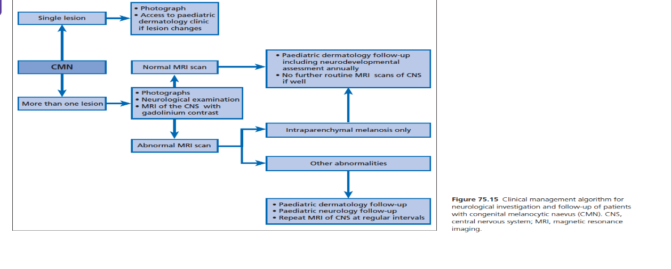
MANAGEMENT
Children with multiple (i.e. two or more) CMN at birth
(independent of size or site) should have a routine MRI
of the brain and whole spine with contrast injection,
preferably within the first 6 months.

Slide 50
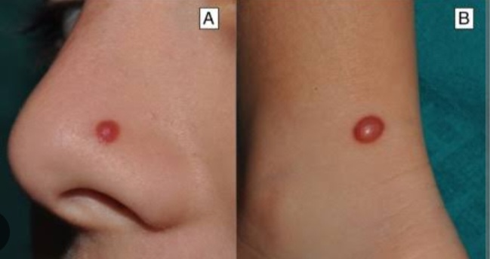
2:Congenital Spitz naevus
RARE
At birth, and, as in later life, they can mimic melanoma.
The diagnosis is made after excisional biopsy.
the histological features are characteristic of acquired Spitz naevi

Slide 51
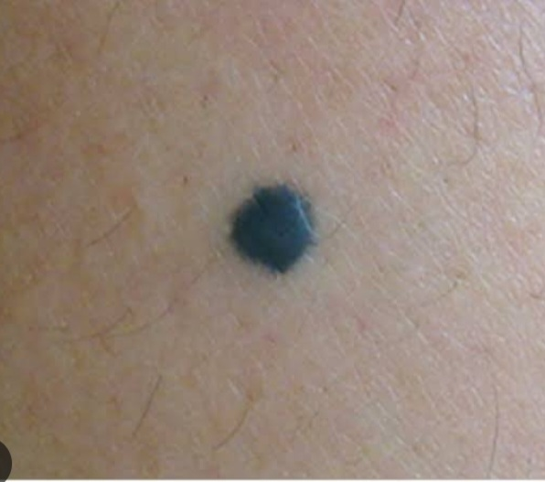
3:Congenital Blue Naevus:
CAN BE CONGENITAL OR AQUIRED → GNAQ
CONGENITAL MOST FREQUENT SITE → scalp→
association with various underlying scalp and
neurological defects and with malignant
transformation
Rarely associated with uveal melanoma.

Slide 52
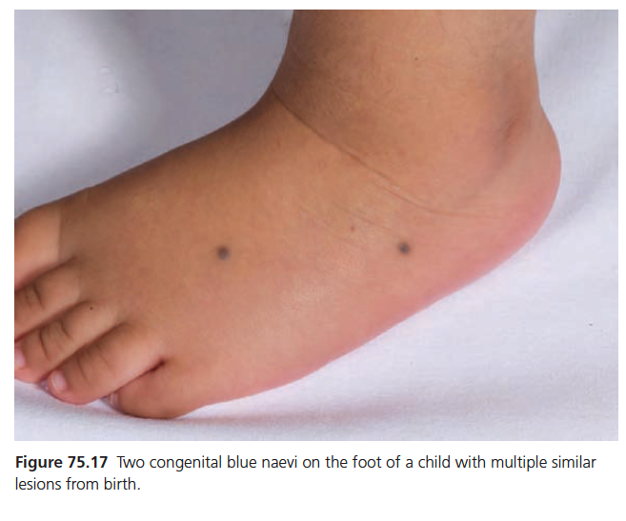
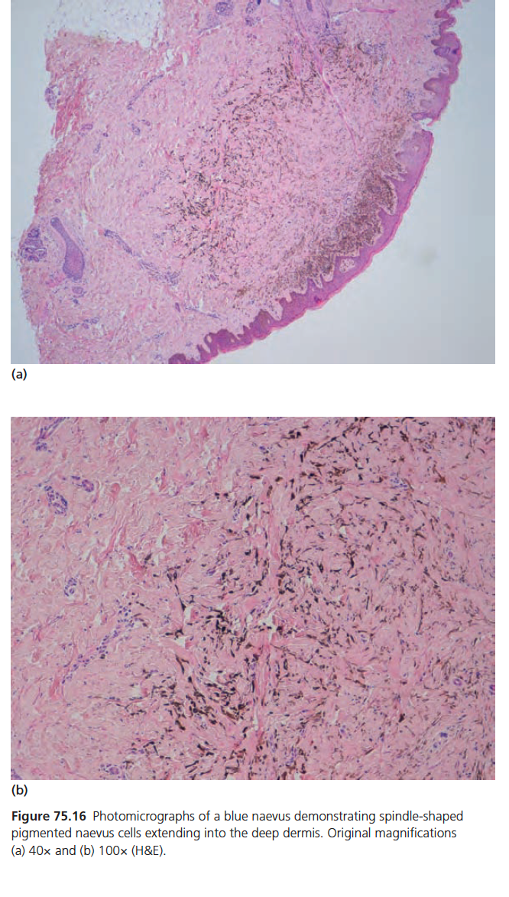

Slide 53

4:Congenital Naevus Spilus (or speckled lentiginous naevi)
Pigmented lesions with a caf ‐au‐lait macule background
and superimposed, more darkly pigmented areas (or speckles).
Generally single but size varies from cm to covering the whole
limb in segmental distribution.

Slide 54
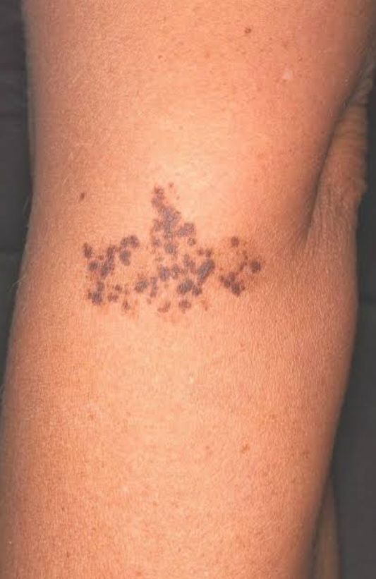
Distinguished from naevus-spilus-type congenital melanocytic naevi by the size of darker areas which usually small a few millimetres in diameter at most The background may not be apparent at birth.
Larger lesions can form part of phakomatosis pigmentokeratotica OR speckled lentiginous naevus.

Slide 55


