Slide 1


Slide 2
Chromosomal disorders
Dr Zeeshan Hameed

Slide 3
Chromosomal disorders
Chromosomal disorders may be due to abnormalities of chromosome number or structure and may involve autosomes or sex chromosomes.
Somatic cells are diploid, with a complement of 46 chromosomes, whereas gametes (ova and sperm) are haploid, with only 23 chromosomes.

Slide 4
Numerical abnormalities that involve the gain or loss of one or more chromosomes are known as aneuploidies.
Chromosomal abnormalities generally cause multiple congenital malformations.

Slide 5
Autosomal chromosome defects
Down’s syndrome
It is the most common autosomal abnormality, with a frequency of about 1 per 700 live births.
Three cytogenetic variants cause Down syndrome:
Trisomy 21, chromosomal translocation and mosaicism
Trisomy 21 accounts for nearly 95% of all patients with down syndrome.
Less commonly, patient with down syndrome may have 46 chromosomes with either 21/22 translocation or 21/21 translocation.

Slide 6
Clinical features
Intellectual disability with IQ usually less than 50
Small head, flat facies with increased interocular distance (hypertelorism), depresssed nasal bridge, flat occiput, broad short neck and small ears.
Narrow and upward and outward slating of the palpebral fissure (80%)
Small mouth (relatively) with protrusion of the tongue (macroglossia)
Short stature, broad, short hands, feet and digits and protuberant abdomen.
Hypocongenitalism
Congenital defects: Heart or endocardial cushion defects (40%)

Slide 7


Slide 8
Cutaneous manifestations of Down syndrome:
Soft and velvety skin in early childhood
Dry skin in late childhood – Xerosis (70%), atopic dematitis (50%), palmoplantar hyperkeratosis (40-75%), and seborrheic dematitis (31%)
Premature wrinkling of the skin, cutis marmorata and acrocyanosis
Bacterial infections, fungal infections (tinea), and ectoparasitism (scabies)
Elastosis perforans serpiginosa
Syringomas
Alopecia areata (6- 8.9%), vitiligo, psoriasis
Anglar cheeilitis

Slide 9
Trisomy 18
Edwards’ syndrome
Severe mental deficiency
Characteristic skull shape with a small chin and prominent occiput
Low- set malformed ears
Clenched hands with overlappling index and fifth fingers, single palmar crease
Cutaneous features include:
Cutis laxa of the neck
Hypertrichosis of the forehead and back
Capillary haemangiomas.
death within a month occurs in (30%). Only (10%) survive beyond the first year and these infants show profound developmental delay

Slide 10
Sex chromosome defects turner’s syndrome
Turner’s syndrome is defined as gonadal dysgenesis due to a missing or structurally defective X chromosome
The frequency of Turner’s syndrome is 1 per 2500 female births.
In some 80% of cases there are 45 chromosomes with an XO sex chromosome complement.
Such cases are chromatin negative in buccal smears.
Turner’s syndrome results in early spontaneous loss of fetus in over 95% of cases.
The diagnosis is usually made later as a result of investigation for short stature and primary amenorrhea.

Slide 11
Clinical features
Short stature:
Ovarian failure: Elevated level of luteinizing hormone(LH) and FSH confirm ovarian failure.
Pubic hair development is normal.
Many patients have hypoplastic or hyperconvex nails.
Excessive numbers of nevi, when compare to other family members are common.
Webbed neck and a low or indistinct hairline.
Cubitus valgus (increased carrying angle).
The chest appears to be broad with widely spaced nipples. This may be cause in part by a short sternum.

Slide 12
Eye: ptosis, strabimus, amblyopia and cataract are more common in girls Turner syndrome.
Hip dislocation and scoliosis.
Hypertension and murmurs (Evaluation prior to initiation of estrogen therapy or assisted reproduction is strongly recommended).
Hypothyroidism
Cutis laxa: Loose folds of skin, particularly in the neck are signs in newborns.

Slide 13
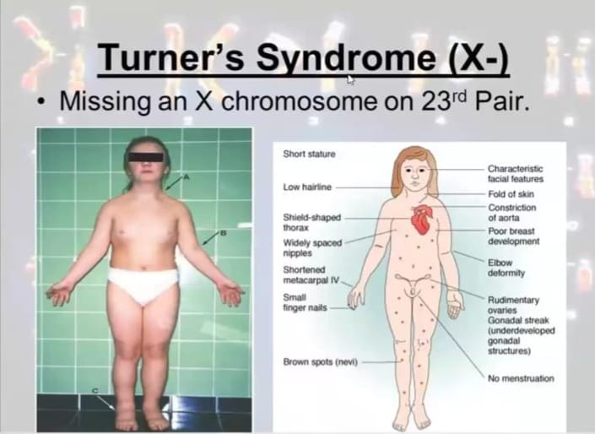

Slide 14
Diagnosis
Diagnosis may be made prenatally by amniocentesis.
Increased urinary excretion of FSH supports the diagnosis, which can be confirmed by examination of buccal smears supplemented by chromosome studies.

Slide 15
Treatment
Oestrogen replacement will allow the development of secondary sexual characteristics but does not seen to influence stature or infertility.
Treatment with human growth hormone may improve the ultimate adult height.
Melanocytic naevi may grow more rapidly during growth hormone.

Slide 16
Klinefelter’s syndrome
The frequency Klinefelter’s syndrome is 1 per 600 male births.
In buccal smears the nuclei are chromatin positive and indistinguishable from those of normal female, but in culture there are seen to be 47 chromosomes with an XXY sex chromosome complement.
The differentiation of the developing gonads proceeds along male lines but the testis fails to develop fully and many seminiferous tubules are replaced by fibrous tissue.

Slide 17
The testes are small and fail to produce adult levels of testosterone, which leads to poorly developed secondary sexual characteristics and infertility.
Hair growth on trunk, limbs and face tends to be bellow average.
Psychiatric disorders are common but mental deficiency is not.
They are tall, obese and may develop gynaecomastia.
Patients with Klinefelter’s syndrome have an increased risk of developing leg ulcers, especially in combination with hyperpigmentation or atrophie blanche. Some authors have attributed the cause of leg ulceration to venous insufficiency.

Slide 18
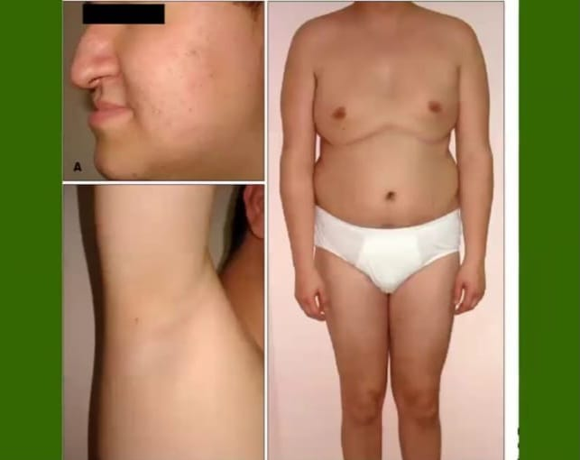

Slide 19
Diagnosis
The association of gynaecomastia with small testes and otherwise apparently normal genitalia should suggest the diagnosis.
It is supported by increased urinary excretion of gonadotrophin.
The diagnosis is confirmed by chromosome studies.
Treatment.
Testosterone replacement therapy will improve secondary sexual charactristics, but infertility is the rule, expect in mosaic patients.

Slide 20
Chromosomal mosaicism
It is the coexistence within an individual of two or more distinct cell lines that are genetically identical expect for the chromosomal difference ( total number/ploidy, deletions, duplications and other chromosomal abnormalities) between them.
Mosaicism results from a post-zygotic event caused by a mitotic error in some cell lines during embryogenesis.
Costitutional mosaicism often involve the skin, is expressed as patchy pigmentary, vascular, atrophic or hyperkeratotic changes along the lines of Blaschko.

Slide 21
POIKILODERMA SYNDROMES

Slide 22
Dyskeratosis congentia
It is a rae inherited disorder characterized by atrophy and pigmentation of the skin, nail dystrophy, leukoplakia, bone marrow faliure and predisposition to malignancy.
The nail changes are usually the first to appear between the ages of 5 and 13 years, the nails become dystrophic and are shed.
Recurrent episodes of suppurative paronychia.

Slide 23
Fine, reticulate, grey-brown pigmentation is most conspicuous on the neck and thigh.
The skin has poikilodermatous appearance.
Small blisters and erosions of the lingual and buccal and mucous membranes are succeeded by irregular patches of leukoplakia.
Similar changes may occur throughout the gastrointestinal tract and the urogenital mucous membranes.
General physical and mental growth is sometimes retarded.
The hair maybe noraml but is sometimes sparse and dry.

Slide 24
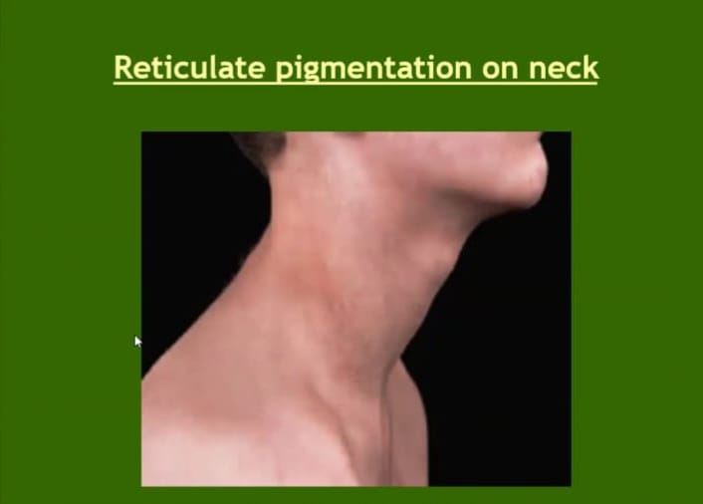

Slide 25
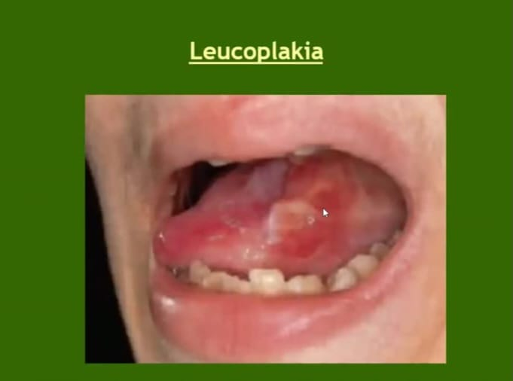

Slide 26
Genetics
All forms of DKC arise from mutations in genes involved in telomere maintenance or protection. Telomere are structures composed of tandem neuclotides repeats and a protein complex at the ends of chromosomes that are required to maintain integrity.
Determine by an X-linked recessive gene, localized to Xq28.

Slide 27
Haematological abnormalities
The incidence of bone marrow faliure in DKC is high.
Myelodysplasia and acute myeloid leukaemia have been.
Bone marrow and stem cell transplantation have been undertaken in many patients.

Slide 28
Malignancy
The incidence of carcinoma in the areas of leukoplakia appears to be high. It may prove fatal between the ages of 30 and 50 years.
Other neoplasms reported include pancreatic carcinoma and hodgkins disease.

Slide 29
Prognosis
The prognosis is usually poor as a result of blood dyscrasia or carcinoma.
Individuals with TINF2 mutations and those with X-linked DKC1 mutations tend to have the most severe and early onset disease.

Slide 30
Management
The aplastic anemia associated with DKC can be successfully treated by allogeneic bone marrow tansplantation.
Granulocyte colony-stimulating factor has been used successfully to improve the haematological parameters in the short term.
Retinoids have been reported to cause regression of lesions in leukoplakia and so may reduce the incidence of malignancy.

Slide 31
Rothmund-Thomson syndrome syn- poikiloderma congenitale
Occurs predominantly in females (1.4:1) and determind by an autosomal recessive gene.
Reports of various karyotypic abnormalities, including trisomy 8 mosaicism.
Reduced RNA-repair capacity and increased sensitivity to UVC have been reported.
The skin appears noramal at birth. The earliest lesions usually develop between the third and sixth month, but sometimes as late as the second year.
Diffise erythema, are succeeded by varying combinations of atrophy, telangiectasia, pigmentation/ depigmentation; seen primarily on the neck, trunk, face and hands.

Slide 32
Light sensitivity is a feature of many cases, and exposure to sunlight may extend the distribution of the eruption on the upper trunk.
In many cases keratoses develop on exposed skin from adolescence onwards. Squmous carcinoma may develop keratoses.
Scalp hair is often sparse and fine, and may be absent.
Bilateral cataracts have developed, usually between the fourth and seventh year, in about 40% of the reported cases.

Slide 33
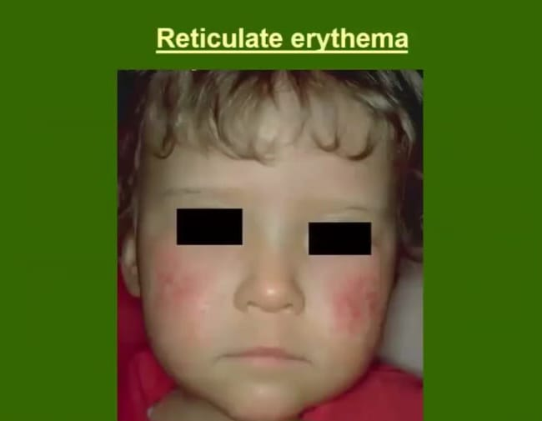

Slide 34
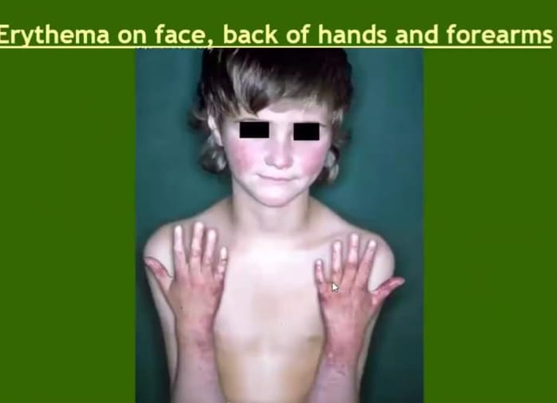

Slide 35
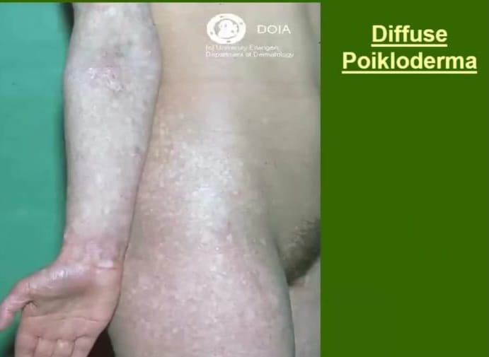

Slide 36
Physical development is frequently retarted; most patients are of small stature and some are dwarfs.
The skull may be small and the features bird-like, sometimes with a saddle nose.
Hypogonadism of slight or severe degree is frequent and the incident of hyperparathyroidism appears also to be increased.
Skeletal abnormalities include radial ray defect and there is a recognized risk of osteosarcoma.
Individuals with Rothmund-Thomson Syndrome are usually of normal intelligence.

Slide 37
Management
Protection against sunlight is important. Careful supervision is essential to ensure detection of carcinoma.
Low blood concentrations of vitamin A have been found in patients with dyskeratoses, and in one case the lesions improved with retinoids.
Telangiectasia, especially on the face, can be improved significantly by treatment the vascular pulsed dye laser.

Slide 38
Acrokeratotic poikiloderma of weary
AD gene.
The main clinical features are
A vesiculopustular eruption of hands and feet in infancy and childhood.
Extensive eczema from around 4 months to 5 years,
Persistent poikiloderma, sparing only the face, scalp and ears;
Wartly papules on hands, feet, elbow and knees.

Slide 39
Kindler’s syndrome
AR disorder
Characterized by neonatal blistering, sun sensitivity, atrophy, abnormal pigmentation and fragility of the skin.
There is a persistent poikiloderma, sparing only the face, scalp and ears.

Slide 40
Poikiloderma with neutropenia clericuzio type
Skin manifestations usually start in the first 6 months, with erythematous, eczematous or ichthyosiform changes on the limbs, subsequently spreading more centrally and being replaced by poikiloderma.
Photosenitivity is variable.
The nails show an early onset of pachyonychia and there may be an associated palmo-plantar keratoderma.

Slide 41
In contrast to RTS, alopecia is not a feature, and unlike DKC, leukoplakia is not seen.
The presence of neutropenia is variable and may be cyclical, and myelodysplasia or acute myeloid leukaemia may occur.
Recurrent airway infections with chronic cough and reactive airway changes are common and otitis media has been described. Affected individuals may have short stature and facial dysmorphism.

Slide 42


