Slide 1
Cutaneous Markers of Internal Malignancy
MUHAMMAD FAHAD

Slide 2
Outline
Tumour spread
Genodermatoses associated with malignant potential (hamartoneoplastic syndromes)
Immunodeficiency and neoplasia syndromes
Paraneoplastic phenomenon involving the skin
Dermatoses associated with internal malignancies
Vascular disorders associated with internal malignancy

Slide 3
TUMOUR SPREAD
Direct tumour spread and invasion
Cutaneous metastasis

Slide 4
Direct tumour spread and invasion
Usually causes nodular infiltration, ulceration or inflammation
Carcinoma en cuirasse (sclerosis)
Vascular changes (carcinoma telangiectodes)
Peau d'orange (orange peel) appearance
Carcinoma erysipeloides (inflammatory metastatic carcinoma) pattern
Inframammary intertrigo-like pattern

Slide 5
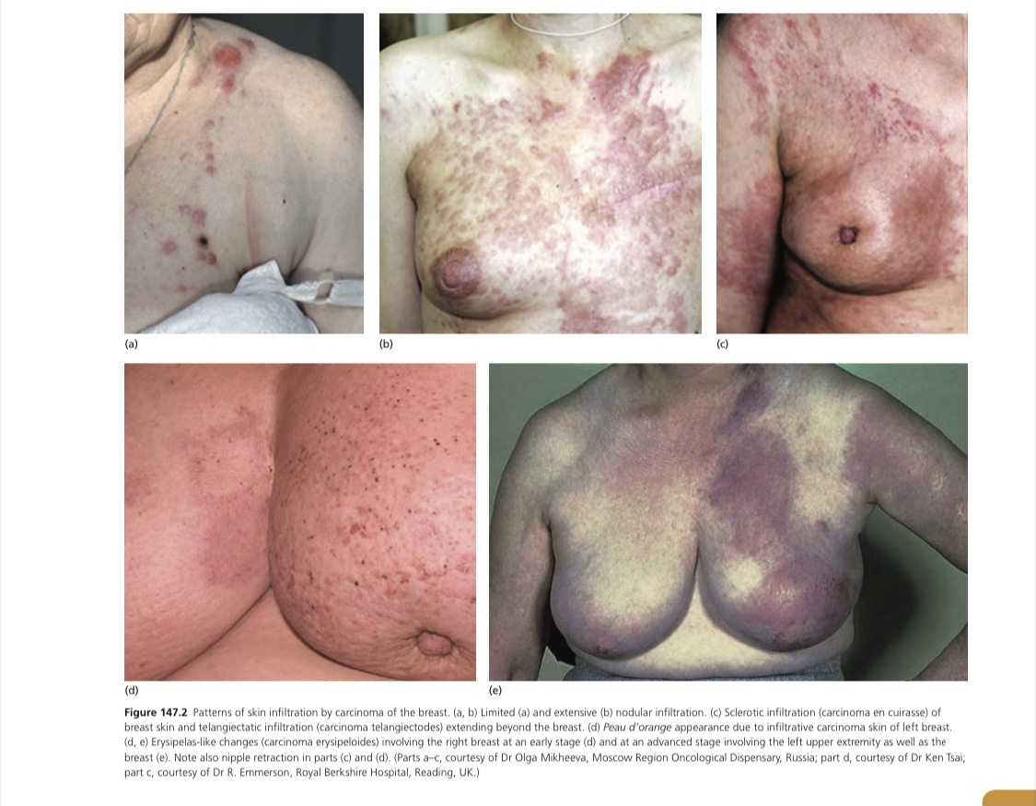

Slide 6
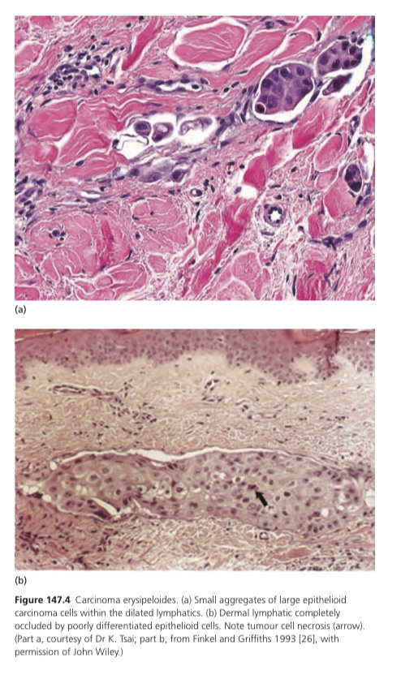

Slide 7
Cutaneous metastasis
Usually occur in subjects with a known cancer
Usually suggestive of disseminated disease
May be the first indication of an internal neoplasm, especially in the case of lung cancers
Solitary metastases without other evidence of dissemination may have a better survival rate
Treatment options, depending on the primary tumour

Slide 8
Cont..
Lymphatic or haematogenous dissemination of tumour
The clinical pattern of metastases may provide clues to the route of metastasis
The most common sources of cutaneous metastases are,
breast, melanoma, lung, colon, stomach,
upper aerodigestive tract, uterus and
kidney

Slide 9
Cont..
75% of metastases are found on the head, neck and upper trunk, which together constitute only 25% of the body surface area
Umbilicus in bowel tumours (Sister Mary Joseph nodule)
Recent operative scars
Tumour spillage
Tumour to tumour metastasis (thyroid and adrenal adenomas)

Slide 10
Appearance of skin metastases
Painless, solitary. firm to hard nodules, which may be skin-coloured, blue-brown or reddish purple
Morphoea-like sclerotic plaques
Scar infiltration
Erysipelas-like diffuse skin infiltration
Infiltrated areas of alopecia (alopecia neoplastica)
Embolic metastasis to digits

Slide 11
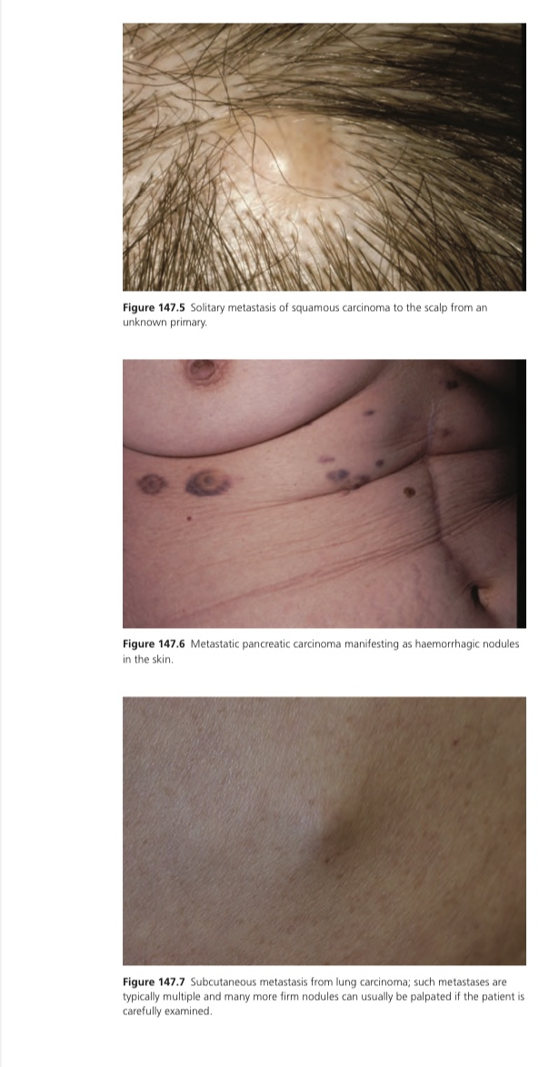

Slide 12
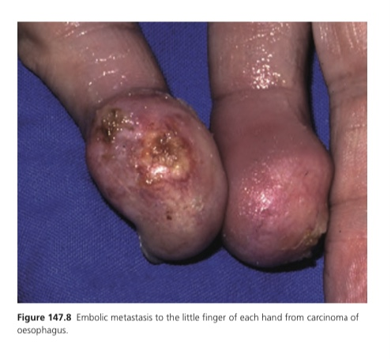

Slide 13
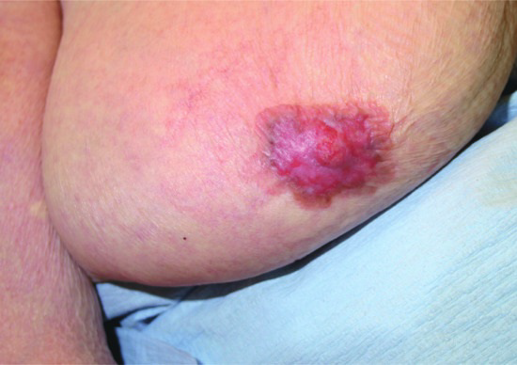
Paget disease
Mammary (due to an underlying ductal tumour)
Extramammary (without an underlying tumour, or distant to a tumour)

Slide 14
Paget disease of the breast
Direct epidermal extension of an underlying ductal adenocarcinoma
Presents with scaling and erythema, sometimes with oozing and crusting, on or around the nipple
Clinical differentials :
Eczema
Psoriasis
Hyperkeratosis
Erosive adenomatosis

Slide 15
Cont..
Histological differentials :
Some melanomas
Bowen disease
Clear cell papulosis
Histopathological markers :
CEA
EMA
CK7
CK8/18
Mucin (MUC1)

Slide 16
Extramammary Paget disease
Occurs in apocrine gland-bearing areas such as anogenital (60% vulval) and axillary sites
25% of patients appear to have an associated invasive malignancy
Most patients are over 60 years of age
Female preponderance

Slide 17
Cont..
Clinical features include itch, a burning sensation, oedema, bleeding and reddish brown (or sometimes hypopigmented) plaques, often with a prominent margin
Antigen RCAS1 is particularly sensitive
Serum CEA being a useful indicator of survival

Slide 18
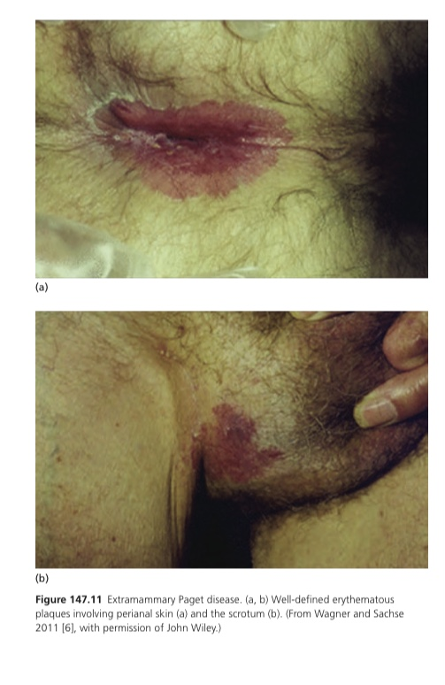

Slide 19
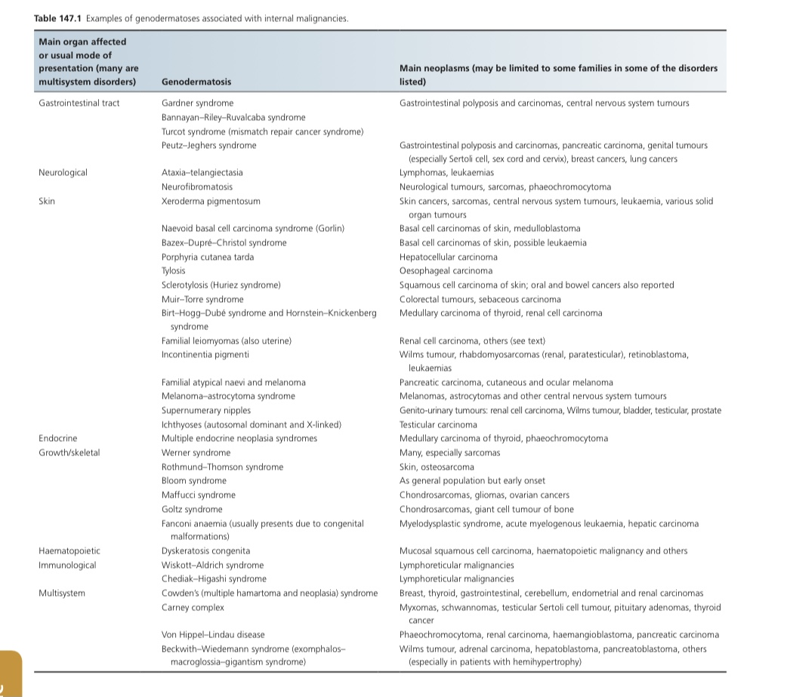
GENODERMATOSES ASSOCIATED WITH INTERNAL MALIGNANCIES

Slide 20
IMMUNODEFICIENCY AND NEOPLASIA SYNDROMES
Wiskott–Aldrich syndrome
X-linked recessive
Mutations at Xp11.23-p11.22
WASp is expressed in all haematopoietic cells and mutations cause defective T-cell function and thrombocytopenia
Increased risk of autoimmune disorders and lymphoid malignancies
Non-Hodgkin lymphoma occurs in almost all subjects

Slide 21
Chediak–Higashi syndrome
Autosomal recessive
Oculocutaneous albinism, silvery hair, photophobia, neurological abnormalities and severe, recurrent bacterial infections
Organ infiltration with lymphoid and histiocytic cells.

Slide 22
Ataxia-telangiectasia
Autosomal recessive
Characterized by progressive cerebellar ataxia, oculocutaneous telangiectasia
Premature ageing of the skin and hair
Non-infectious cutaneous granulomas
Germ-line mutations in the large ATM gene
Majority of tumours are lymphoproliferative (B-cell Lymphomas) or leukaemic (T-cell leukaemia)

Slide 23
PARANEOPLASTIC PHENOMENA INVOLVING THE SKIN
Paraneoplastic dermatoses are skin conditions that have an association with internal malignancy but are not themselves malignant
At least one of the following defining characteristics should be present in order to consider a dermatosis as being related to an underlying malignancy:
The malignancy and the cutaneous disorder should occur concurrently
The two disorders should follow a parallel course
There should be a specific tumour site or cell type associated with the cutaneous disease
There should be a statistical association between the two processes
There should be a genetic association between the two processes

Slide 24
ACANTHOTIC AND ICHTHYOTIC EPIDERMAL DISORDERS
Benign Acanthosis nigricans
Obesity or insulin resistance
Common
Mild
Mainly in the teenage years

Slide 25
Malignant Acanthosis nigricans
Rapid onset
Produce symmetrical, hyperpigmented, rugose, velvety plaques
The axillae and other flexures are particularly affected, along with the areolar area and nape of the neck and, less commonly, mucosal surfaces
Associated with weight loss, generalized pruritus, skin changes of tripe palms
Commonest site of underlying neoplasm is the gastrointestinal tract, nearly all being adenocarcinomas (gastric adenocarcinoma)

Slide 26
Acanthosis palmaris
Thickened skin of the palms and occasionally the soles
Velvety or less commonly a pitted, honeycombed pattern of the hand
Associated with psoriasis, eczema and bullous pemphigoid
More often associated with bronchial carcinoma (alone) and gastric carcinoma (combined acanthosis nigricans and acanthosis palmaris)

Slide 27
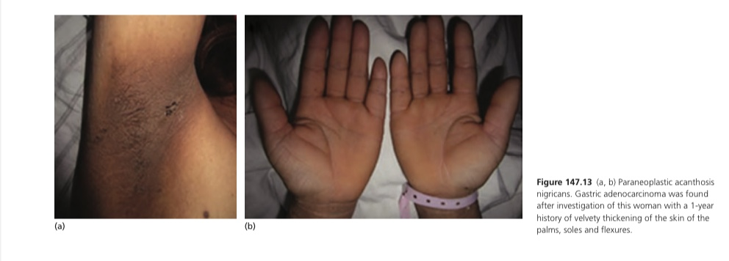

Slide 28
Sign of Leser–Trélat
Sudden development of numerous seborrhoeic keratoses
Young patient, associated with pruritus or with acanthosis nigricans
Indicator of internal malignancy
Half of the tumours are adenocarcinomas most of which arise in the GI tract
Carcinomas of the breast are also frequent
HIV infection, acromegaly and in the resolving phase of erythrodermic dermatoses (other causes)

Slide 29
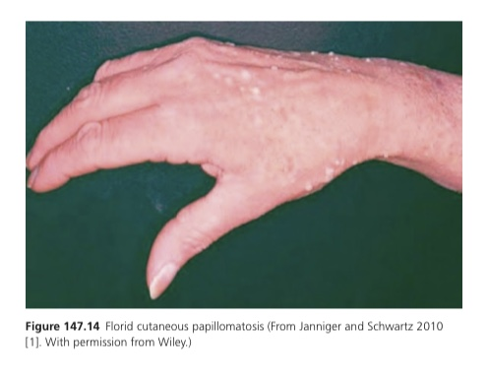
Florid cutaneous papillomatosis
Characterized by a widespread, often pruritic eruption of warty papules
Particularly gastric adenocarcinoma

Slide 30
Acquired ichthyosis
Hodgkin disease
Nutritional deficiencies, sarcoidosis, leprosy, HIV infection, hypothyroidism, lupus erythematosus, graft-versus-host disease and drug reactions
sudden onset, younger age group
Pityriasis rotunda
hepatocellular carcinoma, systemic diseases and leprosy

Slide 31
Other Epidermal Disorders
Transient acantholytic dermatosis
Myelogenous leukaemia and genito-urinary tract carcinoma
Acquired seed-like keratoses of the palms and soles
Normal finding in healthy subjects over 50 years old
Carcinoma of the bladder, bronchus, arsenic ingestion

Slide 32
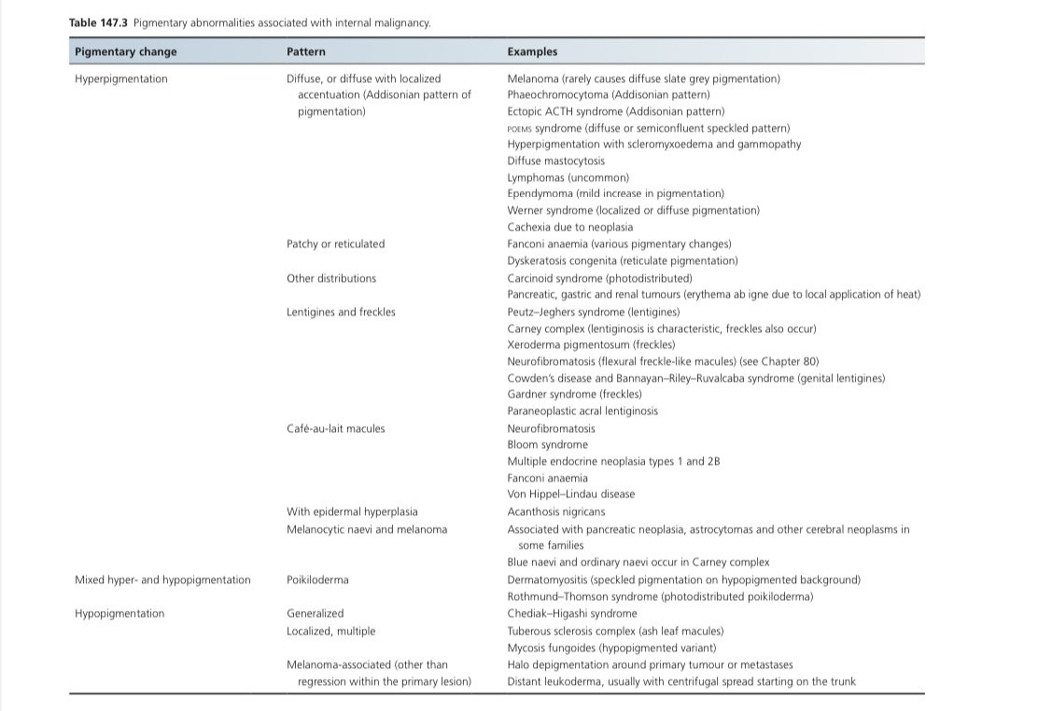
PARANEOPLASTIC PIGMENTATION

Slide 33
HAIR, NAILS AND SKIN APPENDAGES
Paraneoplastic hypertrichosis lanuginose acquisita
Affect the face initially
Hair is of fine, downy lanugo type
Prolongation of the anagen growth phase
Associated acanthosis nigricans, hypertrophy of papillae of the tongue and glossitis disturbances of taste or smell
Men (lung>colorectal), women (colorectal>lung)

Slide 34
Clubbing of nails
Increased transverse and longitudinal nail curvature with hypertrophy of the soft tissue components of the digit pulp
Squamous cell carcinoma or adenocarcinoma of lung

Slide 35
Hyperhidrosis
Generalized hyperhidrosis: Phaeochromocytoma
Nocturnal hyperhidrosis (‘night sweats’): Lymphoma, carcinoid syndrome, thyrotoxicosis, chronic infections and POEMS syndrome
Paroxysmal unilateral hyperhidrosis of the face and neck: Ipsilateral thoracic tumour (adenocarcinoma, squamous cell carcinoma or mesothelioma) compressing or infiltrating the sympathetic trunk

Slide 36
DERMATOSES ASSOCIATED WITH INTERNAL
MALIGNANCIES
Acrokeratosis paraneoplastica
Paraneoplastic condition
Squamous cell carcinoma of the upper respiratory or gastrointestinal tracts, especially when there are metastases in the cervical lymph nodes
Initially with violaceous erythema and scaling on the peripheries, especially the helices of the ears, tip of the nose, hands and feet (particularly the distal portion of digits)

Slide 37
Eruption then becomes more hyperkeratotic, with a keratoderma on the hands and feet
Resolution occur with successful tumour resection
Recurrence develop on relapse of malignancy
systemic retinoids

Slide 38
Migratory erythemas
Erythema gyratum repens (lung cancer) and necrolytic migratory erythema (glucagon-secreting α-cell tumour of the pancreas)
Other migratory erythemas are less clearly associated with neoplasia (myeloproliferative disorder, specifically lymphoma or leukaemia)
Erythema annulare centrifugum is usually not associated with neoplasia

Slide 39
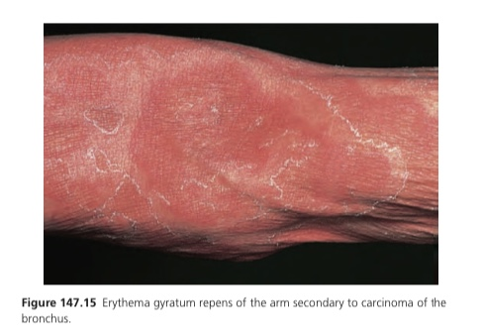

Slide 40
CONNECTIVE TISSUE AND RHEUMATOLOGICAL DISORDERS
Dermatomyositis
Dermatomyositis> polymyositis or dermatomyositis/autoimmune disease overlap conditions
Lung cancer in men, breast and gynaecological tumours in women, and colorectal cancers in both sexes
In South-East Asia, there is a higher frequency of naso-pharyngeal carcinoma
Anti-NXP-2 and anti-TIF-1 γ antibodies
Anti-MDA-5 antibodies

Slide 41
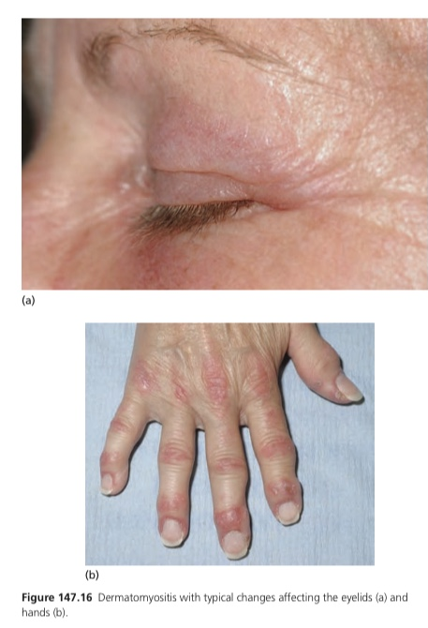

Slide 42
Lupus erythematosus
Controversial
Lymphomas, monoclonal gammopathy and in cervical, lung, hepatobiliary and breast cancer
Non-Hodgkin lymphoma, particularly (DLBCL)
Mechanism: T-cell defect in SLE or may be a result of immunosuppressive medication

Slide 43
BULLOUS DISORDERS ASSOCIATED WITH INTERNAL
MALIGNANCY
Paraneoplastic pemphigus
Multiorgan autoimmune syndrome, in which deposition of autoantibody complexes in different organs
Characteristically with oral involvement
Association with small-airways occlusion
Mucosal disease is often severe and progressive
Hodgkin lymphoma, chronic lymphocytic, leukaemia, Castleman tumour, thymoma, spindle cell neoplasms and Waldenström macroglobulinaemia
Direct immunofluorescence of skin biopsies is usually positive for immunoglobulin G (IgG) and C3

Slide 44
Bullous pemphigoid
Controversial
breast, lung, thyroid, larynx, skin, soft tissue, stomach, colon, lymphoreticular system, prostate, cervix, bladder, kidney and uterus
Pemphigus
Acanthosis nigricans-like lesions and hepatocellular carcinoma

Slide 45
Dermatitis herpetiformis
Small bowel lymphoma
Epidermolysis bullosa acquisita
Myeloma and Lymphoma
Porphyria cutanea tarda and variegate porphyrias
Hepatocellular carcinoma, myeloma and visceral carcinoma

Slide 46
OTHER DERMATOLOGICAL DISORDERS
Cold urticaria and peripheral gangrene
Myeloma and lymphoma
Exfoliative dermatitis
Mycosis fungoides or its leukaemic variant, Sézary syndrome
Erythroderma
Lymphoma or leukaemia, peripheral T-cell non-epidermotrophic cutaneous lymphoma (Ofuji papuloerythroderma)

Slide 47
Lichen planus
Oral squamous cell carcinoma (males)
Granuloma annulare
Lymphomas, other haematological malignancies
Insect bite-like reactions
CLL
Non-melanoma skin cancer
Non-Hodgkin lymphoma

Slide 48
Pyoderma gangrenosum and neutrophilic dermatoses
Acute and chronic myeloid leukaemia, acute lymphocytic leukaemia, myeloid metaplasia, polycythaemia rubra vera, multiple myeloma, lymphoma and myelofibrosis
Association with monoclonal gammopathy is uncertain (IgA)
Sweet syndrome has likewise been associated with several malignancies, especially haematopoietic

Slide 49
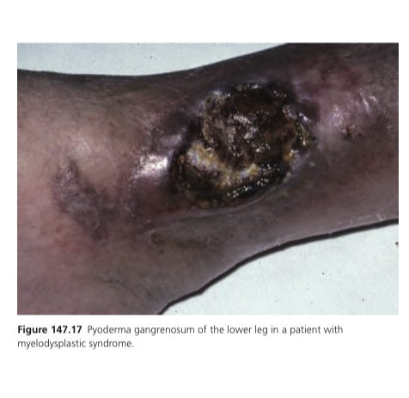

Slide 50
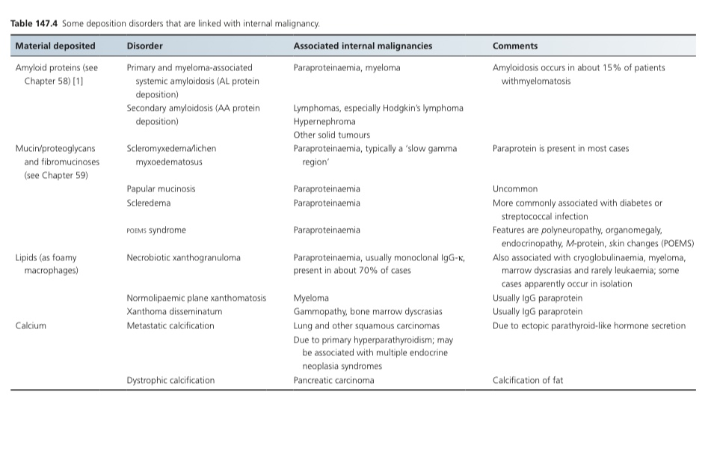
DEPOSITION DISORDERS

Slide 51
VASCULAR DISORDERS ASSOCIATED WITH INTERNAL MALIGNANCY
Raynaud phenomenon and digital ischaemia
Solid tumours and reticuloendothelial
neoplasms
Erythromelalgia
Myeloproliferative disorders, most
commonly polycythaemia vera or essential
thrombocythaemia

Slide 52
Palmar erythema
Astrocytomas and glioblastomas
Vasculitis
*Myeloproliferative disorders (Hairy cell
leukaemia) and myeloma.
*Breast, lung, colon, oesophageal, renal,
prostatic, and head and neck tumours

Slide 53
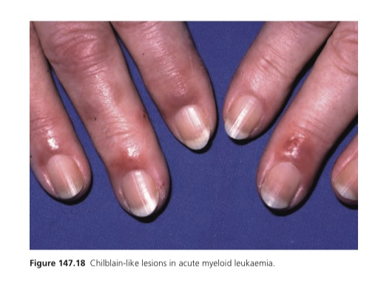
Chilblain–like lesions
Leukaemias, myeloproliferative disorders
and metastasis from breast carcinoma

Slide 54
Flushing
Carcinoid syndrome, mastocytosis,
phaeochromocytoma, medullary carcinoma
of thyroid, hypogonadism in males,
pancreatic tumours producing vasoactive
intestinal peptide (VIPomas), basophilic
leukaemia, horseshoe kidney (Rovsing
syndrome), renal cell carcinoma and POEMS
syndrome

Slide 55
CANCER-ASSOCIATED THROMBOSIS
Interaction of macrophages with cancer cells causes release of tumour necrosis factor and interleukin 6, which damage endothelium, creating a pro-thrombotic situation
Same interaction causes activation of platelets and of clotting factors X and XII
Arterial thrombosis may also occur as a paraneoplastic entity, but is much less common

Slide 56
A. Migratory thrombophlebitis
Thrombophlebitis associated with neoplasia is often recurrent and migratory (Trousseau sign)
Upper extremities and trunk
Usually multiple
Carcinomas of the pancreas, stomach, colon, lung, leukaemias and lymphomas
Causative tumours are often highly malignant and metastatic with a poor prognosis
responds poorly to anticoagulant therapy (heparin>warfarin)

Slide 57
B. Deep-vein thrombosis
Not commonly the presenting feature of malignancy
Adenocarcinomas in the gastrointestinal tract, urogenital tract, breast or lung
DVT of the upper limb is more commonly linked with neoplasia (apical lung tumour)

Slide 58
C. Mondor disease
Cord-like lesion is palpable in the subcutaneous tissue of the anterior or lateral thorax, or sometimes abdomen
Underlying lesion is a thrombophlebitis of thoracic or epigastric veins
Usually unilateral
Trauma, inflammation, post- surgery and breast carcinoma

Slide 59
VENOUS OR LYMPHATIC OBSTRUCTION
Facial and upper limb suffusion of superior vena caval obstruction
Obstruction of venous flow from the head and neck due to benign retrosternal thyroid gland enlargement (Pemberton sign)
Lymphatic obstruction typically occurs at the main lymph node sites, such as in the axilla due to a breast carcinoma, lymphoma or limb melanoma

Slide 60
Cont..
Apical lung causes damage to sympathetic nerves, leading to anhidrosis and sometimes hyperhidrosis and flushing of the contralateral, unaffected side
Arterial obstruction by tumours is much less common, although tumour emboli may occur

