Slide 1
Pruritus, Prurigo and Lichen Simplex
PART 7
Psychological, Sensory and
Neurological Disorders and the Skin
Chapter 83

Slide 2
Outline
Chronic Pruritus
  Introduction/Epidemiology
  Pathophysiology
  Mediators of Itch
  Clinical Features/History
  Clinical variants (Inflamed skin/ Systemic diseases)
  Severity and measurement of pruritus
  Investigations
  Management
Prurigo Nodularis
Lichen Simplex Chronicus

Slide 3
Chronic pruritus (CP)

Slide 4
CP
Synonym (Itch)
‘An unpleasant sensation leading to the desire to scratch’
Lasting at least for 6 weeks
PRURITUS ON INFLAMED SKIN /diseased skin; example: atopic eczema
PRURITUS ON NON‐INFLAMED SKIN (non‐diseased, normal‐looking skin); replaces the previous designation (pruritus sine materia)
Specific terms for unique clinical presentations of CP
  Aquagenic pruritus,
  Premonitory pruritus,
  Paraneoplastic pruritus

Slide 5
Introduction
Symptom of dermatological, systemic, neurological or psychiatric diseases
Patients have a high symptom burden
Impaired quality of life (QoL) including
  difficulties in social life,
  sleep disturbance &
  psychosomatic reactions such as reactive depression
Dermatology Life Quality Index (DLQI) correlates with pruritus & xerosis
Impact on QoL F>M

Slide 6
CP
Examples of diseases that can induce pruritus
DERMATOLOGICAL DISEASES
  Atopic eczema Urticaria (all forms)
  Erythroderma Post‐burn scars Psoriasis
SYSTEMIC DISEASES
  Metabolic and endocrine diseases (Hepatobiliary diseases, PBC, CKD, DM, Anorexia, Hyperthyroidism)
  Infective diseases (HIV and AIDS)
  Haematological diseases and neoplasms (Myelofibrosis, Hodgkin lymphoma, Polycythaemia vera, Non‐Hodgkin lymphoma, Iron deficiency anaemia)
  Drug‐induced pruritus (Rituximab, All targeted cancer therapies)
  Neurological diseases (Brachioradial pruritus, Notalgia paraesthetica, Postherpetic neuralgia)
  Psychiatric or psychosomatic diseases (Depression)

Slide 7
Epidemiology
Incidence of CP in the general population is 7%
With increasing age, the prevalence of CP increased
Pruritus occurred in 42% of dermatological patients (study in France)
No age limit
SEX: Equal in both genders (Men are bit older with co-morbids, Women have more severe itch intensity along with impact on QoL)
Prevalence of CP decrease with Fitzpatrick skin type
Acute pruritus is more prevalent with darker skin types
Neurobiological differences between ethnic groups

Slide 8
Pathophysiology
Cutaneous induction of itch
Central transmission of itch
Scratching
Peripheral and central sensitization
Mediators of itching in skin diseases

Slide 9
1. Cutaneous Induction of Itch
Cutaneous sensory nerve fibres
Weak pain signal
Histamine‐induced itch: unmyelinated, mechano‐insensitive C fibres
Classical pain fibres : mechano‐sensitive C fibres & thinly myelinated Aδ fibres
C fibres = slow burning component (diffuse, dull)
Aδ fibres = fast pricking component (localized warmth & cold)
Spontaneous activity of C fibres
Increased substance P (SP) positive dermal nerve fibres
Nociceptors with the thermoreceptor transient receptor potential cation channel subfamily V member 1 (TRPV1) are capable of transmitting histamine‐induced itch via intracellular phospholipase Cβ3 (PLCβ3)

Slide 10
2. Central Transmission of itch
Peripheral afferent nerve fibres transmit signal to the spinal cord, enter the dorsal horn (superficial laminae I–II) & synapse with secondary neuron
Gastrin‐releasing peptide receptor (GRPR) & natriuretic polypeptide B (nppB) (mast cell degranulation)
Relief of itch by scratching via spinal cord neurons & interneurons
Secondary itch neuron crosses to the contralateral spino‐thalamic tract and ascends to multiple brain areas such as prefrontal areas, supplementary motor areas (SMA), premotor cortex, primary (S1), secondary (S2) somatosensory cortices, thalamus, basal ganglia & cerebellum.
Involved in sensation, evaluative processes, emotion, reward & memory
MR studies showed no specific itch matrix in the brain but a broad overlapping of itch activation maps with pain areas

Slide 11
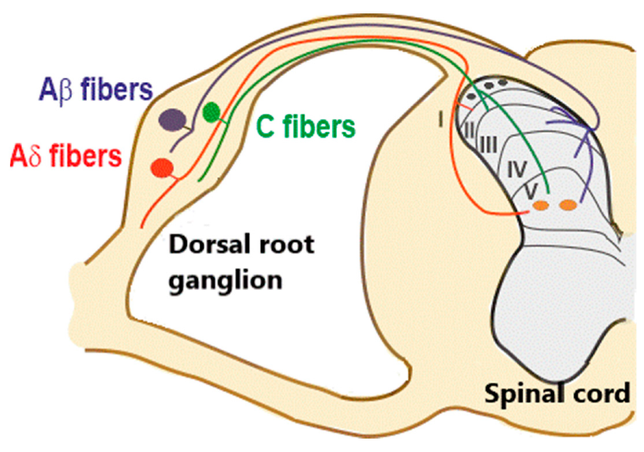
Ascending pain pathways. DRG dorsal root ganglion, PAG
periaqueductal grey matter

Slide 12
3. Scratching
Reflex functioning at a spinal level
Indirect objective method of quantifying itch
SCRATCHING RELIEVES ITCHING:
Temporary suppression of facilitating circuits in the relay synapses of spinal cord
Fast‐conducting myelinated afferents inhibits these circuits via pre‐ and post synaptic mechanisms
These afferents could be activated by transepidermal electrical nerve stimulation by vibration, or simply by scratching.
Scratching could damage sensory nerve endings, repair occupying several minutes.

Slide 13
4. Peripheral and Central Sensitization
Sensitization is the increased responses of primary sensory neurons to itch and pain mediators
ALLOKNESIS (non‐ pruritogenic stimuli such as light touch in an area of CP elicit a sensation of itch)
HYPERKNESIS (enhanced itch sensation elicited by a normal itch stimulus)
Central sensitization is based on spontaneous activity of superficial dorsal horn neurons, enhancement of mechanically evoked responses and their increased response to mediators
Peripheral sensitization mediated by several mediators such as bradykinin or nerve growth factor (NGF) with
hyperplasia of sensory neurons in skin and reduced threshold of neuroreceptors

Slide 14
5. Mediators of itching in skin diseases
No evidence of mediators in the itch of senescent skin or xerosis
Dermatoses mediators\ Inflammatory skin diseases
Involvement of ‘H substances’ by Lewis
Directly identified and measured in tissue fluid from diseased skin
By skin perfusion or microdialysis technology
Intradermal injection of the putative mediator in volunteers
  Histamine and histamine receptors
  Acetylcholine
  Tachykinins
  Opioid peptides
  Proteases, Mas‐related G protein‐coupled receptor agonists and endothelin 1
  Neurotrophins
  Cytokines: interleukin 2, interleukin 31

Slide 15
1. Histamine H1 , H 4 receptor (Urticaria, insect bite reactions, cutaneous mastocytosis)
Histamine binds to G‐protein‐coupled receptors (GPCR)
H4 direct action on immune and inflammatory cells, mast cells and T helper 2 (Th2) lymphocytes
H1 Cross‐linking of the high affinity immunoglobulin E (IgE) receptor to FcεR1
H1 Antihistamines like cetirizine, levocetirizine, desloratadine, loratadine, and fexofenadine
2. Acetylcholine: tissue levels of Muscarinic Ach receptors are reported to be elevated in atopic eczema patients
Botulinum toxin type A is known to inhibit the release of Ach

Slide 16
3. Tachykinins: SP synthesized from cell bodies of C fibers, acts via neurokinin 1 receptor (NK1R) (Atopic eczema, prurigo nodularis, psoriasis)
Aprepitant, a selective NK1R antagonist, is thus effective is suppressing pruritus
4. Opioid peptides: classified into three groups: endorphins, enkephalins and dynorphins, respective receptors are μ, δ and κ.
Cause pruritus via central mechanisms, due to imbalance between μ and κ opioid receptor activation
Endorphins = μ opioid receptor (Antagonist Naloxone, Naltrexone) Cholestatic pruritus
Dynorphins = κ opioid receptor (Agonist Nalfurantine) Uraemic pruritus

Slide 17
5. Proteases, Mas‐related G protein‐coupled receptor agonists and Endothelin 1
Tryptase, mucunain=PAR‐2, PAR‐4 Atopic eczema
Cathepsin S=PAR‐2, PAR‐4, MrgprC11 Cutaneous mastocytosis
Chloroquine= MrgprA3, TRPA1 Chloroquine‐induced pruritus
Cathepsin E= Endothelin1 via Endothelin A receptor Release of nitric oxide, vasodilatation
Mrgprs consist of over 50 members, MrgprAs, MrgprB4–5, MrgprC11 and MrgprD are involved in histamine‐independent itch
Proteinase‐activated receptor (PAR)
6. Neurotrophin: NGF via Tyrosine kinase receptor A (TrkA receptor) ( Atopic eczema, psoriasis) Nerve Growth Factors causes sprouting of nerve fibres and upregulates SP

Slide 18
7. Cytokines: interleukin 2, interleukin 31:
Interleukin 2 (IL‐2), a cytokine secreted by activated T lymphocytes,
Ciclosporin, a suppressor of IL‐2 secretion has anti-pruritic properties
IL–31 is a Th2 cytokine of the skin cutaneous lymphocyte antigen (CLA) subtype
(IL‐31RA) and oncostatin M receptor (OSMR) is located on keratinocytes and monocytes
Co‐localization of IL‐31 receptor A and β endorphin in skin.
IL‐31 release β endorphins from keratinocytes via a calcium flux dependent STAT3 activation

Slide 19
Clinical Features
Important details in history taking
GENERAL HISTORY
• Previous illnesses including dermatoses
• Drug intake, infusions, blood transfusions
• Previous surgeries
• Allergies: type I/type IV allergies
• Atopic predisposition
• Clinical signs for malignancy (weight loss, fever, night sweats)
• Pregnancy

Slide 20
PRURITUS‐SPECIFIC HISTORY
Time point of start of CP and total duration
Localization (start, spreading)
Quality: e.g. burning itch, pricking itch, tingling itch, itch resembling insects crawling on/under skin (formication)
Intensity: severity on the visual analogue scale (VAS) or numeric rating scale (NRS)
Course: variations during the day, continuous CP/attacks, spontaneous improvement/deterioration
Triggering factors, ameliorating factors
Behavioral response to itch: scratch, rub, (more rarely) slap
Temporal association with previous illnesses, surgeries, medication intake, other events
Previous therapies: successful/unsuccessful
Patient's own theory about the cause of CP
Psychogenic stress factors
Impairments in quality of life, burden, sleep disturbances

Slide 21
Presentation
Pruritus on inflamed skin
Pruritus on non‐diseased skin
CP induces scratching which changes the initial clinical picture
Patients may present with excoriations, papules, nodules, lichenification, scars, and hyper or hypopigmentation resulting from scratching
Reaction patterns resulting from chronic scratching like lichen simplex or PN

Slide 24
Clinical Variants
Pruritus in inflamed skin (dermatoses)
  Pruritus of atopic eczema (Atopic itch)
  Pruritus of psoriasis vulgaris (Psoriatic Itch)
  Sezary syndrome
  cutaneous mastocytosis
  Invisible mycosis fungoides

Slide 25
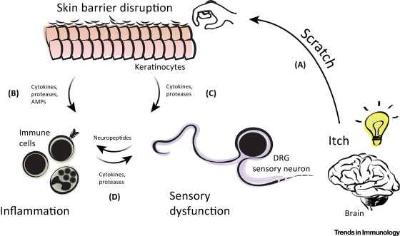
Atopic itch
itch–scratch cycle
Worse at night
Aggravated by contact with wool, sweating, spicy foods and alcohol
Multifactorial, due to dryness, inflammation, hyperplasia of skin nerves, disturbed regulation of itch traffic in CNS
Alloknesis
Emollients, Sedative Antihistamines
Staphylococcus aureus behaves as a superantigen leading to T‐cell activation & IL-31 production
Topical Corticosteroids ‘wet wrap’ technique
broad‐band and narrow‐band ultraviolet B (UVB)
Immunosuppressives: including systemic azathioprine & ciclosporin
Topical calcineurin inhibitors, tacrolimus & pimecrolimus
IL‐31, H4 receptor and SP

Slide 26
Psoriatic Itch
80–89% of patients
Correlations between Psoriasis Area and Severity Index (PASI) scores and intensity of itching
Significantly affects QoL, induces feelings of stigmatization & depressive symptoms
Factors for exacerbation are ambient heat, skin dryness, sweating & stress
8‐item psoriasis symptom inventory (PSI) that assessed the
severity of itch, redness, scaling, burning, cracking, stinging, flaking and pain
Inflammatory T cells, neutrophils, IL‐31 mRNA, IL-17, NGFs TrkA, Neuropeptides SP
Patients report a decline of itch accompanying effective eradication of psoriatic lesions.
Novel therapies such as Apremilast, a specific inhibitor of phosphodiesterase 4

Slide 27
Itching in systemic disease
Itch in skin devoid of primary skin disease, Signs are secondary to scratching or rubbing
Nephrogenic or uraemic pruritus
Cholestatic pruritus
IDA, Polycythemia Vera
Thyrotoxicosis
Diabetogenic pruritus
Drug‐induced pruritus
Paraneoplastic pruritus
Pruritus in pregnancy
Pruritus of senescence
Neuropathic pruritus
Psychogenic pruritus

Slide 28
Nephrogenic or uraemic pruritus
Not a feature in children or in patients with acute renal failure
HD> CAPD
Pigmentation, prurigo nodules and eczematization, often secondarily infected.
Attenuation of sweat and sebaceous glands, and increased population densities of cutaneous mast cells, intraepidermal CD1+ T cells
Elevated Th1 lymphocytes, CRP & IL‐6 serum levels ‘microinflammation’
Neuron‐specific enolase‐positive unmyelinated nerve fibres
Raised serum parathyroid hormone levels
Aluminium overload during HD, treatable by administration of desferrioxamine mesylate
Risk Factors from DOPPS study: male sex, pre‐existing diseases of lung, heart or liver (e.g. hepatitis C), elevated serum calcium/ phosphorus level
Rx κ opioid agonist, HD with better dialysis membranes, renal transplantation, Parathyroidectomy, Phototherapy with UVB, gabapentin, topical capsaicin 0.025%

Slide 29
Cholestatic pruritus
Associated with rubbing of hands & feet rather than scratching
Autotaxin (ATX), and its product, lysophosphatidic acid (LPA), bile acid receptor TGR5
Hepatitis C, elevated plasma levels of bile salts
Rx: bile salt sequestrant (colesevelam), ion‐exchange resins (cholestyramine),
Rifampicin, extracorporeal albumin dialysis and phototherapy
Ursodeoxycholic acid
Naloxone or naltrexone (specific opioid μ receptor antagonists)

Slide 30
Iron deficiency & Polycythaemia vera
Mutation in the enzyme janus kinase JAK2V617 develop severe, prickly and distressing discomfort within minutes of water contact, lasting 15–60 min
Platelet aggregation
‘Bath itch’ or aquagenic pruritus is a premonitory itch
Serotonin reuptake inhibitors such as paroxetine & pregabalin
Some respond to aspirin
Antihistamines are effective in 30%
Photochemotherapy with 8‐methoxypsoralen and UVA

Slide 31
Thyrotoxicosis
Warm moist skin, Cutaneous vasodilatation, both lowers the itch threshold
Cool, dry skin due to Myxoedema can also lead to itch
DIABETOGENIC PRURITUS
Positive associations between postprandial blood glucose and generalized diabetic pruritus
Diabetic pruritus is associated with diabetic polyneuropathy
27.5% of 385 patients with type 2 diabetes suffered from itching.
PARANEOPLASTIC PRURITUS
Hodgkin disease (5 years premonitory pruritus) and PV (13 years premonitory pruritus)
Sezary syndrome, myelodysplastic syndrome & myelofibrosis
Rx with SSRIs (e.g. paroxetine), combined κ opioid receptor agonists/μ opioid receptor antagonists, and pain modulators such as pregabalin

Slide 32
Drug‐induced pruritus
5% of all adverse skin reactions after drug intake
2 groups. 1st Group: drug and its pathomechanism of CP induction are known;
E.g., morphine, chloroquine and hydroxyethyl starch (HES)
2nd Group: role of the drug in causing pruritus is unclear, long latency period
(ACE) inhibitors (e.g. captopril, enalapril), β‐blockers (e.g. atenolol, metoprolol), antidiabetics (e.g. glimepiride, metformin), diuretics (e.g. hydrochlorothiazide), hormones, statins and allopurinol
Poorly responsive to antihistamines, may respond to topical capsaicin or systemic gabapentin or naltrexone

Slide 33
Pruritus in pregnancy
20% of pregnant women
Atopic eruption of pregnancy (AEP) encompasses prurigo of pregnancy and pruritic folliculitis of pregnancy
Polymorphic eruption of pregnancy (PEP; previously as pruritic urticated papules of pregnancy (PUPP)
Pemphigoid gestationis (PG) is rare
Intrahepatic Cholestasis of Pregnancy ICP is the severe form
Splicing mutations in the multidrug resistance P‐glycoprotein3 (MDR3 ) gene related to ICP, associated with stillbirths & gallstone disease
Loratadine is safe in all trimesters
Topical steroids/ UV therapy in late pregnancy

Slide 34
Pruritus of senescence
50% of people in the seventh decade of life or beyond.
women, itching may be a manifestation of the postmenopausal syndrome.
pruritus of multiple aetiologies
failure of the skin to retain water, xerosis, reduction of sebum production
dystrophic changes in afferent nerve terminals
White soft paraffi n ointment is cheap, occlusive, apply four times daily
Paroxetine, amitriptyline or mirtazapine at night are useful in patients of depression
Corticosteroids, antihistamines and cooling lotions are not indicated

Slide 35
Neuropathic pruritus
PRURALGIA = combination of pain and pruritus
Neuropathic itch and neuropathic pain may occur in association
Neuropathic CP may arise out of a local nerve fibre compression (e.g. brachioradial pruritus (BRP), notalgia paraesthetica)
Localized or generalized nerve fibre degeneration (e.g. small fibre neuropathy)
Notalgia paraesthetica: persistent burning pruritus localized to the mid‐scapular area, mild lichenification and pigmentation with or without macular amyloidosis
Sensory neuropathy of the primary dorsal rami of the spinal nerves from T2 to T6.
Rx Capsaicin cream
Brachioradial pruritus: located at the elbow, lower and upper arms, at the dermatomes C5/C6, worsened by sunlight, improved by cold applications (‘ice pack sign’).
MR cervical spine, Rx cooling agents, local anesthetics, Gabapentin

Slide 36
Psychogenic pruritus
Diagnosis of exclusion
‘vicious circle’ of itch, depression and more itch
Anxiety: nocturnal pruritus, associated with a sensation of heat and accompanied by sweating
Parasitophobia (delusions of parasitic infestation of the skin)
Rx Pimozide (phenylbutylpiperidine), phenothiazine, has been used for treatment of delusions of parasitosis
paroxetine, a selective serotonin reuptake inhibitor

Slide 37
Classification of severity and measurement of pruritus
Visual Analogue Scale (VAS) is a 100‐mm long line marked with end points 0 = no pruritus & 100 = the worst imaginable itch.
Numerical Rating Scale (NRS) assess pruritus intensity by assigning to a number between 0 (no pruritus) to 10 (the worst imaginable pruritus).
Verbal Rating Scale (VRS) severity of pruritus is coded with graduated adjectives (from 0 = no pruritus; to 4 = very severe pruritus)
VAS is as follows:
0 points: no pruritus.
>0 points but <30 points: mild pruritus.
≥30 points but <70 points: moderate pruritus.
≥70 points but <90 points: severe pruritus.
≥90 points: very severe pruritus.

Slide 38
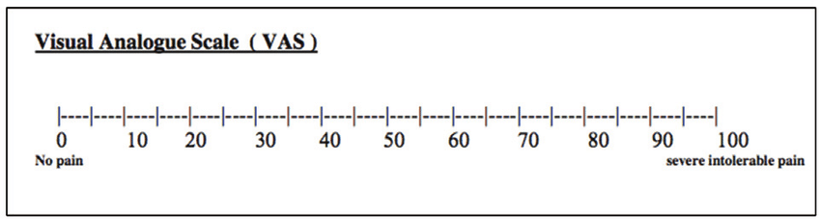
Patients can be advised to keep a diary with daily entries of their pruritus experience.

Slide 39
Investigations
Examination includes thorough inspection of the entire skin, mucous membranes, scalp, hair, nails and ano‐genital region
Skin signs of systemic disease should be recorded. A GPE include palpation of the liver, kidneys, spleen and lymph nodes.
Follow diagnostic algorithm comprising laboratory and radiological investigations,
symptom‐specific diagnostic steps.
CP of unclear origin, examination of the patient should be repeated once a year in an attempt to identify a possible underlying cause

Slide 40
1st Step screening
• ESR
• Differential blood cell count
• Blood urea nitrogen, creatinine
• Alkaline phosphatase,y‐GT, AST, ALT, bilirubin
• TSH
• Glucose
• Ferritin
• Age >40 years: stool occultblood
• Genito‐anal pruritus: stool test for parasites
• Chest X‐ray
• Ultrasound abdomen
• Biopsy with routine histology and DIF(mastocytosis, pemphigoid, etc.)

Slide 41
Further investigations
• Immunelectrophoresis
• Hepatitis B & C antibodies
• Antimitochondrial antibodies,
• ANA
• PTH, calcium
• Parathormone
• Erythrocyte fluorescence
• HIV antibodies
• PSA
• Tryptase
• Bile acid when intrahepatic cholestasis of pregnancy is suspected
• Swab for Candida (mucocutaneous pruritus)
• Urine: histamine and metabolites

Slide 42
Contd.
• Further imaging studies and bone marrow investigation depending on symptoms and previous findings
• e.g. MRI thoracic and cervical spine in neuropathic pruritus
• Skin biopsy in cases of hydroxyethyl starch (HES) (electron microscopy)

Slide 43
Management
Gather data on the age, pre‐existing diseases, medications, and quality and intensity of pruritus
Elderly patients, pregnant women and children need special attention
Prior to therapy beyond general measures, patient should undergo careful diagnostic evaluation and any underlying disease should be treated

Slide 44
General measures
AVOIDANCE OF:
• Dry skin
• Factors that worsen dry skin (e.g. heat, frequent washing and bathing)
• Contact with irritant substances (e.g. camomile, tea‐tree oil)
• Hot and spicy food, large amounts of hot drinks and alcohol
• Excitement, strain, negative stress

Slide 45
Application of:
Non‐alkaline soaps, moisturizing shower or bath oils
• Luke‐warm bath water, bathing time not exceeding 20 min
• Short, luke‐warm showers
• Soft clothing permeable to air (e.g. cotton)
• Skin moisturizer on a daily basis especially after showering and bathing
• Topicals with symptomatic relief, especially for pruritus at night: creams/lotions/sprays containing antipruritics (e.g. urea, camphor, menthol, tannin)
• Wet, cooling wraps (e.g. with black tea)

Slide 46
Recommended Symptomatic therapy
• STEP 1:
General therapeutic measures
• Basic therapy with moisturizers
• Initial symptomatic therapy: systemicnon‐sedative H 1 antihistamines, topical corticosteroids
• STEP 2:
If origin of chronic pruritus is known: symptomatic causative adapted therapy
• STEP 3:
In pruritus of unknown origin or therapy refractory cases in the 2nd step:
Symptomatic topical and/or systemic therapy, e.g. capsaicin, calcineurin inhibitors, naltrexone, gabapentin, pregabalin, UV phototherapy, immunosuppressants (ciclosporin)

Slide 47
Concomitant Treatment In Every Step
Diagnostics and treatment of underlying disease
• General therapeutic measures
• In sleep disorders: sedative H 1 antihistaminics, tricyclical antidepressants or neuroleptics
• Psychosomatic care, habit reversal therapy for scratch behaviour
• In erosive scratch lesions: disinfecting measures, topical corticosteroids

Slide 48
Prurigo nodularis
(PN)

Slide 49
PN
Synonyms = Nodular prurigo, PN Hyde
Reaction pattern in CP due to chronic scratching
Numerous symmetrically distributed hyperkeratotic or eroded nodules
PN occurs in every category of pruritic diseases
Prevalence of PN is 1–2.5/10 000
Common in older patients, average age was 61.54
More common in women
Atopic predisposition is the key factor
Excoriations and crust formation; prolonged scratching induces papules and nodules surrounded by areas of hyperpigmentation

Slide 50
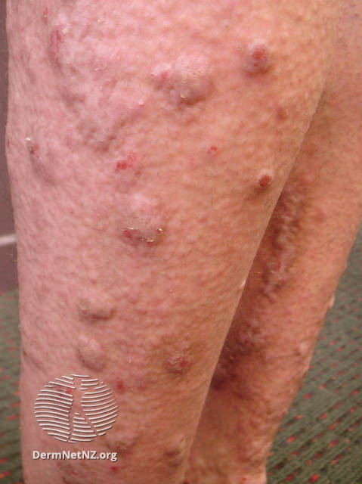
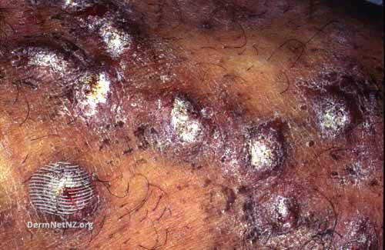

Slide 51
Histology
Constellation of different histological features
Thick compact orthohyperkeratosis, irregular epidermal hyperplasia or pseudoepitheliomatous hyperplasia, focal parakeratosis, hypergranulosis
Hairy palm sign (folliculosebaceous units in non‐volar skin in conjunction with a thick and compact cornified layer, like that of volar skin but contains pilosebaceous unit)
Fibrosis of the papillary dermis with vertically arranged collagen fibres,
Increased number of fibroblasts and capillaries, a superficial, perivascular and/or interstitial inflammatory infiltrate of lymphocytes, macrophages and, to a lesser extent, eosinophils and neutrophils

Slide 52
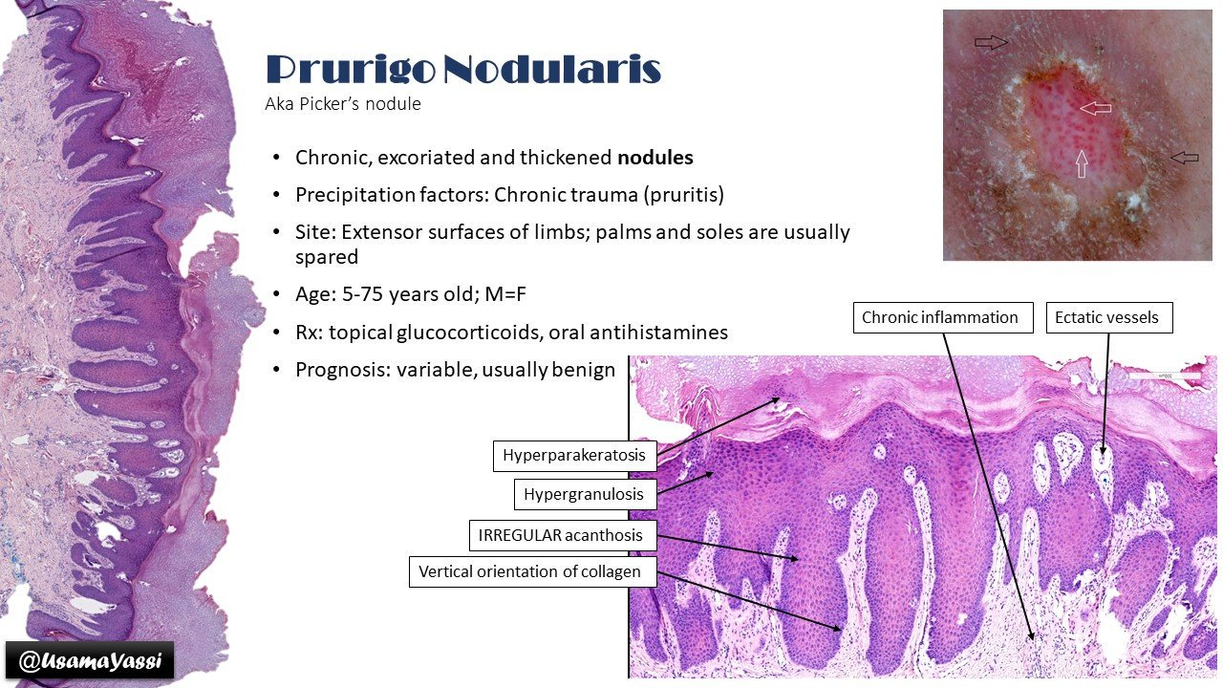

Slide 54
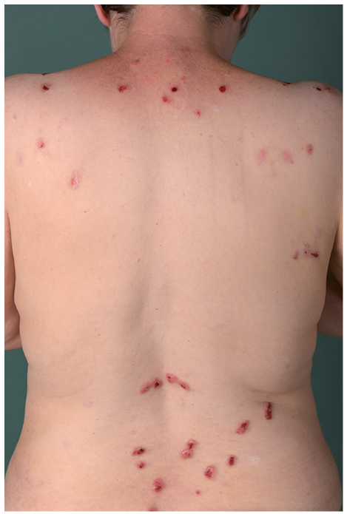
Usually disseminated bilaterally and symmetrically preferentially in the dorsal parts of extremities, decolletee, back and buttocks
Palms, soles and the face are spared
Central back is spared, and this zone is designated as the butterfly sign
Median pruritus intensity in PN patients is high with a score of 8 on the numeric rating scale
qualities of itch are reported by PN patients such as burning, stinging, tingling, heat and cold

Slide 55
highly refractory to therapy and may last for years or even decades with slow progression.
complication that can hinder healing is automatic scratching behavior
PN may be a presentation of bullous pemphigoid (also called pemphigoid nodularis)
Despite thorough investigation, in about 13% of PN patients, an underlying disease or dermatosis is not found
Sorbitol intolerance, lactose intolerance
Gluten enteropathy
Zinc deficiency, cobalamin deficiency
Sarcoidosis
Gastric Helicobacter pylori infection
HIV infection
Pulmonary tuberculosis
Intestinal Strongyloides stercoralis infection

Slide 56
Investigations
Skin:
Clinical examination : search for signs of atopic eczema, bullous pemphigoid, lymphoma or other skin diseases
Skin biopsy:
• H&E staining (routine histology)
• DIF to rule out autoimmune diseases (bullous pemphigoid, epidermolysis bullosa
acquisita) if patient has reported blisters and/or if erythema or blisters are found
• Polymerase chain reaction for mycobacteria if granulomatous inflammatory infiltrate is found on histological investigation
Allergy testing to rule out type I or IV allergies

Slide 57
Labs
Erythrocyte sedimentation rate, differential blood cell count, glucose, immunoglobulin E, HIV serology
Creatinine, urea, uric acid, alkaline phosphatase, γ‐GT, bilirubin, AST, ALT, serum iron, ferritin, TSH, hepatitis C serology, gliadin antibody, zinc, cobalamin, total porphyrins, stool examination for Strongyloides stercoralis
Otolaryngology =Rule out tonsillitis
Psychosomatics/psychiatry =Rule out anxiety, depression
Neurology = Rule out polyneuropathy, restless legs syndrome

Slide 58
Radiology
Chest X‐ray (rule out sarcoidosis, neoplasm, lymphoma)
• Ultrasound abdomen (rule out liver or kidney disease)
• Ultrasound lymph nodes (rule out lymphoma; especially if patient reports weight loss, fever or night‐time sweating)
• Breath test for Helicobacter , lactose and sorbitol intolerance
• Magnetic resonance tomography of cervical spinal column if patient has localized PN (e.g. on lower arms)
• PN on the lower leg: phlebological investigation to rule out chronic venous insufficiency

Slide 59
Management
Same as in CP
Therapy must be multimodal
Psychosomatic counselling.
gabapentin, pregabalin, naltrexone, aprepitant and ciclosporin
For Nodules: betamethasone valerate 0.1% tape, calcipotriol ointment, pimecrolimus cream, bath PUVA and bath PUVA + targeted UVB 308 nm excimer light
More invasive nature such as cryosurgery and intralesional steroids or excimer laser

Slide 60
Lichen simplex chronicus (LSC)

Slide 61
Synonyms and inclusions
Neurodermatitis circumscripta
Pruritus‐associated dermatosis characterized by a small number of heavily lichenified plaques or, commonly, a single lesion.
30 and 50 years of age
Women>Men
Scratching behaviour of the patient influences the development of either nodules (PN) via scratching with the tip of fingers, or plaques (LSC) via rubbing the skin.
nerve fibres is often increased in lesional skin as demonstrated by S100 staining and mast cell numbers also increased.

Slide 62
Histology
Epidermal hyperplasia and hyperkeratosis. The rete ridges are lengthened.
Spongiosis is sometimes present, and small areas of parakeratosis are occasionally seen.
The dermis contains a chronic inflammatory cell infiltrate. In very chronic lesions there may be some fibrosis.
Repeated bouts of intense itching and scratching, interspersed with itch–free intervals
Skin is reddened and slightly oedematous.
With time it becomes pigmented, thickened and slightly scaly.
Accentuation of normal skin markings is characteristic.
Any area may be affected, but the commonest sites are those that are conveniently reached.
The usual sites are the nape of the neck, the sides of the neck, the lower legs and ankles, the scalp, the upper thighs, the vulva, pubis or scrotum, and the extensor forearms.

Slide 63
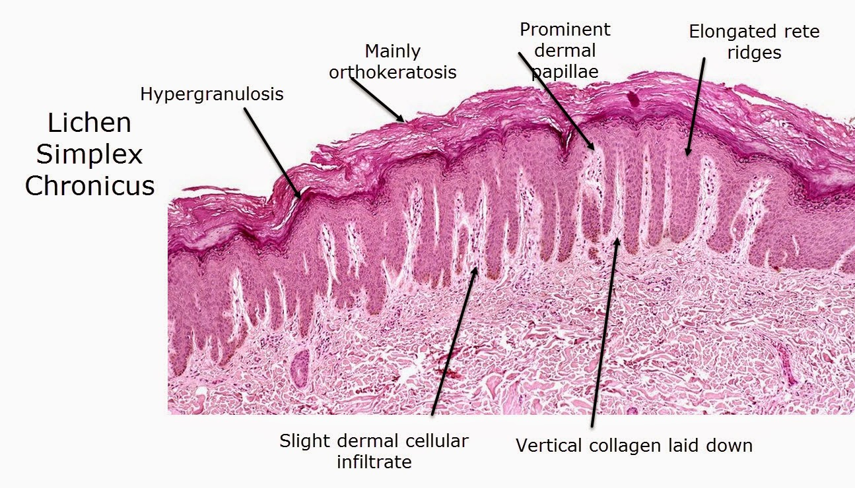

Slide 64
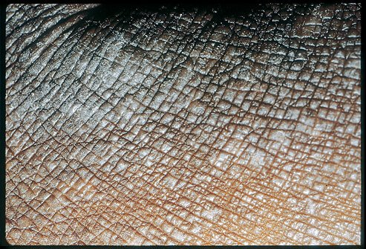
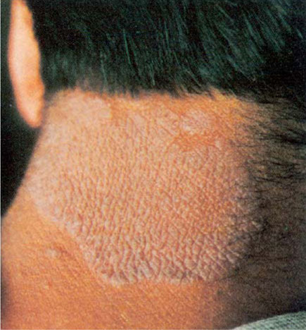

Slide 65
Management
Break the scratching habit must be explained
Topical or intralesional corticosteroids.
The application of an occlusive dressing or an occlusive bandage will intensify the effect of topical steroids.
Self‐adhesive, steroid‐impregnated tape is often beneficial.
For very chronic lesions, systemically applied substances to suppress pruritus such as gabapentin can be helpful.

Slide 66
THANK YOU

