Slide 1
CUTANEOUS PORPHYRIAS
DR NIDA ARIF

Slide 2
Introduction
The porphyrias are a group of disorders caused by defects in the biosynthesis of haem.
Their relevance to the skin arises from the phototoxic properties of the porphyrins, which accumulate in most porphyrias and cause photosensitivity
Porphyrins are intermediates in the biosynthesis of haem.

Slide 3
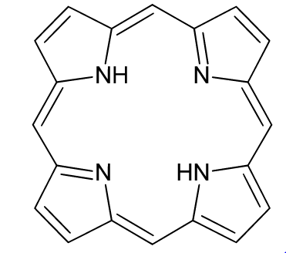
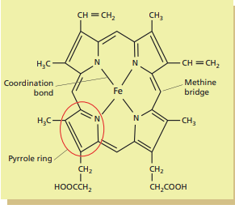
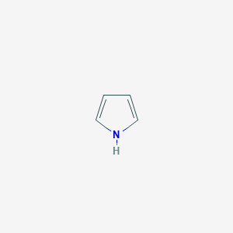
Chemistry of porphyrins and haem
A pyrrole is a ring composed of four carbon atoms and one nitrogen atom. Four pyrroles linked into a ring create a tetrapyrrole, are markable and biologically critical molecular structure found in chlorophyll, haem and vitamin B 12 .
A porphyrin is a special type of tetrapyrrole in which four pyrrole rings are linked by methine bridges into a large ring structure.

Slide 4
Chemistry of porphyrins and haem
Haem is the molecule created by the insertion of ferrous iron into the centre of the porphyrin molecule.
The porphyrin’s central cavity is the right size to fit an iron atom, and its four central nitrogen atoms occupy four of the iron’s coordination binding sites, leaving only two free

Slide 5
Photochemistry/toxocity of the porphyrins
The complex electronic structure of the large aromatic porphyrin molecule results in its 18 delocalized electrons having unusual excitation characteristics.
These electrons are excited by relatively long wavelength light.
The main absorption peak is at 408 nm (‘Soretband’) , and this long wavelength of exciting light predisposes to phototoxic behaviour by the porphyrin.

Slide 6
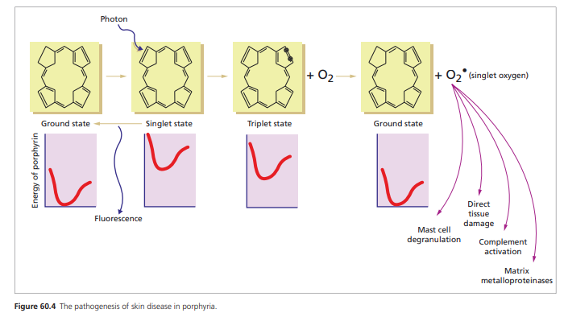

Slide 7
Enzyme deficiencies and the porphyrias
The porphyrias all result from a partial deficiency of one of the enzymes required for the biosynthesis of haem, thus causing accumulation of the enzyme’s substrate.
The toxicity profile of the accumulated molecule determines the clinical features of the resulting porphyria
Approximately 85% of haem synthesis occurs in the bone marrow to support hemoglobin formation, with the remainder mostly in the liver, primarily for cytochrome P450 enzymes (CYPs) found in the endoplasmic reticulum.

Slide 8
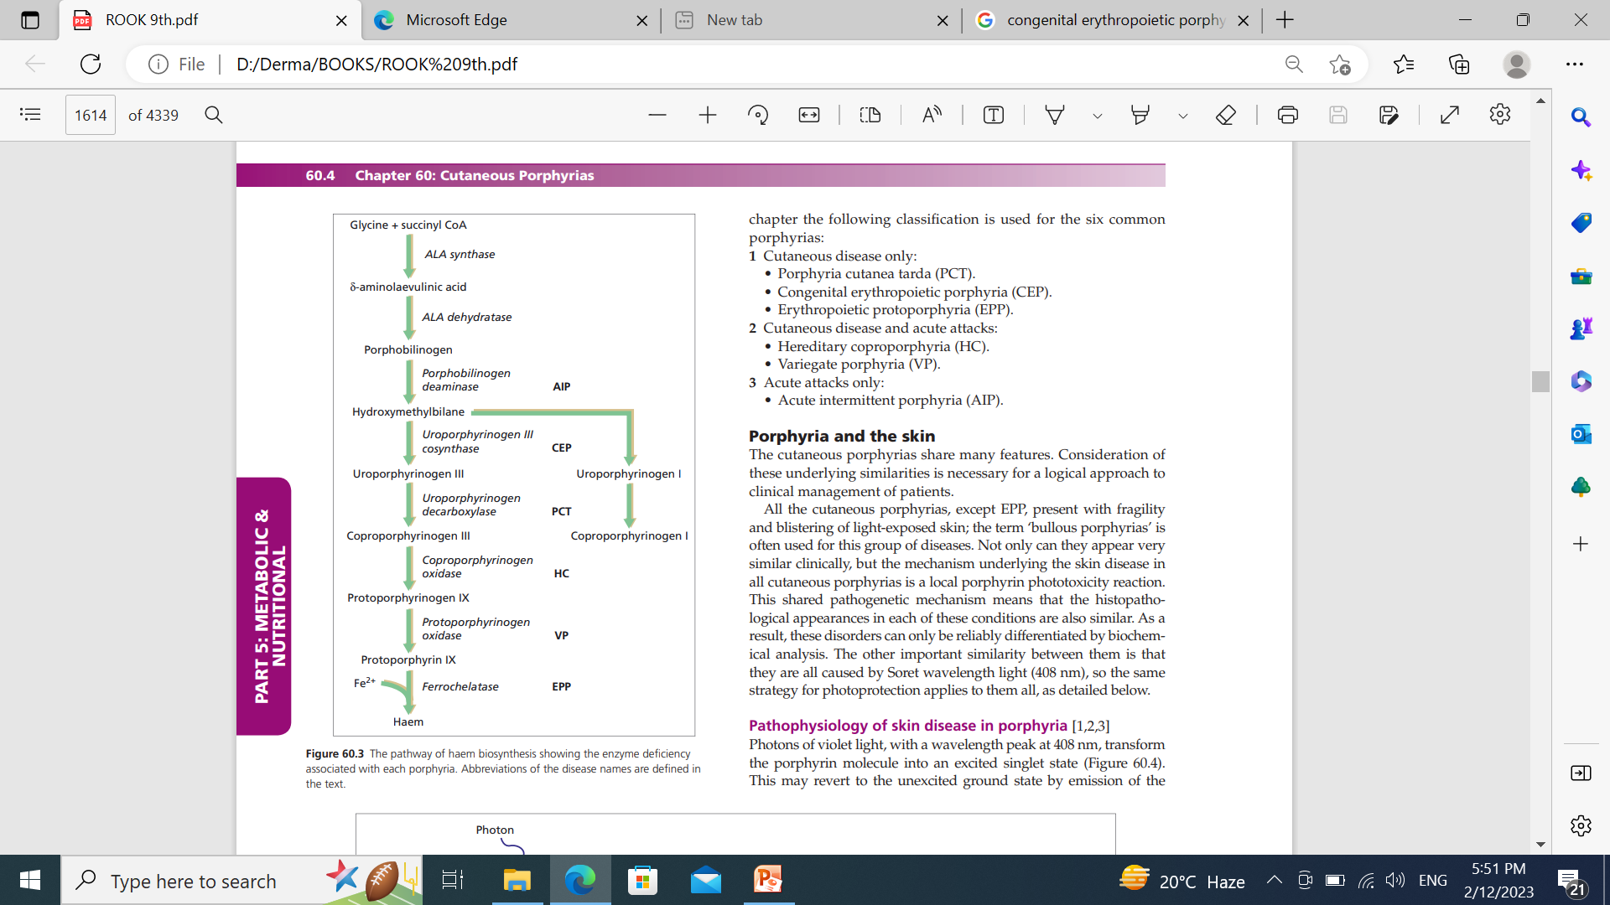
Haem pathway

Slide 9
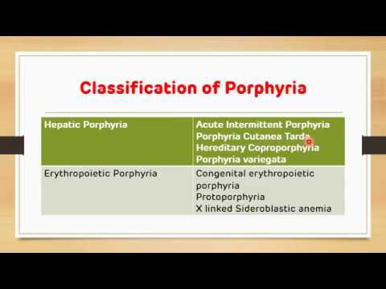
Classification of the porphyrias

Slide 10
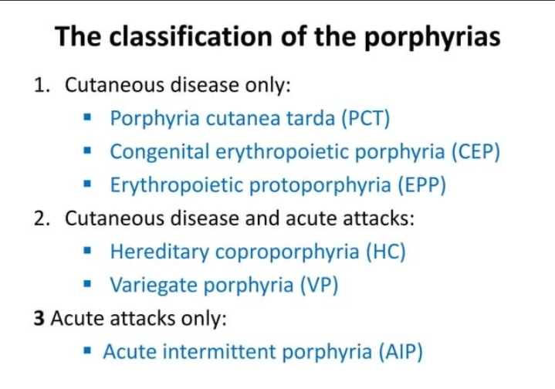

Slide 11
General clinical presentation
All the cutaneous porphyrias, except EPP, present with fragility and blistering of light‐exposed skin; the term ‘bullous porphyrias’ is often used for this group of disease.

Slide 12
pathophysiology
The site of the phototoxic reaction in the skin determines the clinical characteristics of the porphyria.
In EPP, lipophilic protoporphyrin tends to localize to membranes including endothelial cell membranes, and to remain within erythrocytes, and the phototoxic reaction involves upper dermal blood vessels causing pain.
In PCT, the water‐soluble uroporphyrin diffuses easily into surrounding tissues and the photo-toxic reaction occurs in the upper dermis, causing lysis of cells in the superficial dermis with the formation of membrane‐limited vacuoles that merge to produce a blister under the basal lamina, producing the characteristic clinical presentation.

Slide 13
Histopathology
Subepidermal vesicle (cell poor blister)
Marked thicking of superficial dermal vessels
In all the cutaneous porphyrias, homogeneous material is seen within the vessel walls of the upper dermal and papillary vascular plexus. It is periodic acid–Schiff (PAS) positive
In PORPHYRIA CUTANEA TARDA dermal papillae protrudes into bulla with festooned pattern.

Slide 14
Histopathology
In EPP, the vessel wall changes are more pronounced, whereas the basement membrane zone changes pre-dominate in affected skin in PCT and VP.
In bullous porphyrias, bullae are subepidermal with the split occurring in the lamina lucida leaving the dermal papilla protruding into the blister cavity, an appearance called ‘festooning’
The findings in bullous porphyrias are indistinguishable from pseudoporphyria. In EPP, in the acute phase, there is visible endothelial damage in superficial dermal vessels.

Slide 15
Histopathology
Immunofluorescence reveals immunoglobulins (mainly IgG) in a similar vascular distribution, and IgG at the dermal–epidermal basement membrane zone, in involved skin.
Electron microscopy shows reduplication of the vascular basal lamina and the presence of masses of fine fibrillar material, mainly around these blood vessels and often also at the dermal epidermal junction.

Slide 16
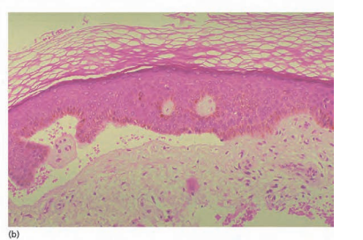
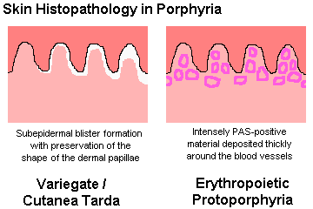

Slide 17
General managment
Apart from PCT, and to some extent CEP, where effective specific treatments exist, the management of the skin in the other cutaneous porphyrias is based on PHOTOPROTECTION.

Slide 18
sun avoidance behaviour sun protective clothing and hats.
sunscreens, including UV‐absorbent chemical ‘total sun blocks’,
Sunscreens containing titanium dioxide , zinc oxide and iron oxide, can effectively protect against violet light .

Slide 19
Diagnosis
Porphyria is confirmed by blood ,urine and stool tests.
High levels of porphyrins or porphyrin precursors in blood,urine or stool indicate porphyria.
DNA testing of a blood sample to look for known gene mutations that causes pporphyria.

Slide 20
Handling of samples
Laboratory testing of body fluids measures porphyrins since porphyrinogens are spontaneously oxidized to their respective porphyrins outside the body. PBG has a tendency to polymerize too their molecules but porphyrins are reasonably stable when protected from light and oxidants.
Thus, all specimens should be kept at room temperature or at 4°C in the dark and ideally should be analysed within 48 h of collection. For urine and faecal analysis, fresh random specimens (10–20 mL urine or 5–10 g dry weight faeces) are preferable to 24 h collections. Random specimens yield equally useful results, and 24 h collections delay samples reaching the laboratory. Very dilute urine (creatinine <4 mmol/L) is unsuitable.

Slide 21
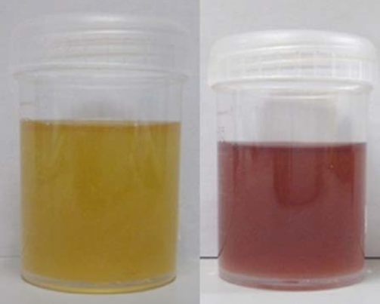
Laboratory analysis of porphyrins
Old‐fashioned qualitative screening methods for detecting porphyrins in specimens (often involving a Wood’s light) are insensitive, and negative results from such tests are not of value. Whether testing urine, faeces, red cells or whole blood, quantitative screening using spectrophotometric or fluorimetric techniques is necessary and yields results as a total porphyrin concentration.

Slide 22
Whole blood or red cell porphyrin testing measures both the total and free protoporphyrin concentrations. Plasma is analyzed by fluorimetric scanning – a diagnostically powerful and simple qualitative technique.
In urine and faeces, the finding of an increased porphyrin concentration will lead on to high‐performance liquid chromatography (HPLC), which can be used to rapidly identify the accumulated porphyrins

Slide 23


Slide 24
Screening of relatives
In VP and HC, porphyrin levels are normal before puberty. Over the age of 15 years, a plasma fluorimetry scan is a reasonably sensitive biochemical test for latent VP in asymptomatic relatives of patients, picking up most cases.
A positive scan is diagnostic of latent VP but a negative result is uninformative
In VP and HC, a negative porphyrin screening test in a relative needs to be followed by DNA analysis before latent disease can be excluded.

Slide 25
Eating,Diet and Nutrition in Porphyria
People with acute porphyria should eat diet with an average to high level of carbohydrates. The recommended dietary allowance is 130 g per day.
Dieting or fasting can trigger symptoms.
People undergoing therapeutic phlebotomies should drink plenty of milk, water or juice before and after each procedure.
Vitamin and mineral supplements for people with a cutaneous porphyria.

Slide 26
ACUTE ATTACKS OF PORPHYRIA

Slide 27
DEFINITION
AIP, HC and VP can all cause acute attacks, and HC and VP may also cause cutaneous disease.
A rare autosomal recessive acute porphyria, aminolaevulinic acid (ALA) dehydratase porphyria,
has also been reported but does not cause skin disease

Slide 28
Epidemiology
The commonest acute porphyria is AIP, followed by VP. HC is rare.
AIP or VP gene defects are asymptomatic, so the enzyme deficiencies are common.
PBG deaminase deficiency, which causes AIP, is present in 0.2% of all blood donors.

Slide 29
PATHOPHYSIOLOGY
Impaired activity of PBG deaminase is associated with acute attacks.
The deficiency can be
primary (AIP)
secondary ( due to inhibition of the enzyme by accumulated coproporphyrinogen and protoporphyrinogen )(as in HC and VP)

Slide 30
PATHOPHYSIOLOGY
When a drug or hormone induces cytochrome P450, and hence acutely increases the hepatic requirement for haem, the inability of the pathway to respond adequately because of the PBG deaminase deficiency is exposed.
This acute hepatic haem deficiency in turn causes secondary accumulation of ALA and increased ALA synthase activity.

Slide 31
Factors that may precipitate an acute attack
DRUGS
MENSTRUAL CYCLE
ALCOHAL
CANNBIS
FASTING
STRESS
INFECTION
SMOKING

Slide 32
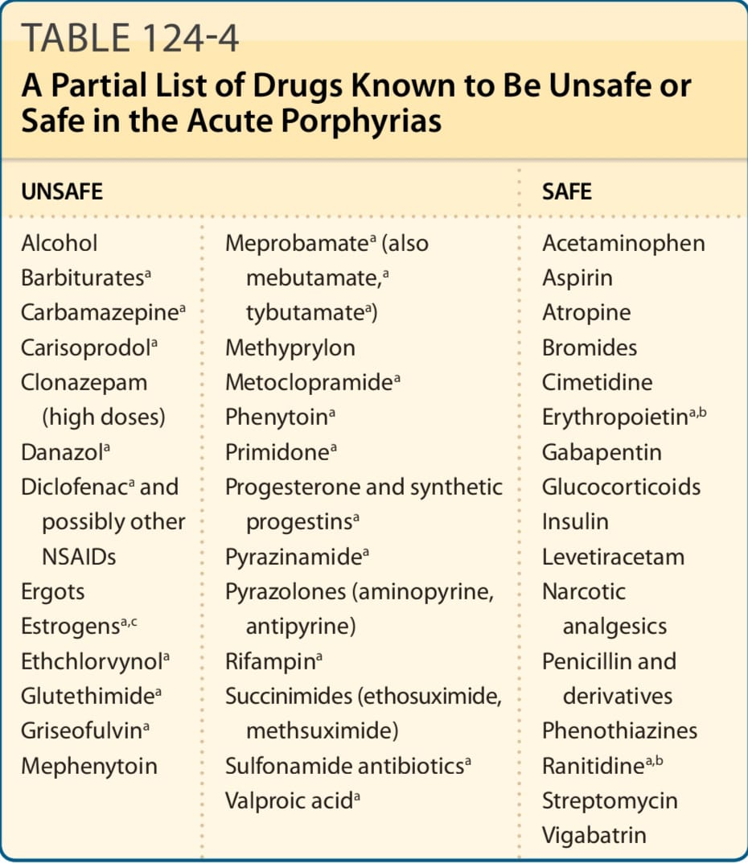

Slide 33
CLINICAL FEATURES
More common in females
Between the ages 10 and 40 years
Rarely before puberty
Vomiting and constipation
Constant abdominal pain
Dehydration is common and hyponatraemia
Tachycardia, hypertension
Confusion and hallucination
Bulbar palsy and respiratory paralysis
A motor neuropathy occurs in 5–10% of cases
Respiratory paralysis is the commonest cause of death

Slide 34
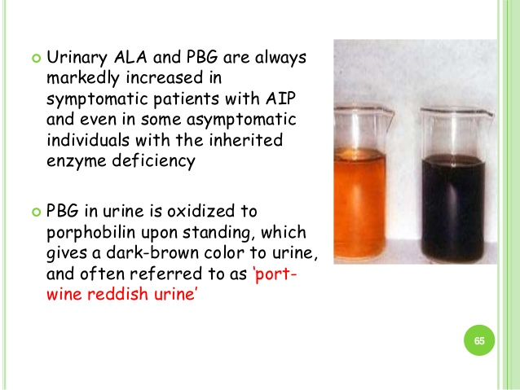
Biochemical diagnosis of an acute attack
Increased urinary PBG excretion.
A normal urinary PBG concentration excludes an acute porphyric attack
Urinary ALA is also increased during an acute attack.

Slide 35
Long‐term management of patients with acute porphyria
List of safe and unsafe drugs.
Avoid alcohol
cannabis
prolonged calorie‐restricted diets
To wear an emergency identification bracelet
Screening of relatives

Slide 36
Treatment of the acute attack
Early diagnosis
Avoidance of acute attack‐inducing drugs
Supportive treatment includes analgesia, sedatives and antiemetic .
Careful management of fluid balance with rehydration and correction of hypernatremia.
The specific treatments
Intravenous haematin
Haem arginate
In rara cases,if symptoms are severe liver transplantation is recommended.
Notes:
These drugs suppress hepatic ALA synthase activity and so reduce ALA and PBG accumulation.
Haem arginate is more effective when given earlier during an attack, increasing the importance of early diagnosis.

Slide 37
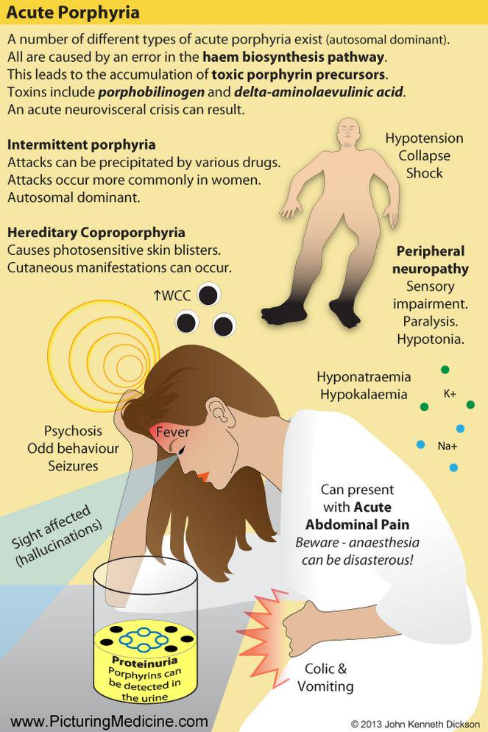
Treatment of the acute attack
Early diagnosis
Once the diagnosis has been made, avoidance of acute attack‐inducing drugs
Supportive treatment includes analgesia, sedatives and antiemetics .
Careful management of fluid balance with rehydration and correction of hyponatraemia.
The specific treatments
intravenous haematin
haem arginate .
Notes:
These drugs suppress hepatic ALA synthase activity and so reduce ALA and PBG accumulation.
Haem arginate is more effective when given earlier during an attack, increasing the importance of early diagnosis.

Slide 38
CONGENITAL ERYTHROPOIETIC PORPHYRIA

Slide 39
DEFINITION AND NOMENCLATURE
This is a severe and rare childhood porphyria causing lifelong mutilating photosensitivity and haematological disease
SYNONYMS
Gunther Disease

Slide 40
EPIDEMIOLOGY
It is a rare disease: the incidence in Europe is 0.007 per year per 10 million population
Roughly 200 cases have ever been reported worldwide.
Rare adult‐onset cases of acquired CEP have been reported secondary to myelodysplasia

Slide 41
Introduction and pathophysiology
CEP is caused by an autosomal recessive inherited deficiency of the uroporphyrinogen III cosynthase enzyme.
Its absence results in non‐enzymatic reactions producing large amounts of type I isomer porphyrins which cannot participate in haem formation, and which massively accumulate in erythroid cells and then gradually leak into the plasma

Slide 42
CLINICAL FEATURES
Wide spectrum of presentation, from hydrops fetalis through to severe disease starting in infancy and also mild forms presenting later in life.
The first sign of CEP is often the
child’s mother noting brown discoloration of amniotic fluid at the onset of labour, or observing pink or brown porphyrin staining of nappies (which fluoresce red‐orange under Wood’s light)

Slide 43
CLINICAL FEATURES
Photosensitivity results in blisters,erosions,swelling and scarring of skin particularly of the face and hands
This photomutilation is associated with erosion of
the terminal phalanges, onycholysis and destructive changes affecting the pinnae and nose.
Hypertrichosis on the upper arms, temples and malar region.
Patchy hyper and hypopigmentation

Slide 44
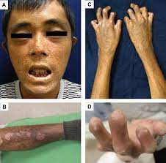

Slide 45
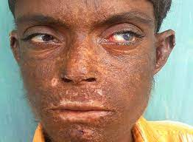

Slide 46
Mild late onst form
occurs either as a result of mild inherited gene mutations or as an acquired disease secondary to bone marrow myelodysplasia
the eyes and internal organs are frequently involved
.

Slide 47
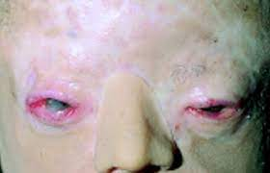
Eyes
Keratoconjunctivitis,
blepharitis,
cataracts,
corneal ulcers,
scars,
cicatricial ectropion and scarring alopecia of eyelashes eyebrows Scleromalacia,
pterygium formation, optic atrophy, retinal haemorrhage and scleral necrosis are less common.

Slide 48
Bones and teeth
Brown staining of teeth (and fluoresce under Wood’s light).
Decreased bone density, osteopenia and osteolytic lesions secondary to erosion by hyperplastic bone marrow are seen on X‐ray
vertebral compression and collapse, and with pathological fractures.
Occasionally, strict avoidance of the sun may impair vitamin D metabolism.

Slide 49
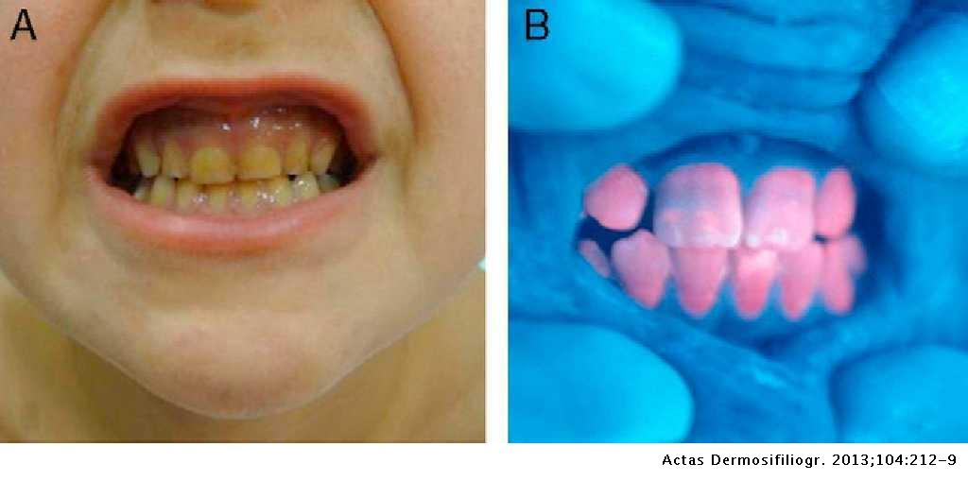

Slide 50
Hematology
Haemolytic anaemia
Hypersplenism
Very severe haemolytic anaemia may even cause hydrops fetalis.
Bone marrow examination reveals normoblastic hyperplasia.

Slide 51
Differential Diagnosis
Epidermolysis bullosa dystrophica.
Hep (the homozygous form of familial pct)
Homozygous VP
PCT or VP.

Slide 52
Diagnosis and prognosis
Most patients died by the age of 40 years
But improvements in supportive care have improved the prognosis
The haematological complications may be fatal.
Long‐term hypertransfusion causes significant problems with iron overload

Slide 53
Diagnosis and prognosis
Bone marrow transplantation now holds out the promise of cure for these patients
The key markers of poor prognosis are
early onset of disease (especially in the first year of life)
a significant haematological involvement.

Slide 54
Investigations
Massive accumulation in all tissues of type I isomers of porphyrins, mainly uroporphyrin, along with coproporphyrin.
Red cells and urine contain large amounts of uro‐ and coproporphyrin (mainly type I) and faeces contain increased concentration of coproporphyrin (mainly type I).
A plasma spectrofluorimetry peak is seen at 615–620 nm.

Slide 55
Treatment
PHOTOPROTECTION
Sun avoidance use of sun protective clothing and hats are essential.
Opaque sunscreens containing pigmentary grade titanium dioxide or zinc oxide, possibly with added iron oxide
Amber window films on home or car windows can reduce exposure to soret wavelength

Slide 56
Treatment
Hyper transfusion
Treatment of secondary infections
Intravenous haematin has been tried in late‐onset disease
Splenectomy
Bone marrow transplantation
Gene therapy

Slide 57
Genetic councelling
CEP is autosomal recessive ,and the risk of disease is in further offspring is 25%.
The diagnosis is may be made before birth by measuring the uroporphyrin 1 concentration in amniotic fluid (16 wk in utero)

Slide 58
PORPHYRIA CUTANA TARDA

Slide 59
Definition
PCT is the commonest of all the porphyrias . It is characterized by fragility and blistering of exposed skin.
Autosomal dominant
It is usually acquired and is often associated with liver disease. It does not cause acute attacks
PCT results from deficiency of UROD

Slide 60
Introduction and pathophysiology
Type I (Sporadic form) 75 % ,in which the enzyme deficiency is acquired and restricted to hepatocytes.
Type II ( familial ) 25 %,where the enzyme deficiency is hereditary, present in all tissues and associated with a UROD gene mutation
Type III disease is rare ,hereditary enzyme deficiency localized to liver
Toxic porphyria , in which halogenated aromatic hydrocarbons inhibit the enzyme, is rare and mainly affects workers making herbicides

Slide 61
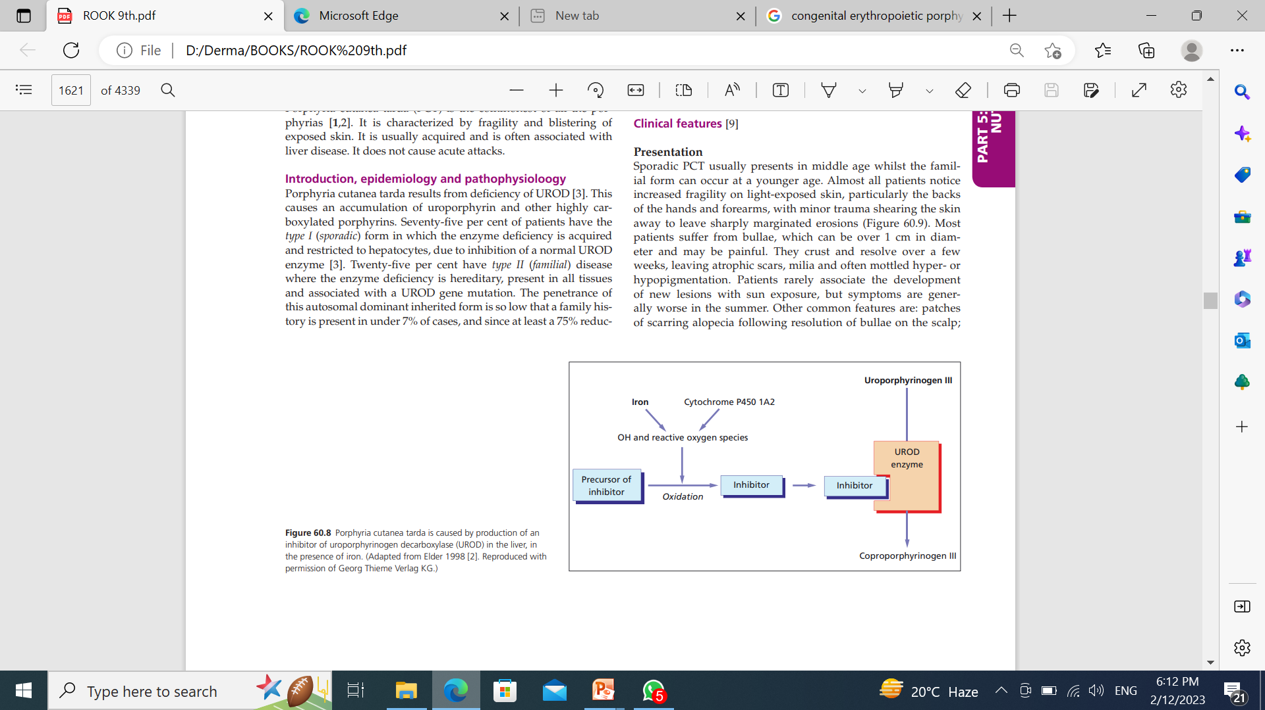

Slide 62
Epidemiology
The prevalence varies but in most countries is around 1 in
10 000.
Sporadic PCT usually presents in middle age whilst the familial form can occur at a younger age.

Slide 63
Risk factors for the development of PCT
HEAMCHROMATOSIS
HEPATITIS C
ALCOHOL
OESTROGEN
OCPs

Slide 64
Other less common risk factors are
Haemodialysis in renal failure
Hiv) infection
Non‐insulin‐dependent diabetes,
Systemic lupus erythematosus,
Dermatomyositis,
Hepatitis A and B infection,
Haematological malignancy,
Sideroblastic anaemia, thalassaemia
Tamoxifenge

Slide 65
Histopathology
The bullae in PCT are subepidermal with a sparse inflammatory infiltrate and ‘festooning’ of dermal papillae into the bullae.
There is deposition of PAS‐positive diastase‐resistant fibrillar glycoprotein material in and around the upper dermal blood vessel walls, and reduplication of the basement membrane.
Immunofluorescence reveals IgG, a little IgM, fibrinogen and
complement at the epidermal–dermal junction.

Slide 66
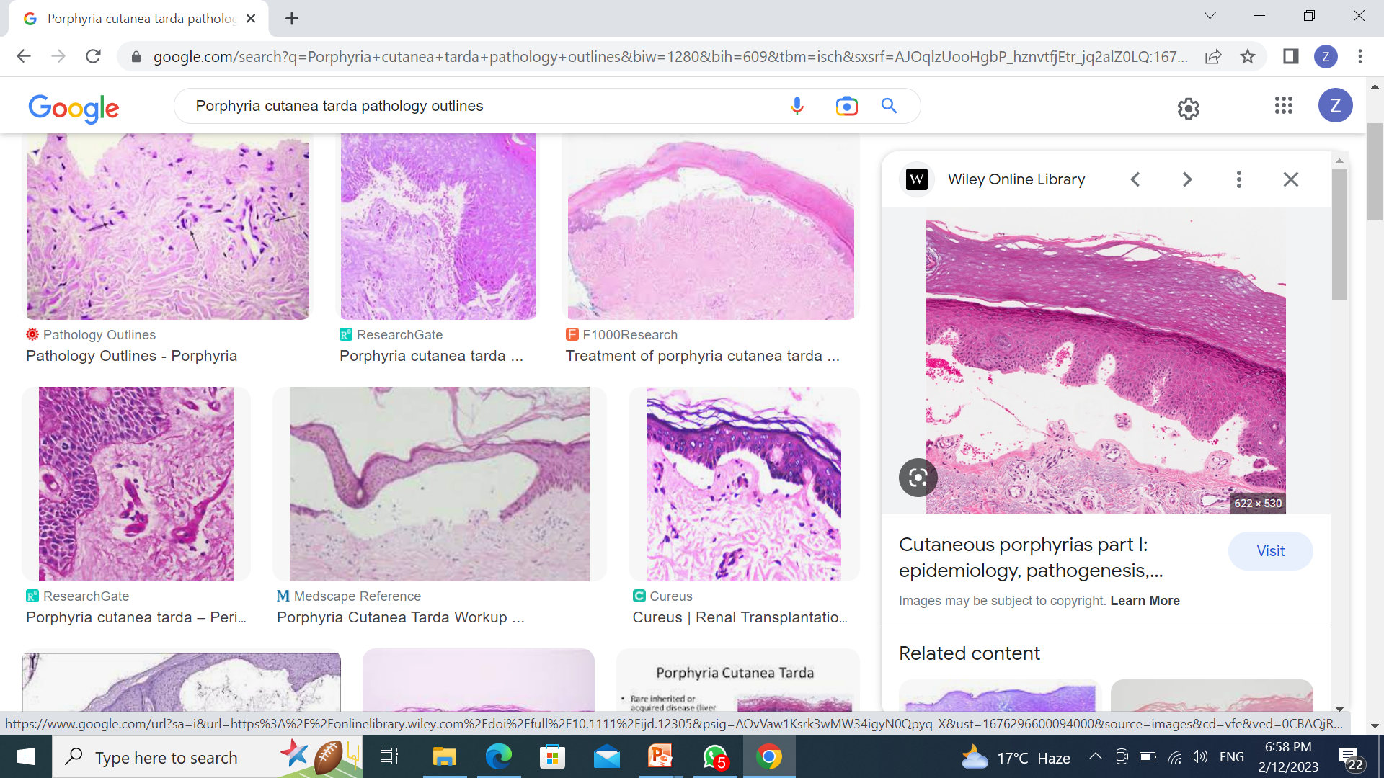

Slide 67
Clinical features
Excess porphyrin in the skin results in photosensitivity. Individuals with PCT present with increasingly fragile skin on the back of the hands and the forearms.
Other sun-exposed sites such as the face, scalp, neck, and arms may also be affected.
Features include:
Slow to heal crusted erosions following minor injuries
Fluid or blood-filled blisters
Postinflammatory pigmentation and cysts (milia)

Slide 68
Clinical features
Symptoms are generally worse in the summer
Other common features are:
Patches of scarring alopecia following resolution of bullae on the scalp
Hypertrichosis
Hyperpigmentation in a melasma‐like pattern on the cheeks and around the eyes, or in a diffuse pattern
Photo‐induced onycholysis
Accelerated solar elastosis morphoea‐like plaques may develop,particularly on the head and upper trunk.

Slide 69
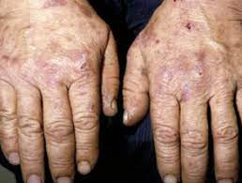

Slide 70
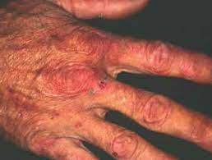

Slide 71
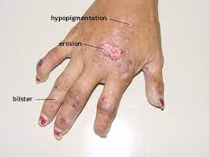

Slide 72
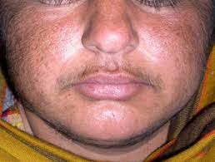

Slide 73
Clinical Varients
The homozygous form of familial PCT, hepatoerythropoietic porphyria (HEP), is associated with over 90% reduction in UROD activity.
usually causes a severe disease clinically similar to CEP, with photosensitivity during infancy causing immediate pain on sun exposure, blisters on sun‐exposed skin
mutilating scarring of the face and fingers.
Prominent hypertrichosis, fluorescent teeth, eye involvement and shortened distal phalanges also occur.
Haemolysis is milder than in CEP, and life expectancy is normal.
.

Slide 74
Differential diagnosis
Vp
Drug‐induced pseudoporphyria
Renal pseudoporphyria,
HC
Late‐onset günther disease
Mild HEP
.

Slide 75
Investigations
urinary porphyrin concentration is increased, consisting mainly of uroporphyrin,
A plasma spectrofluorimetry peak is seen at 615–620 nm.
Isocoproporphyrin accumulates in the faeces.
Urine analysis alone is insufficient to diagnose PCT, since a few patients with VP have the PCT urine pattern (‘dual porphyria’)
In patients with renal failure, faecal analysis is essential, since plasma porphyrins are increased by haemodialysis and urine collection may not be possible
.

Slide 76
Liver disease in PCT
Since PCT is primarily a liver disorder with secondary effects in the skin, liver disease is a major concern.
In almost all cases, liver biopsy reveals increased stainable iron, fatty change and intracellular porphyrin crystals.
Fifty per cent of patients have more severe changes (lobular necrosis or inflamed fibrotic portal tracts), and cirrhosis occurs in 15% .
The most severe liver disease tends to occur in patients who have alcoholism, hepatitis C infection and iron overload
The accumulated porphyrins are carcinogenic to the liver, so PCT confers an additional risk for developing hepatocellular carcinoma .
.

Slide 77
RISK FACTORS FOR DEVELOPING HCC
Symptomatic period longer than 10 years prior to treatment
severe changes on hepatic histology at presentation
hepatitis C infection
Male sex
age over 50 years at presentation

Slide 78
Management
Photoprotection
Visible light sunscreens containing pigmentary grade titanium dioxide or zinc oxide, sometimes with added iron oxide .
Filter films for car and home windows, gloves, hats and clothes play an important role in controlling symptoms during the period
of several months before specific therapies take effect.
.

Slide 79
Management
Elimination of risk factors
Stopping oestrogen therapy
Abstaining from alcohol
Treating hepatitis c with interferon α
Abstain from alcohol
Avoid oral contraceptive pills
.

Slide 80
Management
Specific Treatment
Definitive treatment with venesection or low‐dose antimalarials is required in almost all cases.
Venesection depletes iron stores and eliminates hepatic iron overload, thus restoring normal enzyme activity.
Around 500 mL of blood is removed every week or every 2 weeks, aiming to decrease transferrin saturation to 15%, haemoglobin to 11–12 g/dL and plasma ferritin to below 25 μg/L.
.

Slide 81
Management
Blistering usually resolves within 2–3 months, skin fragility within 6–9 months , and porphyrin concentrations generally normalize within 13 months or so , at which point treatment should be stopped.
Hypertrichosis and sclerodermoid lesions respond more slowly during the years after treatment has stopped.
Excision and grafting may be needed for ulcerated sclerodermoid lesions
.
.

Slide 82
Management
Desferrioxamine leads to earlier remission than venesection because it rapidly chelates hepatic iron, and it may be of value in PCT with renal failure but it is expensive and requires the use of a subcutaneous pump at night.
Erythropoietin mobilizes hepatic iron into haemoglobin and is the treatment of choice for PCT in renal failure where patients are too anaemic for venesection and cannot excrete chloroquine.
.

Slide 83
Management
Low‐dose antimalarials are a very effective treatment for PCT..
Chloroquine at the low dose of 125 mg or 250 mg taken twice a week is safe and effective.
It leads to clinical remission within 6 months or so and biochemical remission after 6–15 months, at which point treatment is stopped
Retinopathy does not seem to occur with such low doses of chloroquine .
Hydroxychloroquine (100 mg twice weekly) is also effective.
.

Slide 84
Management
Low‐dose chloroquine is the treatment of choice except in the following situations, in which venesection is preferable
Patients who do not respond to chloroquine
Patients with a pathologically high serum ferritin concentration or homozygous for the cys282tyr mutation who require iron depletion to protect internal organs
Patients with significant hepatitis c liver disease
.
.

Slide 85
Management
Remission with low‐dose chloroquine generally lasts 17–24 months
With venesection, relapse generally occurs around 2.5 years after the end of treatment .
Long‐term follow‐up is necessary for all patients to monitor for relapse (by measuring urinary porphyrin excretion) and for the management of coexisting liver disease.
.

Slide 86
ERYTHROPOIETIC PORPHYRIA

Slide 87
Definition
Erythropoietic protoporphyria (EPP) is a hereditary porphyria
characterized by painful, lifelong photosensitivity and occasionally liver disease
.

Slide 88
Epidemiology
The incidence of EPP in Europe varies between countries (from
0.03 new cases/million per year in Spain to 0.36 in the UK).

Slide 89
Epidemiology
EPP usually results from deficient activity of ferrochelatase,
the final enzyme of haem biosynthesis.
In a minority of cases it is caused by gain‐of‐function mutations in ALAS‐2 (the first enzyme in the pathway)
This causes the accumulation of protoporphyrin predominantly in cells of the erythroid series, which causes a phototoxic reaction as the porphyrin‐laden cells pass through the small upper dermal blood vessels and are exposed to the Soret wavelength in sunlight

Slide 90
Introduction & patophysiology
EPP usually results from deficient activity of ferrochelatase,
the final enzyme of haem biosynthesis.
In a minority of cases it is caused by gain‐of‐function mutations in ALAS‐2 (the first enzyme in the pathway)
This causes the accumulation of protoporphyrin predominantly in cells of the erythroid series, which causes a phototoxic reaction as the porphyrin‐laden cells pass through the small upper dermal blood vessels and are exposed to the Soret wavelength in sunlight

Slide 91
Clinical features
EPP causes immediate pain on exposure to bright sunlight.
It presents most commonly in the first year
Quite often in babies who usually present with crying in their prams in sunny weather, or crying for no obvious reason at night in the summer.
Few minutes to an hour or two of sun exposure,patients describe discomfort, tingling or itching in exposed skin,particularly the dorsae of the hands and the face.
Severe burning pain may follows which can last between an hour and several days.

Slide 92
Clinical features
Children often find partial relief with cold water and wet cloths, and this feature may be diagnostically useful.
Usually the only physical sign during an attack is oedem.
The lack of physical signs often leads to delay in diagnosis, with some patients initially being labelled as malingerer.
In severe attacks, purpuric lesions and crusted erosions or vesicles may occur.

Slide 93
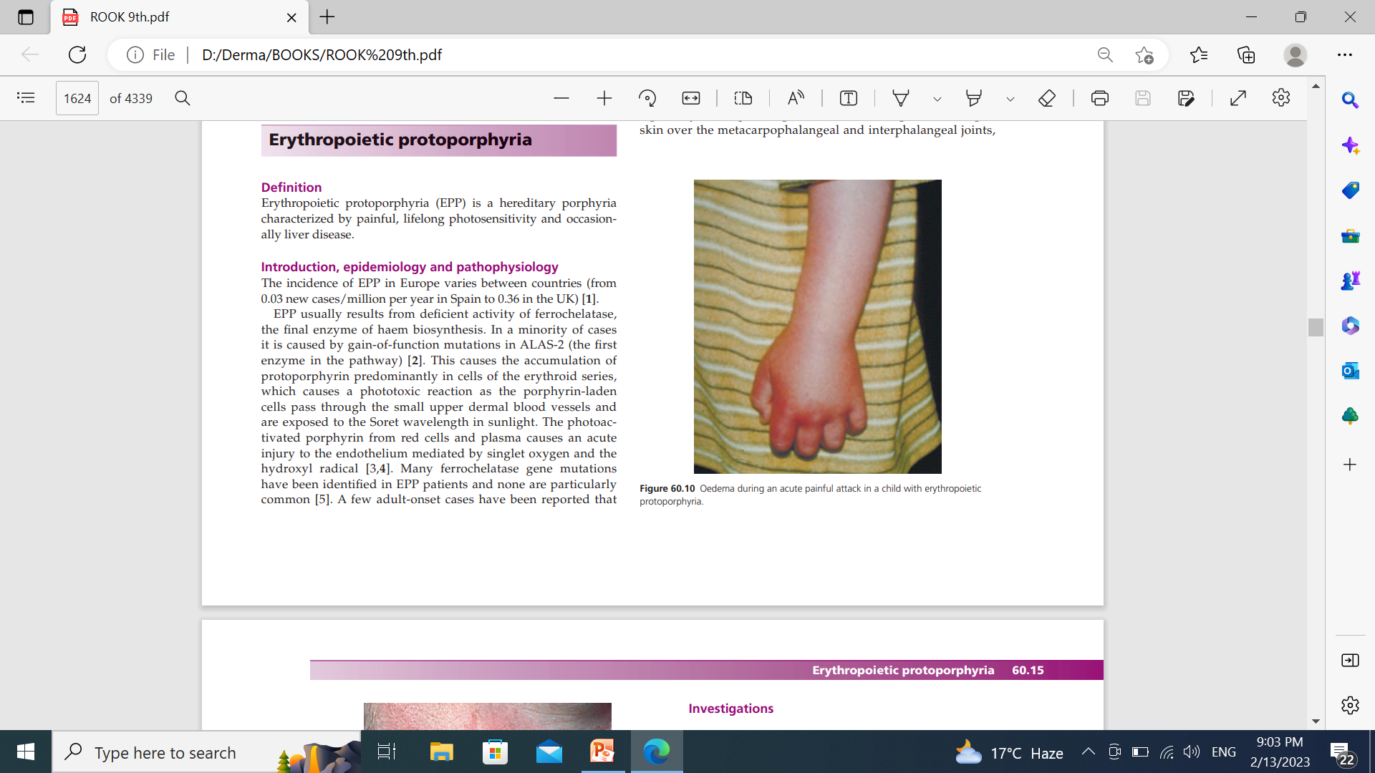
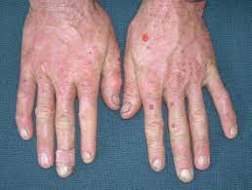

Slide 94
Clinical features
Over the years superficial vermicular waxy scarring on the nose, shallow linear, punctate or small circular scars on the cheeks and back of hands
The skin over the nose, cheeks and forehead can become roughened and ‘pebbly’ in texture.
The keratoderma is more commonly seen in autosomal recessive EPP
Children with EPP suffer from social isolation due to difficulty joining friends to play outside.

Slide 95
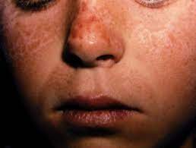

Slide 96
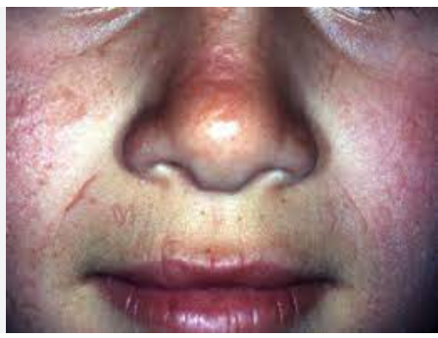

Slide 97
Investigations
The diagnostic finding is of an increased red cell‐free protoporphyrin concentration.
Protoporphyrin is seen as a peak at 633 nm on plasma fluorimetric scanning.
Sixty per cent of EPP patients have an increased faecal protoporphyrin concentration.
Urinary porphyrins are normal except in biliary impairment, when
coproporphyrinuria develops.
Umbilical cord protoporphyrin concentration is not a useful test to identify EPP in newborn

Slide 98
Histology
In the acute phase there is visible endothelial damage in superfi cial dermal vessels.
In the chronic phase, in exposed areas of skin, the repeated episodes of damage to small vessels cause deposition of PAS‐positive diastase‐resistant hyaline material in the walls of blood vessels of the upper dermal and papillary vascular plexuses
Immunofluorescence showsimmunoglobulins (mainly IgG) in a similar distribution.
On electron microscopy the hyaline material can be seen with
fine fibrillar material permeating the capillary connective tissue sheath extending beyond the vessel walls

Slide 99
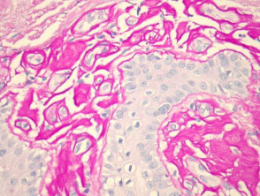

Slide 100
Management
No therapy has ever been proven to be effective in EPP .
PHOTOPROTECTION
Visible light sunscreens containing pigmentary grade titanium dioxide or zinc oxide, sometimes with added iron oxide .
Filter films for car and home windows, gloves, hats and clothes play an important role in controlling symptoms during the period
of several months before specific therapies take effect.
.

Slide 101
Management
ACUTE REACTION
For an acute reaction, complete sun avoidance (even through windows) leads to earlier resolution, and fans and cold water provide some pain relief.
Antihistamines and most analgesics are of little value.
For severe attacks, hospital admission may be necessary –for light avoidance and analgesia (usually opiate.
.

Slide 102
Management
Specific reactions
Oral β‐carotene is the most widely used treatment, usually at a dose around 180 mg daily in adults (90 mg daily in children) taken throughout the spring and summer.
The most common adverse effect of β‐carotene is reversible skin
discoloration. .
Short courses of puva and narrow‐band uvb used in the early spring may be valuable, particularly in milder cases
Afamelanotide, the α‐melanocyte‐stimulating hormone analogue, has shown promising results in initial trials in EPP patients
.

Slide 103
Liver disease in EPP
Protoporphyrin is excreted exclusively into the bile. It precipitates to form gallstones in around 12% of patients.
It is also hepatotoxic, particularly to bile canaliculi, and severe liver damage occurs in around 1% of patients.
Usually a patient develops jaundice, worsening photosensitivity and often upper abdominal pain over a period of weeks or months.
Investigation shows severe or total cholestasis, and a dramatically high red cell protoporphyrin concentration , which causes the worsening photosensitivity.
.

Slide 104
Liver disease in EPP
Liver histology reveals deposition of protoporphyrin in vacuoles within bile canaliculi and hepatocytes, which may be accompanied by cirrhosis
Patients with severe liver disease have been treated by bone marrow transplantation
.

Slide 105
HEREDITARY PORPHYRIA

Slide 106
Definition
This is a rare inherited disease usually characterized by acute attacks, which involves the skin as well in a minority of patients.
.

Slide 107
Clinical features
presents from puberty onwards.
The skin is only involved in around 10–20% of patients have cutaneous involvement with fragility and blistering in sun‐exposed areas, indistinguishable from that seen in PCT or VP.
Rare variants include a homozygous form characterized by short stature, acute attacks and skin changes with prominent hypertrichosis and pigmentation , and harderoporphyria which causes haemolysis in the neonate or bullae.
HC is caused by an autosomal dominant inherited deficiency of coproporphyrinogen oxidase.
.

Slide 108
Investigations
The biochemical findings are of a 615–620 nm peak on plasma spectrofl uorimetry.
Increased uro‐ and coproporphyrin concentrations in urine, and increased coproporphyrin in faeces.
Predominance of the type III isomer in faeces is a sensitive indicator of HC
.

Slide 109
VARIEGATE PORPHYRIA

Slide 110
Definition
This is a rare inherited disease usually characterized by photo‐
induced skin fragility and blistering, which may cause acute
attacks.
.

Slide 111
Introduction & pathophysiology
Variegate porphyria is caused by an autosomal dominant inherited deficiency of protoporphyrinogen oxidase.
In addition to causing photosensitization, accumulated coproporphyrinogen and protoporphyrinogen also inhibit PBG deaminase, theprobable mechanism for acute attacks in VP.
.

Slide 112
Epidemiology
In South Africa,VP is common with a prevalence in whites and Afrikaner‐descended non‐whites of 1/200.
The incidence of VP in Europe varies between countries in the range 0.01–0.26 new cases/million/year .
Elsewhere the prevalence is around 0.5–1/100 000 .
At least 80% of South African carriers of a pathogenic VP mutation are completely asymptomati.
.

Slide 113
Clinical features
SKIN
Around 70% of patients have cutaneous involvement.
Vp only very rarely presents before puberty, and usually the skin disease begins in adolescence or young adulthood.
Skin fragility, usually mild, affecting sun‐exposed skin particularly on the backs of the hands .
With painful tense bullae occurring in sun‐exposed skin, as well as scarring, pigmentary abnormalities,sometimes pseudosclerodermatous changes of the hands and fingers, and occasionally photo‐onycholysis.
.

Slide 114
Clinical features
ACUTE ATTACKS
17% of patients will ever suffer an acute attack
70% of acute attacks occur between the ages of 20 and 40 years.
The severity of acute attacks varies from mild abdominal pain, sometimes accompanied by vomiting and constipation, through to very severe attacks with bulbar palsy and respiratory paralysis.

Slide 115
Clinical varients
In homozygous VP a mutation on both protoporphyrinogen oxidase alleles results in an enzyme activity less than 20% of normal,compared with the 50% in other VP patients
Skin Fragility, bullae and often hypertrichosis
Delayed development, epilepsy, sensory neuropathy, nystagmus, various hand deformities and growth retardation also commonly occur.
Acute attacks do not occur in these patients.

Slide 116
Investigations
A plasma spectrofluorimetry peak around 626 nm is diagnostic of VP .
The urine contains increased levels of coproporphyrin, and increased concentrations of copro‐ and protoporphyrin are found
in the faeces.
During acute attacks, urinary PBG (and ALA) are raised.

Slide 117
Management
The key to successful management of the skin disease is photoprotection with sun avoidance using clothes, hats and gloves.
Opaque sunscreens, containing pigmentary grade titanium dioxide or zinc oxide sometimes with the addition of iron oxide, are protective eagainst Soret wavelength light.
β‐Carotene and canthaxanthin have also been claimed to provide limited protection in some patients,and UVB phototherapy may also be of value

Slide 118
Management
The risk of acute attacks is the key issue for the safe management of patients and their families.
Patients should be directed to a list of drugs to avoid , including those that can induce attacks, and also those known to induce cholestasis, as well as cannabis.
They should also be advised to wear an emergency identification bracelet, to avoid low calorie diets .
Liver transplantation has been successfully used to cure variegate porphyria

Slide 119
PSEUDOPORPHYRIA

Slide 120
Definition
Pseudoporphyria is a non‐porphyric dermatosis clinically and histologically indistinguishable from porphyria cutanea tarda.
Porphyrin concentrations are entirely normal.
Pseudoporphyria is one of the clinical presentations of drug‐induced photosensitivity.
.

Slide 121
Causes
The most common causes of pseudoporphyria are non‐steroidal NSAIDs especially naproxen and nabumetone.
Oxaprozin, ketoprofen, mefenamic acid and diflunisalare also reported causes.
Other drugs reported to induce pseudoporphyria include nalidixic acid, tetracyclines including minocycline, bumetanide,furosemide, isotretinoin and dapsone.
Common is in patients with chronic renal failure undergoing haemodialysis.
The third group of patients are those whose pseudoporphyria is induced by UVA tanning beds. This group are predominantly
female

Slide 122
Clinical features
The clinical features in the skin are indistinguishable from porphyria cutanea tarda :vesicles, bullae, fragility, milia and scarring on exposed skin, particularly the dorsal hands, but also the face, chest and occasionally other sites.
Hypertrichosis, hyperpigmenation, sclerodermoid changes are much less commonly seen than in PCT.
Unlike the porphyrias, pseudoporphyria has no manifestations except in the skin.

Slide 123
Differential Diagnosis
PCT
EPP
EBA
BP

Slide 124
Investigations
The porphyrin concentrations in urine, plasma, red cells and faeces must be normal for a diagnosis of pseudoporphyria to be made
The histopathological and immunofluorescentappearances of affected skin are essentially identical in pseudoporphyria and pct.
Blood vessel thickening and sclerosis of collagen are less common in pseudoporphyria

Slide 125
Management
The key to management is to remove the provoking factor by stopping the relevant drug or sunbed usage.
Dialysis‐related pseudoporphyria generally persists until renal transplantation removes the need for dialysis.
Broad spectrum UV protection is vital until the disease resolves
The treatments of PCT (antimalarials, venesection) are obviously not effective in pseudoporphyria.

Slide 126


