Slide 1

CUTANEOUS LYMPHOMAS
DR. SOHAIL SHAHEEN

Slide 2
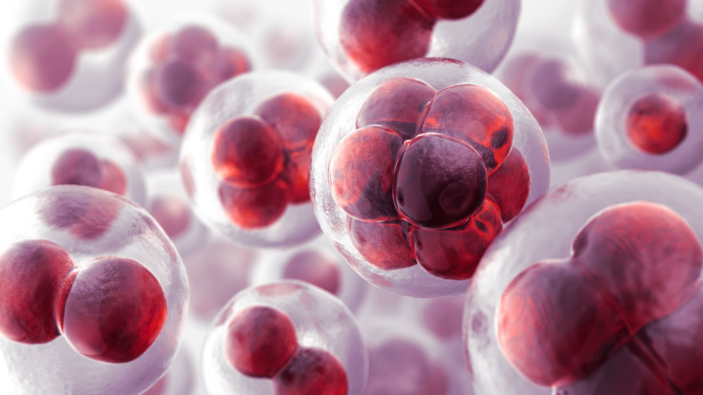
LYMPHOMA
Cancer that mainly effects or arise from the Lymphatic system or Lymphoid cells

Slide 3

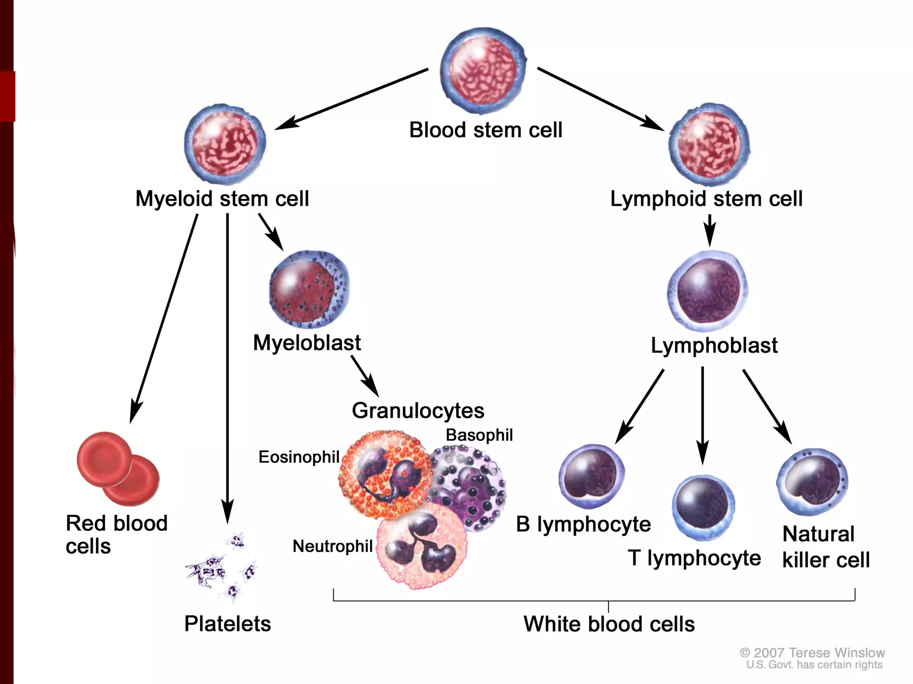
INTRODUCTION

Slide 4
CUTANEOUS LYMPHOMAS
Neoplastic proliferation of lymphoid cells mainly effecting skin
Majority of cells effecting skin are T-Cells → Cutaneous T-Cell Lymphomas

Slide 5
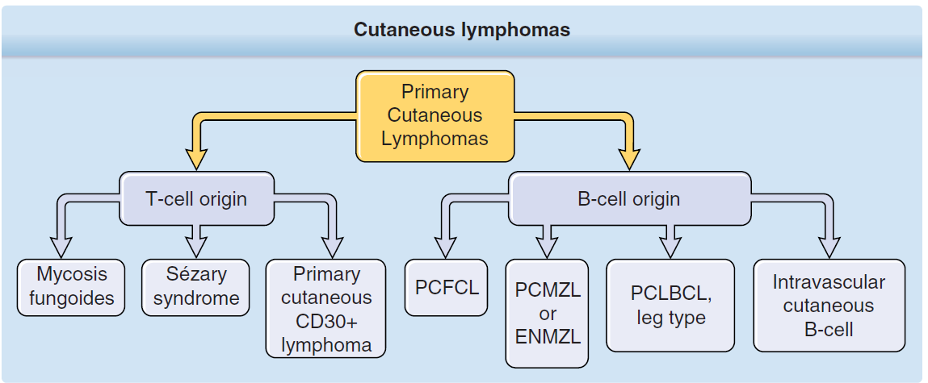

Slide 6
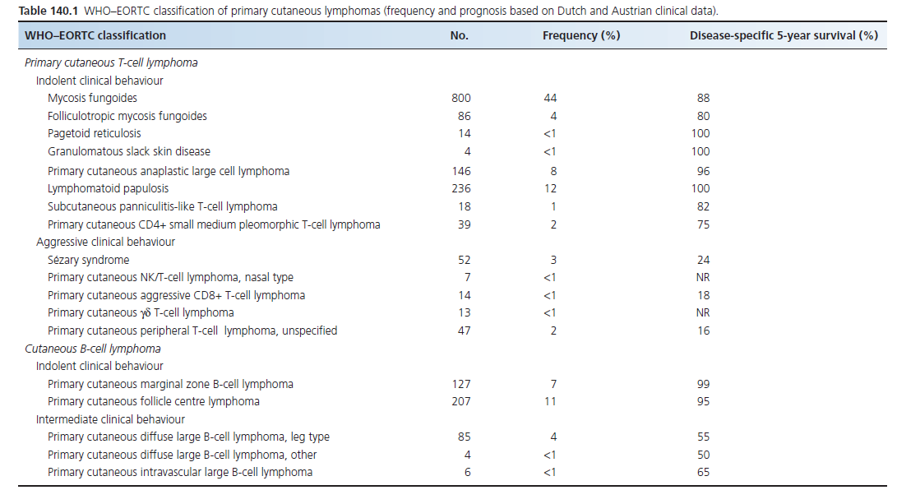

Slide 7
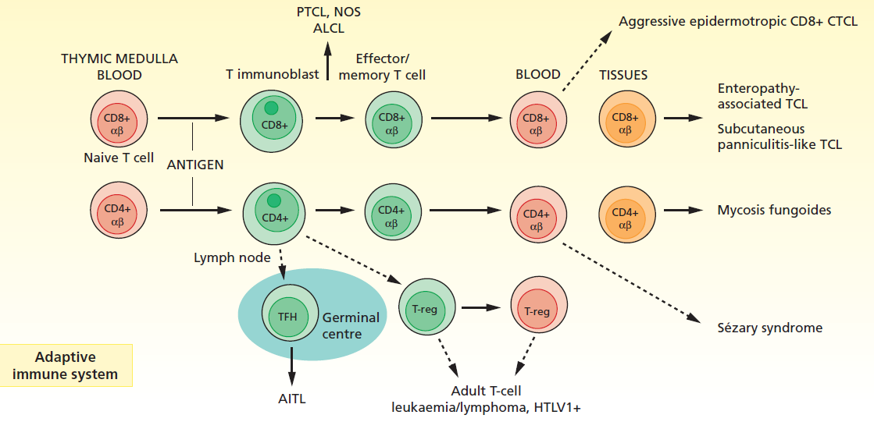

Slide 8
MYCOSIS FUNGOIDES

Slide 9
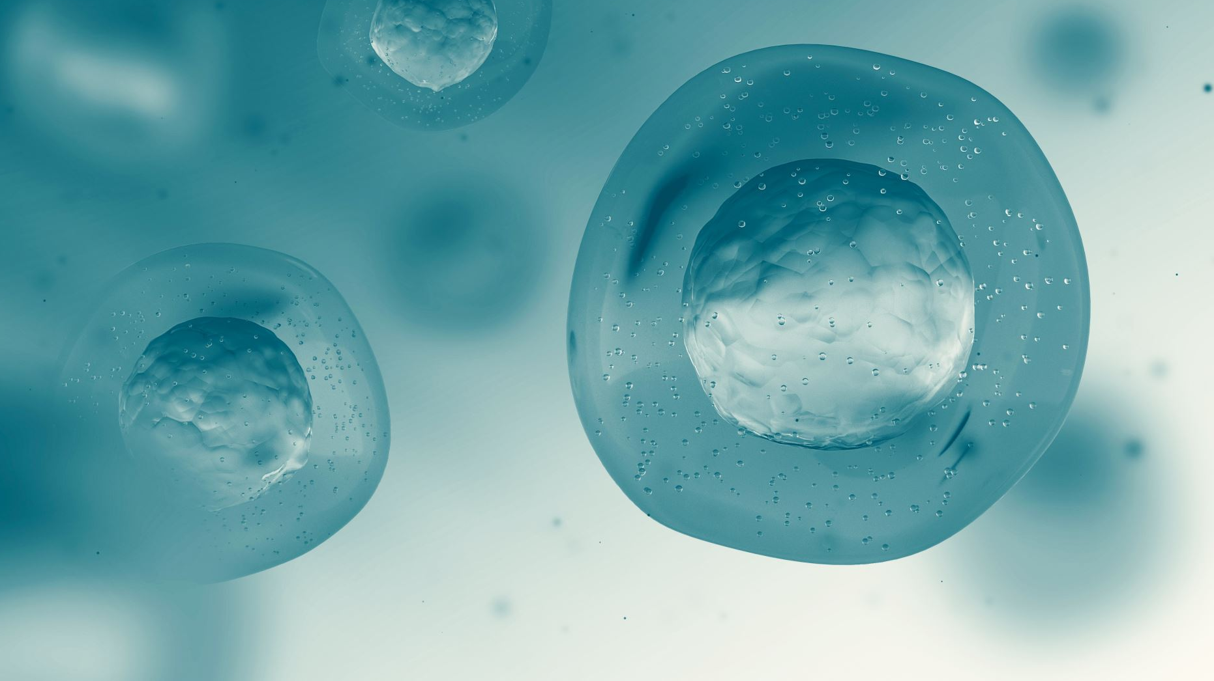
INTRODUCTION
Most common type of primary CTCL
Indolent clinical course
Closely related to other CTCLs
Numerous Clinical variants
Mimic T-Cell mediated Inflammatory dermatosis
Derived from skin-resident effector memory T-Cells

Slide 10
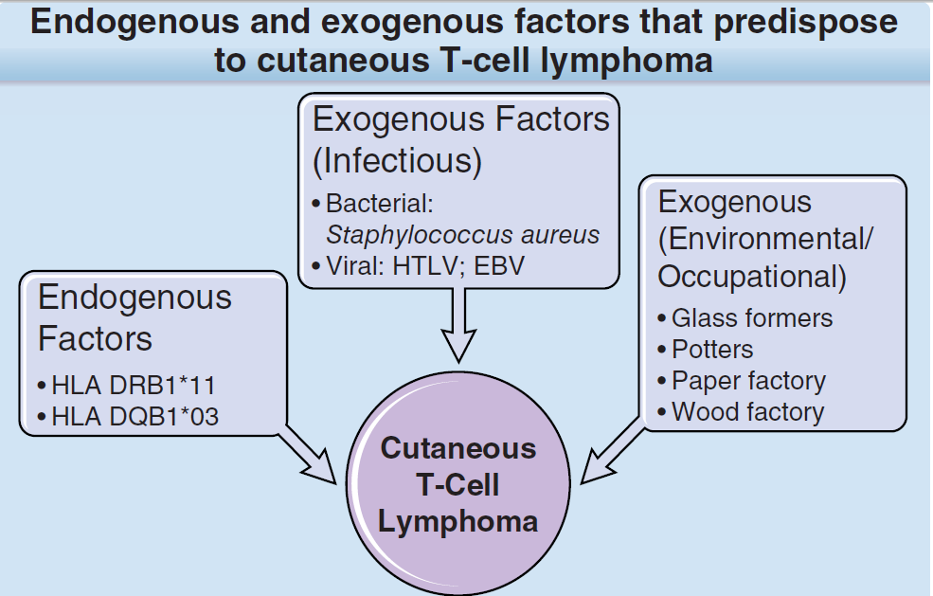
Predisposing Factors

Slide 11
Predisposing Factors
Chemical, Textile, Machine and Metal Industry
UV Radiation has protective effect
Atopic Eczema
Patients on TNF-A Inhibitors

Slide 12
PATHOLOGY
Earliest → moderate lymphocytic infiltrate in papillary dermis. Line up at DEJ
Prominent epidermotropism along basal and or clusters of atypical cells called Pautrier microabcesses

Slide 13
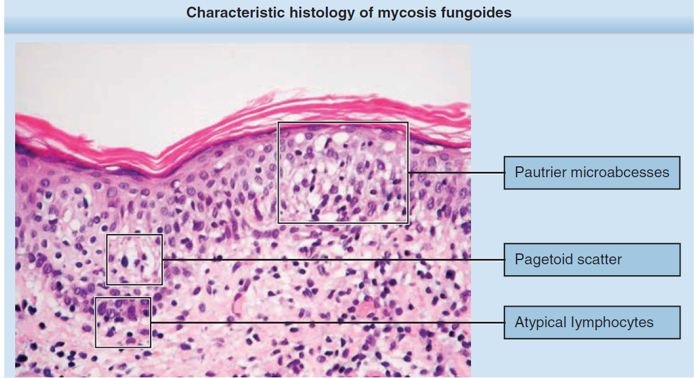

Slide 14
PATHOLOGY
T-Cells are strikingly cribriform with irregular nuclear outline and heavy staining

Slide 15
PATHOLOGY
In later stages, infiltrate becomes denser, monotonous and monomorphic
In advanced stages, epidermotropic infiltrate maybe lost
Scattered larger tumour cells with marked atypia. → poor prognosis
Large Cell transformation, with presence of >25-50% of large cells

Slide 16
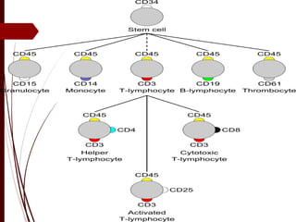
IMMUNOPATHOLOGY

Slide 17
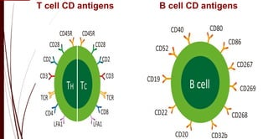

Slide 18
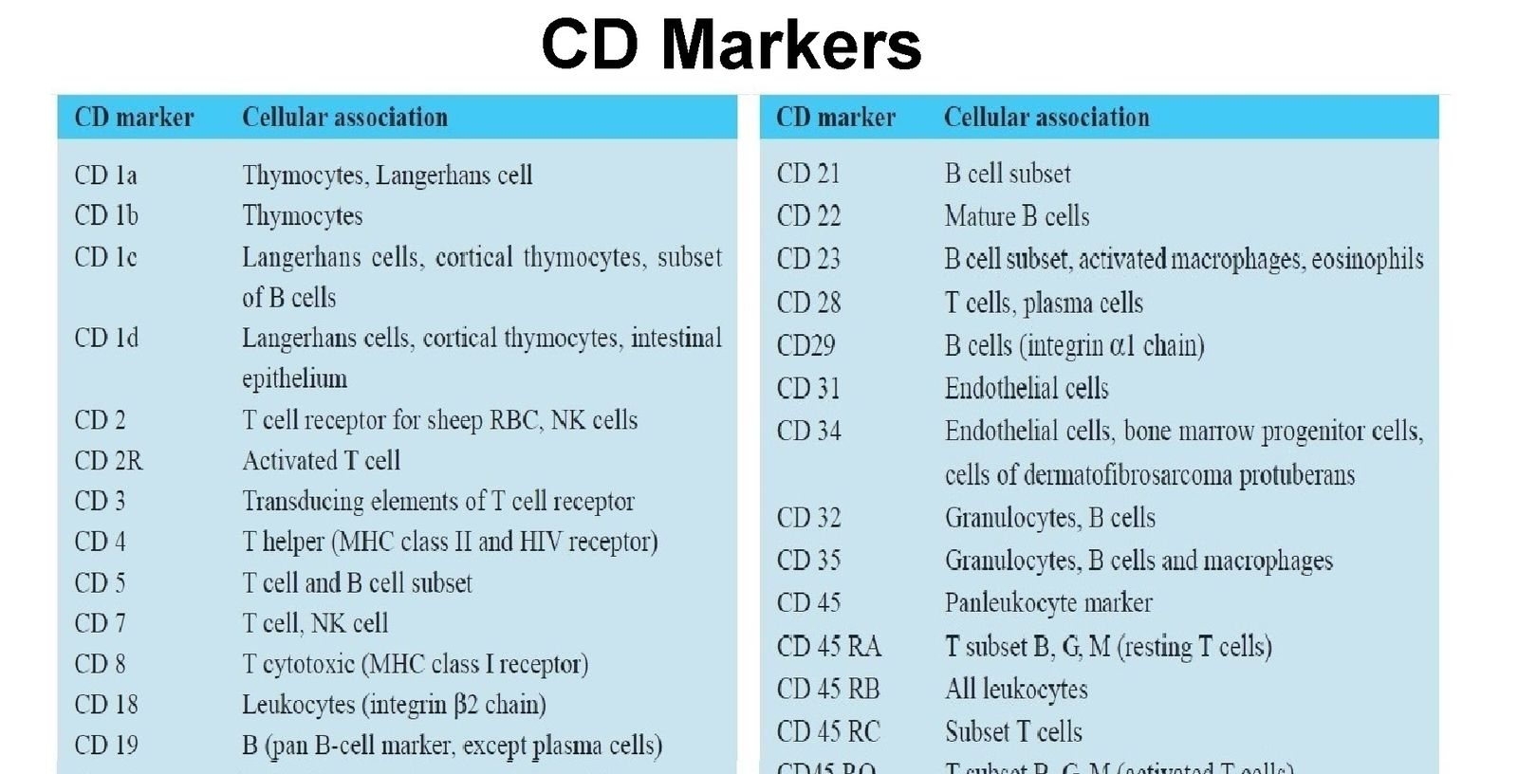

Slide 19
IMMUNOPATHOLOGY
Tumour cells in MF are CD3+, CD4+, CD45RO+; the phenotype of mature helper T-cell of memory subtype
CD8+ occasionally
Often have Dendritic and histiocytic cells
TCR usually
CD25+ T cells with suppressive function, good prognostic factor

Slide 20
TCR GENE ANALYSIS
For detection of clona rearrangement of TCR gene as marker of monoclonal T-Cell population
Clonal → neoplastic proliferation
PCR technique
Clonal proliferation also seen in PLEVA, PLC, parapsoriasis.

Slide 21
PATHOLOGY OF EXTRACUTANEOUS SITES
Spread is from skin to LNs and rarely to visceral organs
LN1 → infrequent atypical cells
LN2 → small clusters of atypical cells
LN3 → larger aggreagates
LN4 → complete effacement

Slide 23
PATHOLOGICAL DDs
DERMATITIS
  No epidermotropism, cytological atypia or irregular nuclear outline
  Spongiosis
  Immunophenotyping
ARTHROPOD BITE:
  Higher proportions of eosinophils
LYMPHOMATOUS DRUG ERUPTION:
  Perivascular infiltrate rather than epidermotropism

Slide 24
CLINICAL FEATURES
Polymorphic patches and plaques usually involving limb girdle, breasts and buttock area

Slide 25
Subtle, fine, scaly and often slightly atrophic (wrinkled) erythematous patches

Slide 26
CLINICAL FEATURES
Individual plaques may become very large, and there may be some degree of regression, giving rise to unusual arcuate lesions that can show considerable variation in colour, degree of scaling and border definition

Slide 28
34% progress to extensive plaques or tumours and erythroderma

Slide 29
CLINICAL FEATURES
Peripheral lymphadenopathy associated with B symptoms i.e fever, weight loss
Poor prognostic sign
Any systemic organ can be involved. Commonly in Lung, Bone, Brain, Nasopharynx

Slide 30
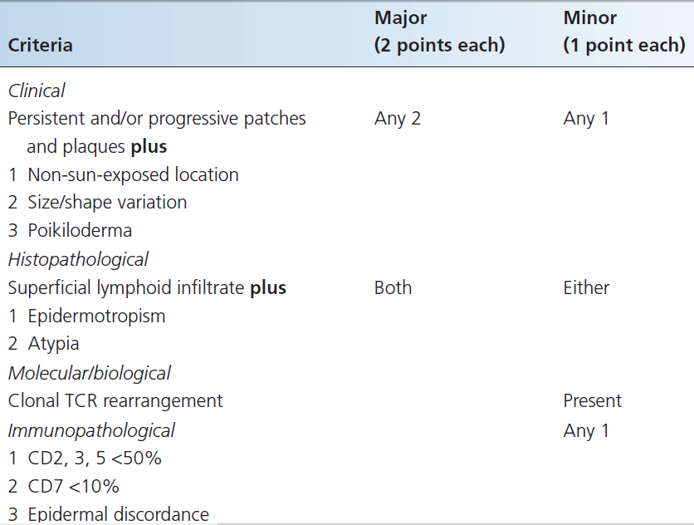
DIAGNOSTIC CRITERIA

Slide 31
CLINICAL VARIANTS
Annular polycyclic

Slide 32
CLINICAL VARIANTS
POIKILODERMATOUS:
  widespread or isolated poikiloderma
  Trunk, breast and pelvic girdle usually

Slide 33
HYPOPIGMENTED
striking hypopigmented scaly patches

Slide 34
FOLLICULOTROPIC VARIANT
Involve pilosebaceous follicles
Alopecia
Resistant to treatment
Poorer prognosis

Slide 35
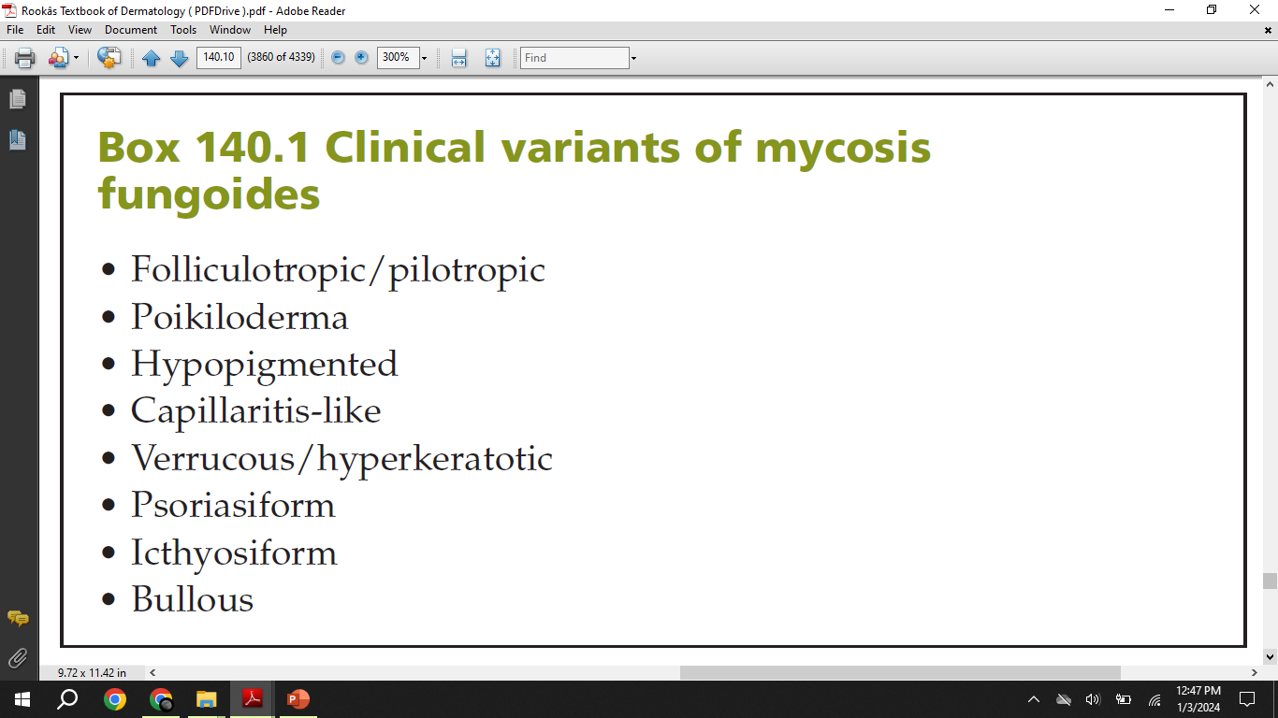

Slide 36
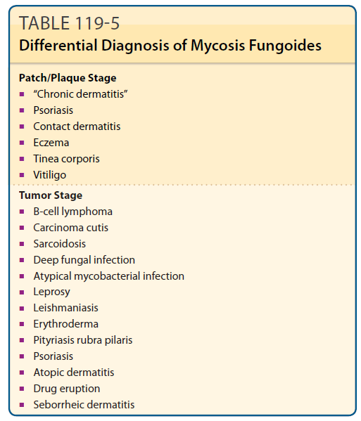
DIFFERENTIAL DIAGNOSIS

Slide 37
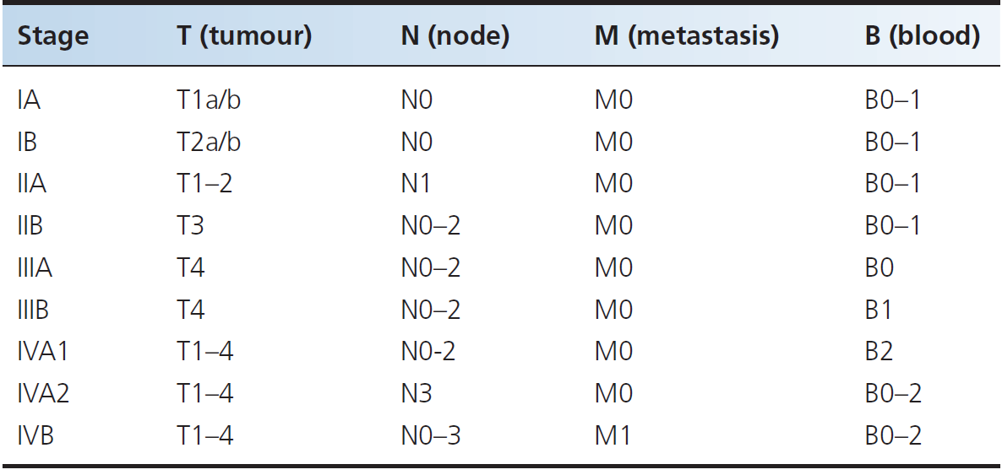
CLASSIFICATION OF SEVERITY
Stage IA; patches <10% area
Stage IB; patches with >10% area
T1a/T2a; patches only
T1b/T2b; patches and plaques
Stage IIA; dermatopathic nodes
Stage IIB; Tumours
Stage IIIA; erythroderma without blood invlolvement
Stage IIIB; erythroderma with blood involvement
Stage IVA1/2; Blood with/without nodal involvement
Stage IVB; visceral involvement

Slide 38
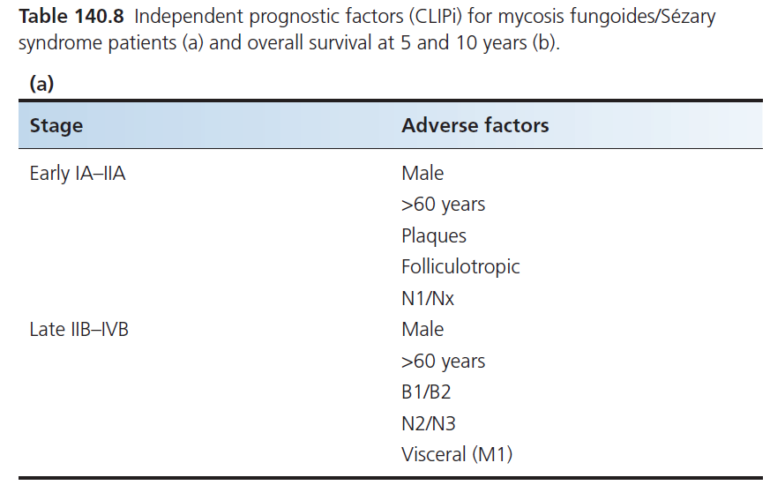
COURSE AND PROGNOSIS
Adverse prognostic factors

Slide 39
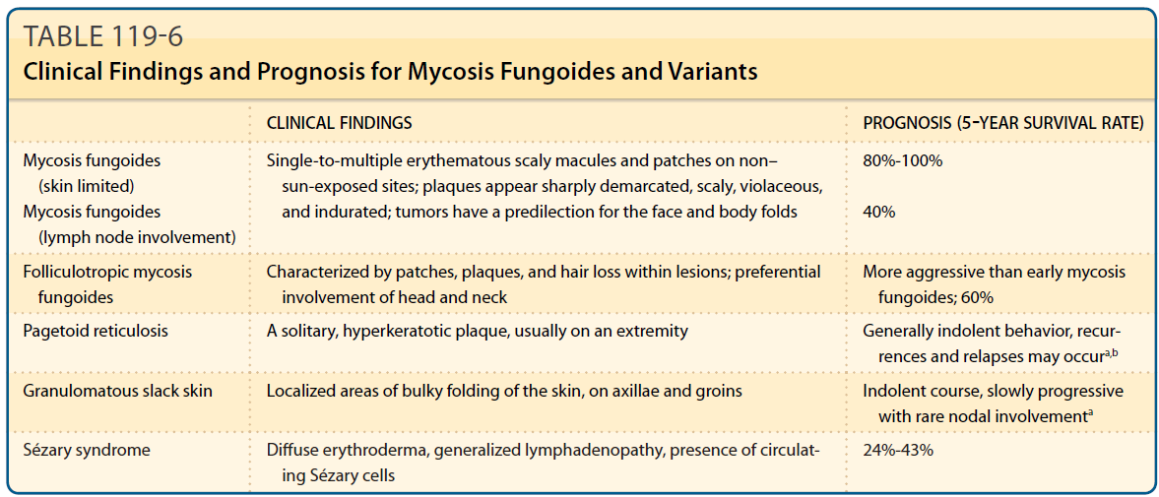
COURSE AND PROGNOSIS

Slide 40
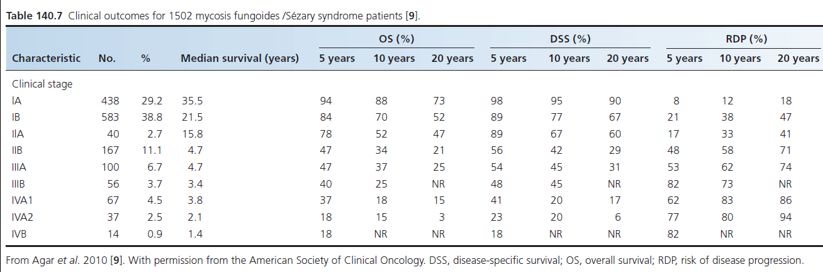
DISEASE COURSE AND PROGNOSIS

Slide 41
DISEASE COURSE AND PROGNOSIS
Stage IA MF unlikely to die
Stage IB have variable prognosis
Stage IIB with Tumours have poor prognosis ( 40-65% OS )
Stage III erythrodermic patient without nodal involvement have same prognosis as IIB
Second Malignancies in MF:
Non-melanoma skin cancer
Lung cancer
Melanoma
Other lymphomas and luekemias
Family history+

Slide 42
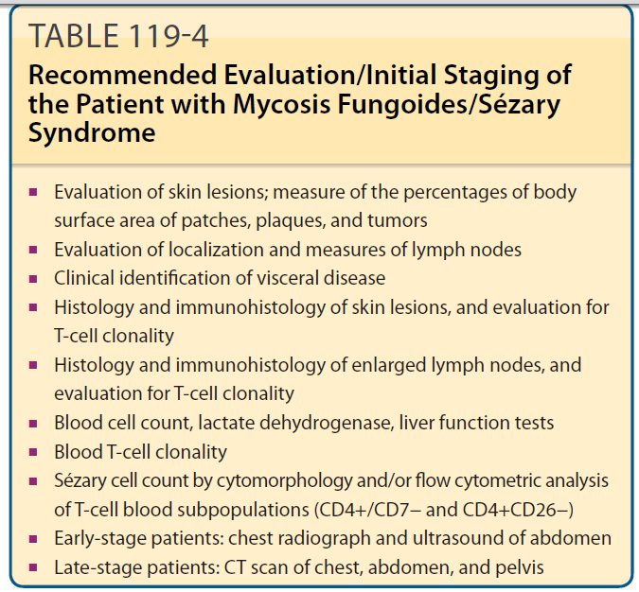
INVESTIGATIONS

Slide 43
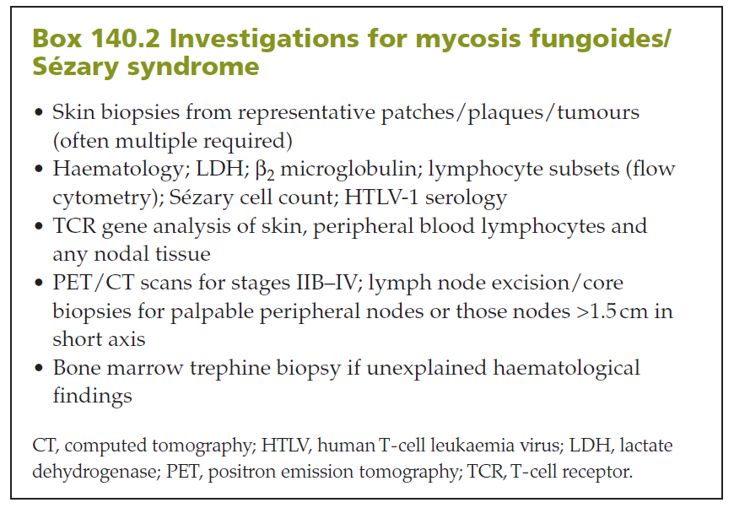
INVESTIGATIONS

Slide 44
FOLLICULAR MUCINOSIS
ALOPECIA MUCINOSA

Slide 45
INTRODUCTION
This disease represents follicular (pilotropic) variant of MF with mucinous degeneration
Presence of this clinical and histological variant along with typical features of MF

Slide 46
PATHOLOGY
Degeneration of hair follicles
Prominent pilotropic atypical T-Cell infiltrate
Interfollicular epidermotropism
Large quantities of mucin
Inflammatory form; no atypical cells
IMMUNOPHENOTYPE:
  CD3+, CD4+, CD8-, CD30 +-
  TCR Gene rearrangement

Slide 47
CLINICAL FEATURES
Two Distinct forms;
  Associated with MF
  Benign inflammatory form
Identical clinical features
Follicular papules and boggy cutaneous plaques with follicular prominence
Severe pruritus
Face, scalp. Trunk, proximal limbs
Significant alopecia; scarring type
Prominent giant comedones
Worse Prognosis as compared with classical MF

Slide 49
MANAGEMENT
Skin Directed therapies:
INF-A, Retinoids ( bexarotene )
Radiotherapy. Total skin electron beam therapy
Dapsone for inflammatory form

Slide 50
PAGETOID RETICULOSIS
Localized, solitary, variant of MF which shows intense epidermotropism
Striking colonization by large, pale, atypical mononuclear cells
Cells fail to express lymphoid markers. i.e CD4-, CD8-. Clonal TCR gene rearrangement

Slide 51
CLINICAL FEATURES
Rare. Younger adults
Isolated, persistent, scaly plaques at acral sites
Asymptomatic. Slowly expand. Excellent prognosis
Can be psoriasiform or Bowenoid
Managed by excision or low-dose superficial radiotherapy.

Slide 53
GRANULOMATOUS SLACK SKIN DISEASE
Rare. Middle-aged adults
Characterized by thickened pendulous folds of erythematous skin of flexures
Dense granulomatous infiltrate. Histiocytic giant cells
Destruction of dermal elastic tissue; Elastolysis
Atypical lymphocytic infiltrate. T-cell clones
DD→ Cutis Laxa
Excellent prognosis
Managed by interferon, retinoid, surgery and radiotherapy

Slide 54

SEZARY SYNDROME

Slide 55
INTRODUCTION
Consists of a Clinical Triad:
  Erythroderma
  Peripheral Lymphadenopathy
  Atypical mononuclear cells ( Sezary Cells )
    Comprising >20% of total lymphocyte count OR
    Total Sezary cells of > 1000 x mm3
  T-Cell clonal proliferation
  Elderly Males

Slide 56
PATHOLOGY
Large number of atypical cells in dermis with epidermotropism
Very large nucleus with minimal cytoplasm
Cerebriform nucleus
Sezary Cells also present in:
  Actinic reticuloid
  Erythrodermic eczema
  Psoriasis
  Severe drug reaction
  Normally in blood

Slide 57
IMMUNOPHENOTYPE
CD3+, CD4+, CD7-, CD26-
CD4:CD8 Always elevated. (>10 ) Denotes clonal expansion. Distinguishes from inflammatory dermatosis
SS is derived from central memory T-Cells while MF from Skin resident, peripheral memory T-Cells

Slide 58
CLINICAL FEATURES
Generalised exfoliative erythroderma
Systemic problems including high output cardiac failure
Ectropion
Scalp alopecia
Palmoplanter hyperkeratosis with fissuring and subungual hyperkeratosis
Peripheral lymphadenopathy

Slide 61
DIFFERENTIAL DIAGNOSIS
Erythrodermic MF;
  Peripheral blood involvement
  Absolute Sezary count of >1000/mm3

Slide 62
COURSE AND PROGNOSIS
POOR
11% Overall 5-year survival
32 months median survival from diagnosis
Age, gender, Degree of lymph node and peripheral blood involvement are prognostic factors
Most patients die of opputunistic infections

Slide 63
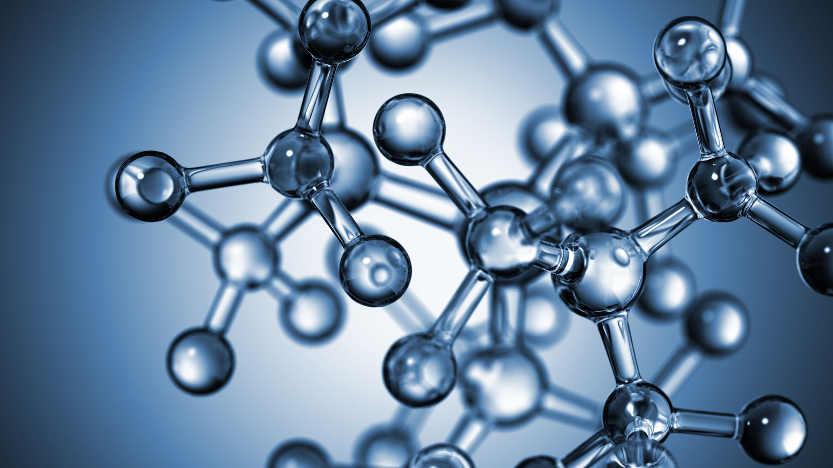
MOLECULAR FEATURES OF MF & SS
Abnormalities of Cell cycle
DNA Repair defects
Defects in apoptotic pathways
Chromosomal gains and losses leading to Genomic instability and abnormalities
Genes including p53, CDKN2A, FAS, PTEN
Results in dysregulation of apoptotic signaling pathways including TNF , STAT, NF,kB signaling pathway.
This effect T-Cell homeostasis and ultimately acquire malignant phenotype

Slide 64
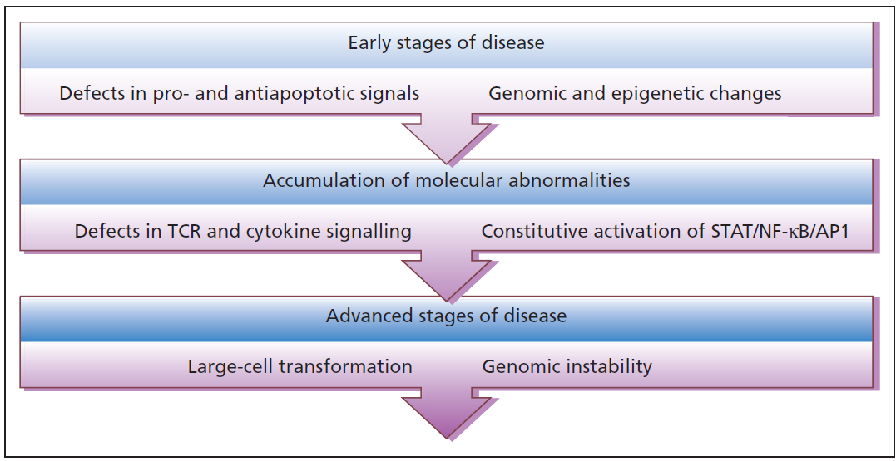

Slide 65
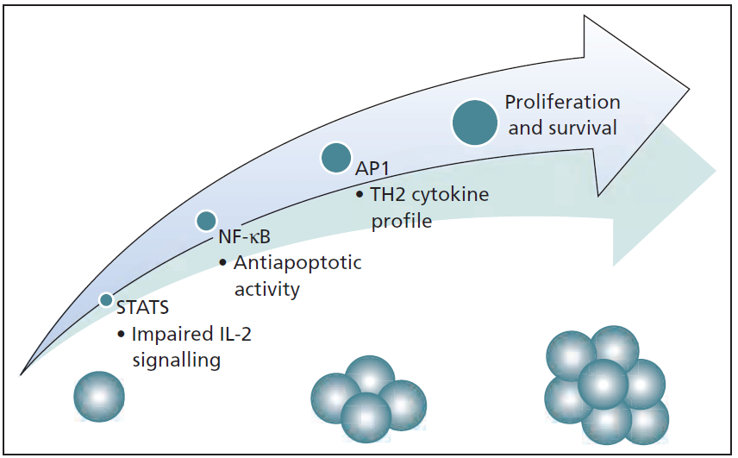

Slide 66
MANAGEMENT OF MF & SS

Slide 67
POSSIBLE TREATMENTS
Topical steroids
Topical chemotherapy
Phototherapy
Radiotherapy,
Immunotherapy
Retinoids
Combination therapies
Systemic single and multiagent chemotherapy
Photopheresis
Toxin therapies
Monoclonal antibodies
Histone deacetylase inhibitors
Other novel therapies

Slide 68
MANAGEMENT
Choice of treatment according to Stage of disease, patient’s performance status and Quality of Life
Preferable to aim treatment at palliation rather than aggressive intent to cure
Early stage→ skin directed therapies
Resistant early and late stage → Systemic

Slide 69
SKIN DIRECTED THERAPY
TOPICAL STEROIDS:
Moderate to Potent +- emolients
For early-stage MF
TOPICAL CHEMOTHERAPY:
Nitrogen Mustard ( mechlorethamine):
Aqueous or ointment base
Pregnancy contraindicated
Irritant, allergic, non-melanoma skin cancers
Carmustine ( BCNU ):
Alcohol/ointment base
Daily or alternate day application
Monitor CBC

Slide 70
SKIN DIRECTED THERAPY
TOPICAL RETINOIDS:
Targretin ( bexarotene ) Gel 1%; early stage MF. Duration 20-99 weeks
OTHER:
Imiquimod
5-FU
Peldesine Cream
PUVA THERAPY:
One of most effective therapies for Early stage MF. Ideal for stage IB-IIA
Longer durations of remissions and complete response
2-4 times weekly
Avoid cumulative dose of 1200J/cmm2 or 200 sessions
Risks of non-melanoma, melanoma and merkel cell caricinoma developments
Not tolerated by erythrodermic patients
OTHER PHOTOTHERAPY OPTIONS:
NB/BB-UVB
Photodynamic therapy
308nm excimer laser

Slide 71
SKIN DIRECTED THERAPY
RADIOTHERAPY:
MF and other CTCLs are highly Radiosensitive
Thick plaques and Tumours can be treated with low-dose superficial radiotherapy
Can be combined in Phototherapy
TOTAL SKIN ELECTRON BEAM THREAPY:
Treat whole skin uniformly to a depth of 1cm
Good response in early stage
High relapse
Greater response in erythrodermic patients
Similar efficacy to topical nitrogen mustard
For those who fail 1st and 2nd line therapies

Slide 73

SYSTEMIC THERAPY

Slide 74

IMMUNOTHERAPY
Aim is to enhance anti tumour host response
IFN-α:
  3MU Thrice weekly – 36MU/day
  Pegylated more effective and better tolerated
  Complete response in 10-27%
IL-12
INF-γ

Slide 75
RETINOIDS AND REXINOIDS
ACETRETIN/ ISOTRETINOIN:
Similar response
As singe agent or combined with PUVA or interferons
BEXAROTENE:
Rexinoid
Promote apoptosis. Inhibit cell proliferation
300mg/m2/day Dose
Require treatment of hyperlipidemia and central hypothyroidism along
Side effects are transient and mild
Overall response of 54% in early stage and 45% in advanced

Slide 76
COMBINATION THERAPY
INCLUDE PUVA + INF-α,:
Overall response of 100%
Can be used in resistant early stage and folliculotropic MF
PUVA + Acetretin:
Similar efficacy
PUVA +Bexarotene

Slide 77
CHEMOTHERAPY
MF & SS are relatively chemoresitant and responses are short-lived
Combination therapy with cyclophosphamide, doxorubicin, vincristine, prednisolone ( CHOP )
Prone to infection and septaemia
Single agent chemotherapy with
Chlorambucil
Methotrexate
Etoposide
Deoxycoformycin
Pralatrexate
Bone marrow transplantation

Slide 78

PHOTOPHERESIS
Administration of oral psoralen
Ex vivo collection of white cells by cell separator
Exposure to UVA
Cells returned to patient
Repeated two consecutive days each month or fortnightly
Overall response of 35-71%
Lesser response in early stage disease

Slide 79
TOXIN THERAPY
DENILEUKIN DIFTITOX: ( Ontak, Onzar )
Diphtheria toxin + IL-12
Inhibit protein synthesis, result in cell death
18ug/kg/day for 5 days every 21 days for 4-8 cycles
Overall response of 30%
Advrese effecrs:
Fever, chills
Gi upset
Myalgia
Acute hypersensitivity reaction
Vascular leak syndrome
myelosupression

Slide 80
MONOCLONAL ANTIBODY THERAPY
ANTI-CD4 Antibody: ( humanized form → ZANOLIMUMAB)
56% overall response
Campath ( Anti-CD52/ALEMTUZUMB)
55-85% Overall response
Excellent response in SS
ANTI-CD5 Antibody

Slide 81
HISTONE DEACETYLASE INHIBITORS
FDA approved 2nd Line treatment for MF and SS
Vorinostat, romidepsin etc.
Effect gene expression
Side effects:
lethargy
QT prolongation
Thrombocytopenia
GI upset

Slide 82
OTHER NOVEL THERAPIES
Bortezomib ( proteosome inhibitor )
Enzastaurin
Lenalinomide

Slide 83
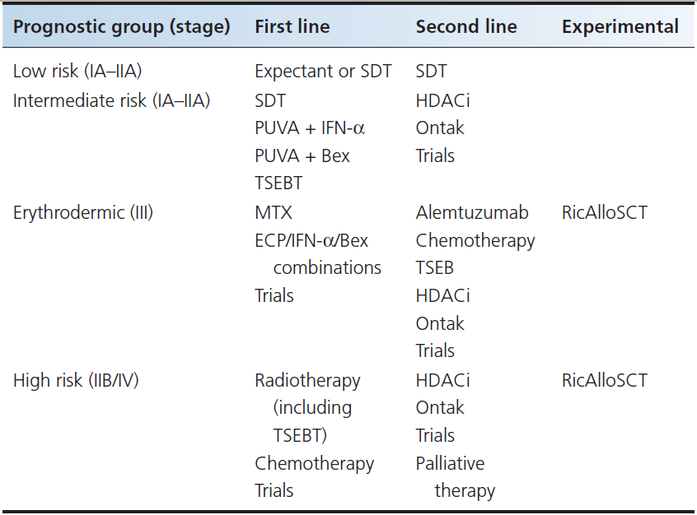

Slide 84

THANK YOU!

