Slide 1
Burns and thermal injury

Slide 2
A burn is a type of injury to skin, or other tissues, caused by heat, cold, electricity, chemicals, friction, or radiation.
Most burns are due to heat from hot liquids, solids, or fire

Slide 3
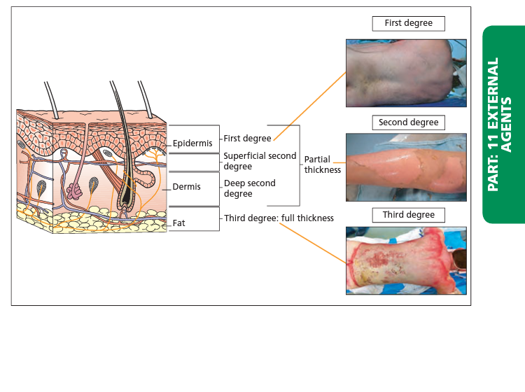
Types of burns

Slide 4
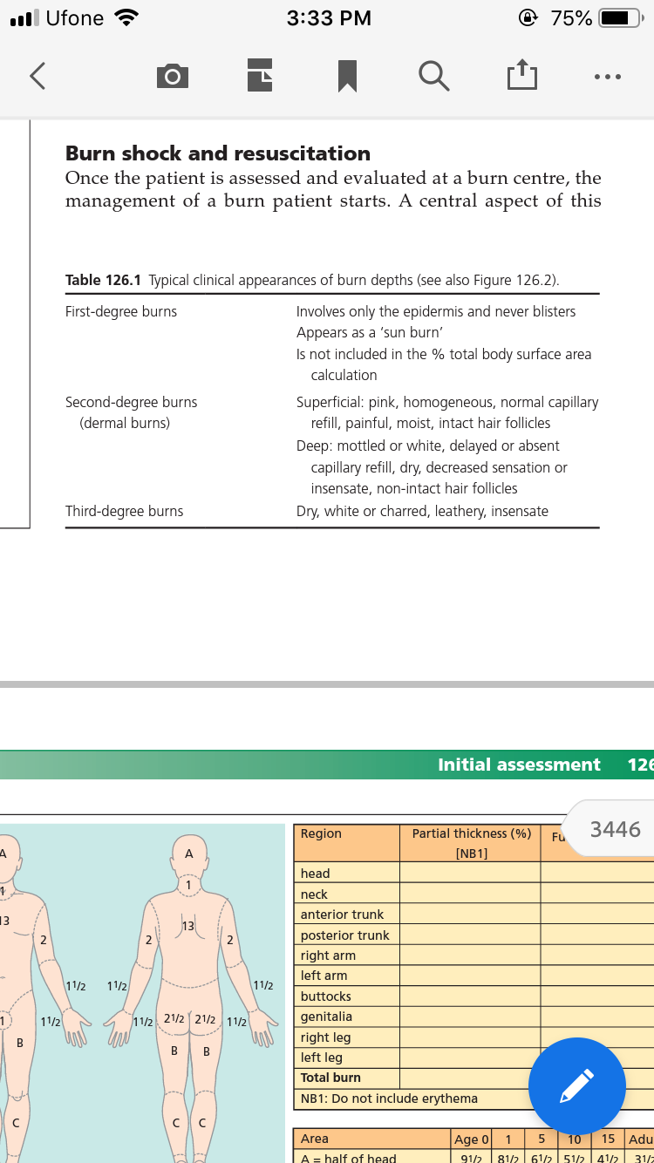
LAYERS

Slide 5
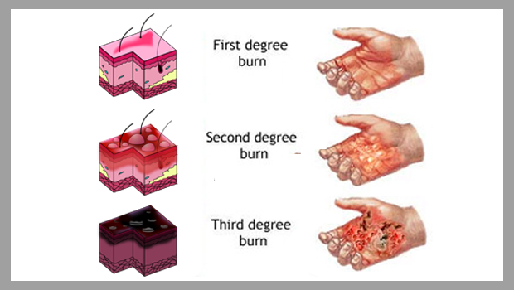
CLINICALLY

Slide 6
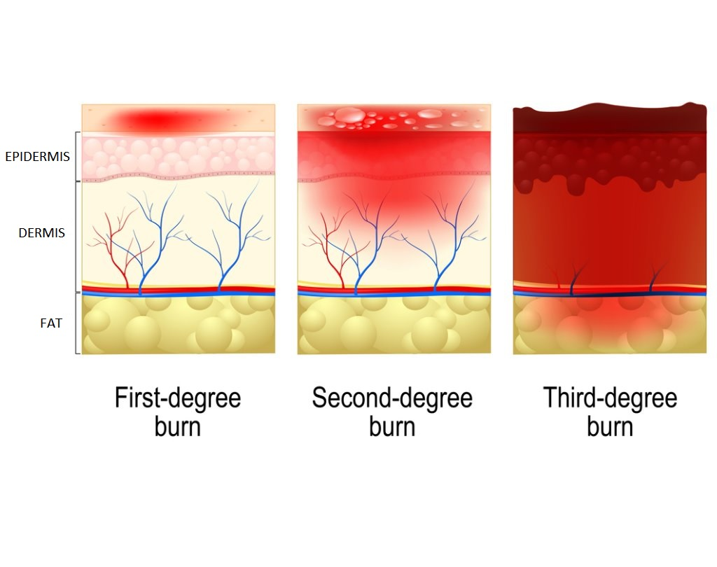

Slide 7
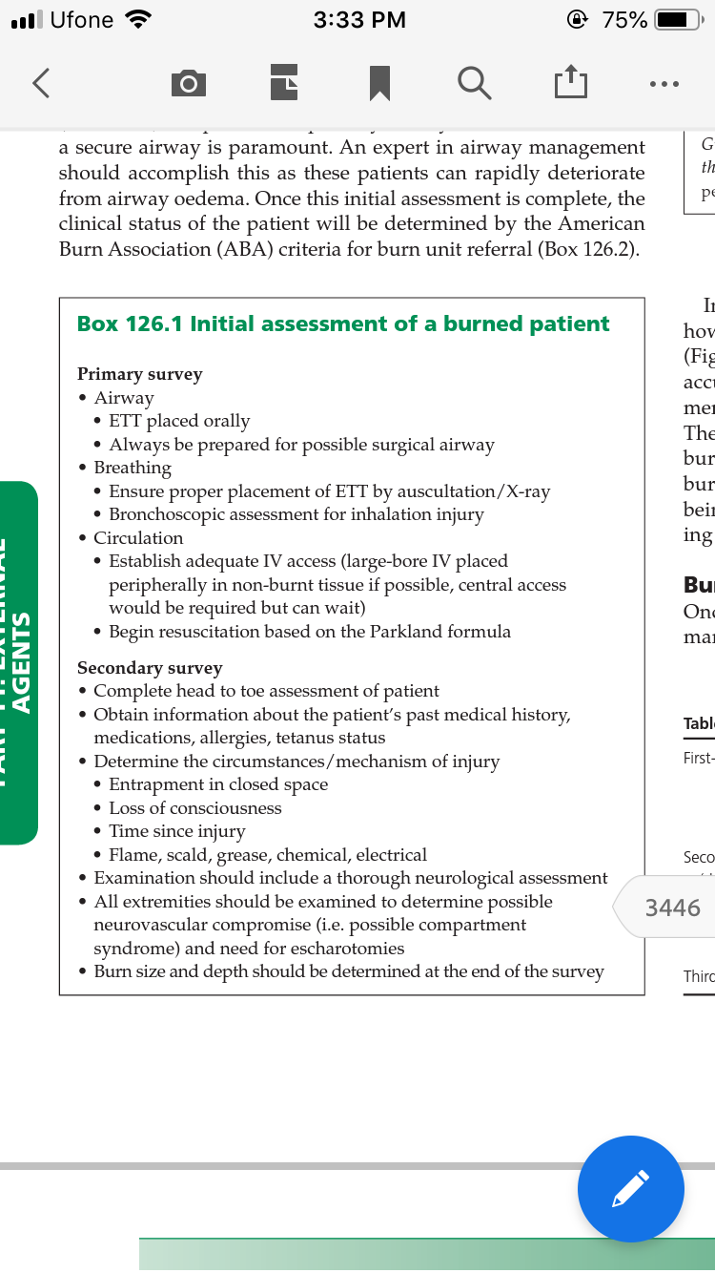
ABC

Slide 8
resuscitation
Many formulas have been studied, with all having the same goal: ××
4mL%TBSA x weight(kg)=24h fluid requirement,with half given over the first 8hand the remainder over the following 16 h

Slide 9
The catastrophic events associated with underresuscitation include multiple organ failure and death.
Overresuscitation induces ‘fluid creep’ with its inherent complications such as pulmonary oedema, pleural effusions, pericardial effusions, abdominal compartment syndrome, extremity compartment syndrome and conversion of burns to deeper wounds .
In addition, providing greater fluid than required in burn patients significantly increases the risk of developing acute respiratory distress syndrome, pneumonia, bloodstream infections, multiple organ failure and death.

Slide 10
Resuscitation goal
One of the greatest challenges in resuscitation is monitoring whether it is adequate and effective. The traditional endpoints of urine output (0.5–1 cl/kg body weight/h), mean arterial pressure (>65 mmHg), normal base excess and lactate levels are important physiological markers.

Slide 11
Type of fluid
To date, no large prospective randomized trial has been conducted to determine whether crystalloids are superior to colloids. However, the majority of specialist burn surgeons use crystalloids (e.g. Ringer lactate) and add colloids (e.g. albumin) as a rescue modality

Slide 12
Inhalational injury
A total of 20–30% of all major burns are associated with a concomitant inhalation injury, with a mortality of 25–50% when patients required ventilatory support for more than 1 week post‐injury . A significant portion of fire‐related deaths result not from burn injury but from inhalation of the toxic products of combustion.

Slide 13
toxins
of carbon monoxide (CO) and hydrogen cyanide have been found to increase tissue hypoxia and acidosis and may also decrease cerebral oxygen consumption and metabolism.
Controversy remains as to the need for specific antidotes in CN poisoning. The use of hydroxycobalamine is controversial.There is minimal evidence for the role of CN antidotes in smoke inhalation injury, therefore, aggressive supportive therapy aimed at permitting hepatic clearance of CN without specific antidotes should be the first line of treatment

Slide 14
Other possible contributing toxic substances are hydrogen chloride (produced by polyvinyl chloride degradation), nitrogen oxide or aldehydes which can result in pulmonary oedema, chemical pneumonitis or respiratory irritability. Direct thermal damage to the lung is seldom seen except as a result of high pressure steam, which has 4000 times the heat‐carrying capacity of dry air. Laryngeal reflexes and the efficiency of heat dissipation in the upper airway prevent heat damage to the lung parenchyma.

Slide 15
stages
The clinical course of patients with inhalation injury is divided into three stages.
•First stage: acute pulmonary insufficiency. Patients with severe lung injuries show acute pulmonary insufficiency from 0 to 36 h after injury with asphyxia, CO poisoning, bronchospasm, upper airway obstruction and parenchymal damage.
•Second stage: pulmonary oedema. This stage occurs in 5–30% of patients, usually from 6 to 72 h post‐burn and is associated with a high mortality rate.

Slide 16
•Third stage: bronchopneumonia appears in 15–60% of these patients and has a reported mortality of 50–86%. Bronchopneumonia occurs typically 3–10 days after burn injury, is often associated with the expectoration of large mucous casts formed in the tracheobronchial tree

Slide 17
diagnosis
Early detection of bronchopulmonary injury is critical in improving survival after a suspected inhalation injury. Clinical signs include the following
•History of exposure to smoke in closed space (patients who are stuporous or unconscious). •Physical findings of: facial burns/singed nasal vibrissae/bronchorrhoea/sooty sputum/auscultatory findings (wheezing or rales). •Laboratory findings: hypoxaemia and/or elevated levels of CO. •Chest X‐ray (insensitive method because admission studies are very seldom abnormal and may remain normal as long as 7 days post‐burn).

Slide 18
Bronchoscopy should be the standard diagnostic method on every burn patient
GRADING
•No inhalation injury (grade 0): absence of carbonaceous deposits, erythema, oedema, bronchorrhoea or obstruction.
•Mild injury or (grade I): minor or patchy areas of erythema, carbonaceous deposits in proximal or distal bronchi any or combination.

Slide 19
•Moderate injury (grade II): moderate degree of erythema, carbonaceous deposits, bronchorrhoea with or without compromise of the bronchi any or combination

Slide 20
Severe injury (grade III): severe inflammation with friability, copious carbonaceous deposits, bronchorrhoea, bronchial obstruction any or combination.
•Massive injury (grade IV): evidence of mucosal sloughing, necrosis, endoluminal obliteration any or combination.

Slide 21
Treatment
The treatment of inhalation injury should start immediately, with the administration of 100% oxygen via face mask or nasal cannula. This helps reverse the effects of CO poisoning and aids in its clearance, as 100% oxygen lowers its half‐life time from 250 to less than 50 min.
Maintenance of the airway is critical. If early evidence of upper airway oedema is present, early intubation is required because the upper airway oedema normally increases over 8–12 h

Slide 22
Prophylactic antibiotics for inhalation injury are not indicated, but clearly are indicated for documented lung infections. Empirical choices for the treatment of pneumonias prior to culture results should include coverage of meticillin‐resistant Staphylococcus aureus in the first few days post‐burn (these develop within the first week after burn) and of Gram‐negative organisms (especially Pseudomonas or Klebsiella) which mostly occur after 1 week postburn.

Slide 23
Pharmacological management •Bronchodilators: every 2 h. •Nebulized heparin: 5000–10 000 units with 3 mL normal saline 4 hourly which alternates with
Nebulized acetylcysteine: 20%, 3 mL 4 hourly. •Hypertonic saline: to induce effective coughing.

Slide 24
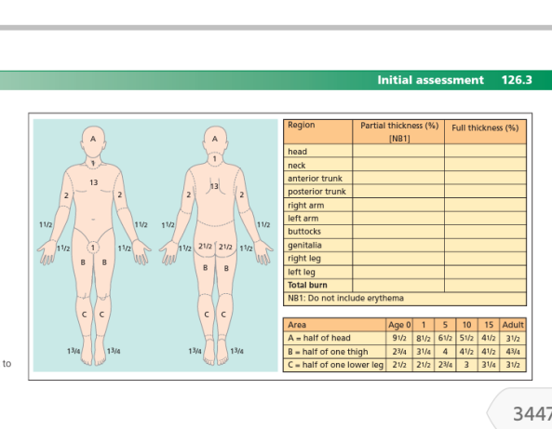
Non inhalational burn injury
Calcualting BSA

Slide 25
management
First‐degree burns are of minimal concern. They only involve the epidermis with erythema and no blisters and do not require grafting

Slide 26
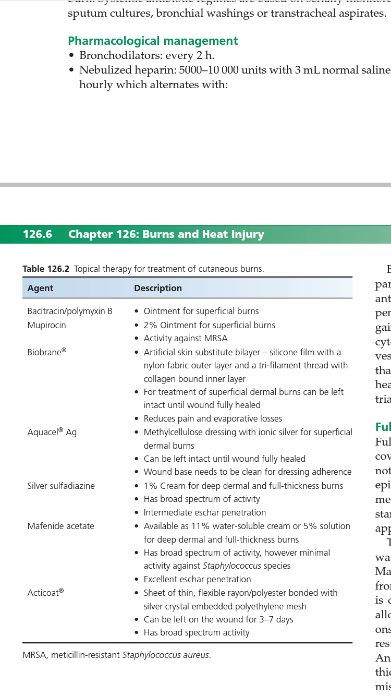
Topical therapy

Slide 27
Second‐degree burns (dermal burns) and beyond are those that will require medical attention.
Dermal burns are divided into superficial and deep.
The ideal treatment for all burns, which will not heal between 14 and 21 days, is operative excision and skin grafting. The conservative management of burns includes appropriate wound care and therapy aimed at maintaining range of motion and overall function.

Slide 28
Partial‐thickness burns can be categorized as superficial or deep burns.
Superficial wounds usually heal between 7 and 14 days. Conversely, complete re‐epithelialization of deep dermal burns can take up to 4–6 weeks, with scarring often resulting from the loss of dermis.

Slide 29
Bioengineered approaches have also been tested for use in partial‐thickness burns. Examples include keratinocyte‐fibrin sealant sprays, fibrin sealant‐containing growth factors and cell suspensions.
An autologous cell suspension known as ReCell® has contains autologous keratinocytes, melanocytes, fibroblasts and Langerhans cells that are harvested from a split‐thickness biopsy.

Slide 30
Full‐thickness burns will not heal and are treated by excision and coverage with autograft. allograft or other dermal/ epidermal substitutions are required.
The oldest and best studied dermal substitute is Integra® .
Integra is composed of bovine collagen and glucosaminoglycans which allow fibrovascular ingrowth.
Another dermal analogue available for the treatment of full‐ thickness burns is Alloderm®. Alloderm consists of cadaveric dermis devoid of cells and epithelial elements. Its use is very similar to that of other dermal analogues, and it has shown favourable results.

Slide 31
Latest
Stem cells represent a new hope in the management of burns. These cells play an important role in wound healing, both locally and systemically.
In humans, stem cells can be found in adipose tissue, bone marrow, umbilical blood and the blastocystic mass of embryos .
Given their clonicity and pluripotency, they can be used to regenerate dermis and expedite reepithelialization. Another important characteristic of stem cells is their lack of immunogenicity, which would allow them to be transplanted with relative ease .

Slide 32
escharotomy
escharotomy In the evaluation of wounds, consideration also needs to be given to the possible need for escharotomy. All deep circumferential burns to the extremity have the potential to cause neurovascular compromise and therefore benefit from escharotomy. The typical clinical signs of impaired perfusion in the burned extremity/hand include cool temperature, decreased or absent capillary refill, tense compartments with the hand held in the claw position and, as a late sign, absence of pulses.

Slide 33
Managing Infections
infections remain one of the leading causes of death in burn patients.
This is not only the result of loss of the environmental barrier function, but also due to a combination of immunosuppression, inflammation, hypermetabolism and catabolism.
The pathophysiological progression of burn wound infection runs the spectrum from bacterial wound colonization to infection to invasive wound infection. The characteristics of each are as follows:
•Bacterial colonization: •Bacterial levels of <105. •Does not necessarily prevent wound healing.

Slide 34
•Bacterial infection: •Bacterial levels >105. •Can result in impaired wound healing and graft failure. •Can lead to systemic infection.
•Invasive wound infection: •Clinically, can have separation of the eschar from the wound bed. •Appearance of focal dark brown, black or violaceous discoloration of the wound. •Presence of pyocyanin (green pigment) in subcutaneous fat. •Erythema, oedema, pain and warmth of the surrounding skin. •Associated with signs of systemic infection/sepsis and positive blood cultures

Slide 35
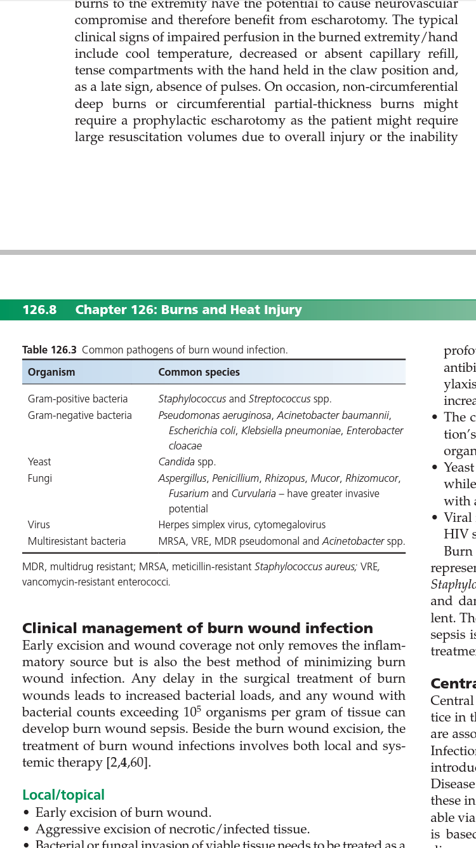

Slide 36
Central line associated infections Central catheters inserted into veins and arteries are common practice in the management of the burn patient and are necessary, but are associated with an increased risk of infection and thrombosis.

Slide 37
Ventilator‐associated pneumonia is an infection that occurs in a mechanically ventilated patient with an endotracheal or tracheostomy tube (by definition > 48 h after hospital admission).
The diagnosis of VAP in burn patients can be challenging, as the symptoms such as fever, leukocytosis, tachycardia and tachypnoea are typically present due to the inflammatory response.

Slide 38
The organisms also have a temporal pattern, community‐acquired organisms (Streptococcus pneumoniae and Haemophilus influenzae) are dominant in the early phase of VAP and Gram‐negative and multiresistant organisms (i.e. meticillin‐resistant Staphylococcus aureus (MRSA)) are the common pathogens in late‐stage VAP

Slide 39
hypermetabolism
hypermetabolism A key cause of poor outcomes after burn injury is the hypermetabolic response, which is associated with severe alterations in glucose, lipid and amino acid metabolism . Hypermetabolism leads to vast catabolism that is associated with protein breakdown in muscle and specific organs, leading to multiple organ dysfunction. Therefore, hypermetabolism, organ function and, consequently, survival are likely closely linked with one another.

Slide 40
Burn‐induced changes in metabolism occur in two separate phases .
The ‘ebb phase’ usually occurs within 48 h of burn and is associated with a reduction in cardiac output, oxygen consumption and metabolism. It is also associated with diminished glucose tolerance and a hyperglycaemic state.
After the ebb phase, the metabolic rate slowly increases within the first 5 days after injury to a plateau or ‘flow’ phase. This phase is associated with hypermetabolism and hyperdynamic circulation. The flow phase is also associated with insulin resistance (IR) , as seen by a two‐fold increase in insulin release in response to glucose load and elevated blood glucose levels

Slide 41
In addition, lipolysis is tremendously increased, leading to elevated levels of free fatty acids and triglycerides.

Slide 42
Nutrition care
The primary goal of nutritional support is to provide an adequate energy supply and the nutrients necessary to maintain organ function and survival
however, overfeeding in the form of excess calories and/or protein is associated with hyperglycaemia, carbon dioxide retention, fatty infiltration of organs and azotaemia.

Slide 43
Harris Benedict | Men: 66.5 + 13.8(weight in kg) + 5(height in cm) − 6.76(age in years) Women: 655 + 9.6(weight in kg) + 1.85(height in cm) − 4.68(age in years) | Estimates basal energy expenditure; can be adjusted by both activity and stress factor, multiply by 1.5 for common burn stress adjustment
Toronto Formula | −4343 + 10.5(TBSA) + 0.23(calorie intake in last 24 h) + 0.84(Harris Benedict estimation without adjustment) + 114(temperature) − 4.5(number of postburn days)

Slide 44
No ideal nutrition or gold standard for burn patients exists. Many experts recommend using high‐glucose, high‐protein/ amino acid and low‐fat nutrition with some unsaturated fatty acids
Carbohydrates and amino acids should serve as the chief energy source, sparing protein from oxidation for energy and allowing it to be effectively used by the skin and organs. Plasma levels of vitamins and trace elements are significantly depressed for prolonged period Replacement of these micronutrients reduces morbidity in severely burned patients. Therefore, a complete daily multivitamin/mineral supplement should be given.

Slide 45
Excision and dressing
Other non‐pharmacological strategies Of the advances in burn care occurring over the past few decades, early wound excision and closure has been the greatest. It has considerably reduced basal energy expenditure, mortality and costs . Excising burn wounds early and covering the excised areas with temporary cover materials or autologous skin is imperative. This will diminish burn‐induced inflammatory and stress responses, in turn decreasing hypermetabolism.

Slide 46
Temp regulation
Accordingly, the skin and core body temperature are elevated by 2°C. It is not often realized that increasing ambient room temperature is a simple approach to counteracting this response to burn injury . In fact, a change in temperature from 25°C to 33°C has been shown to reduce resting energy expenditure in seriously burned patients.
Providing burn patients with physical therapy is a crucial yet easy intervention that can ameliorate metabolic disruptions and prevent contractures of the burn wound.
Progressive resistance exercises have been shown to promote muscle protein synthesis, increase body mass, strengthen muscles and build endurance.

Slide 47
Recombinant human growth hormone
Acute administration of recombinant human growth hormone (rhGH) (0.1–0.2 mg/kg/day IM) has been shown to have a host of beneficial effects. It increases donor site healing and quality of wound healing , diminishes stress responses and inflammation , elevates levels of insulin‐like growth factor 1 (IGF‐1) , decreases basal energy expenditure and cardiac output and augments muscle protein and preserves muscle growth.

Slide 48
Insulin‐like growth factor
administering IGF‐1/binding protein‐3 (BP‐3) complex (i.e. equimolar amount of recombinant human IGF‐1 and IGFBP‐3) ameliorates protein metabolism in burned children and adults with fewer episodes of hypoglycaemia than rhGH .
IGF‐1/ BP‐3 reduces muscle protein breakdown, ameliorates gut mucosal integrity, improves immune function, attenuates the acute‐phase response, elevates constitutive proteins in the serum and decreases inflammatory responses

Slide 49
Oxandrolone
is structurally similar to testosterone but, for the most part, lacks the virilizing effects of this hormone. This anabolic agent has been shown to stimulate muscle protein synthesis , reduce weight loss and promote wound healing .

Slide 50
Finally, longterm treatment with oxandrolone decreases hypermetabolism and promotes weight gain, with lean body mass and bone mineral content increasing from 6 to 12 months post‐burn

Slide 51
Propranolol
Of the anticatabolic therapies for burns, the β‐adrenergic blocker, propranolol, is perhaps the most effective. When administered acutely, propranolol exerts anti‐inflammatory and antistress effects . In burn patients, propranolol counters loss of skeletal muscle, augments lean body mass and decreases IR .

Slide 52
insulin
Burn patients with stress‐induced hyperglycaemia have a greater incidence of bacteraemia/fungaemia, poorer wound healing, more pronounced protein catabolism and lower likelihood of survival than burn patients with adequate glucose control . Normalization of blood glucose levels with insulin is an effective therapy for stress‐induced diabetes and coincident IR and hyperglycaemia.

