Slide 1
CASE PRESENTATION:

Slide 2
BIODATA:
NAME: HUSNA
AGE: 70 yrs
SEX: FEMALE
RESIDENT: ROHRI
OCCUPATION: HOUSE WIFE
CO-MORBS: NONE.

Slide 3
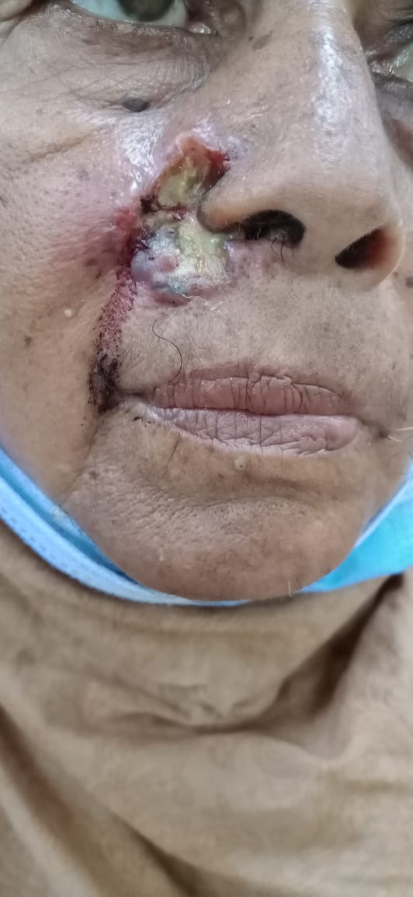
PRESENTING COMPLAIN:
A PAINLESS NON HEALING ULCERATED LESION ON HER RIGHT CHEEK FOR 1 YEAR.

Slide 4
HISTORY OF PRESENTING COMPLAIN:
ACCORDING TO MY PATIENT, SHE WAS ALRIGHT ONE YEAR BACK, WHEN SHE HAD A FALL (TRAUMA ON FACE)WHICH RESULTED IN BLEEDING AND PROGRESSED TO A NON HEALING LESION ON HER CHEEK.
THE LESION WAS PAINLESS, NOT ASSOCIATED WITH ITCHING.
IT WAS SLOW GROWING, GRADUALLY INCREASING IN SIZE.
IT WAS ASSOCIATED WITH BLEEDING AND PUSSY DISCHARGE (YELLOW IN COLOUR)
HISTORY OF SUN EXPOSURE WAS POSITIVE. (4-5 HOURS A DAY)

Slide 5
THE PATIENT ALSO GIVES HISTORY OF UNDOCUMENTED LOW GRADE FEVER FOR THE LAST FEW WEEKS.
THERE WAS HISTORY OF WEIGHT LOSS WHICH WAS ALSO UNDOCUMENTED.
NO HISTORY OF ANY ORAL ULCERS
HER TRAVEL HISTORY WAS NEGATIVE
THERE WAS NO HISTORY OF TB IN HER FAMILY.
SHE WENT TO SOME LOCAL CLINICS FOR THIS CONDITION AND WAS PRESCRIBED SOME TOPICAL MEDICATION BUT DOESN’T REMEMBER THE NAME, THEY DIDN’T PROVIDE ANY RELIEF.

Slide 6
SYSTEMIC REVIEW:
CNS: NOT SIGNIFICANT
CVS: NOT SIGNIFICANT
RESPIRATORY SYSTEM: NOT SIGNIFICANT
GI SYSTEM: NOT SIGNIFICANT
GU SYSTEM: NOT SIGNIFICANT
ENDOCRINE SYSTEM: NOT SIGNIFICANT
ENDOCRINE SYSTEM: NOT SIGNIFICANT
ENT AND EYE: NOT SIGNIFICANT
MUSCULOSKELETAL: NOT SIGNIFICANT

Slide 7
PAST MEDICAL AND SURGICAL HISTORY:
SHE HAS HAD HER HYSTERECTOMY DONE – 15 YEARS BACK.

Slide 8
FAMILY HISTORY:
FAMILY HISTORY FOR SIMILAR LESION WAS NEGATIVE.

Slide 9
PERSONAL HISTORY:
BOWEL HABITS: NORMAL
MICTURATION: NORMAL
SLEEP: NORMAL
APPETITE: REDUCED
ADDICTION: NONE
WEIGHTLOSS: HISTORY OF WEIGHT LOSS.

Slide 10
SOCIOECONOMIC HISTORY:
SHE BELONGED TO LOW SOCIOECONOMIC CLASS.

Slide 11
ON EXAMINATION:
AN OLD FEMALE OF AVERAGE HEIGHT AND LEAN BUILT SITTING COMFORTABLY ON A CHAIR, WELL ORIENTED TO TIME, PLACE AND PERSON.
VITALLY STABLE
SUBVITALS:
ANEMIA: NEGATIVE
JAUNDICE: NEGATIVE
CLUBBING, KOILONYCHIA, LEUKONYCHIA: NEGATIVE
CYANOSIS: NEGATIVE
OEDEMA: NEGATIVE
THYROID: NOT PALPABLE
LYMPH NODES: NOT PALPABLE.

Slide 12
CUTANEOUS EXAMINATION:
ON EXAMINATION, A WELL DEFINED ULCERATED PLAQUE OF IRREGULAR SHAPE WITH ROLLED BORDERS WAS PRESENT, ON THE RIGHT SIDE OF HER FACE MEASURING ABOUT 2 X 2CM.
THE PLAQUE WAS EXTENDING MEDIALLY TOWARDS THE ALA OF THE RT. SIDE OF THE NOSE AND LATERALLY TOWARDS THE RIGHT CHEEK.
THE BORDER WAS RAISED AND ROLLED AND SHOWED HYPERPIGMENTATION
THE EDGE OF THE LESION WAS ERYTHEMATOUS AND CRUSTING WAS APPRECIATED AT THE LOWER EDGE OF THE PLAQUE

Slide 13
THE FLOOR OF THE PLAQUE WAS COVERED WITH PUS AND BLOOD.
ON PALPATION OF THE BASE OF THE PLAQUE, INDURATION WAS APPRECIATED
NO TENDERNESS AND TEMPERATURE CHANGE WAS APPRECIATED.
THE REGIONAL LYMPH NODES WERE NOT PALPABLE
THE NASAL MUCOSA WAS UNREMARKABLE.

Slide 14
SYSTEMIC EXAMINATION:
GCS: 15/15 INTACT
CVS: UNREMARKABLE
CHEST: UNREMARKABLE
ABDOMEN: SOFT, NON TENDER.

Slide 15


Slide 16
DIFFERENTIAL DIAGNOSIS:
ULCERATED BASAL CELL CARCINOMA
LUPUS VULGARIS
SARCOIDOSIS
SCC
POROKERATOSIS

Slide 17
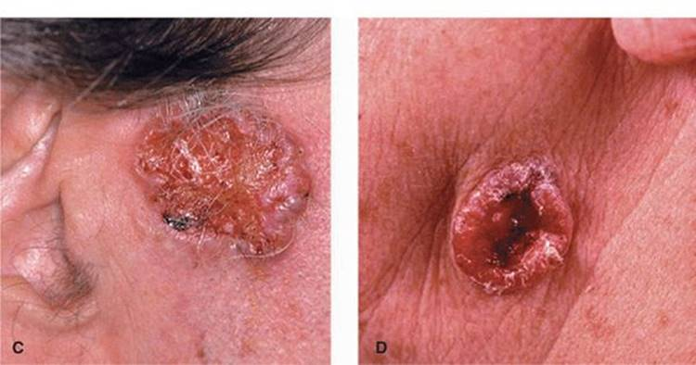
ULCERATED BASAL CELL CARCINOMA:
Basal cell carcinoma (BCC) is a common, locally invasive, keratinocyte cancer (also known as nonmelanoma cancer).
The risk factors include; Advancing age, sunexposure, male sex, Fitzpatrick type 1-3
Most common site: head and neck
It is characterized by a slow growing lesion and;
Translucent/ Pearly
Central ulceration
Rolled borders
Telengiactasia

Slide 18
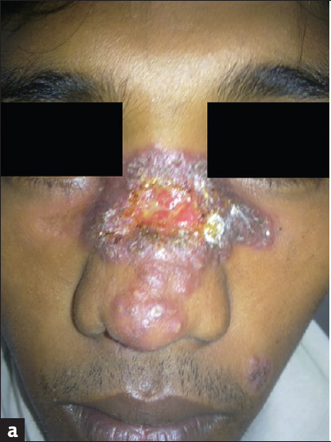
LUPUS VULGARIS:
It is a chronic paucibacillary form of Cutaneous TB occurring in a previously sensitized individual with a high immunity.
The characteristic lesion is a slowly enlarging plaque with an elevated border and central atrophy, with an advancing edge.
Most commonly affects women.
The most common site is head and neck followed by hands and feet.
Nasal, buccal or conjunctival mucosa maybe involved.
Sporotrichoid spread is also a feature.

Slide 19
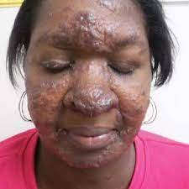
SARCOIDOSIS:
It is a multisystem disorder characterized by granuloma formation in organs.
It most commonly involves the lungs followed by skin, eyes, liver and heart.
It typically affects women, age 20-40 years and then above 60 years.
The skin lesions are characterized by asymptomatic red-brown to violaceous papules, nodules or plaques that are symmetrically distributed on the head, neck upper trunk and upper extremities.
Ulcerative sarcoidosis is an uncommon variant.
Ulcers tend to arise within existing papulonodules and atrophic lesionson the lower legs.
It may occur on previously normal skin and in a generalized distribution.

Slide 20
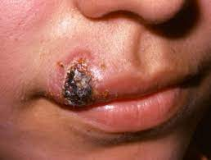
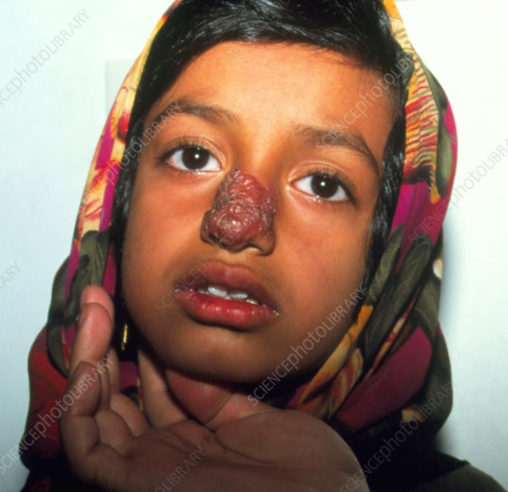
SQUAMOUS CELL CARCINOMA:
SCC Is a malignant tumor arising from the epidermal keratinocytes and its appendages.
Most common risk factors include, UV exposure, immunosuppression, advancing age and males, Fitzpatrick 1 and 2.
Most commonly involve the light exposed areas and is usually solitary.
The typical lesion maybe plaque like, verrucous or ulcerated with marked induration.
The limit of induration are not sharp and extends beyond the visible changes.
The tumors are usually capped by a crust which sheds off to reveal and underlying purulent ulcer with indurated margins that bleeds very easily.

Slide 21
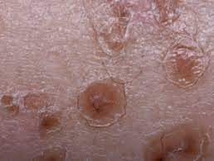
POROKERATOSIS:
Porokeratosis is a clonal expansion of keratinocytes with abnormal differentiation but are not hyper proliferative. It may present as a single or multiple lesions.
It shows a thin column of parakeratosis and a cornoid lamella.
Most commonly affects males.
Risk factors include: UV exposure and Immunosuppression and pale skin
It presents as an asymptomatic single or multiple nodules or plaques which grows which develop into annular lesions with a thin and raised border.
Family history is usually positive

Slide 22


Slide 23
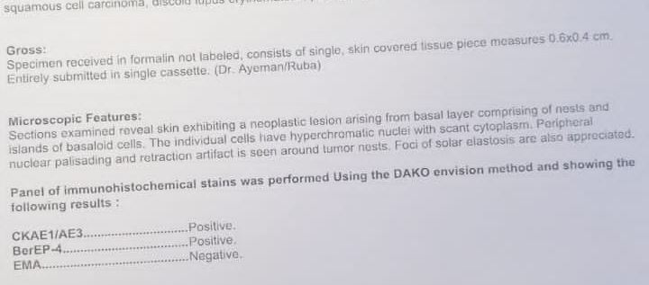
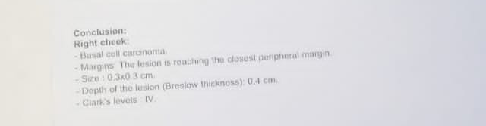

Slide 24
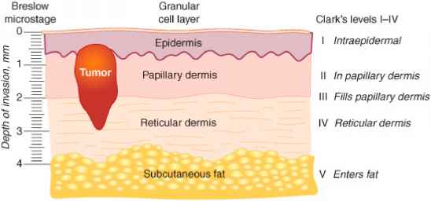

Slide 25
FINAL DIAGNOSIS:
BASAL
CELL
CARCINOMA

Slide 26
TREATMEN GIVEN:
PATIENT WAS PRESCRIBED BACTROBAN OINTMENT (MUPIROCIN ) APPLICATION LOCALLY, TWICE DAILY.
SHE WAS COUNSELLED ABOUT HER CONDITION .
AND WAS REFERRED TO PLASTIC SURGERY FOR FURTHER MANAGEMENT.

Slide 27
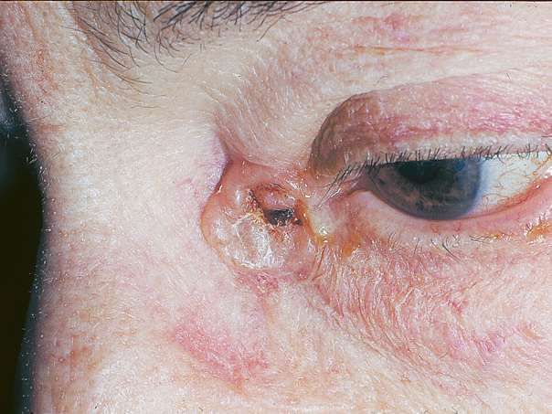
BASAL CELL CARCINOMA:
Basal cell carcinoma is a common, locally invasive, keratinocyte cancer( also known as nonmelanoma cancer.)
It is the most common form of skin canncer.
BCC is also known as rodent ulcer and basalioma.
It is more common in Fair skin individuals, with inability to tan.
More common in males
More common with advancing age.

Slide 28
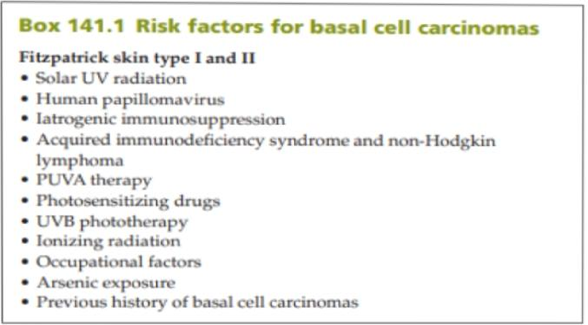
RISK FACTORS FOR BASAL CELL CARCINOMA:

Slide 29
CLINICAL VARIANTS:
    Nodular basal cell carcinoma
    Superficial basal cell carcinoma
    Morphoeic basal cell carcinoma
    Ulcerated Basal cell carcinoma
    Pigmented basal cell carcinoma

Slide 30
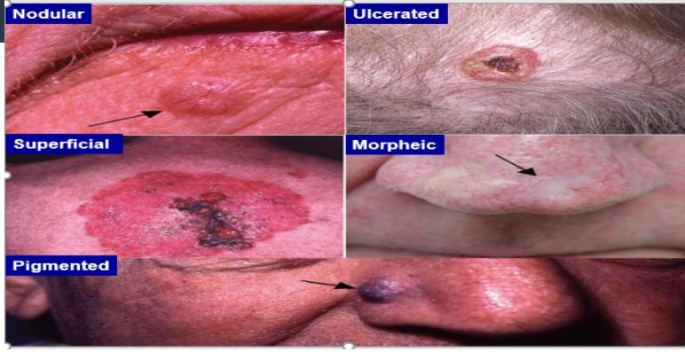

Slide 31
SITES:
Majority on the head and neck- predilection for the upper central part of the face.
Morphoeic type- almost exclusively on face.
Superficial type- mainly on the trunk.
Palms and soles- rarely affected.

Slide 32
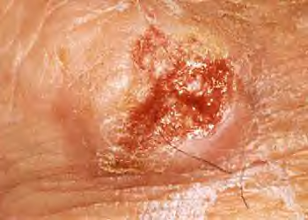
ULCERATED BCC:
It may start as a small macule or papule but with extension of the thread like margins, the attenuated surface ulcerates.
The edge is usually indurated and raised.
Attempts to treat with topical antibiotics are unsuccessful.
The floor of the ulcer is depressed below the skin surface, fleshy in appearance and not very vascular.

Slide 33
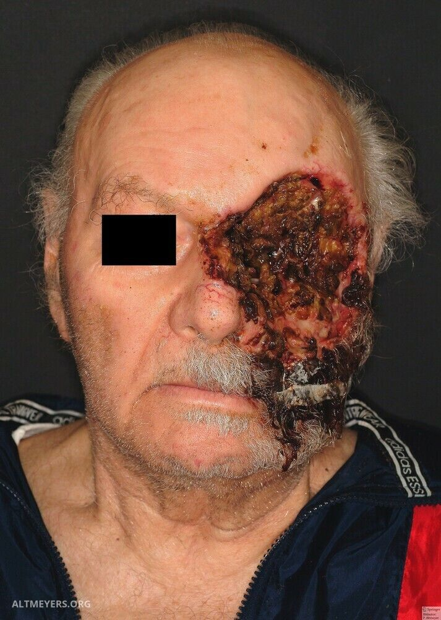
‘Ulcus terebrans’ (penetrating ulcer):
If left untreated then the ulcer spreads deeply and cause great destruction, especially around the eyes, nose or ear.
It may involve the peri orbital tissue, the bones of the face, the skull and even the meninges maybe invaded.

Slide 34
INVESTIGATIONS:
Clinical.
Biopsy.
Dermoscopy.
Others: High- frequency ultrasound, Optical coherence tomography, confocal microscopy.

Slide 35
HISTOPATHOLOGY:
Nests of Basaloid tumor cells- Budding from epidermis or follicle within the dermis.
Peripheral palisading of nuclei.
Peritumoral clefting.

Slide 36
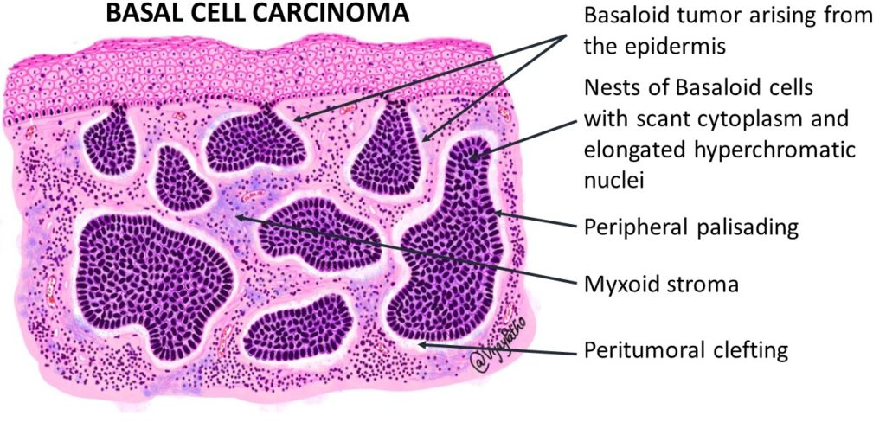
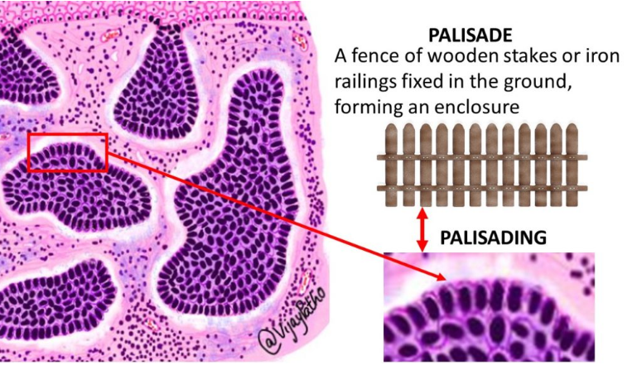
HISTOPATHOLOGY:

Slide 37
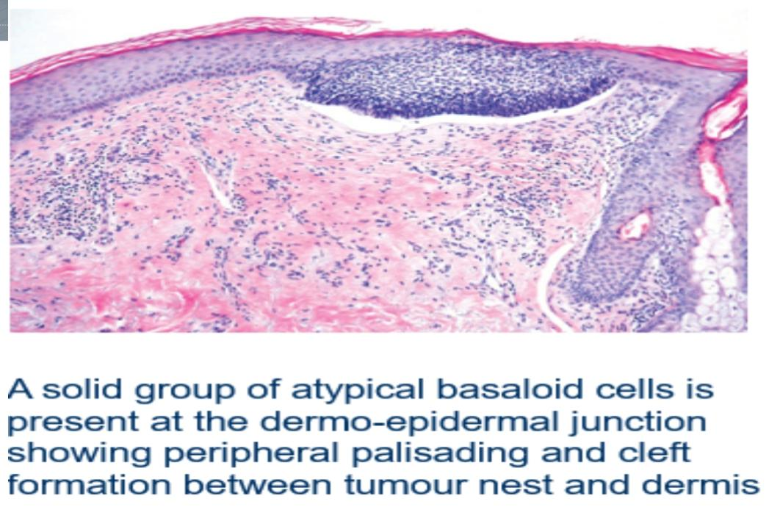

Slide 38
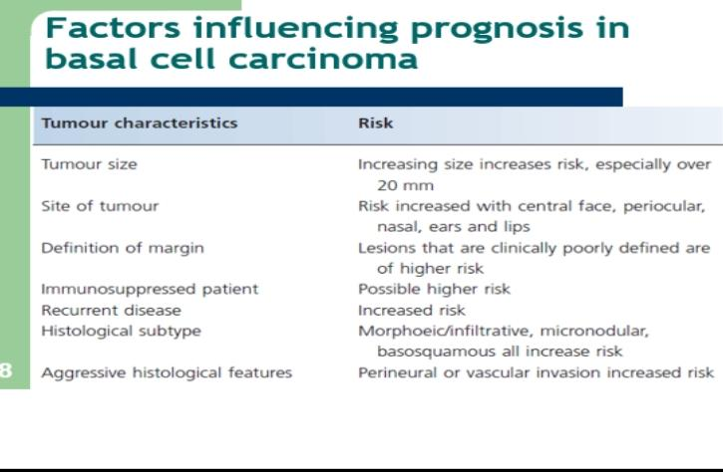

Slide 39
TREATMENT:
TOPICAL THERAPY( IMIQUIMOD, 5-FU)
SURGICAL EXCISION WITH PREDETERMINED MARGINS
MOH’s MICROGRAPHIC SURGERY
PHOTODYAMIC THERAPY
RADIATION THERAPY
LASERS

Slide 40
IMIQUIMOD
MOA: It stimulates toll‐like receptor 7 and 8 expressed on dendritic cells and monocytes, leading to increased production of cytokines and chemokines.
Dose : Topical 5% imiquimod cream, applied five times per week over 6 weeks.
It is licensed for use in superficial BCC in immunocompetent adults, with a maximum tumour diameter of 2.0 cm.
Patients may experience flu‐like symptoms such as fever, chills, body aches and lymphadenopathy
Cutaneous side effects include, erythema, pruritis, erosion, ulceration, dyspigmentation and scabbing.

Slide 41
5 FLUOROURACIL:
MOA: It disrupts DNA and RNA synthesis by inhibiting the enzyme thymidylate synthetase.
Despite high histological cure rates and good cosmesis with topical 5‐FU treatment of small and superficial BCC, it is rarely used for this indication .
Side effects: local irritation and skin reaction resulting in erythema, swelling, desquamation and tenderness are common post treatment

Slide 42
SURGICAL EXCISION WITH PREDETERMINED MARGINS:
Surgical excision is one of the most effective treatments for well‐ defined BCCs with a 4–5 mm surgical margin .
Recurrence rates are low.
Surgical excision may not be appropriate for recurrent, morphoeic or large BCC which require a 3–15 mm margin.

Slide 43
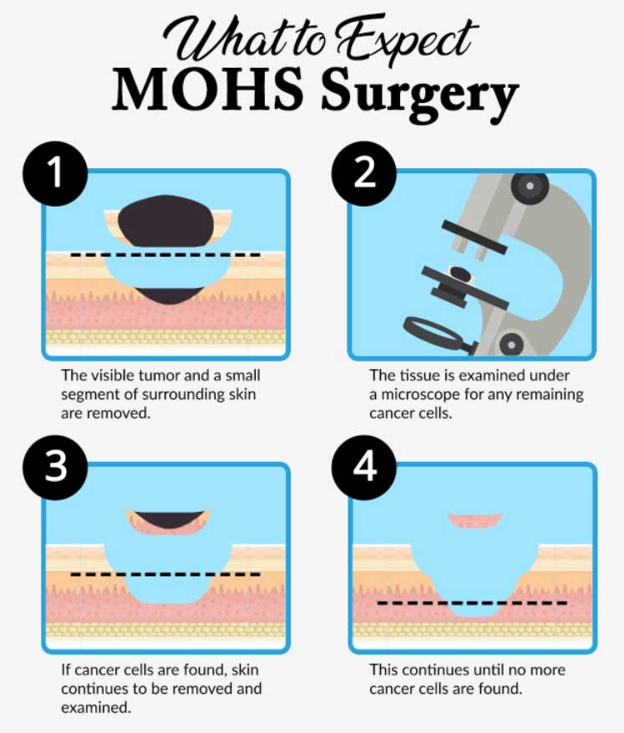
MOHS MICROGRAPHIC SURGERY:

Slide 44
PHOTODYNAMIC THERAPY
Photodynamic therapy relies on the production of ROS, which results in necrosis or apoptosis of tumour cells.
LASERS
Carbon dioxide laser can use should be restricted to low‐risk BCC.
The pulsed dye laser has also been employed in the treatment of superficial BCC .

Slide 45


