Slide 1
CUTANEOUS BACTERIAL INFECTIONS
MEHAK WARDA
PAEDS MEDICINE

Slide 2
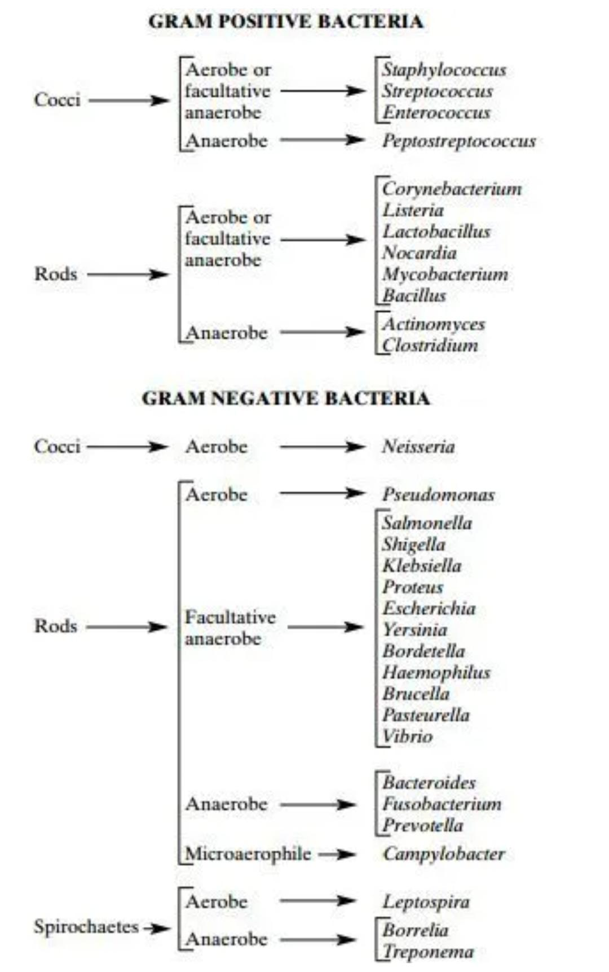

Slide 3
STAPHYLOCOCCAL AND STREPTOCOCCAL INFECTIONS
DIRECT EFFECT OF SKIN AND ADJACENT TISSUES:
IMPETIGO
ECTHYMA
CELLULITIS AND ERYSIPELAS
FOLLICULITIS
FURUNCLES AND CARBUNCLES
PERIANAL STRETOCOCCAL CELLULITIS
BLISTERING DIST DACTYLITIS
CUTANEOUS DISEASE DUE TO EFFECT OF BACTERIAL TOXIN:
STAPHYLOCOCCAL SCALDED SKIN SYNDROME
STAPHYLOCOCCAL TOXIC SHOCK SYNDROME
RECURRENT TOXIN MEDIATED PERINEAL ERYTHEMA
SCARLET FEVER
STREPTOCOCCAL TOXIC SHOCK LIKE SYNDROME

Slide 4
STAPHYLOCOCCAL AND STREPTOCOCCAL INFECTIONS
Impetigo:
Contagious, superficial pyogenic infection
Two main clinical forms:
  Non‐bullous
  Bullous
Common in children
Newborn-pemphigus neonatorum (widespread bullous impetigo)
Causative organisms
S. Aureus.
Strep. Pyogenes

Slide 5
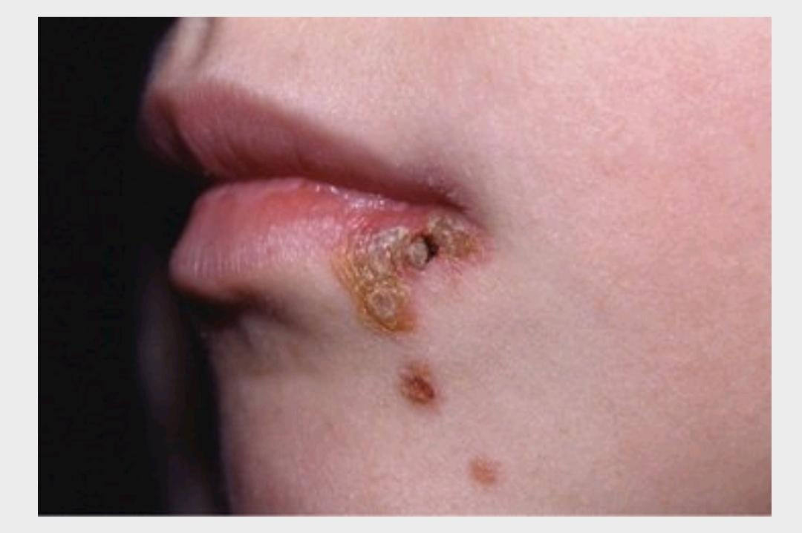
Impetigo
NON BULLOUS IMPETIGO
Thin walled vesicle on erythematous base→ ruptures rapidly → exudate dries → yellowish brown crusts→ separate to leave erythema→ fades without scarring →spontaneous cure in 2-3 wks
Face ( nose and mouth ) & limbs
Regional adenitis + fever (severe cases)
Mucous membrane(rare)

Slide 6
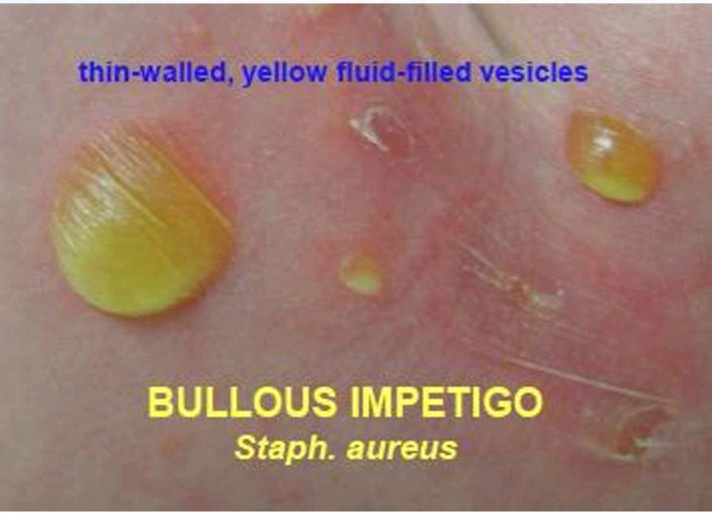
Impetigo
BULLOUS IMPETIGO
become much larger
Bullae (persist for 2-3 days) → contents at first clear→ cloudy → rupture →thin, flat, brownish crusts→ eroded circinate lesions (central healing with peripheral extension)
Involves face, may be widely distributed.
Buccal mucosa may be involved.
Regional adenitis is rare.

Slide 7
DIFFERENTIAL DIAGNOSIS
NON BULLLOUS IMPETIGO
viruses (herpes simplex, varicella-zoster),
fungi (tinea corporis, kerion),
arthropod bites,
parasitic infestations (scabies, pediculosis capitis), all of which may become impetiginized.
BULLOUS IMPETIGO
Neonates:
epidermolysis bullosa,
bullous mastocytosis,
herpetic infection,
Early staphylococcal scalded skin syndrome
BULLOUS IMPETIGO
Children:
dermatitis
allergic contact
dermatitis,
burns,
erythema multiforme,
linear immunoglobulin A dermatosis,
pemphigus,
bullous pemphigoid

Slide 8
Impetigo
INVESTIGATIONS
Microbiological skin swabs taken from affected skin.

Slide 9
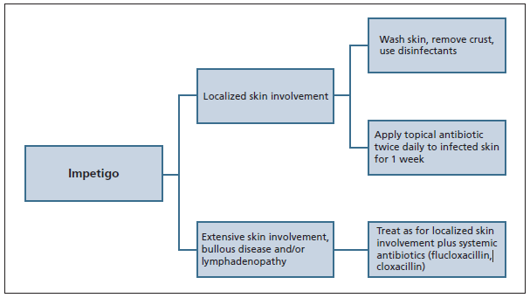
Management
Impetigo
Topical antibiotics mupirocin, retapamulin 2% 2 to 3 times/day for 10 to 14 days, fucidic acid, clindamycin.
First line: flucloxacillin, cephalexin (20 – 50mg/kg/day ÷ tds for 7 days), co-amoxiclav, cloxacillin,clindamycin.
Second line: macrolides, co-trimoxazole.
Third line: trimethoprim, tetracycline.

Slide 10
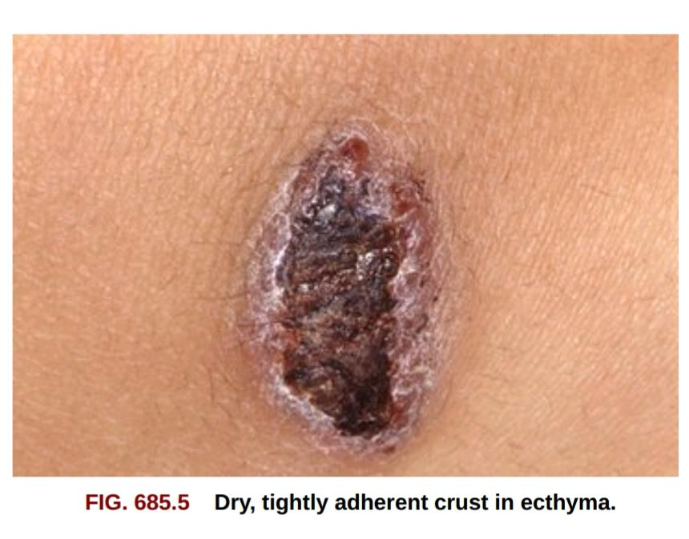
Ecthyma
Ecthyma
Pyogenic infection of skin characterized by formation of adherent crusts, beneath which ulceration occurs.
Deeper than impetigo
Buttocks, thighs and legs
Complicated by autoinoculation
Causative Organisms
Group A strept: S. Pyogenes
Pseudomonas aeruginosa
S aureus.

Slide 11
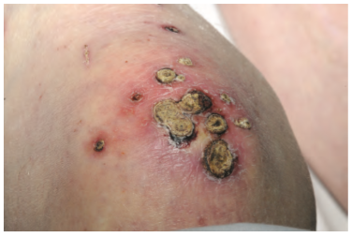
Clinical features
Ecthyma
Small bullae/pustules on an erythematous base → hard crust of dried exudate →removed with difficulty
Adherent crusts, with indurated irregular ulcers →loss of the epidermis, dermis → heals with scarring in few weeks.

Slide 12
Investigations
Ecthyma
Microbiological swabs should be taken from affected skin.

Slide 13
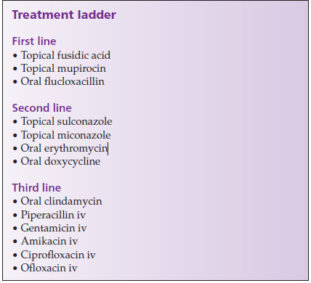
Ecthyma

Slide 14
Cellulitis and erysipelas
Cellulitis: acute, subacute or chronic inflammation of loose connective tissue.
Erysipelas: infection of dermis & upper subcutis; well‐defined raised edge(hallmark) → superficial (dermal) involvement
May coexist
Lower limb & face.
4th and 6th decades
CAUSATIVE ORGANISMS
Group A & B streptococci
Strep. Pneumoniae
S. Aureus

Slide 15
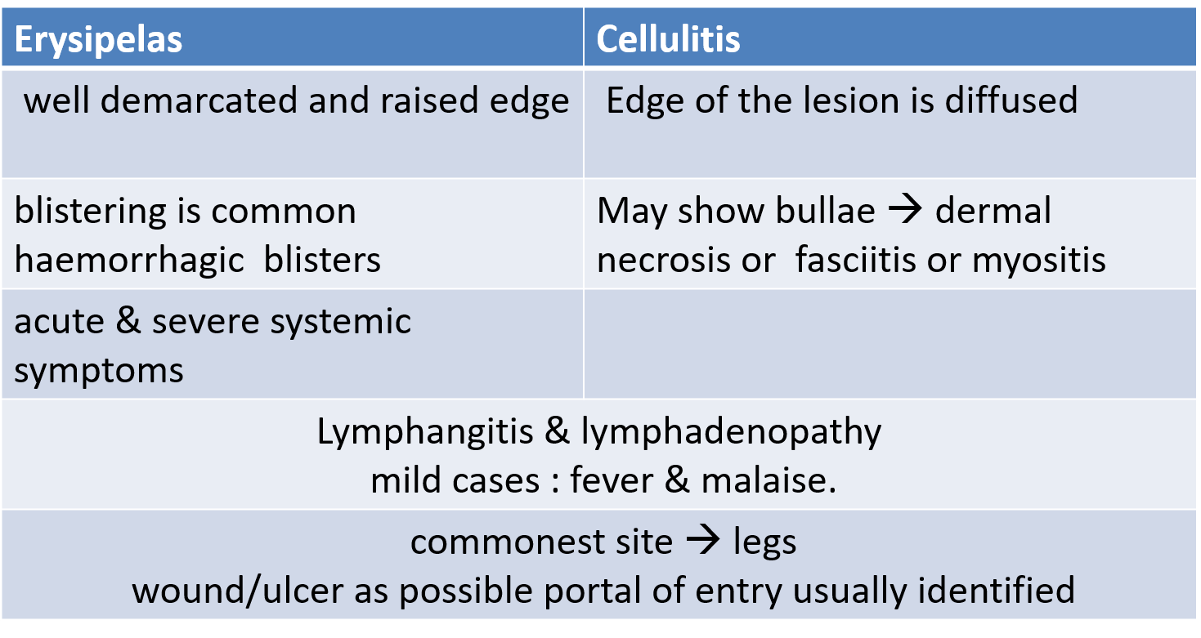
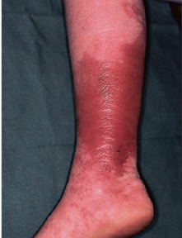
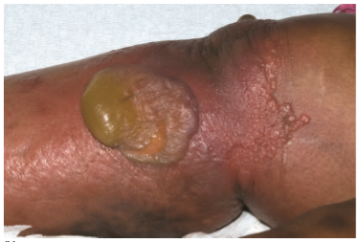
Cellulitis and erysipelas

Slide 16
Investigations
Cellulitis and erysipelas
Specimen from vesicle fluid or eroded ulcers
Blood cultures
In facial infections the pathogen should be sought in nose, throat, conjunctiva and sinuses.
Serology

Slide 17
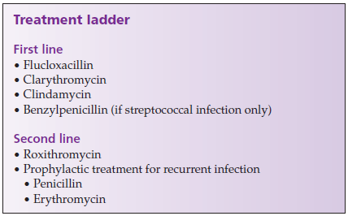
Cellulitis and erysipelas

Slide 18
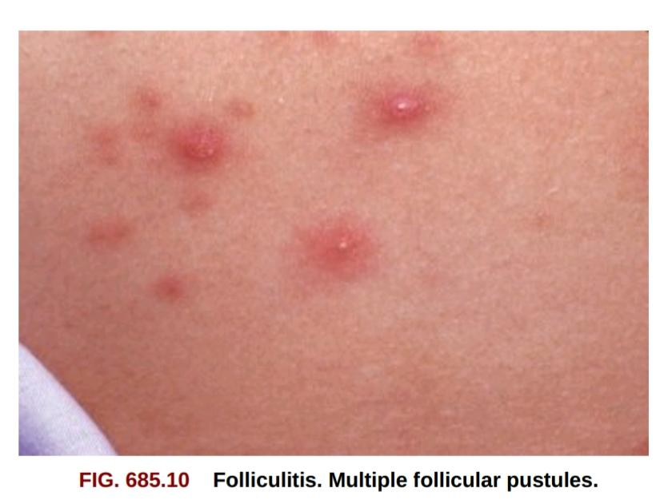
Folliculitis
Folliculitis
Subacute or chronic
Inflammation: ostium/only slightly below it
Heals without scar formation
Superficial S.aureus folliculitis –childhood(scalp/scalp margins or on limbs)
Spread : athletes, military personnel, prisoners
Male – beard area

Slide 19
Folliculitis
CAUSATIVE ORGANISMS
S. Aureus
CA‐MRSA infections
Coagulase‐negative staphylococci
Pseudomonas aeruginosa
Pityrosporum yeast

Slide 20
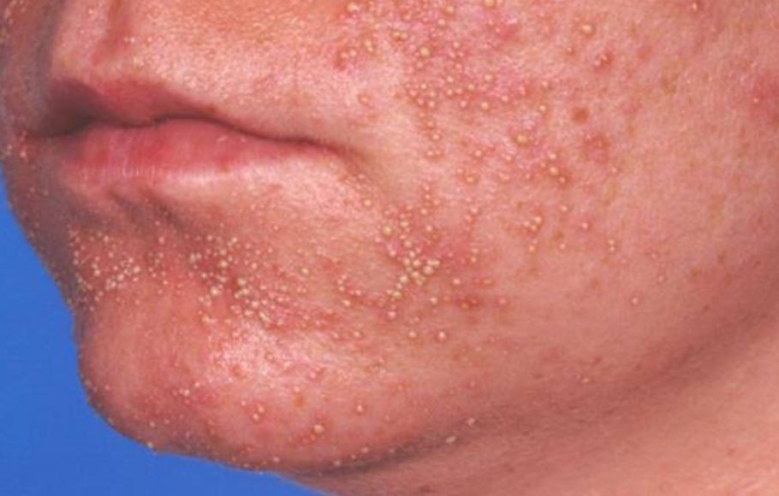
Clinical Features
Folliculitis
Small follicular papules & pinhead pustules: in crops
Rarely painful
Superficial folliculitis : domed yellow pustules + narrow red areola → heal within 7–10days.
Pustular dermatitis atrophicans of the legs: ( males )
  Symmetrically anterior tibial surfaces of the legs
Miliary pustules → atrophic scars.

Slide 21
Investigations
Folliculitis
If CA‐MRSA suspected, swabs taken for sensitivity of the organism.

Slide 22
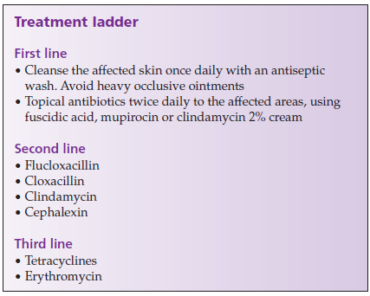
Management
Folliculitis

Slide 23
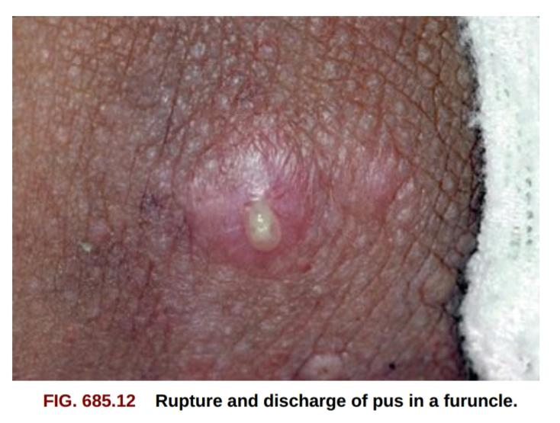
Furuncle (boil, abscess)
Furuncle
Acute, necrotic infection of hair follicle with S. Aureus.
Sterile furuncle: after injection of oil based drugs
Common in DM, HIV, malnourished
Recurrent boils: S. Aureus infections of (MSSA/MRSA)
PVL infections: overcrowding/close contact, poor hygiene and skin breaks
PVL lesion - >5cm in diameter , necrotic and more painful.
Causative organism:
Staph. Aureus – MSSA, MRSA or PVL positive

Slide 24
Clinical Features
Furuncle
Involves :
Face & neck
Arms, wrists & fingers
Buttocks & anogenital region
Small follicular inflammatory tender nodule → pustular then necrotic →discharge of a necrotic core → single/multiple/ in crops → healing → violaceous macule → permanent scar..

Slide 25
investigations
Furuncle
Swabs from discharging pus for microbiological analysis including PVL analysis

Slide 26
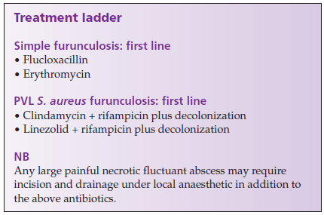
Management:
Furuncle

Slide 27
Carbuncle
Carbuncle
Deep infection of contiguous follicles with inflammatory changes in surrounding & underlying tissues
Causative organism: S. Aureus
DM, malnutrition, CHF, drug addiction, obesity & steroid therapy.
Site :back of the neck, shoulders & hips and thighs
Complications:
toxemia, metastatic infections , eventually death.

Slide 28
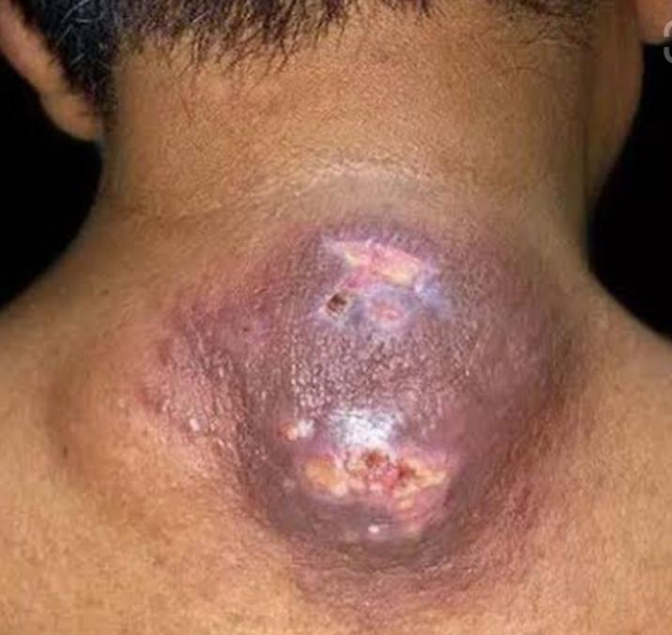
CLINICAL FEATURES
Carbuncle
Dome‐shaped acutely tender lump → 3-10cm dia in few days →suppuration after 5–7 days → multiple discharging follicular orifices → necrosis of the intervening skin → yellow slough covered crateriform nodule → slow healing with scar formation
Fever, malaise

Slide 29
Investigation & Management
Carbuncle
Skin swabs for microbiology.
Management
Penicillinase‐resistant antibiotic
Flucloxacillin
Incision and drainage
Saucerization

Slide 30
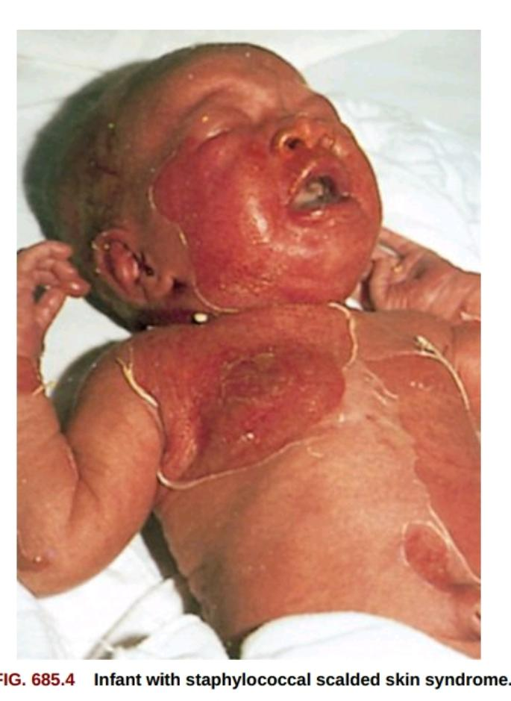
Staphylococcal scalded skin syndrome
ssss
Ritter disease in children
Exfoliative dermatosis: body surface become tender and erythematous, superficial dermis strips off.
S. Aureus exfoliative toxin (ETA, ETB)
Children (< 6 years)
Neonates
Types:
Generalized
Localised : flexures (axillae, groin & limb flexures)

Slide 31
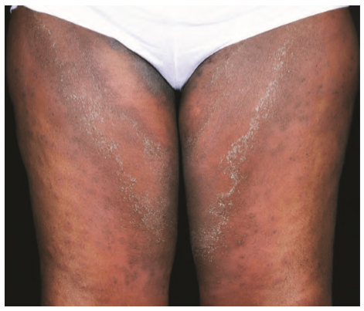
CLINICAL FEATURES
ssss
Localized staph infection →fever, irritability and skin tenderness. → Erythema more in flexures →superficial blister → painful raw area → heals within 7–14 days.

Slide 32
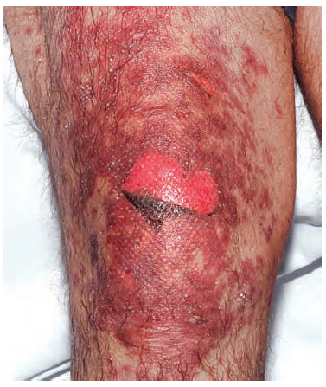
DIFFERENTIALS
ssss
Toxic epidermal necrolysis

Slide 33
Investigation
ssss
Organism may be isolated from the original septic site if identified
Blood cultures
Raised ESR

Slide 34
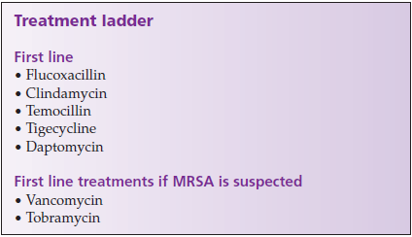
Management:
ssss

Slide 35
Toxic shock syndrome
Toxic shock syndrome
Life‐threatening, multisystem disease:
Mediated by bacterial toxins
S. Aureus & strep pyogenes.
Toxic shock syndrome toxin 1 : produced by 80–90% of s. Aureus
Extremes of age & in menstruating women (15–40 years).

Slide 36
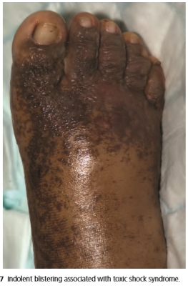
CLINICAL FEATURES
Toxic shock syndrome
fever & malaise
Widespread macular erythema → clears in 3 days → limb edema + blistering → mucous membrane involvement
2nd week : maculopapular rash → desquamation 21 days
Thrombocytopenia → retiform purpura

Slide 37
Toxic shock syndrome
Systemic features: GI symptoms→ muscles, liver, kidneys, CNS.
Circulatory shock : unresponsive to iv fluids
Multi organ failure
Complications
DIC
ARDS
CRF

Slide 38
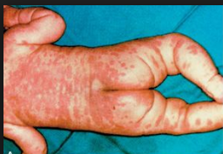
DIFFERENTIALS
Toxic shock syndrome
Kawasaki disease

Slide 39
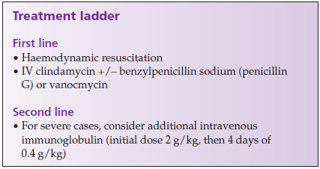
Management
Toxic shock syndrome
Tampons should be sought and removed & infected wounds debrided

Slide 40
Recurrent toxin‐mediated perineal erythema
Recurrent toxin‐mediated perineal
erythema
Superantigen toxins
Children < 12 years of age
Causative Organisms
Strep pyogenes.
S aureus.

Slide 41
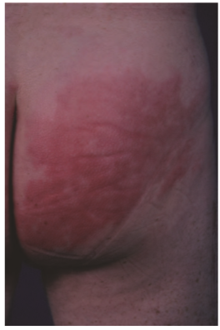
CLINICAL FEATURES
Recurrent toxin‐mediated perineal
erythema
Preceded by recurrent pharyngotonsillitis
Macular erythema in the perineal area → settles with desquamation
Other areas: hands, feet and axillae

Slide 42
Investigation & Management
Recurrent toxin‐mediated perineal
erythema
Diagnosis is made on clinical grounds
Throat swabs may yield staphylococcus aureus or streptococcus pyogenes.
Management
Patients respond well to a short course of antibiotics, which covers streptococci and staphylococci

Slide 43
Perianal streptococcal cellulitis
Uncommon superficial cutaneous infection
In children: 6 months-10 years
Causative organism:
Streptococcus pyogenes.

Slide 44
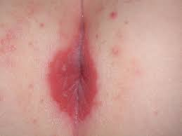
CLINICAL FEATURES
Perianal soreness →pain on defecation → secondary faecal retention
Skin is bright red, fissured.

Slide 45
Investigation & Management
Perianal swab for microbiology
2‐week course of oral antibiotic treatment
  Penicillin
  Erythromycin
Topical mupirocin

Slide 46
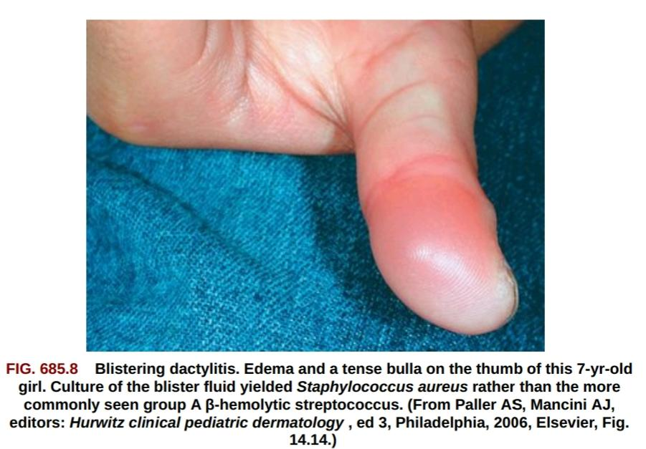
Blistering distal dactylitis
Group A β‐haemolytic streptococcus
Age: 2-16 years
Clinical features
Blister/blisters→ seropurulent fluid
Distal phalanx on palmar pad

Slide 47
INVESTIGATIONS & MANAGEMENT
INVESTIGATIONS
Organism is cultured from blister fluid.
MANAGEMENT
Gentle disruption of tense bullae.
Β‐lactamase‐ resistant antibiotics
Topical therapy with wet dressings

Slide 48
Toxin‐mediated streptococcal disease
Scarlet fever
Toxic shock‐like syndrome

Slide 49
Scarlet fever
Pharyngitis, fever & distinctive scarlatiniform rash
Erythrogenic toxin
Young children
Portal of entry: throat or wound infection
CAUSATIVE ORGANISMS
Strept pyogenes

Slide 50
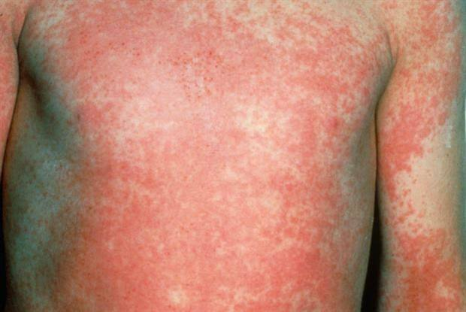
Clinical features
IP: 2-5 days
Fever, anorexia & vomiting
Acute follicular/membranous tonsillitis + painful lymphadenopathy
Rash on 2nd day → from upper trunk → punctate ‘sandpaper’ erythema.
Pastia lines: transverse red streaks in skin folds due to capillary fragility → desquamation in 10 days

Slide 51
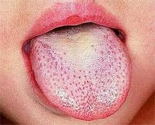
Flushed face with relative pallor around the mouth is characteristic
Red puncta on the palate + ‘white strawberry tongue
As epithelium shed tongue become smooth and dark red (red strawberry tongue)

Slide 52
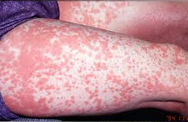
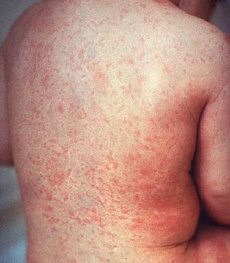
Differentials
Drug reaction
Rubella

Slide 53
COMPLICATIONS
Myocarditis
Hepatitis
Arthritis
Meningitis
Osteomyelitis
Rheumatic fever & glomerulonephritis

Slide 54
Investigations
Culture of a group A β‐haemolytic streptococcus
Raised ASO titre
Schultz–charlton test – blanching of rash around point of injection of antitoxin
CBC- polymorphonuclear leukocytosis.

Slide 55
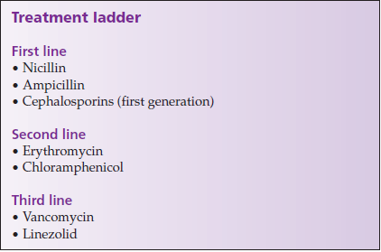
Management

Slide 56
Streptococcal toxic shock‐like syndrome
Circulatory shock & multisystem disease
Follows Surgical wounds, throat infections, vaginal infections postpartum or soft‐tissue infections due to GAS
CAUSATIVE ORGANISM
Group A β‐haemolytic streptococci
(Strep pyogenes, S. Suis, S. Mitis, S. Dysgalactiae, S. Agalactiae)

Slide 57
Clinical Features
Rapid onset + high fever→ desquamating rash → hypotension → multiorgan failure
COMPLICATIONS
Myositis
Endophthalmitis
Peritonitis
Renal failure

Slide 58
Investigations
Blood cultures
Swabs from the site of clinical infection almost always yield GAS M types 1, 3, 12 and 28

Slide 59
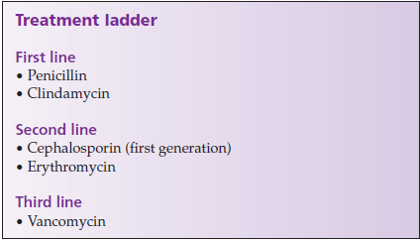
Management
If necrotizing fasciitis or myositis: rapid debridement, fasciotomy or amputation

Slide 60
Erythrasma
Chronic localized superficial infection
Aerobic coryneform : C. Minutissimum
Axillae, groins, sub mammary flexures, intergluteal region and toe webs
Diabetics

Slide 61
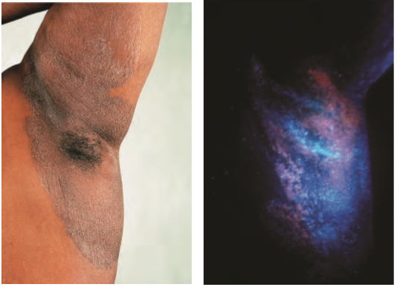
CLINICAL FEATURES
Irregular, sharply marginated smooth, red patches→ later brown, finely creased & scaly.
Scratching & lichenification in tropical climate
May be extensive involvement

Slide 62
Investigations
Coral‐red fluorescence with wood’s light
Scrapings of affected skin may show bacteria & fine filaments if stained with gram or giemsa or with potassium hydroxide clearance

Slide 63
Management
First line
Topical antifungal : clotrimazole & miconazole: 2 weeks
Extensive lesions: erythromycin
Topical fucidin & oral tetracycline.
Relapse
Long‐term antiseptics: povidone–iodine
Second Line
Photodynamic therapy using porphyrin produced by causative organisms

Slide 64
Investigations
Potassium hydroxide mounts
Culture

Slide 65
Management
Antiperspirant such as aluminium chloride

Slide 66
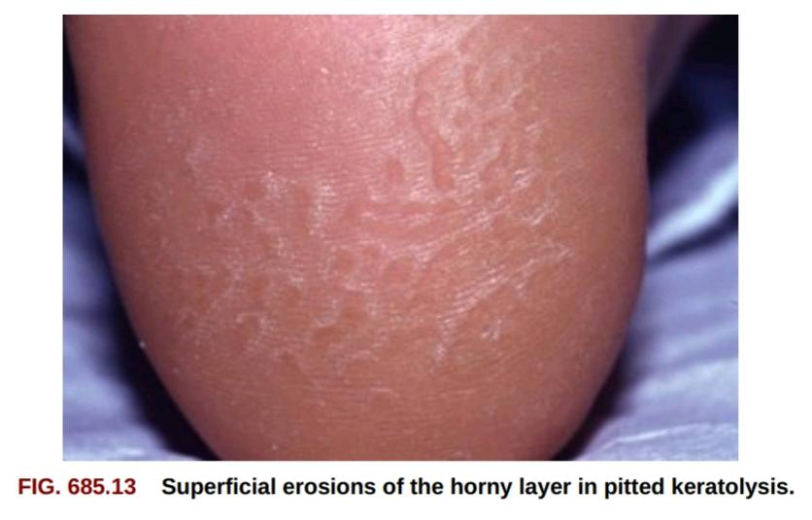
Pitted keratolysis
Superficial infection of the skin
Actinomyces keratolytica
Soles, pressure‐bearing friction areas

Slide 67
Clinical features
Conspicuous, discrete, shallow, circular lesions with a punched‐out appearance coalesce to produce irregular erosions.
Occasionally green or brown discoloration
Hyperhidrosis, sometimes with maceration, stickiness & foul odor

Slide 68
Investigations
Clinical diagnosis
Gram‐stained scrapings.
Histology: mixture of coccoid bacteria & filamentous microorganisms in the most superficial parts of the stratum corneum, extending downwards between keratinocytes

Slide 69
Management
Treatment of hyperhidrosis
Potassium permanganate soaks, aluminum chloride & iontophoresis
First line
Fucidin ointment
Imidazoles (clotrimazole)
Second line
Botulinum toxin which reduces hyperhidrosis

Slide 70
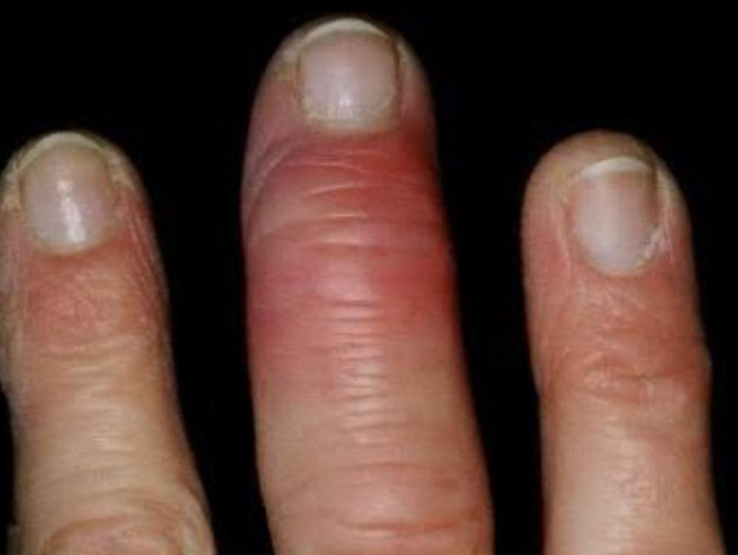
Erysipeloid
Acute, rarely chronic, infection
Confined to the skin
Contracted by direct contact: carcasses
Butchers, cooks, fishermen, farmers & veterinary surgeons

Slide 71
Clinical features
Three clinical syndromes in humans:
Localized cutaneous: most common (erysipeloid of rosenbach)
Generalized cutaneous
Systemic
Hand, fingers or forearms
Fever and mild constitutional symptoms

Slide 72
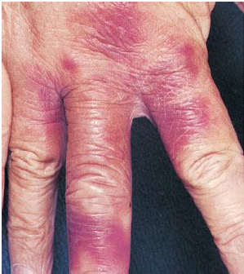
3 days post inoculation, hot violaceous tender erythema develops
Extends centrifugally with a sharp gyrate border
Extension continues for 3 or 4 days
Heals spontaneously in 2 weeks without desquamation or suppuration

Slide 73
Investigations
Culture
Cultures of deep biopsy material from the advancing edge of recent lesions occasionally yield the organism

Slide 74
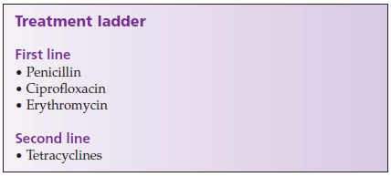
Management
Most isolated skin lesions heal spontaneously in about 4 weeks.
Healing is facilitated by antibiotic therapy.

Slide 75
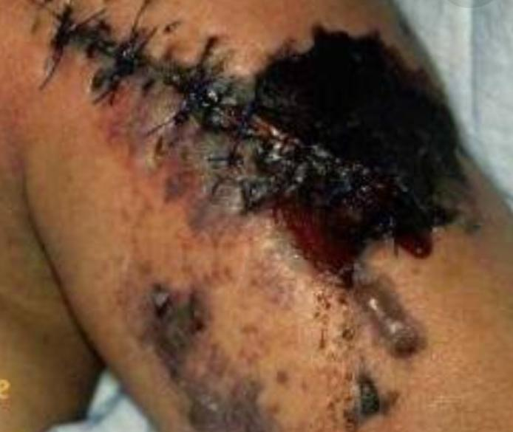
Gas gangrene (clostridial myonecrosis)
Wounds contaminated with soil or water after trauma
Causative organisms
Clostridium involved are
C. Perfringens (formerly C. Welchii)

Slide 76
Clinical features
IP: 12 H – 5/6 days
Affected area painful & swollen → mottling, bullae and black sloughs → crepitation from gas in tissues → serous discharge →toxaemia
Tachycardia , hypotension, irritability.
Pale afebrile patient

Slide 77
Investigations
Bacterial examination of exudate
Blood cultures
Radiology : gas in the tissues

Slide 78
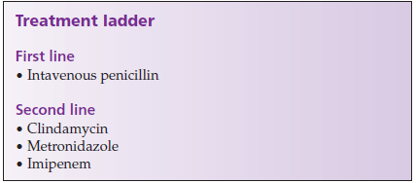
Management
Immediate surgical debridement of all damaged tissue

Slide 79
Gram negative bacteria
Pseudomonas Aeruginosa:
Introduction:
Aerobic, gram-negative rod.
Colonizes:
Skin surface
The repeated application of bactericidal agents.
Prolonged maceration
Intensive therapy units
Neutropenic patients
Burns

Slide 80
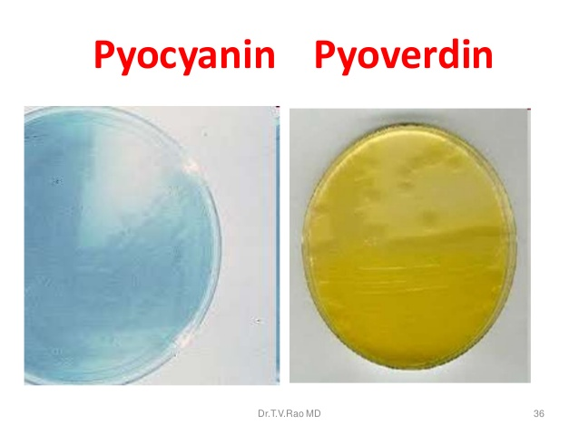
Pathology:
Typical strains produce two pigments:
  The blue-green pyocyanin, a phenazine derivative
  A greenish yellow pyoverdin.
Environmental factors:
Soil and water, including household or hospital bathroom appliances (e.g. Sinks).

Slide 81
Clinical presentation:
INFANTS:
Periumbilical infection→a foul‐smelling bluish green discharge and spreading erythema.
In humid condition→ widely scattered pustules may break down to form necrotic ulcers.

Slide 82
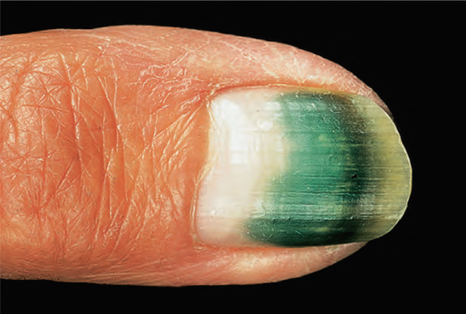
Perionychial pustules, accompanied by green discoloration of the nails.

Slide 83
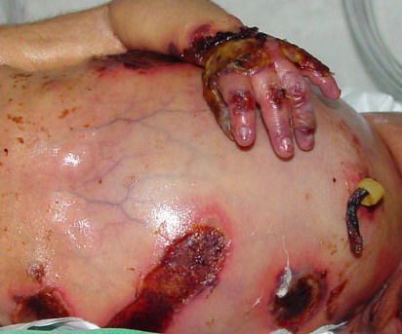
Severely ill or in compromised neutropenic patients:
Primary cutaneous invasion with extensive necrosis develop around a local erosion.

Slide 84
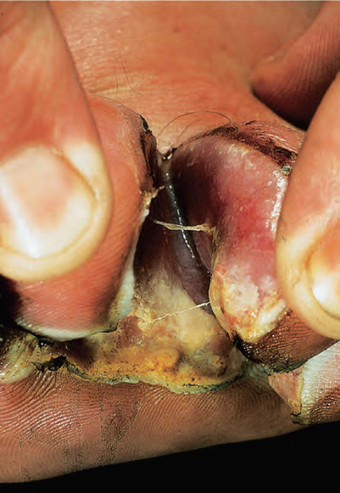
Tropical Immersion foot:
Infection of the toe webs.
Cause:
Inhibition of the gram‐positive flora by maceration or antibiotics .

Slide 85
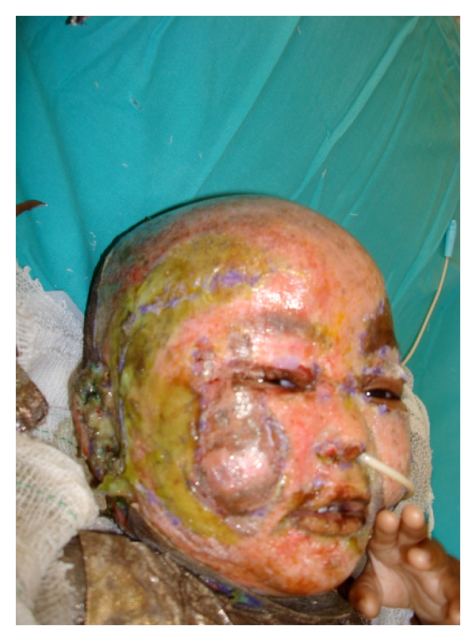
Burns:
High mortality
Organism thrive in burn eschar.
Secondary septicaemia.
Discoloration of the slough with extensive surrounding oedema.
Fever and shock.

Slide 86
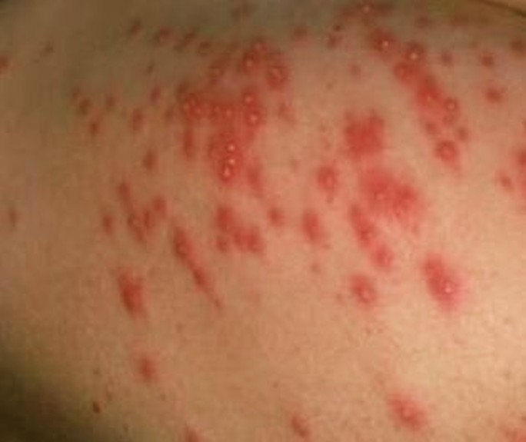
Gram negative Folliculitis:
Swimming pool or jacuzzi users.
Tender macular, papular or pustular lesions.
Worst affected areas → in contact with bathing costumes.
Rash settles spontaneously within 7–10 days in the absence of re‐exposure.

Slide 87
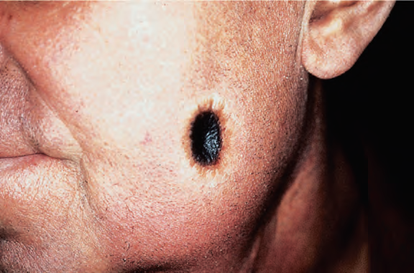
ECTHYMA GANGRENOSUM.
Bullae may rapidly rupture to give necrotic
Ulcers – ECTHYMA GANGRENOSUM.

Slide 88
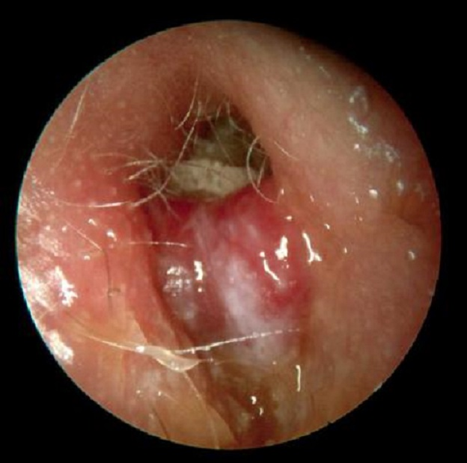
Malignant external otitis
Elderly diabetics
HIV/AIDS
Neutropenic patients

Slide 89
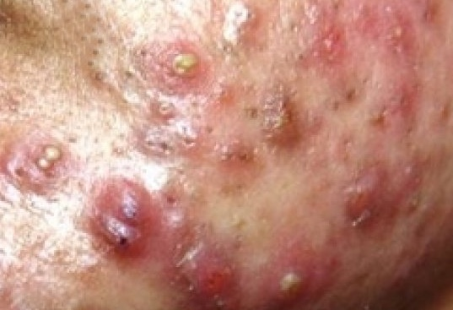
Exacerbation of acne vulgaris:

Slide 90
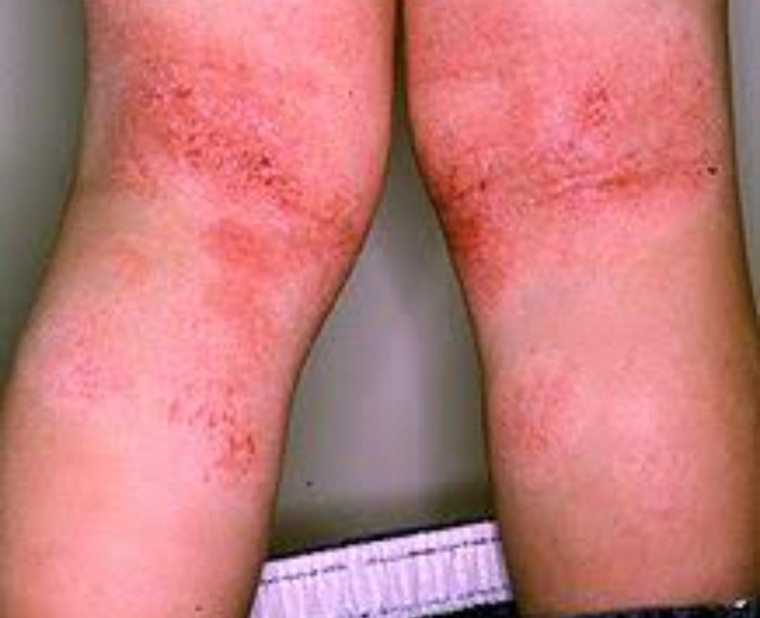
Flexural dermatitis
Mainly in atopics
Painful and fissured exacerbation of the underlying condition

Slide 91
Disease course and prognosis
Poor with systemic infections.
Local infections in infants or severely ill patients → potentially dangerous → systemic extension .

Slide 92

Investigations:
Cultures from the skin lesions or blood.

Slide 93
Management:
Superficial lesions respond best if drying out is possible.
1% acetic acid compresses
Potassium permanganate soaks
Povidone or silver sulfadiazine cream
Topical antibiotics(e.g. Polymyxin) are generally disappointing.
Burns→ extensive debridement
Followed by :
Topical applications of silver sulfadiazine therapy
Ceftazidime can also be used.

Slide 94
Anaerobes:
Four genera:
Bacteroides,
Prevotella,
Porphyromonas
Fusobacterium.

Slide 95
Bacteroides spp.
Gram‐negative bacteraemia and abscesses.
Suppurative hidradenitis
Infected pilar cysts.
Diabetic ulcers.
Prevotella-intraoral infections, including pyorrhoea
Fusobacterium Organisms→ less common severe intraoral infections.

Slide 96
Management:
Metronidazole
Clindamycin
Imipenem
Amoxicillin–clavanulate

Slide 97
management
First Line:
  Doxycycline 100mg 2-3 times daily for 14-21 days
  Amoxicillin 500-1000mg 3 times daily for 14-21 days
Second line:
  Cefuroxime 500mg twice daily for 14-21 days
  Erythromycin 500mg 4 times daily for 14 – 21 days

Slide 98

Necrotizing fasciitis:
(Fournier gangrene)
Necrotizing fasciitis (NF), also known as flesh-eating disease, is an infection that results in the death of parts of the body's soft tissue. It is a severe disease of sudden onset that spreads rapidly.
Symptoms usually include red or purple skin in the affected area, severe pain, fever, and vomiting.

Slide 99
Associated with diabetes.
May occur after any surgical procedure.
Rare in children
Causative organism:
Group A b-hemolytic streptococci
Anaerobes

Slide 100
Clinical features
Hallmark –appearance of necrosis in addition to cellulitis accompanied by rapid toxaemia→ leads to death.
Predisposing factors are trauma, infections, diabetes and previous surgery.
Site- lower anterior abdominal wall, scrotal fascia.
Hot tender area of swelling, erythematous, occasionally dusky.
Bullae and necrosis of underlying tissue.
Deep invasion with progressive necrosis and infarction of subcutaneous tissue→ toxemia →septicaemia

Slide 101
Investigations:
Swab from skin surface –negative
Surgical exploration –necrotic tissue
Serological evidence of streptococcal infection.

Slide 102
Differential diagnosis:
Gas gangrene
Mucormycosis
Cellulitis
Pyoderma gangrenosum
Ecthyma gangrenosum

Slide 103
Management:
Surgical debridement of infected tissue and surrounding area
Skin grafting
Iv penicillin G – high dose
Metronidazole
Heparinization- control dic

Slide 104
Kawasaki disease
Multisystem disease seen in childhood under 2 yrs
Fever, generalized exanthem with lymphadenitis
Bacterial superantigens- possible trigger factors.
Antibodies to rickettsia in some patient
Super antigens(toxic shock antigen) producing strains of s. Aureus & s. Pyogenes cause activation of immune system T lymphocytes(vb2 vb8)
with cytokines release leads to damage to elastic layer.

Slide 105
Clinical features:
Acute , high fever lasts for 5-7 days
Mucosa and conjunctivae, throat injected
Mouth, lips – dry and fissured
Red tongue with prominent papillae (strawberry tongue)
After 3-4 days –widespread exanthems (Morbilliform or EM-like) on limbs and trunks
Affected area become oedematous followed by scaling, starting with digits and in periungual area.

Slide 106

Fever resolves after 1-2 weeks
30% patients develop pericarditis, myocarditis, coronary artery disease & myocardial infarction

Slide 107
Complications and co-morbidities:
Coronary artery aneurysms
Arthritis
Arthralgia
Severe erythema multiforme
Iritis
Proteinuria
Hepatitis
Aseptic meningitis

Slide 108
investigation
Leukocytosis
Thrombocytosis (post acute phase)
Raised ESR
Presence of typical rash with myocarditis (characteristic for diagnosis)

Slide 109
management
No definitive treatment
Intravenous gammaglobulins in high dose (2g/kg in single infusion over 10 hours) reduces complications and mortality
Aspirin – reduce platelet aggregation

Slide 110
Thank you

