Slide 1
Auto inflammatory syndromes
Dr Zarghoonah Sajid

Slide 2
General features :
Abnormal activation of innate immunity
Recurrent inflammation
Fever
Clinically:
urticarial reactions
oedema
erysipelas‐like lesions (raised well defined erythema , bright red)
pustulosis
pyoderma gangrenosum.

Slide 3
Types of lesions :
Red or pink macule
Pruritis +/-
Angio edema absent
Urticaria
Healing ein 24 hrs eout sequale
Neutrophilic infilterate eout vasculitis & edema
Clinical diagnosis
CRP , neutrophils , Serum Amyloid A levels increased

Slide 4
Classification criteria :
Clinical criteria
Mode of inheritance
Major signs and type of rash
Pattern of recurrence & duration of the inflammatory flare
Genetic abnormality
Inflammatory pathway & Response to treatment ( IL )

Slide 5
Classification :
Monogenic
Hereditary periodic fevers
Autoinflammatory granulomatosis of childhood(Blau syndrome)
Autoinflammatory syndromes with pustulosis
Misc
Complex polygenic
Schnitzler syndrome
Adult‐onset Still disease
Systemic‐onset juvenile idiopathic arthritis
Synovitis, acne, pustulosis, hyperostosis & osteitis syndrome,
Other disorders presenting with auto inflamation

Slide 6
Monogenic syndromes
Bouts of recurrent inflammation
Skin , joints ,eyes , serous membrane
Leucocytosis , Raised CRP
Leucocytoclasia & neutrophils marginating along collagen bundles
Genetic predisposition >> exaggerated response
FMF , TRAPS most common
Neonatal to childhood & adulthood
Trauma , cold , infections

Slide 7
Familial Medeteranian fever
MEFV gene , IL 1 beta involvement
AR
Neutrophils , leucocytoclasia , histiocytes , eosinophils
recurrent flares of fever, abdominal pain, pleurisy & large joint arthritis(1-3 days)
50% skin involvement , in pts wd early age of onset
Risk of AA amyloidosis ( prevented by colchicine)
ERYSIPELAS LIKE ERYTHEMA (red swollen erythema)
B/L or U/L symmetrical lower extremities ( perimaleolar area)

Slide 8
Acute scrotal inflammation,
Localized erythema of the face or of the palmoplantar regions with sec desquamation
Scattered non‐vasculitic purpura on the
face, trunk and extremities or
Henoch–Schonlein purpura or polyarteritis nodosa

Slide 9
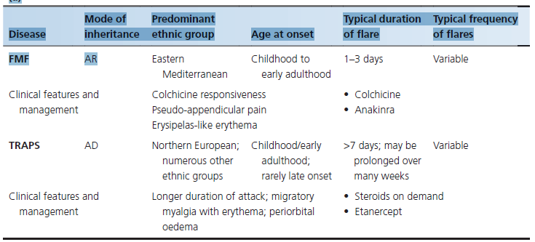

Slide 10
HIDS
MVK gene mutation
Cholesterol & isoprenoids biosynthesis
Depletion of long chain fatty acids
Partial: fever & hyper IGD
Complete : fever & aciduria ( severe )
3-7 fever , chills, headache, polyarthralgia , abd pain with diarhoea & B/L cervical tender lymphadenopathy.
Axillary or inguinal lymph nodes and spleen(less freq) enlarged
Diagnosis : mevalonic aciduria during flares

Slide 11
Cont …
Immunization, surgery, trauma & stress
Inc IgD & IgA levels
Severity of flares decreases with age
Skin findings in 2/3rd pts
Intermittent & painful erythematous macules, maculo papular rashes ( morbiliform) , urticaria, purpura & erythema nodosum
PIH
Aphthous ulcers in 50% & telengectasias in only 2 pts
Amyloidosis , macrophage activation syndrome & angiomyolipoma

Slide 12
TRAPS
Tumor necrosis factor ass
AD
TNF induced NF KB pathway & IL 1 beta
Deep perivascular monocytic infilterates &
CD68+ histiocytes & CD3+ lymphocytes

Slide 13
CAPS
IL 1 mediated overlapping entities
Familial cold autoinflmatory synd ( least severe)
Muckle wells syndrome ( moderate)
Chronic infantile neurological & articular syndrome( most severe)
AD
Inflammasome (cytosolic protein family) death domain protein
neutrophilic intravascular, perivascular, peri‐eccrine and interstitial infiltrate

Slide 14
CONT…
Episodes of pyrexia lasting 1–3 weeks (mean 13 days)
Abdominal or chest pain, myalgia, arthralgia, conjunctivitis & periorbital oedema
Macules & papules coalesce over an area of local muscle tenderness
Usually 1 anatomical area at 1 time
Echymoses after resolution of attack

Slide 15
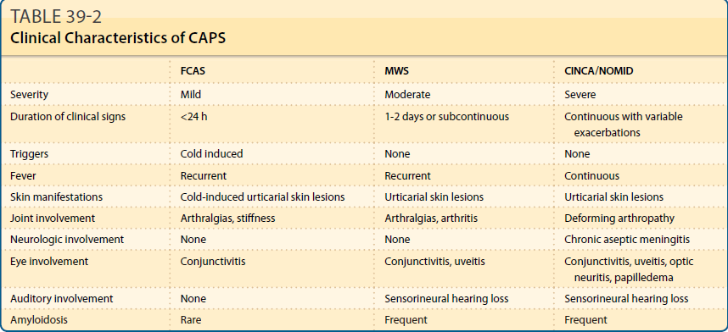

Slide 16
MWS

Slide 18
SCHNITZLER SYNDROME :
Strong clinicopathological similarities with CAPS.
High spontaneous and lipopolysaccharide‐induced IL‐1 release from peripheral blood mononuclear cells of affected patients.
Dramatic and immediate responsiveness to IL‐1 inhibitors.
50 yrs & older pts
Non pruritic , urticated macules
Trunk , brown hyperpigmentation
Immunoelectrophoresis

Slide 19
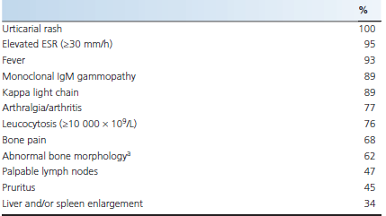

Slide 20
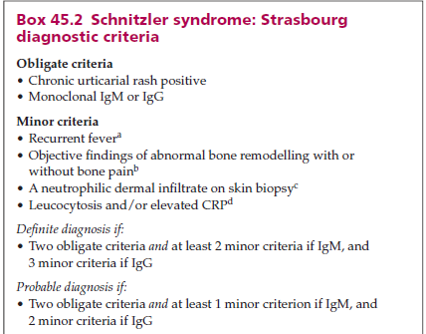

Slide 21
Schnitzler syndrome

Slide 22
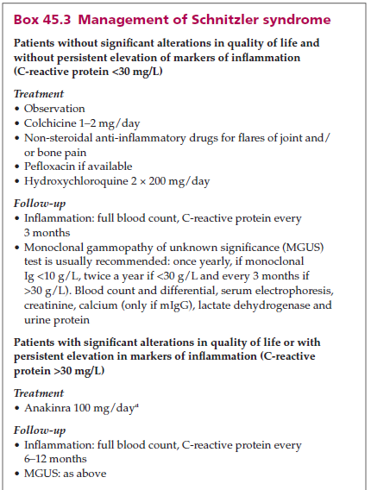

Slide 23
BLAU SYNDROME :
Early‐onset (>4 yrs) chronic granulomatous arthritis, uveitis and rash
Early onset sarcoidosis
AD & NOD 2 gene mutations
Inheritance from mother to child
NF KB , IL 6 , IL 1 beta
Peripheral arthritis , mostly tenosynovitis
Uveitis in 80% of cases
discrete skin‐coloured or slightly yellowish to red‐brown coloured papule measuring 1–5 mm … widespread eruption

Slide 24
Cont …
Grouped or confluent
Face < extremities < trunk
Fade & leave atrophic pitted scars ( follicular atrophoderma)
Histo :
non‐caseating granulomatous dermal inflammatory infiltrate
Ichthyosiform skin changes
Erythema nodosum
Leucocytoclastic vasculitis

Slide 25
Notes:
Blau syndrome (BS)/early-onset sarcoidosis (EOS). A, Generalized orange-brownish asymptomatic
lichenoid papules at the age of 12 months. (From Stoevesandt J, Morbach H, Martin TM, et al. Sporadic Blau syndrome
with onset of widespread granulomatous dermatitis in the newborn period.B,A noncaseating epithelioid
granulomas in the dermis accompanied by some multinucleated giant cells.C, The characteristic polyarthritis involves a thick
granulomatous intraarticular synovitis and tenosynovitis, causing a boggy appearance in fingers and wrists.Preferentially inflamed tendon sheaths in the swollen but not tender joints

Slide 26
Deficiency of the IL-1 receptor antagonist
(DIRA)
fever, aseptic pustular dermatitis,
multifocal osteomyelitis and periostitis.
Grouped pustules appear on an erythematous base in the newborn or within the first 3 weeks > yellowish crusts
Localized or generalized
Scalp involvement , PG.
Onychomycosis
Diffuse erythema wd desquamation
Oral mucosa

Slide 27
clinical and radiological findings
(widened ribs and clavicles, osteolytic lesions of the long bones)
autosomal recessive loss of function mutation in
the IL‐1RN gene

Slide 28
Chronic atypical neutrophilic dermatosis with lipodystrophy and elevated temperature
PMSB8 mutation
JMP syndrome (joint contractures, muscle atrophy, microcytic anaemia & panniculitis‐induced childhood‐onset lipodystrophy )
foci of interstitial collagen degeneration
Immature neutrophils
Eosinophils
violaceous or erythematous, often annular and oedematous plaques on the face and trunk and over the interphalangeal joints
Leave purpura or pigmentation

Slide 29
Cont …
Rash , recurrent fever , arthralgia or arthritis
Persistent voilaceous erythema & peri orbital edema
Panniculitis
Lipoatrophy
Thickened lips, hypertrichosis,mouth ulcers and muscle atrophy. Lymphadenopathy , hepatomegaly , splenomegaly , LFTS raised
Chondritis , episcleritis
50% die before adulthood
Cardiomyopathy ( dilated) , arrhythmias , muscle atrophy

Slide 30
Majeed syndrome :
Chronic recurrent multifocal osteomyelitis
Dyserythropoietic anaemia
Neutrophilic dermatosis resembling Sweet syndrome
AR

Slide 31
Synovitis, acne, pustulosis, hyperostosis,
and osteitis (SAPHO) syndrome.

Slide 32
Other disorders presenting with autoinflamation
Behcet disease
Crohn disease
Relapsing polychondritis
Neutrophilic dermatoses
Rare variants of psoriasis such as DITRA (deficiency of IL‐36 receptor antagonist) or CAMPS ( CARD14 ‐mediated pustular psoriasis) are

Slide 34
A&B ,Circinate erythema, accompanied by miliary pustules on trunk,
C and D,generalized pustular psoriasis, which developed in 2 months after the appearance of circinate erythema, accompanied
by a high fever, edema, pustules, and yellow-green lakes of pus.
E, Histopathologic examination showing spongiform pustules of Kogoj

Slide 36
CARD14-mediated pustular psoriasis (CAMPS)/
psoriasis 2 (PSORS2)
A and B, Generalized pustular psoriasis.
C, Extensive plaque-type psoriasis. D,E Mild plaque-type
Psoriasis

Slide 37
