Slide 1
SKIN DISEASES DUE TO ARTHROPODS

Slide 2
SCABIES
Scabies is an ectoparasitic infection caused by Sarcoptes scabiei
Approximately 40–50 eggs are laid by each female during a lifespan of 4–6 weeks
Eggs hatch after 3–4 days into larvae; the larvae mature into adult mites in about 4 days
The adults may then either stay in that host or be scratched off and transmitted to a new host
The average number of adult female mites on an individual suffering from the common form of scabies is about 12
Only in crusted scabies are large numbers of mites present

Slide 3
SCABIES
The mites show a preference for certain sites in which to burrow, and appear to avoid areas with a high density of pilosebaceous follicles, usually sparing face in adults
Typical locations of lesions are the finger webs, flexor surfaces of the wrists, elbows, buttocks, genitalia and breasts of women
Scabies is usually transmitted by close physical contact, such as prolonged hand‐holding or the sharing of a bed
Away from the host, scabies mites survive for 24–36 h at room conditions (21°C and 40–80% relative humidity)

Slide 4
SCABIES
The onset occurs 3–4 weeks after the infection is acquired. Reinfection of a previously cured individual, may provoke immediate symptoms, generally within 02 days
The typical lesions of scabies are burrows
Identification of a burrow can be facilitated by rubbing a black felt-tip marker across an affected area. After the excess ink is wiped away with an alcohol pad, the burrow appears darker than the surrounding skin because of ink accumulation in the burrow

Slide 5
SCABIES
Allergic sensitivity to mite or its products leads to development of lesions other than burrows, and in producing pruritus
Inflammatory pruritic papules or nodules, sometimes surmounted by burrows, on genitalia are characteristic
Nodules are intensely itchy, and may persist for weeks or months after the scabies has been effectively treated
Secondary lesions are not specific; they include excoriations, eczematization and impetiginization, and may occur anywhere

Slide 6
SCABIES
The clinical features of scabies in infants and young children differ in certain respects from those in older children & adults
In addition to the more extensive distribution of burrows, vesicular and vesiculopustular lesions on the hands and feet are frequent, extensive eczematization is often present, and there may be multiple crusted nodules on the trunk and limbs
In the elderly, burrows commonly occur on the palms and soles
Truncal papulosquamous lesions, often surmounted by burrows, are common

Slide 7
SCABIES
Scabies is treated by combination of a scabicide & fomite control
With all insecticidal therapies, a second application, usually a week after the initial treatment, is required to reduce the potential for reinfestation from fomites as well as to kill any nymphs that may have hatched after treatment as a result of a semiprotective environment within the egg
All household and close contacts must be simultaneously treated to prevent reinfestation from asymptomatic carriers

Slide 8
SCABIES
Topical treatment must be applied to the entire skin surface, below neck, including all folds, groin, navel and external genitalia, as well as the skin under the nails
Treating the face of babies is essential because transmission may occur by breastfeeding
Hands should not be washed during therapy, otherwise the treatment should be reapplied
All clothes and bedding must be washed at high temperature (>50°C) or must be kept in a plastic bag for up to 72 h

Slide 9
SCABIES
Topical treatment includes 5% permethrin, 1% lindane, 25% benzyl benzoate, crotamiton and 10% sulphur
Topical scabicides have neurotoxic effects on mites
Oral ivermectin interrupts the γ‐aminobutyric acid induced neurotransmission of many parasites including mites. It is given at 200 μg/kg as a single dose in patients >2 years of age and >15 kg. A second dose is necessary 7–14 days later due to the lack of ovicidal action of the drug
As ingestion of food increases the bioavailability of ivermectin by a factor of 2, taking it with food might enhance the penetration of the drug into the epidermis

Slide 10
SCABIES
Most treated individuals experience relief from symptoms within 3 days, but patients must be informed that even after adequate scabicidal therapy, the rash and pruritus may persist for up to 4 weeks
The itching experienced during this time period is commonly referred to as “post-scabetic itch”

Slide 11
SCABIES
If itching persists after treatment, following may be considered
Post scabetic itch
Overtreatment leading to cutaneous irritation, eczematization, contact dermatitis
Treatment failure
Poor compliance
Inappropriate or insufficient treatment leading to resistance to scabicide, reinfestation or relapse
Psychogenic pruritus, Delusions of parasitosis
Non‐parasitic dermatosis

Slide 12
SCABIES
In common scabies, there are few mites, probably because scratching destroys the burrows
Crusted scabies occurs in people with an inadequate immune response to the mite, patients who are mentally retarded or suffer from dementia, patients who are immunosuppressed, either as a result of disease or therapy
Crusted scabies has also resulted from the use of topical steroids and pimecrolimus
Crusted scabies sometimes occurs in otherwise healthy individuals with no identifiable risk factors

Slide 13
SCABIES
Large warty crusts form on the hands and feet and the palms and soles may be irregularly thickened and fissured
The nail apparatus is frequently affected, with masses of horny debris accumulating beneath thickened and discoloured nails
Erythema and scaling occur on the face, neck, scalp and trunk, and may generalize; Crusted scabies may be localized, affecting only the scalp, face, fingers, toenails or soles
Itching is often absent or slight, but may occasionally be severe
Crusted scabies may masquerade as hyperkeratotic eczema, psoriasis, Darier disease, contact dermatitis and LCH
The diagnosis is readily confirmed by examination of scrapings, which will be teeming with mites and eggs

Slide 14
SCABIES
Hospitalization and isolation of the patient are required to manage crusted scabies because of the risk of transmission to people in physical contact
A keratolytic agent such as a salicylic acid preparation should be used to treat hyperkeratosis
Nails should be cut short and brushed with a scabicidal agent
Combining topical and oral therapy is recommended
Topical scabicide application should be repeated until two parasitological tests 3 days apart become negative
The administration schedule of ivermectin should be based on the severity of infection; 3-7 doses have been proposed

Slide 15
DEMODEX MITES
Only Scabies and Demodex mites live in the skin, most other mites drop off human host after feeding
Demodex folliculorum and Demodex brevis reside in the hair follicle and the infundibulum of seb gland, respectively
Follicle mites show a predilection for seborrhoeic areas
They are most numerous on the forehead, cheeks, nose and nasolabial folds, but they are also found on the scalp, in the external ear, in eyelash follicles and meibomian glands, and on the upper chest and nipples. They have also been discovered on the penis, mons veneris, buttocks and in ectopic sebaceous glands in the buccal mucosa

Slide 16
DEMODEX MITES
Demodex folliculorum assumes a head‐down position in the follicle, often with the tip of the abdomen protruding from the follicular orifice
Follicle mites are quite motile, and migrate from follicle to follicle
Most infested follicles contain two to six mites, but occasionally they are much more numerous
The lifespan of Demodex folliculorum is thought to be approx 2 weeks. The heart‐shaped eggs hatch to produce hexapod larvae, and the eight‐legged adults develop via two nymphal stages

Slide 17
DEMODEX MITES
The prevalence of both Demodex folliculorum and Demodex brevis increases with age
The skin surface biopsy technique is a useful method of assessing population density & distribution of Demodex mites
New imaging techniques such as high‐definition optical coherence tomography or confocal laser scanning microscopy may be helpful for the in vivo detection of Demodex mites
It enables fast and noninvasive recognition of Demodex mites and might become a useful tool in the diagnosis and treatment monitoring of Demodex‐related skin diseases

Slide 18
DEMODEX MITES
Demodex folliculorum has been associated with Pityriasis folliculorum, occurring predominantly in middle‐aged or older women who rarely washed their faces, but used large quantities of make‐up and cleansing creams. It is characterized by diffuse facial erythema, follicular plugs and vesiculopustules, which impart a ‘nutmeg grater’ appearance to the skin
Rosacea
Perioral dermatitis
Blepharitis

Slide 19
HOUSE-DUST MITE
Dermatophagoides pteronyssinus, the house‐dust mite, is widely distributed in the human environment in house dust and beds
The largest numbers of mites are found in houses that are damp and inadequately heated
The main food of D. pteronyssinus is human skin scales
Xerophylic moulds, especially Aspergillus penicilloides, are essential for the growth and survival of D. pteronyssinus
The moulds digest lipid in the scales which is toxic to the mites
The major house‐dust mite allergens (Der p1 and Der f1) are present in the faecal pellets of the mite

Slide 20
HOUSE-DUST MITE
The role of the house‐dust mite in the pathogenesis of atopic eczema remains controversial; The mites that most frequently induce atopic eczema are D. pteronyssinus and D. farinae
Measures employed to reduce the house‐dust mite allergen load include regular vacuum cleaning of carpets, or their removal, bedding covers made of material such as microporous Goretex and the use of acaricides, including benzyl benzoate and permethrin

Slide 21
LICE (PHTHIRAPTERA)
Humans are parasitized by two species of suborder Anoplura: 1. Pediculus humanus, Pediculus humanus capitis (the head louse) Pediculus humanus humanus (the clothing or body louse) Head lice and clothing lice are morphologically and biologically similar but have distinct territories
2. Pthirus pubis, the pubic or crab louse

Slide 22
PEDICULUS HUMANUS CAPITIS
The entire life cycle of head lice is on the scalp
During its lifespan of approximately 40 days, the female lays an average of about seven eggs daily
The eggs are laid about 1 cm from the scalp surface, firmly attached to individual hairs
Eggs hatch in 8-10 days and, following three moults, nymph or instar reaches maturity in approx 10 days. Instars look like miniature adult louse and take 14 days for full maturation
Once the louse has emerged, the empty egg case or ‘nit’ appears white, and is easier to see than the intact eggs close to the scalp surface

Slide 23
PEDICULUS HUMANUS CAPITIS
Lice typically survive less than 2 days away from the scalp, although under favorable conditions of heat and humidity, survival has been reported at 4 days
Nits can survive for 10 days away from the scalp

Slide 24
PEDICULUS HUMANUS CAPITIS
Although many individuals are asymptomatic, scalp pruritus is the characteristic manifestation of head louse infection
Secondary bacterial infection may occur because of scratching
Pruritic papular lesions may occur on the nape of the neck
In severe neglected cases, pus and exudate may produce matting of the hair – ‘plica polonica’
The empty egg cases (nits) occur in greatest density on the parietal and occipital regions
On naked eye inspection, nits may be confused with peripilar keratin casts (‘pseudonits’; hair muffs) or dried globules of cheap hair lacquer

Slide 25
PEDICULUS HUMANUS CAPITIS
Pyrethrins: mixture of 06 chemicals toxic to insects
Permethrin 5%, topically overnight
Malathion 0.5%, topically overnight
Carbaryl 0.5%, topically overnight
Lindane 1%, topically overnight
Ivermectin, oral 200 μg/kg orally on days 1, 8, and 15. Very good efficacy on adult lice; not ovicidal; not recommended for pregnant females or children weighing less than 15 kg
With increasing resistance to pediculocides, a multimodal approach is warranted to prevent widespread resistance to currently available products

Slide 26
PEDICULUS HUMANUS CAPITIS
To accurately evaluate pediculicidal activity of any compound, one must appreciate that head lice have the ability to “resurrect” from a state of seeming death, in which respiratory and motor function appear to have ceased. These insects are less dependent than mammals for continuous nervous control of respiration and circulation, and the exact point of death is not readily defined
World Health Organization recommends pediculicidal testing to be read 24 hours after application of insecticide since otherwise mortality rates are overestimated

Slide 27
PEDICULUS HUMANUS HUMANUS
Body lice/clothing lice are associated with poor socioeconomic conditions; infestation occurs only when clothes are not changed or washed regularly
Several important human diseases are transmitted by the body louse. The major diseases include: Epidemic typhus (caused by a Rickettsia prowazekii), Murine typhus (caused by Rickettsia typhi) Trench fever (caused by Bartonella quintana), Relapsing fever (caused by a spirochete, Borrelia recurrentis)

Slide 28
PEDICULUS HUMANUS HUMANUS
Lice obtain organisms, such as rickettsiae and spirochetes, from ingestion of blood meals from infested hosts
Transmission of microorganisms from body lice is not from the louse bite, but rather by: contaminated fecal material being scratched into excoriated skin of bite sites, inhalation of dry, powdery louse feces from handling typhus-contamined bedding or clothing, or infected lice having its gut ruptured, allowing an infective blood meal to enter excoriations on the skin
In addition, excoriation can lead to secondary infection with S. aureus, S. pyogenes, and other bacteria

Slide 29
PEDICULUS HUMANUS HUMANUS
This louse is almost identical in appearance to the head louse, except that it is usually slightly larger (approx 30% larger)
Its natural habitat is the clothing of its host, and it only visits the skin to feed
The body louse’s lifespan is 20 days during which the female may lay up to 300 eggs. The lice lay their eggs in the seams of clothing
The body louse can survive without a blood meal for up to 3 days
The clothing louse and its eggs will not survive high temperature washing and ironing

Slide 30
PEDICULUS HUMANUS HUMANUS
In most infected persons, itching is the principal complaint. Pruritus is the result of sensitization to louse salivary antigens. Others, who have not become sensitized or have acquired tolerance to the bites, are asymptomatic
The body is often covered in excoriations, and there may be secondary bacterial infection
In those who have harboured clothing lice for long periods of time, the skin is often hyperpigmented (so‐called ‘vagabonds’ disease’; morbus errorum), and this is probably a post‐inflammatory phenomenon
Lice and eggs should be sought in the clothing

Slide 31
PEDICULUS HUMANUS HUMANUS
The most important treatment of body lice is disinfestation of all clothing and bedding, because the body louse may lay eggs on the seams of the mattress or couch
Clothing is best treated like bio-hazardous waste, bagged & tightly sealed in specially marked, plastic, bio-hazard bags
Hot ironing of the seams of upholstered furniture should also be performed and exposure to infested items should be strictly avoided for 2 weeks
The patient should be treated from head to toe with a topical insecticide or given oral ivermectin

Slide 32
PTHIRIASIS PUBIS (CRAB LICE)
Crab lice are transmitted by close physical contact, usually sexual, as well as via fomites
The crab louse is quite distinctive in appearance and habits from Pediculus
Crab louse will colonize axillary hair, eyebrows, eyelashes, beard hair and hair on the trunk and limbs, in addition to pubic hair. Scalp hair, except at the margins, is too dense
It is mainly sedentary, but becomes active at night. It moves by transferring its grip from one hair to another
The crab louse has difficulty moving when taken from its host, whereas head and clothing lice are quite mobile off the host

Slide 33
PTHIRIASIS PUBIS (CRAB LICE)
The louse has a lifespan of less than 3 weeks during which time the female will lay about 25 eggs on human hairs. The adult crab louse can survive for 36 hours off the human host, while the eggs are viable for up to 10 days
Itching, mainly at night, is the principal symptom
Slate grey to blue irregular shaped macules, about 1 cm in diameter (maculae caeruleae) representing hemorrhage, can be occasionally seen
Bullous lesions attributed to crab lice have also been reported

Slide 34
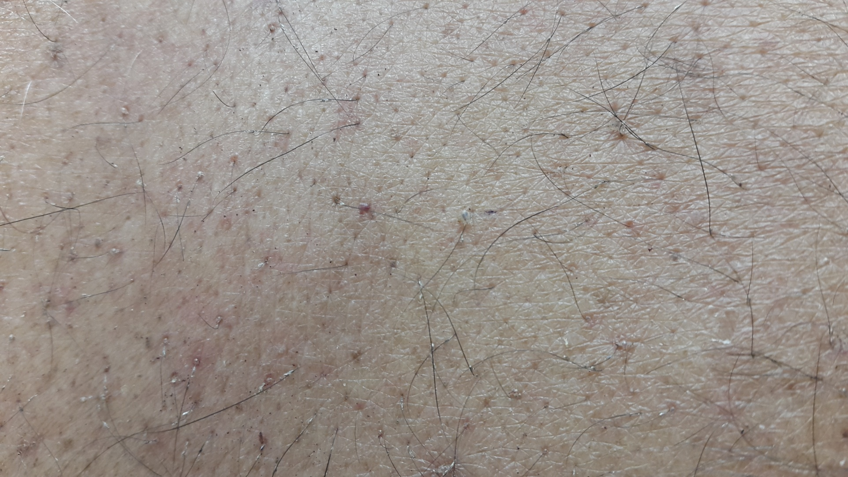
PTHIRIASIS PUBIS (CRAB LICE)

Slide 35
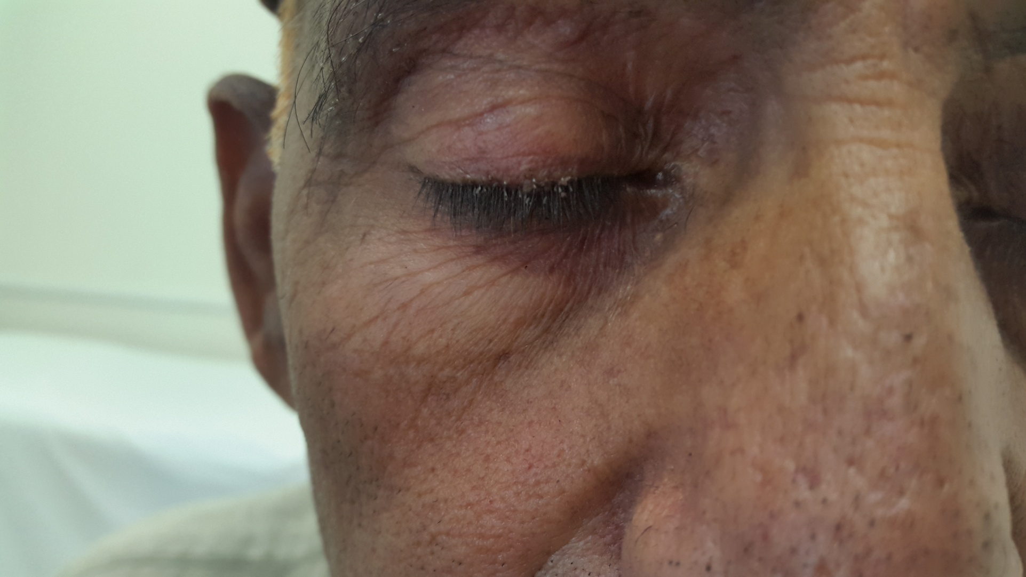
PTHIRIASIS PUBIS (CRAB LICE)

Slide 36
PTHIRIASIS PUBIS (CRAB LICE)
Pubic lice are treated with the same insecticidal creams or lotions as pediculosis capitis, with a second application after 7–10 days as the products have a poor ovicidal activity. All hairy areas of the body should be treated at the same time
Shaving is sometimes necessary when nits are plentiful
Infestations of the eyelashes should be treated with permethrin 5% cream (washed off after 10 min) or only with petrolatum (applied twice a day for 8–10 days), followed by mechanical removal of the nits. Oral ivermectin has also been used
Sexual contacts should be examined and treated if necessary
Bedding and clothes should be washed in hot water (50°C)

Slide 37
PTHIRIASIS PUBIS (CRAB LICE)
Shaving is not curative as the louse will seek another hairy area of the body to reside
Unless the physician is certain that only one body area is involved, all hairy areas of the body should be treated, as: (1) it is not uncommon to have other areas infested, and (2) lice can migrate away from a treated areas to other hair- bearing locations
For this reason, oral ivermectin is recommended; however, as ivermectin treatment relies on the insect obtaining a blood meal, so the nits are not affected and the patient requires repeat oral ivermectin on day 8 and day 15

