Slide 1
Arteriovenous disorders
Dr Hamna Hafeez

Slide 2
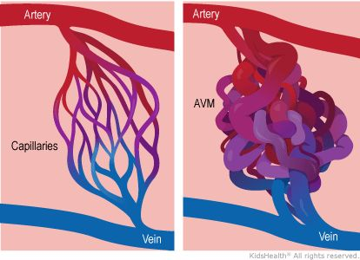
Arteriovenous malformation
. AVM is characterized by the presence of a “nidus,” the epicenter of the lesion that is composed of direct communications between multiple feeding arteries and draining veins without an intervening normal capillary bed
Congenital, fast-slow malformations that can be occult until puberty
Most difficult vascular malformation to treat; need a multidisciplinary approach

Slide 3
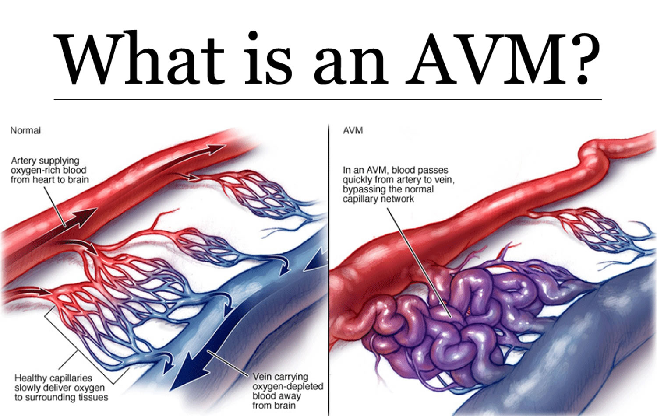

Slide 4
Pathophysiology
Arteriovenous malformations consist of distorted arteries, and veins with thickened muscle walls due to arteriovenous shunting and fibrosis .
In AVM, the normal capillary bed is replaced by a nidus, via which blood shunts from feeding arteries into draining veins.
An arteriovenous fistula consists of a direct communication between an artery and a vein.
They are less frequent than AVMs, and usually post‐traumatic.
The origin of AVM is unknown. It is usually sporadic, but an underlying predisposing genetic defect exists when it is part of CM‐AVM, HHT or PTHS.

Slide 5
Clinical features
Arteriovenous malformations are localized, affecting the brain, skin, muscles, bone or viscera.
AVMs usually manifest as cutaneous, faint, red to purple, ill-defined masses with a thrill, a bruit, or a pulsation of increased amplitude
About one third of AVMs are present at birth, another –third appear during childhood or at puberty, and the rest manifest in adulthood because hormonal changes and trauma usually trigger the growth of an AVM.

Slide 6
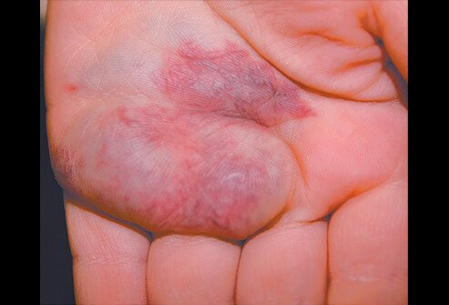

Slide 7
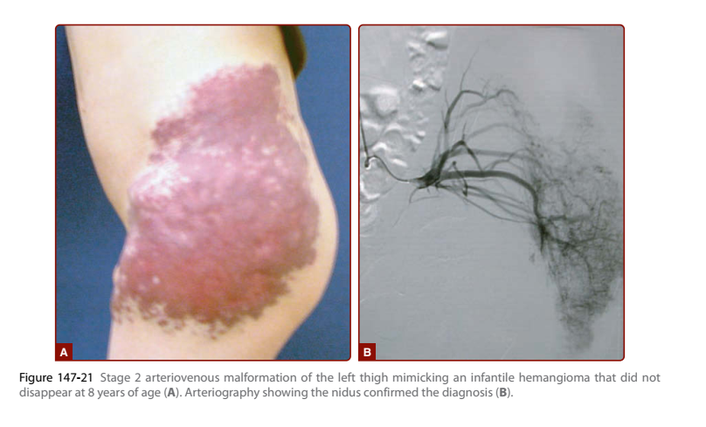

Slide 8
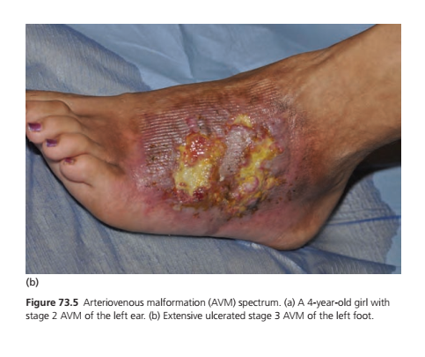
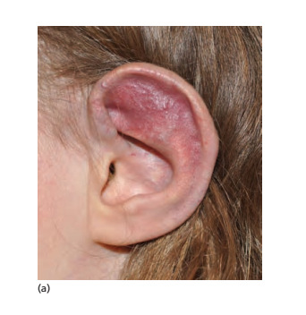
Clinical features
Can appear as a capillary blush misdiagnosed as CM

Slide 9
Cont.
hydrocephaly, headache, epilepsy, haemorrhage and focal neurological deficit in intracranial lesions;
cyanosis, clubbing, polycythaemia and right‐to‐left shunt with cerebral abscess
and embolic stroke in pulmonary lesions;
cardiac failure, portal hypertension and biliary disease in hepatic lesions;
and heaviness, pain, pulsatile mass, thrill, trophic changes (deformation,
ulceration, destruction) and bleeding in cutaneous, subcutaneous and muscular lesions.

Slide 10
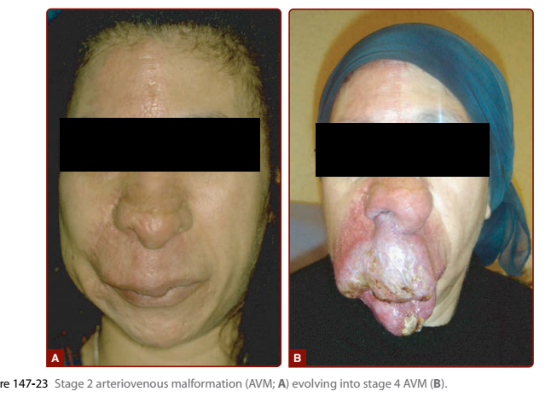

Slide 11
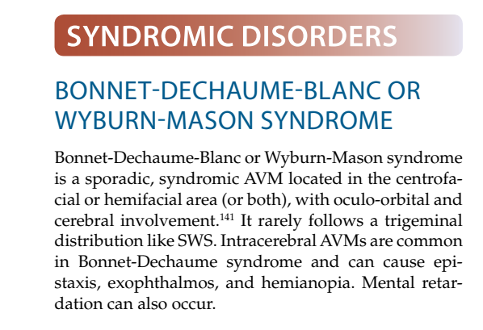
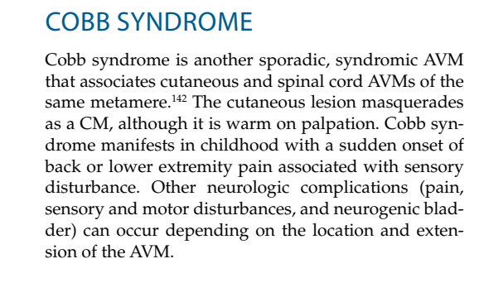
.

Slide 12
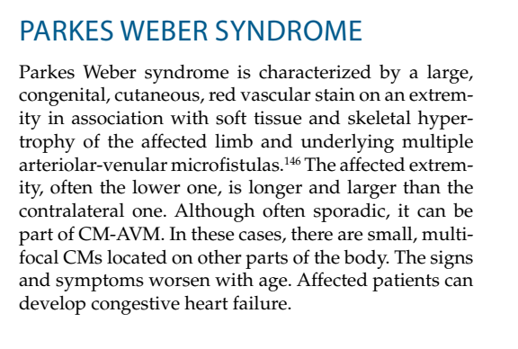
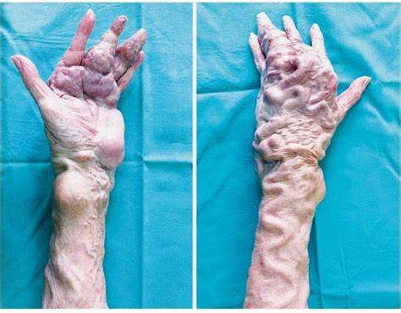
.

Slide 13
Investigations
Pathology: Histologically, AVMs are poorly demarcated and consist of distorted arteries and veins with thickened muscle walls caused by arteriovenous shunting and fibrosis
Imaging : USG, color doppler, MRI, arteriography
Genetic testing

Slide 14
Management
Therapeutic attitude depends on lesion type, location and symptoms. Evaluation should be made by a multidisciplinary team,
It varies from conservative follow‐up to aggressive treatment consisting of embolization and/or surgical resection.
Conservative treatment includes antihypertensive medications, pain killers, elastic stockings and wound management.

Slide 15
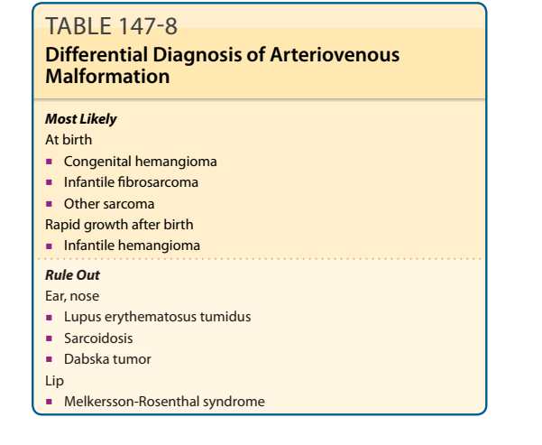

Slide 16
Hereditary hemorrhagic telengectasia
Synonyms and inclusions : Rendu–Osler–Weber syndrome
Hereditary haemorrhagic telangiectasia is an autosomal dominant disorder characterized by mucocutaneous and gastrointestinal telangiectasias
, associated with AVMs/AVFs in the lungs, liver or brain

Slide 17
Cont
Ultrastructurally, the telangiectasias of HHT are micro‐AVFs
Histological analysis of a cerebral and a pulmonary AVM in two HHT1 patients showed vessel dilatation, and variable thickness and disorganization of the smooth muscle cell layer

Slide 18
Genetics
At least six genes are involved: four identified (ENG, ACVRL1,
SMAD4, GDF2) and two localized (HHT3 on chromosome 5q31.3‐q32,
and HHT4 on chromosome 7p14) [58–64].
More than 80% of HHT patients have mutations in ENG, ACVRL1 or SMAD4 (61%, 37% and 2%, respectively)

Slide 19
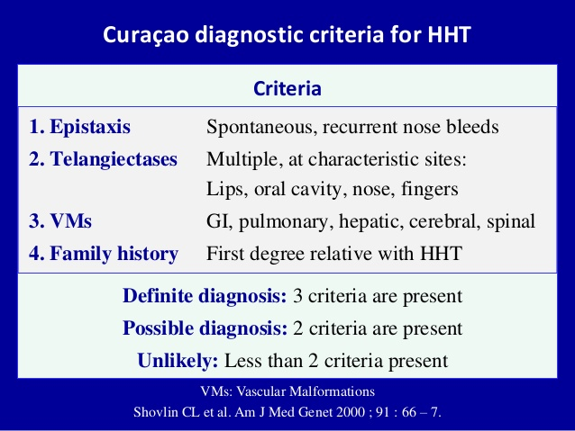

Slide 20
.
patients with ACVRL1 mutations are characterized by later onset, lower penetrance, less frequent cerebral and pulmonary AVMs,more frequent liver involvement and a risk of developing pulmonary arterial hypertension.
Patients with mutations in SMAD4 have HHT combined with juvenile polyposis. The HHT phenotype in these patients is similar to those caused by mutations in ENG or ACVRL1

Slide 21
Investigations
Contrast echocardiography is indicated . Cerebral MRI, thoracic computed tomography (CT) scan and hepatic
Doppler ultrasound should be performed to screen for asymptomatic AVMs in children and young adults, as they are at higher risk for haemorrhage than the general population
Genetic consultation is needed to assess family history and to perform genetic testing.
Blood haemoglobin and haematocrit be measured annually.

Slide 22
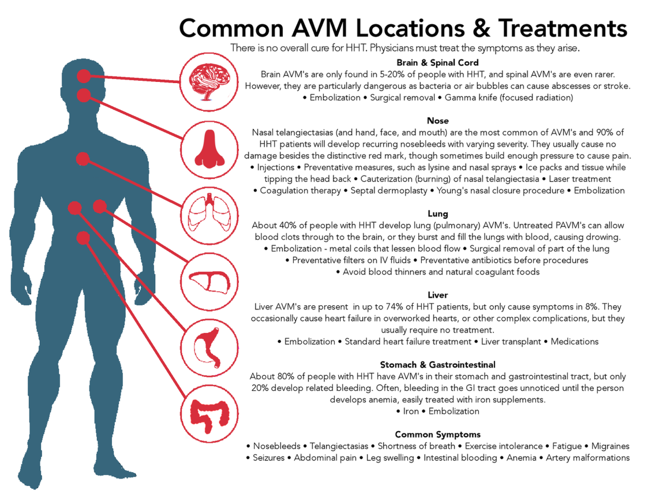

Slide 23
PTEN hamartoma tumor syndrome
PTEN hamartoma tumour syndrome is an autosomal dominant disorder that regroups patients with Bannayan–Riley–Ruvalcaba syndrome (BRRS) and Cowden syndrome.

Slide 24
Features
Most vascular anomalies (86%) in PHTS patients are fast-flowing
The extracranial ones are in general intramuscular or subcutaneous, associated with ectopic fat, disrupted architecture and
severe and progressive enlargement of affected muscles.
In addition to swelling, patients can have pain and a cutaneous capillary stain

Slide 25
Features of cowden
These patients often have
macrocephaly,
facial trichilemmomas,
papillomatous papules,
acral keratoses,
benign thyroid disease,
lipomatous masses,
multiple hamartomas with an increased risk for benign and malignant tumours (such as thyroid, breast and endometrial cancer), and
Vascular anomalies

Slide 26
Features of BRSS
BRRS is characterized by macrocephaly,
variable degrees of developmental delay,
hamartomatous intestinal polyposis,
lipomas and
pigmented macules of the glans penis

Slide 27
Pathophysiology
Heterozygous PTEN mutations are identified in approximately 60% of BRRS and 81% of Cowden syndrome patients
Mutations cause a Loss of function effect

Slide 28
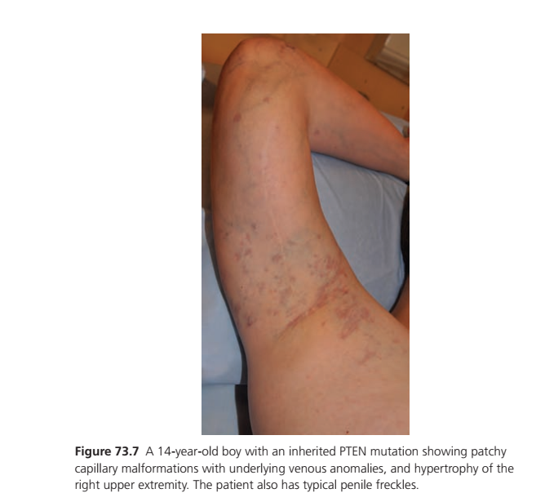

Slide 29
Investigations
Family History
Genetic testing
Thyroid and breast ultrasonic examination should be done to rule out cancer repeated yearly.
Moreover, women older than 30 years of age should have breast mammography yearly.
Colo‐rectal cancer surveillance by colonoscopy should be started at age 35
Radiological investigations of PHTS vascular lesions include Doppler ultrasound, T2‐weighted MRI and magnetic resonance angiography (MRA)

Slide 30
Management
The papillomatous papules are treated when symptomatic with topical agents, curettage, cryosurgery, laser or surgery.
Treatment of PHTS fast‐flow lesions is similar to that of sporadic AVMs.
Rapamycin seems effective in clinical trials .
Genetic counselling is needed

Slide 31


