Slide 1


Slide 2
Approach to a patient with pruritus
Dr.Ayesha Batool
PGR Dermatology
LGH, Lahore

Slide 3
Contents
Pruritus
Pathway of itch
Neurotransmitters
How to approach to a patient with pruritus

Slide 4
Pruritus – Definition
“A subjective, unpleasant sensation leading to the desire to scratch.”

Slide 5
Introduction
Radcliffe Crocker , 1893.
A dominant symptom of skin diseases & can also occur in many systemic diseases
Socially disturbing
Impairment in quality of life.

Slide 6
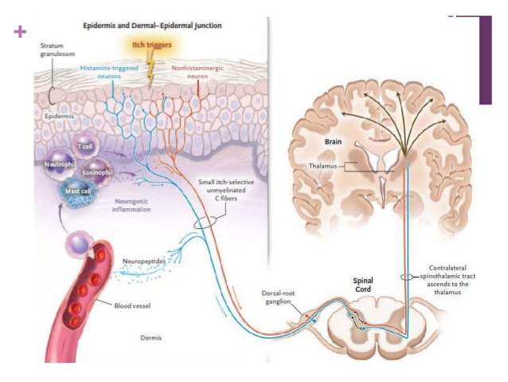

Slide 7
Chemical mediators of itch
Acetylcholine
Histamine
IL-31
Endothelin-1
Serotinin
Neurotrophin Growth Factor
Endorphins
Dynorphin
Tryptase
Substance P
Thromboxane A2

Slide 8
How to approach a patient with pruritus

Slide 9
Causes of itch
Dermatological Diseases:
Atopic eczema
Allergic contact dermatitis
Urticaria
Scabies
Pediculosis
Folliculitis
Xerosis
Dermatophyte infection
Mastocytosis
Psoriasis
Lichen planus
Dermatitis herpetiformis
Bullous pemphigoid
Systemic sclerosis
Erythroderma
Lichen simplex chronicus
Prurigo nodularis
Pruritic papular eruption in HIV
Sunburn

Slide 10
Systemic Diseases associated with itching:
Metabolic & endocrine diseases
Renal disease
Hematopoietic diseases
Neurological diseases
Infections
Infestations

Slide 11
Contd…
Drug induced pruritus
Psychiatric or Psychosomatic diseases
Pruritus of Pregnancy.

Slide 12
history
Pruritus specific history:
Onset
Localization
Quality
Intensity
Continuous or intermittent
Diurnal variation
Triggering factors, ameliorationg factors
Behavioural response to itch
Previous therapies
Impact on quality of life

Slide 13
Skin Rash – if any :
Onset
Development
Progression
General condition of skin

Slide 14
Hair
Nails
Mucosae

Slide 15
General History:
Previous illnesses including dermatosis
Family or personal Hx of Atopy
Drug Hx, Blood transfusion
Social Hx – household & other contacts
Contact with pets
Occupational Hx, Hobbies
Sexual Hx
Skin contact specially those e febrile disease & rashes
Allergies
Recent travel

Slide 16
Systemic Review:
General Health
Endocrine
Gastrointestinal
Genitourinary
Hematopoietic
Mental status
Pregnancy

Slide 17
Examination
Primary dermatosis
Secondary changes from scratching
Relevant systemic examination

Slide 18
Dermatological diseases

Slide 19
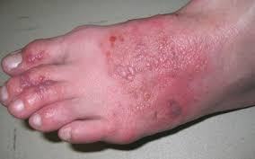
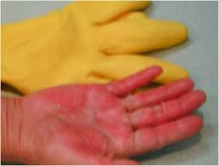
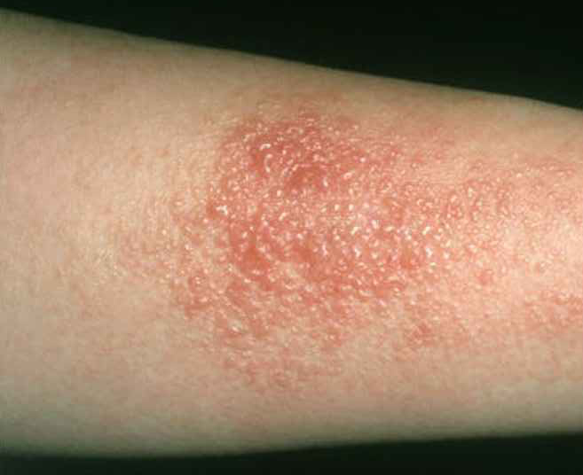
Allergic contact dermatitis

Slide 20
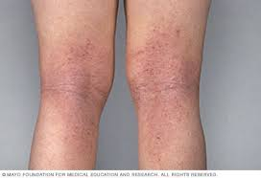
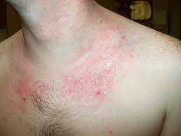
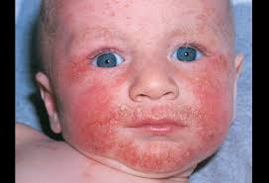
Atopic dermatitis

Slide 21
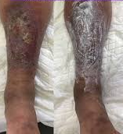
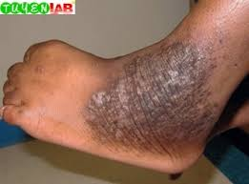
Chronic eczema

Slide 22
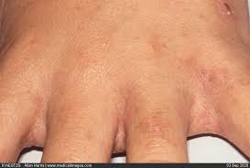
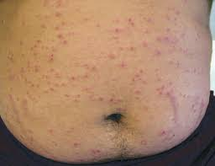
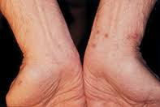
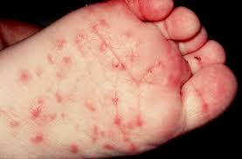
scabies

Slide 23
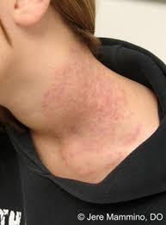
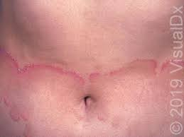
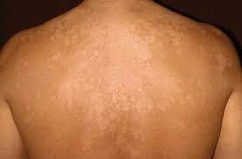
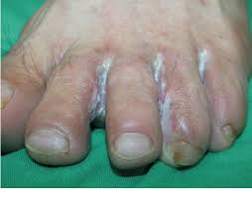
Dermatophyte infection

Slide 24
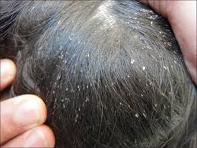
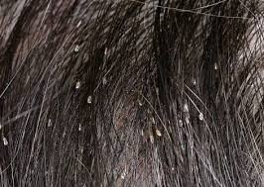

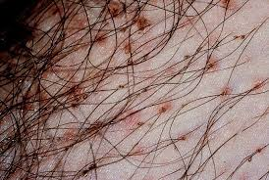
pediculosis

Slide 25
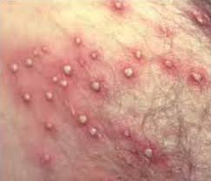
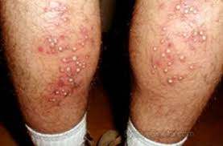
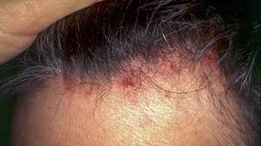
folliculitis

Slide 26
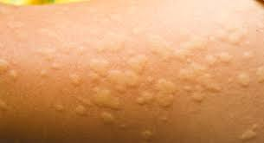
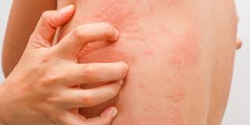
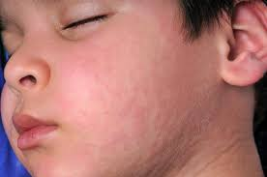
urticaria

Slide 27
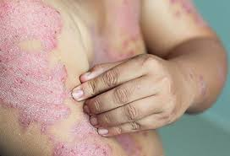
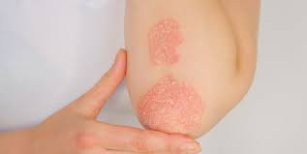
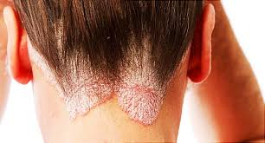
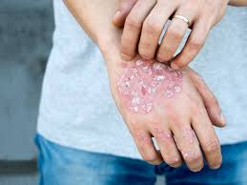
psoriasis

Slide 28
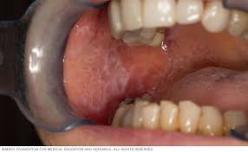
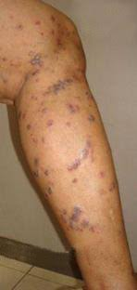
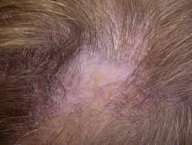
Lichen planus

Slide 29
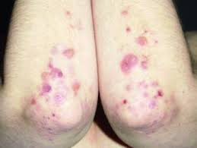
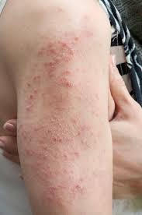
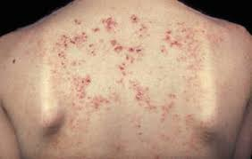
Dermatitis herpetiformis

Slide 30
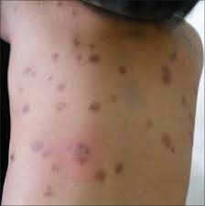
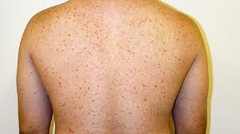
mASTOCYTOSIS

Slide 31
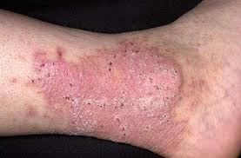
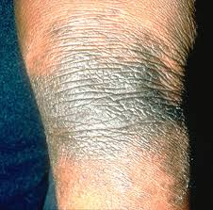
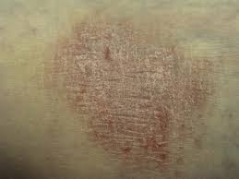
Lichen simplex chronicus

Slide 32
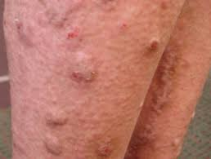
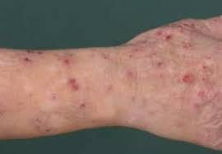
Prurigo nodularis

Slide 33
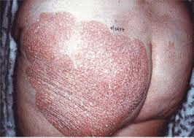
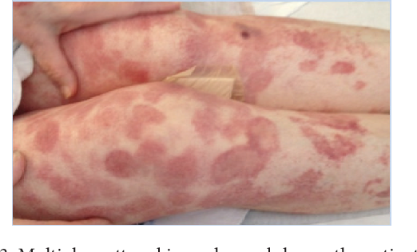
Cutaneous T-cell lymphoma

Slide 34
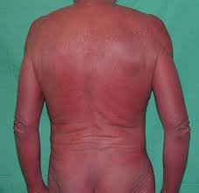
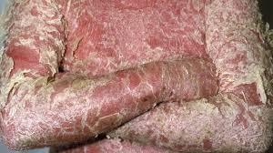
erythroderma

Slide 35
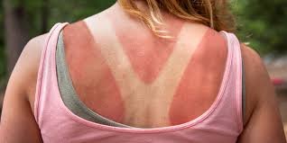
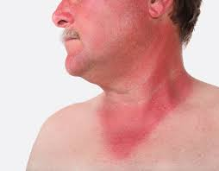
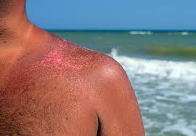
sunburn

Slide 36


xerosis

Slide 37
Pruritus in Systemic illnesses

Slide 38



Renal failure

Slide 39




Cholestasis, chronic liver disease

Slide 40




Thyroid disease

Slide 41
Paraneoplastic pruritus
Premonitory pruritus
Hodgkin disease
Myelodysplastic syndrome
Myelofibrosis
Sezaray syndrome
Examination should be repeated every year.

Slide 42
Contd….
Unilateral pruritus on face – early symptom of brainstem glioma
Pruritus of nose – may be a presenting symptom of cerbral tumor
Abdominal itching – Astrocytoma in neurofibromatosis

Slide 43
Neuropathic pruritUs
Generally associated with pain – Prulalgia
Burning, wet sensation, electric shock or pins & needles.

Slide 44


Notalgia paresthetica

Slide 45
BRACHIORADIAL PRURITUS
Elbow, adjacent lower & upper arms, at the dermatome C5, C6 & may involve shoulder & neck
Females > males, >60yrs.
Pt’s Hx, neurological & orthopedic examination.

Slide 46
pruritus of senescence
Look for subtle skin ds
Xerosis
A manifestation of an underlying systemic ds
A skin manifestation of an adverse drug reaction
Depression, lonliness
Combination of above factors.
Address the underlying cause
Emolients
Paroxetine, Amitryptiline, Mirtazapine at night -- depression

Slide 47




PruritUs in pregnancy
Atopic eruption of pregnancy
Polymorphic eruption of pregnancy
Pustular psoriasis of pregnancy
Pemphigoid gestationis

Slide 48
Psychogenic Pruritus
Diagnosis of exclusion
Anxiety:
Attacks of nocturnal pruritis, associated with a sensation of heat & accompanied by sweating.
Hydroxyzine, Risperidone.
Delusion:
Parasitophobia
Pimozide – a Phenothiazine, Paroxetine, Haloperidol.
Depression:
Amitryptiline, Fluoxetine.

Slide 49
investigations
First Step Screening:
CBC
ESR
Bld Glucose
Bld Urea Nitrogen, Creatinine
LFT’s
Ferritin
Thyroid function tests
Urinalysis
Stool for occult bld if age > 40 yrs
Stool for parasites.

Slide 50
Radiological Investigations:
CXR
USG abdomen

Slide 51
Biopsy
Further Investigations:
Hep B, Hep C
HIV antibodies
ANA
PTH, Calcium
Tryptase
Swab for candida
RA factor
IgE level

Slide 52
Contd…
MRI ( thoracic & cervical spine)
Bone marrow investigations.

Slide 53
Management
General measures:
Avoidance of:
Dry skin – Moisturizers, Emolients
Avoid hot & prolong bathing, frequent washing
Contact with irritant substances
Hot spicy food, alcohol
Strain, stress.

Slide 54
Application of:
Mild-Alkali soaps
Luke warm bath water
Bathing time not exceeding 20 minutes
Soft clothing permeable to air
Moisturizers on a daily basis esp. after showering

Slide 55
Treatment of underlying disease

Slide 56
Guideline to the recommended symptomatic therapy in chronic pruritus:
Step 1:
General measures
Systemic non-sedating antihistamines
Toipcal corticosteroids

Slide 57
Contd…
Step 2:
If origin of chronic pruritus is known –symptomatic causative adaptive therapy
Step 3:
If pruritus of unknown origin or therapy refractory cases in 2nd step:
Symptomatic topical & /or systemic therapy e.g Capsaicin, Calcineurin inhibitors, Naltrexone, Gabapentin, Pregabalin, UV phototherapy, Immunosuppressants (Ciclosporin).

Slide 58
Topical Agents:
Moisturizers
Topical corticosteroids
Topical calcineurin inhibitors
Topical antihistamines
Cooling agents ( Menthol, Phenol 1-2%)
Capsaicin(0.075 – 1%) cream
Topical anaesthetics

Slide 59
Systemic therapy:
1. Antihistamines:
H1 blockers
H2 blockers

Slide 60
Neuroleptics:
Gabapentin, Pregabalin
100mg – 1800mg/day

Slide 61
3. Opiate Agonists & Antagonists:
u –opioid antagonists:
Naltrexone, Naloxone
20mg – 250mg daily orally
Kappa opioid agonists:
Nalfurafine hydrochloride

Slide 62
4. Immunomodulators:
Ciclosporin, Azathioprine
Phototherapy:
UVB radiation alone or combined with UVA

Slide 63
6. Tricyclic antidepressants, SSRI’s:
Amitryptiline, Nortryptiline, Paroxetine
7. Others:
Leukotriene receptor antagonists: Monteleukast, Zafirlukast
Mast cell stabilizers: Cromolyn Sodium
Ondensetron: 5-HT3-receptor antagonist
Aspirin
Disinfecting measures

Slide 64
Behavioural therapy:
Stress reduction techniques.
Habit reversal therapy for scratch behaviour.

Slide 65
Take home message
Diagnosis of the cause is of prime importance in treatment of pruritus.
Needs an individualistic approach.
Pay special attention to specific population – Elderly patients, Pregnant women, Children.

Slide 66


Slide 67


