Slide 1
Allergic contact dermatitis

Slide 2
Definition
ACD, as the name implies, is an adverse cutaneous inflammatory reaction caused by contact with a specific exogenous allergen to which a person was previously sensitized.
Following contact with an allergen, the skin reacts immunologically so that in allergic individuals, such contact produces eczematous inflammation, which can range from a mild, short lived condition to a severe, persistent, chronic disease, depending on the specific allergen and the amount, extent, and frequency of exposure

Slide 3
ACD represents a classic cell-mediated (type IV), delayed hypersensitivity reaction. Type IV hypersensitivity reactions result from exposure and sensitization of a genetically susceptible host to an environmental allergen, followed by subsequent re exposure that triggers a complex inflammatory reaction.
To mount such a reaction, the individual must have sufficient contact with a sensitizing chemical, develop immunologic memory, and then have repeated contact with that substance later to elicit the immune response.

Slide 4
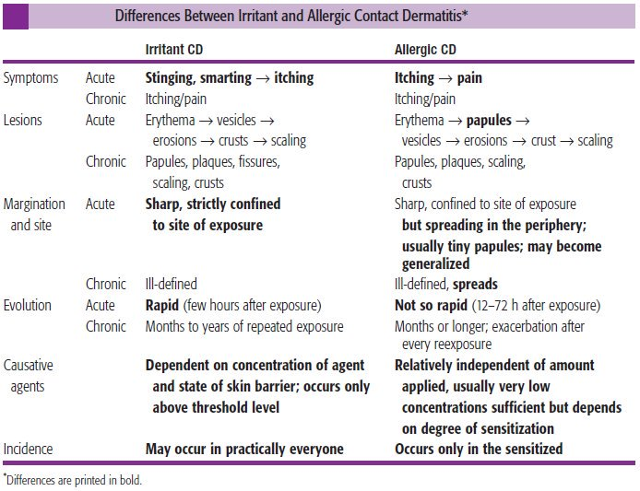
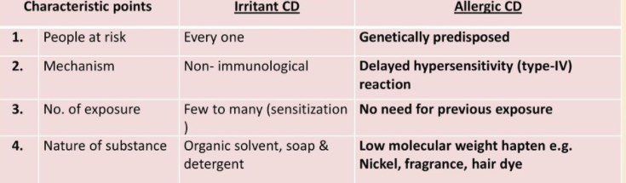

Slide 5
SENSITIZATION PHASE
Unprocessed allergens are more correctly called haptens, which are typically small, lipophilic molecules with a low molecular weight which produces a complete antigen.

Slide 6
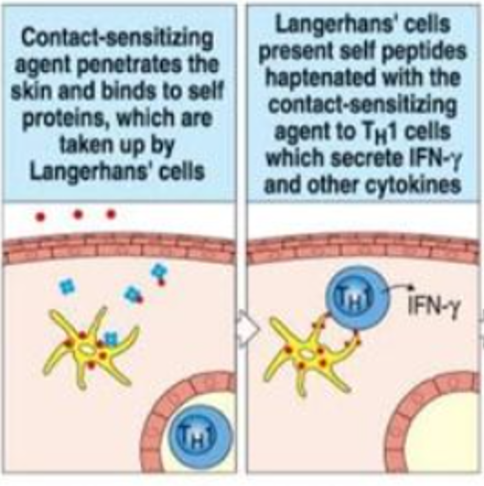
Innate immunity is activated by keratinocyte release of several cytokines including interleukins 1, 8, and 18, tumor necrosis factor-α, and granulocyte-macrophage colony-stimulating factor.

Slide 7
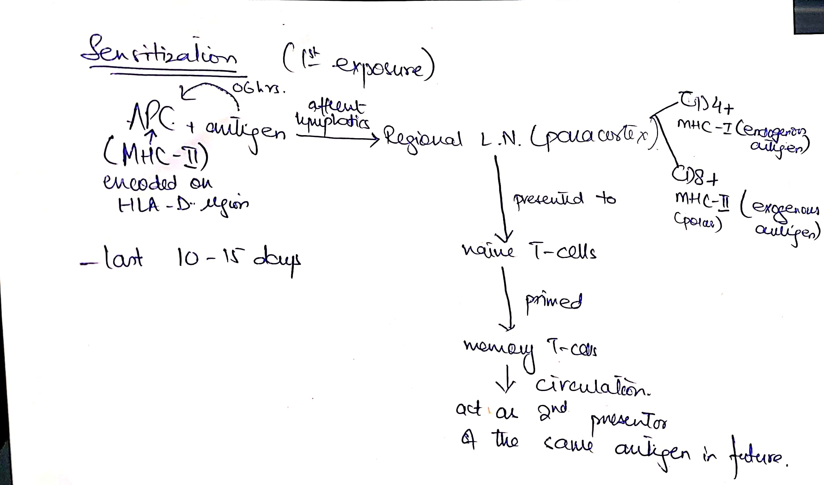
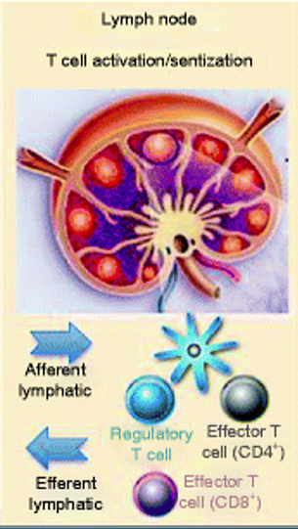

Slide 8
Newer studies have identified that allergic contact dermatitis has been associated with defective T reg cells

Slide 9
ELICITATION PHASE
During this phase, subsequent exposure to an allergen to which the patient is already sensitized leads to clinical disease.
Most subjects develop a local reaction after 5–25 days. During this period, sensitization has been accomplished, and the residues of the allergen in the skin react with the newly formed, sensitized T lymphocytes. Such a response has been termed a ‘late’ reaction.

Slide 10
Antigen may be presented not only by antigen‐presenting Langerhans cells but also by IL‐1‐secreting keratinocytes that acquire Ia/HLA‐DR status, augmenting the cascade of cytokine, immune cell and inflammatory response.

Slide 11
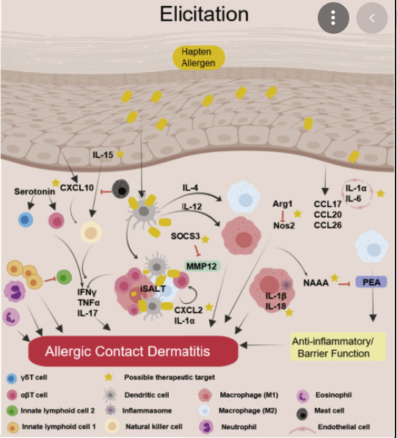

Slide 12
Myths
These were described by Marks and DeLeo and include the following:
■ ACD is not always bilateral even when the antigen exposure is bilateral (eg, shoe or glove allergy).
■ Even when exposure to an allergen is uniform (eg, contact allergy to an ingredient of a cream that is applied on the entire face), eczematous manifestations are very often patchy.
■ ACD can and does affect the palms and the soles.

Slide 13
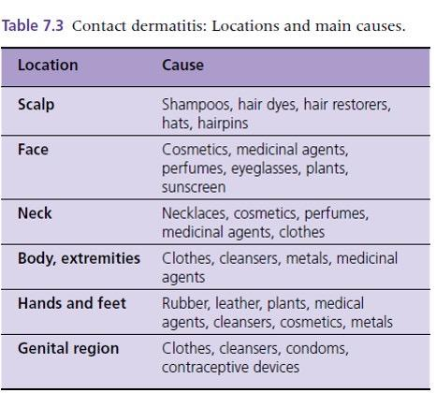

Slide 14
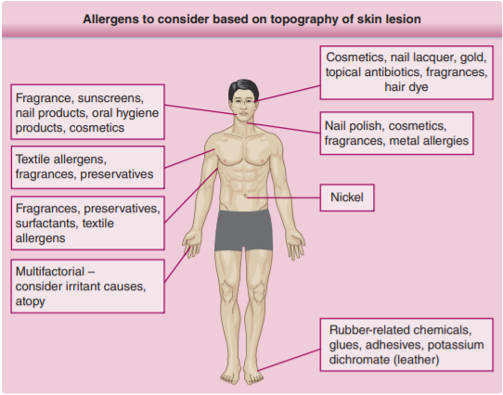

Slide 15
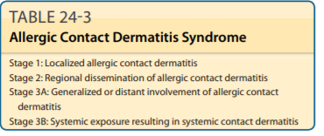

Slide 16
Presentation-acute
Eczematous responses (dermatitis) The severity of the dermatitis is determined by the intensity of exposure and the level of sensitivity.
The primary signs in acute contact dermatitis are erythema, swelling, papules and papulovesicles, which reflect the sequence of inflammatory changes in the dermis and the intracellular and intercellular oedema in the epidermis.
In more acute and severe cases this may progress to disruption of the intercellular bridges and the development of larger vesicles or blisters; if they burst, a weeping dermatitis results. The dominant symptom is itching.

Slide 17
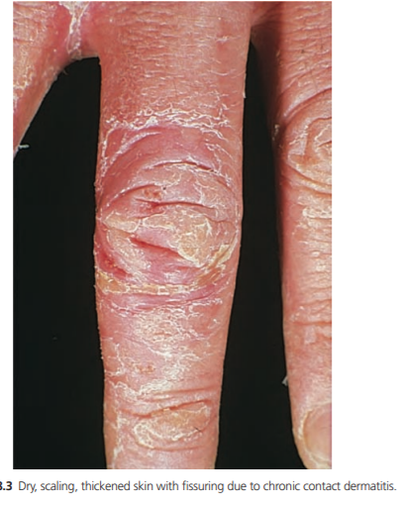
Presentation-chronic
If contact dermatitis persists, it may be due to
continued or repeated exposure to the allergen
or to secondary irritants or allergens. The skin
becomes dry, scaly and thicker as a result of
acanthosis, hyperkeratosis, oedema and cellular
infiltration in the dermis. Lichenification and
fissuring may develop later

Slide 18
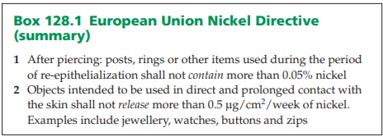
Specific allergens-Metals
Jewellery and metal components of clothing are the usual sources of nickel in prolonged contact with the skin.
coins, keys,
scissors, knitting needles,
thimbles, scouring pads and
other metallic tools and utensils

Slide 19
Presentation
Patches of dermatitis at sites of contact with metal objects, most commonly the ears from earrings, the wrists from watches and bracelets, the neck from necklaces and their clasps, the central back, the central abdomen from studs and zips in trousers, especially jeans, and the dorsa of the feet from shoe buckles.
Lesions on the upper cheeks and sides of the nose and face may relate to metal‐framed spectacles, and on the eyelids to eyelash curlers.

Slide 20
The eruption may be papular, nummular, diffuse or consist only of excoriated papules on almost normal‐looking skin
.The secondary rash normally starts shortly after, or at the same time as, the primary eruption.
It affects the neck, face (especially the eyelids, the elbow flexures and the flexor surfaces of the arms; the ano‐genital area may also be affected, and the rash may be generalized.
Flexural lesions may resemble textile dermatitis or atopic eczema.

Slide 21
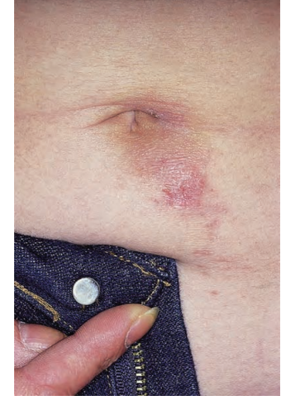
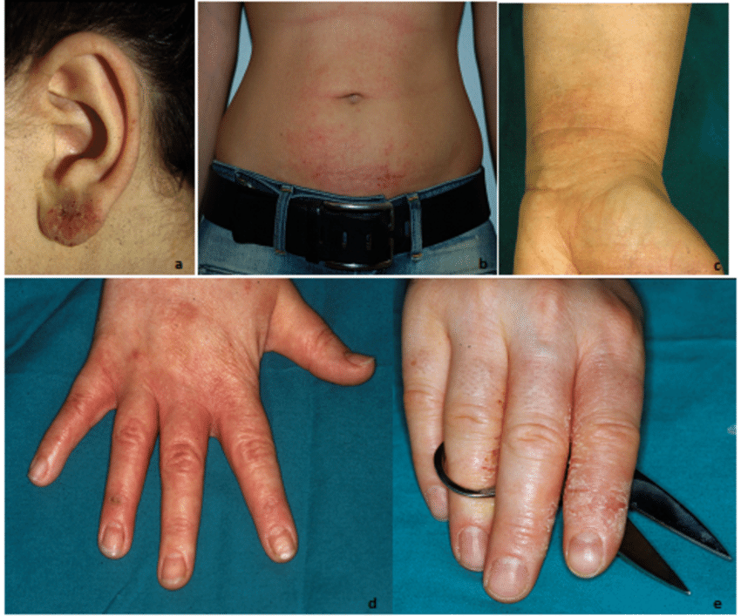
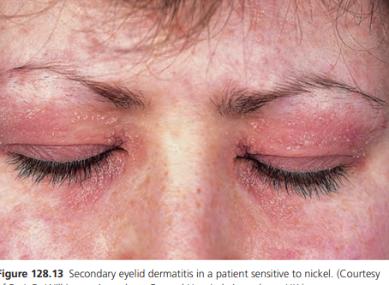

Slide 22
Chronic/Relapse
Wet work, atopy and nickel sensitivity are associated with an increased risk of hand dermatitis
Protection with rubber gloves may be insufficient, as nickel solutions may penetrate them . Heavy‐duty vinyl gloves have been suggested as an alternative
Once the hands are involved, the eczema may remain chronic, persistent or intermittent.
Ingestion of nickel is a possible cause of chronicity

Slide 23
Specific thearapies
Clioquinol is known to chelate nickel , and a topical clioquinol–steroid combination can be considered as a treatment.
Treatment with tetraethylthiuramdisulphide (disulfiram; Antabuse), which chelates nickel, has been reported as helpful Liver enzymes should be carefully monitored
Nickel sulphate 5% in petrolatum is used for patch tests

Slide 24
Cobalt
Cobalt metal and its oxides (e.g. Co 2 O 3 and CoO) and salts (e.g. CoCl 2 and CoSO 4 ) are sensitizers.
Metallic cobalt is present in ‘hard metal’ used for metal cutting and drilling. It is used in magnets and jewellery. It is always present as a contaminant in nickel .
Cobalt compounds are found in paints, glass, china, pottery, ceramics, enamel (blue), coloured crayons and animal feed additives , multivitamin pills, textile dyes , tattoos , soaps , cosmetic pigments, hair dye and detergents .

Slide 25
Clinically
Cobalt allergy usually presents as a chronic or subacute allergic contact dermatitis at sites with direct contact but may become more extensive
Photosensitive dermatitis has been reported with cement and pig fodder
Cobalt blue used in light blue tattoos can cause sarcoidal allergic reactions
Erythema multiforme has been rarely reported
Dust containing cobalt may cause asthma in metal workers.

Slide 26
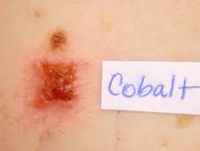
Isolated cobalt allergy is seen in hard‐metal workers and in the pottery and glass industries, when it is usually associated with hand dermatitis. Stomatitis has been reported from dentures .
Allergic granulomatous reactions to tattoo pigment are recognized
Vitamin B 12 is a cobalt‐containing compound and cheilitis has been reported from oral vitamin B 12 ingestion
Cobalt chloride 1% in petrolatum is reliable for
testing

Slide 27
Chromium
Exposure to chromate in leather occurs occupationally in tanners, and in the general population from clothing, especially shoes, and furniture.
More commonly there is a dry insidious eruption, which tends to fissure, particularly on the hands. Secondary lichenification is often a feature

Slide 28
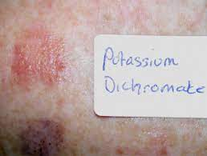
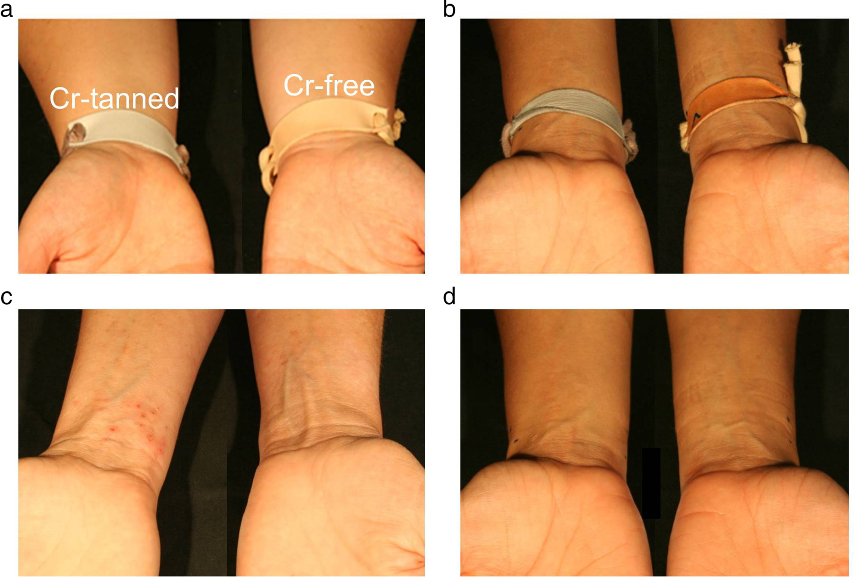
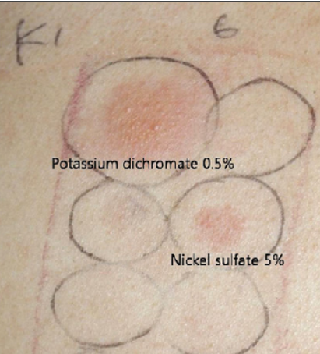

Slide 29
Disease course and prognosis
Chromate sensitivity tends to persist and the prognosis of occupational dermatitis is poor as a result of its persistence and the associated social and financial handicap
Affected individuals have been labelled as ‘chrome cripples’ .
Once established, hand dermatitis tends to continue, and superimposed shoe dermatitis may prevent any improvement unless chromate‐free shoes can be acquired
Sensitivity is demonstrated by a closed patch test with potassium dichromate 0.5% in petrolatum

Slide 30
Gold
Metallic gold is mainly encountered in jewellery, stents and dental materials. Gold salts are used in the plating, electronics, photographic, glass and porcelain industries
A seborrhoeic eczema pattern has been described, as have persistent papules and nodules on the ear lobes, with lymphomatoid or granulomatous histology .
Reported oral manifestations of allergy have included erythema, burning mouth, erosions, ulceration, oro‐facial granulomatosis and lichen planus‐like lesions
Gold sodium thiosulphate 0.5% in petrolatum. Late reactions are common and an additional 7‐day or even 2‐ or 3‐week reading has been advised

Slide 31
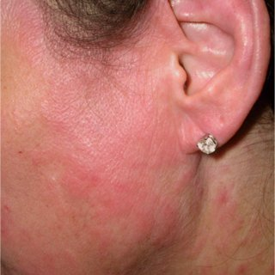

Slide 32
Mercury
The metal is used in instruments and amalgam (alloy of silver or copper and mercury) for filling teeth.
Mercury and inorganic mercurials may be used in disinfectants, fungicides, herbicides, insecticides, detonators, emulsion paints and jewellery, as well as in the production of caustic soda and chlorine.
Red mercuric sulphide (cinnabar, HgS) is used in red tattoos and in artists’ paints.
Organic mercurials may be found in topical and parenteral medicaments

Slide 33
Clinical presentation
Hypertrophic amalgam dermatitis
Oro‐facial granulomatosis
Generalized exanthems and erythema multiforme have been reported from mercury exposure, including inhalation, dental fillings, following the breakage of thermometers in the mouth and also the use of an antiparasitic powder for the treatment of crab lice
Red mercuric sulphide (cinnabar) in a tattoo may induce granulomatous reactions in allergic subjects

Slide 34
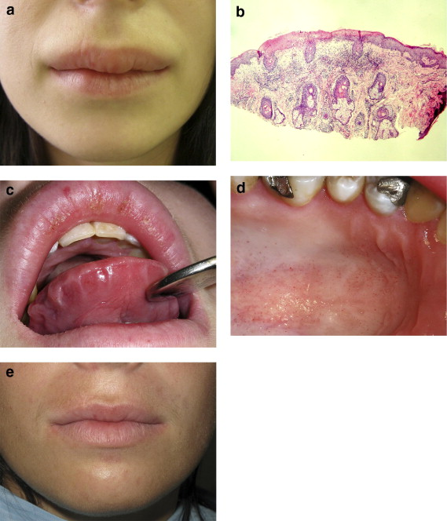
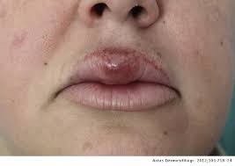

Slide 35
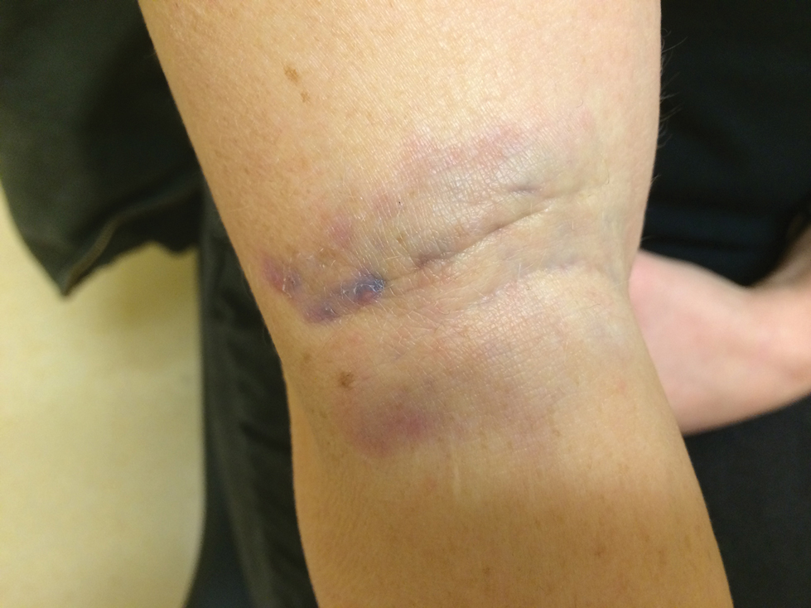
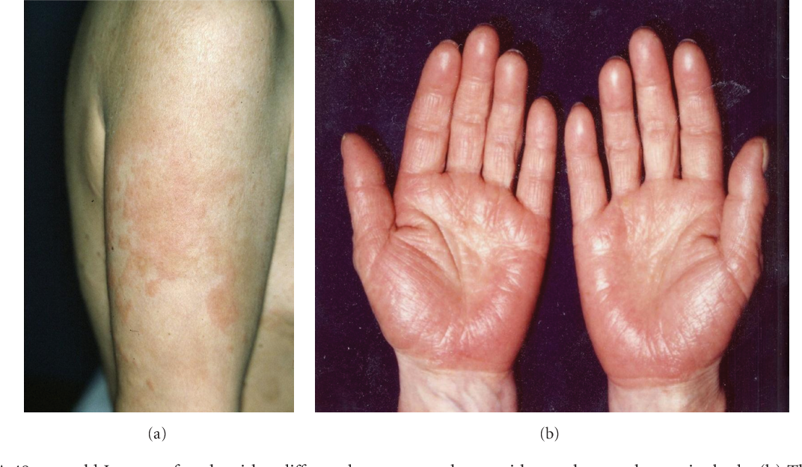
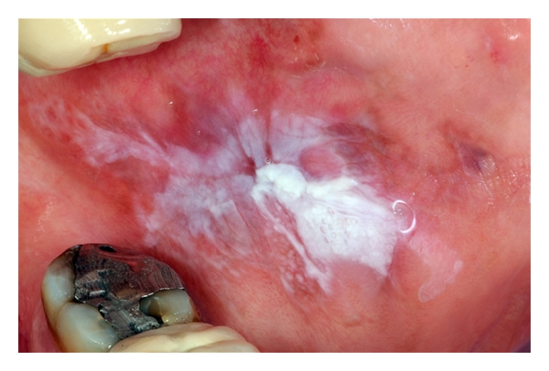
Mercury is normally tested at 0.5% in petrolatum, mercurochrome 2% in petrolatum or aqueous, mercuric chloride 0.1% in petrolatum and ammoniated mercury 2% in petrolatum

Slide 36
Aluminum
It is found in antiperspirants, and axillary dermatitis (usually irritant) may occur. Allergy in a child with chronic otitis externa treated with aluminium acetate ear drops has been seen
As Finn chambers are aluminium, a positive patch test, often annular in configuration, may develop under every single test site in sensitized persons.

Slide 37
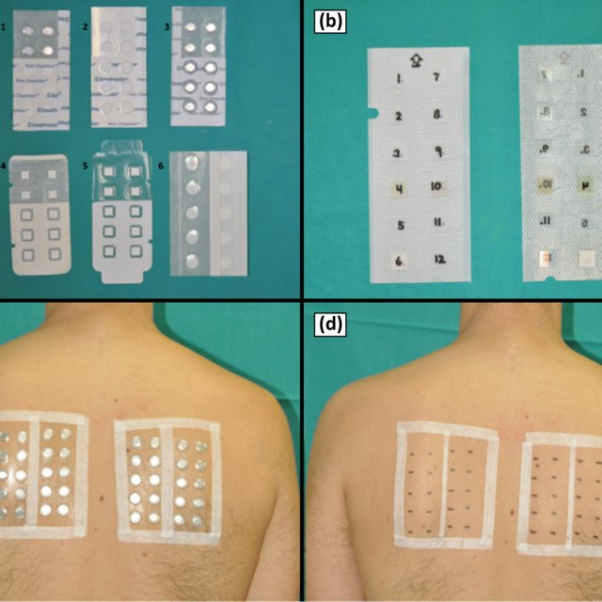

Slide 38
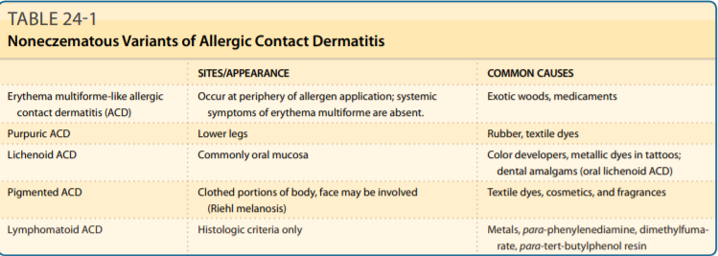
Variants

Slide 39
