Slide 1
Acquired Pigmentary Disorders
DR. GULL RAIZ

Slide 2
Acquired hypomelanosis
Vitiligo
Common form of localized depigmentation
An acquired condition resulting from the progressive loss of melanocytes
Characterized by milky‐white sharply demarcated macules

Slide 3
vitiligo
Two major forms:
Segmental vitiligo (typically unilateral maculae in a segmental/band‐shaped distribution)
Segmental vitiligo (uni‐, bi‐, or plurisegmental) is classified separately
Non‐segmental vitiligo (bilateral maculae, often distributed in an acrofacial pattern or scattered symmetrically over the entire body)
Non‐segmental forms of vitiligo (including several variants: acrofacial, mucosal, generalized, universal, mixed and rare variants of vitiligo
Notes:
According to a recent Vitiligo Global Issue Consensus Conference, the term ‘vitiligo’ can be used as an umbrella term for all non‐segmental forms of vitiligo (including several variants: acrofacial, mucosal, generalized, universal, mixed and rare variants of vitiligo

Slide 4
Epidemiology
Incidence and prevalence:
Vitiligo affects 0.5–1% of the world’s population
Age:
Can begin at any age but in the majority of cases between the age of 20 and 30 years
Sex:
The prevalence is most probably the same in both sexes
Vitiligo affects all races.

Slide 5
Associated diseases
Thyroid disease
Pernicious anaemia
Addison disease
Diabetes
Hypoparathyroidism
Myasthenia gravis
Alopecia areata
Halo naevi
Melanoma
Uveitis
Premature greying of the hair occurs in the Vogt–Koyanagi– Harada syndrome
Notes:
Vogt-Koyanagi-Harada disease (VKH) is a central nervous system condition that specifically affects vision and hearing

Slide 6
Pathophysiology
Show a lack of dopa‐positive melanocytes in the basal layer of the epidermis
In inflammatory vitiligo, there is an infiltrate of lymphocytes and histiocytes

Slide 7
aetiology
Loss of melanocytes in vitiligo may also be the result of different pathogenetic mechanisms working together (‘convergence’ or ‘integrated’ theory)
The autoimmune/autoinflammatory theory is currently the leading hypothesis
A combination of deregulated innate and adaptive immune responses has been proposed in vitiligo
An important role of heat shock protein 70 (hsp70) and LL37 (which is released after cell injury) has been suggested
Notes:
A combination of deregulated innate and adaptive immune responses has been proposed in vitiligo. Interestingly, several components of the innate immune system have been found to be associated with vitiligo (e.g. NLRP‐1, XBP‐1)
. LL-37 is able to kill bacteria through direct antibacterial activities, as well as through immunomodulation

Slide 8
aetiology
Both helper and cytotoxic T cells from progressing margins generate predominantly type 1 cytokines. This theory is supported by the fact that various effective treatment options in vitiligo have an immunosuppressive effect on the activation and maturation of T cells (e.g. local steroids and topical immunomodulators).
The self‐ destruction theory of Lerner suggested that melanocytes destroyed themselves due to a defect in a natural protective mechanism that removed toxic melanin precursor
In vivo, repeated frictional trauma to perilesional skin in non‐segmental vitiligo has been shown to induce detachment and death of melanocytes (‘melanocytorrhagy’)
Notes:
It has also been proposed that increased oxidative stress may trigger the process of ‘haptenation’ by increasing the levels of surrogate substrates of tyrosinase resulting in the formation of highly immunogenic neoantigens in vitiligo
Additionally, a neurogenic mechanism has been suggested whereby it has been hypothesized that a compound released at peripheral nerve endings in the skin could have a toxic effect on melanocytes. neuropeptide Y may play a role

Slide 9
Genetics
Approximately 30% of patients have a positive family history and vitiligo has been reported in monozygotic twins
Environmental factors
The Koebner phenomenon (also called isomorphic response) is defined as the development of lesions at sites of trauma to uninvolved skin of patients with cutaneous diseases
Notes:
Genome‐wide association studies have identified several susceptibility loci for generalized vitiligo, each responsible for a small part of the genetic risk
*It has been suggested that the Koebner phenomenon may function as a clinical parameter to assess and predict the clinical profile and course of vitiligo

Slide 10
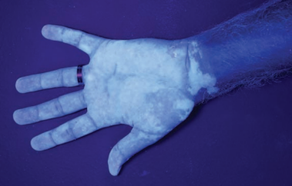
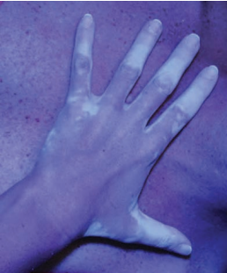
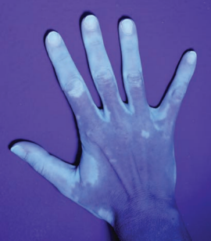
Clinical features
The amelanotic macules in vitiligo are found particularly in areas of repeated friction, chonic pressure or trauma, for example the hips, dorsa of the hands/fingers, feet, elbows, knees and ankles
The lesions are also prone to sunburn
The distribution of the lesions is usually symmetrical, although in the segmental subtype it is usually unilateral and band shaped
The pigment loss may be partial or complete, or both may occur in the same areas (trichrome vitiligo)
Notes:
Rarely, there is complete vitiligo (universalis), although most often a few pigmented areas remain indefinitely
trichrome vitiligo describes lesions that have a tan zone of varying width between normal and totally depigmented skin, which exhibits an intermediate hue

Slide 11
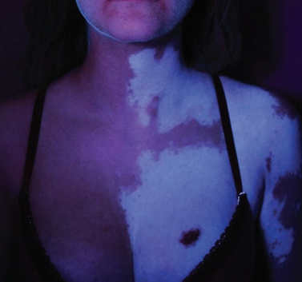
Clinical features
The macules usually have a convex outline, increase irregularly in size and fuse with neighbouring lesions to form complex patterns
The hairs in the patches can remain normally pigmented, but can also depigment after a certain period of time (poliosis/leukotrichia)
The main symptom is the cosmetic disability
Although some patients present because of sunburn in the amelanotic areas

Slide 12
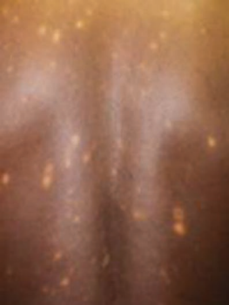
Clinical variants
Mixed vitiligo:
The coexistence of non‐segmental and segmental vitiligo
Hypochromic vitiligo(vitiligo minor):
That seems to be limited to dark‐sknined individuals
The term ‘minor’ refers to the partial defect in pigmentation
Notes:
Figure Hypochromic vitiligo affecting the back

Slide 13
Differential diagnosis
Halo naevi.
Naevus depigmentosus.
Naevus anaemicus.
Inherited or genetically induced hypomelanosis (usually present at birth).
• Piebaldism.
• Waardenburg syndrome.
• Tuberous sclerosis.
• Pigmentary mosaicism (hypomelanosis of Ito).
Progressive macular hypomelanosis.
Secondary hypomelanosis. • Post‐inflammatory hypomelanosis (e.g. pityriasis alba, lichen sclerosus, morphoea). • Post‐traumatic hypomelanosis.
Notes:
• Post‐infectious hypomelanosis (e.g. pityriasis versicolor, leprosy). • Cutaneous lymphoma.
Nevus depigmentosus congenital nonprogressive hypopigmented macule or patch that is stable in its relative size and distribution throughout life.
Nevus anemicus is an uncommon, congenital vascular malformation resulting in hypopigmented cutaneous macules and/or patches that characteristically do not become erythematous in response to trauma, heat, or cold.
Waardenburg syndrome is a group of genetic conditions that can cause hearing loss and changes in coloring (pigmentation) of the hair, skin, and eyes
Pigmentary mosaicism refers to patterned hypo- and/or hyperpigmentation that results from genetic heterogeneity of skin cells. The most common clinical patterns are streaks and swirls following Blaschko's lines in narrow or broad bands and a block-like distribution
Lichen sclerosus is a skin condition that causes itchy white patches on the genitals or other parts of the body
Morphea, also called localized scleroderma, is a rare inflammatory skin condition that can also affect the subcutaneous tissues

Slide 14
Disease course and prognosis
Most frequently, vitiligo is gradually progressive, sometimes extending rapidly over a period of several months and then remaining quiescent for many years
Segmental vitiligo generally starts earlier in life than non‐segmental vitiligo and often stabilizes within the first year of onset
Notes:
Spontaneous repigmentation can sometimes be noted in sun‐exposed areas, and can have a typical perifollicular appearence

Slide 15
Investigations
The diagnosis of vitiligo is based essentially on clinical examination, because the lesions have a typical appearance.
Inspection with the aid of a Wood’s light can be helpful
The presence of a family history of vitiligo, the Koebner phenomenon, leukotrichia or associated autoimmune disorders such as thyroid disease can help to support a clinical diagnosis of vitiligo

Slide 16
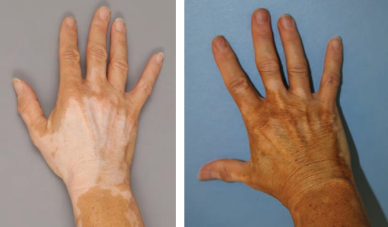
Management
Response to treatment of vitiligo varies between individuals but is often unsatisfactory, especially for acral lesions
Patients are best advised to seek effective cosmetic camouflage and to use sunscreen
First line:
Once‐daily application of potent topical corticosteroid preparations (e.g. 0.1% betamethasone valerate or 0.05% clobetasol propionate)
Topical calcineurin inhibitors
Notes:
It is preferable to use an intermittent regimen (e.g. 15 days per month for 6 months) to avoid local side effects (skin atrophy, telangiectasia, striae, hypertrichosis and acneform eruptions)
Figure Vitiligo: before and after camouflage of the hands.

Slide 17
Management
Second line:
Treatment with psoralen photochemotherapy (PUVA) is effective
UVB therapy can also be used selectively and localized targeted phototherapy devices (excimer lamp or lasers with a peak at 308 nm)
Notes:
The use of topical applications of psoralens is more hazardous and may result in untoward blistering of the skin
Most often irradiation will be stopped if no repigmentation occurs within the first 3 months of treatment.

Slide 18
Management
Third line:
Grafting techniques:
Surgical methods have been proposed as a therapeutic option in patients with stable vitiligo (e.g. segmental vitiligo). Includes:
Tissue grafts (full‐thickness punch grafts, split‐thickness grafts, suction blister grafts)
Cellular grafts (cultured melanocytes, cultured epithelial sheet grafts and non‐cultured epidermal cellular grafts).
Notes:
These surgical techniques are based on a common basic principle: to transplant autologous melanocytes from a normal pigmented area to the affected depigmented skin

Slide 19
Management
Depigmenting treatment:
Skin bleaching with laser therapy (e.g. Q‐switched alexandrite 755 nm, Q‐switched ruby 694 nm)
Cryotherapy
Creams (e.g. 20% monobenzylether of hydroquinone)

Slide 20
Halo naevus
Synonyms and inclusions
• Sutton naevus
• Leukoderma acquisitum centrifugum
Designates the development of a halo of hypomelanosis around a central cutaneous tumour
This tumour is usually a benign melanocytic naevus but may be a neuroid naevus, blue naevus, neurofibroma, or primary or secondary malignant melanoma

Slide 21
Epidemiology
Incidence and prevalence:
The prevalence of halo naevi has been estimated to be approximately 1% in the white population
Age:
Can be seen at all ages, but is usually seen in young people

Slide 22
Associated diseases
Occur with increased frequency in patients with vitiligo
Cutaneous malignant melanoma
Turner syndrome
Notes:
Antibodies against the cytoplasm of malignant melanoma cells are found in the serum of patients with halo naevi
a congenital condition(present from birth) that only affects people assigned female at birth (AFAB). It happens when one of two of the X chromosomes is missing, either partially or completely

Slide 23
Pathophysiology
Most halo naevi are compound naevi
There is frequently a lymphocytic infiltration of the naevus and the constituent cells may show damage

Slide 24
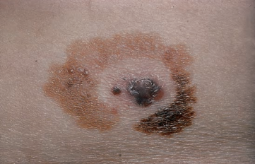
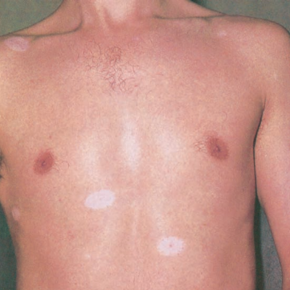
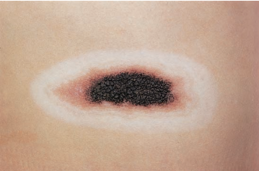
Clinical features
Circular areas of hypomelanosis occur around pigmented naevi, particularly on the trunk, less commonly on the head and rarely on the limbs
Multiple lesions are common
The halos being about 0.5–2.0 cm wide and developing simultaneously or at intervals around several, but not all, naevi
Notes:
History Vitiligo can be present in the personal or family history
Figure (a) Multiple halo naevi in a young man who also had vitiligo. (b) Unusually large halo naevus. (c) Halo phenomenon developing within a malignant melanoma that later proved fatal

Slide 25
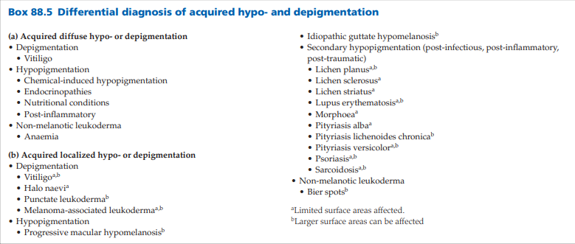

Slide 26
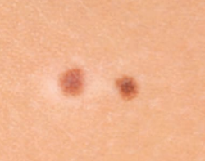
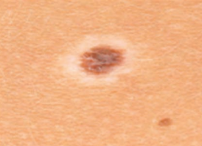
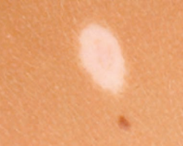
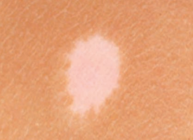
Disease course and prognosis
The naevus tends to flatten and may disappear completely
The depigmented areas often persist, but may pigment after many year
Notes:
Figure Halo naevi in different stages of evolution concurrently in a 13‐year‐old girl: (a) early depigmentation; (b) established halo naevus; (c) faint pink residuum of naevus just visible in the centre of the hypomelanotic macule; and (d) residual hypomelanotic macule following complete destruction of the naevus

Slide 27
Halo naevus
Investigations:
Excision of the naevus may be indicated in case of doubt about its benign character.
Management:
Normally none is required
Mutilating surgery must never be undertaken without preliminary histological examination by an experienced pathologist
Notes:
It should be remembered that a halo around a benign naevus is relatively common, whereas malignant melanoma is rare, and a melanoma surrounded by a halo is extremely rare

Slide 28
Acquired syndromic hypomelanosis

Slide 29
Vogt–Koyanagi–Harada syndrome
Various combinations of synonym have been used for this disorder, which is now generally referred to with the above three names, and abbreviated to VKHS.
Pathophysiology:
The aetiology of VKHS has yet to be established
Electron microscopy of depigmented skin shows an absence of melanocytes as in vitiligo
Colloid-amyloid bodies are also found at the dermal-epidermal junction
Inflammatory skin lesions are characterized by a chronic mixed inflammatory cell infiltrate

Slide 30
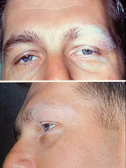
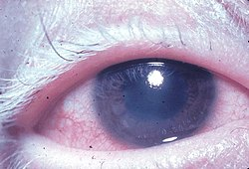
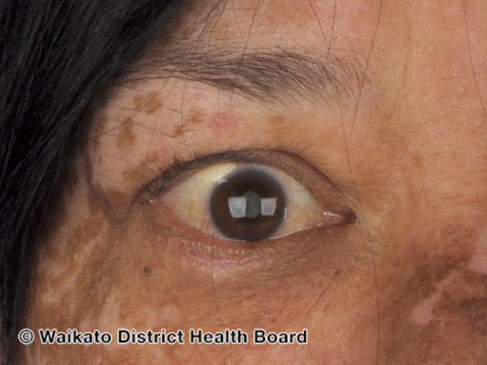
Clinical features
Mainly affects dark‐skinned people or Caucasian people with dark pigmentation
Most cases occur in the third and fourth decades but children may be affected
It affects the skin, eyes, inner ears and meninges.

Slide 31
Criteria for diagnosis
No history of ocular trauma or surgery preceding the initial onset of uveitis
No clinical or laboratory evidence suggestive of ocular disease entities
Bilateral ocular involvement: an early sign is diffuse choroiditis; a late sign is ocular depigmentation
Neurological and auditory findings: meningismus, tinnitus, cerebrospinal fluid pleocytosis
Skin and hair changes: alopecia, vitiligo, poliosis
Notes:
Meningism involves the triad (3-symptom syndrome) of nuchal rigidity (neck stiffness), photophobia (intolerance of bright light) and headache
sterile CSF pleocytosis defined as CSF white blood cell count of 10/μL or higher in the absence of bacterial meningitis and clinical course and treatment

Slide 32
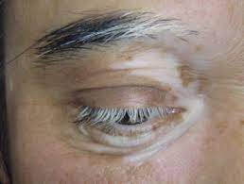
Alezzandrini syndrome
Characterized by unilateral, facial vitiligo associated with unilateral retinal degeneration, white hair, poliosis and deafness
The aetiology of this syndrome is unknown

Slide 33
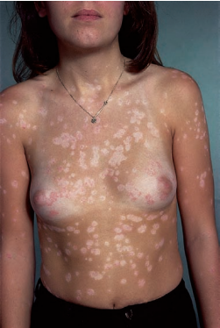
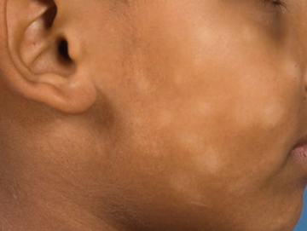
Post‐inflammatory hypomelanosis
Hypomelanotic areas occur following the resolution of areas of eczema, psoriasis, pityriasis lichenoides and cutaneous T‐cell lymphoma
Pityriasis alba commonly presents with white, somewhat scaly, and not so well‐defined areas of skin, which are most noticeable on the cheeks of racially pigmented children
Notes:
Pic:Hypopigmentation in a girl with resolving psoriasis and P. alba
PLEVA presents abruptly with a rapidly progressive rash:
10-50 reddish brown, erythematous, ovoid papules, 5-15mm in diameter
Mainly on the trunk and proximal extremities

Slide 34
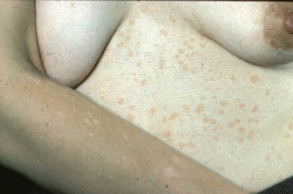
Post‐inflammatory hypomelanosis
Hypopigmented macules also occur in the superficial fungal infection pityriasis versicolor
Hypomelanosis due to loss of functional melanocytes is seen in lupus erythematosus, lichen planus, sarcoidosis, lichen stiatus, leprosy and syphilis
Notes:
Figure Hypomelanotic macules on a sun‐exposed arm compared with tan‐coloured macules on the trunk of the sun‐protected abdominal skin of a woman with pityriasis versicolor

Slide 35
Post‐inflammatory hypomelanosis
Investigations:
A skin biopsy can be helpful in investigating possible underlying causes
Disease course and prognosis:
Post‐inflammatory hypomelanosis is in general reversible if melanin production and transfer to the keratinocytes can be restored
Notes:
. In suspected pityriasis versicolor, demonstrating a yellow‐green fluorescence on Wood’s light may help confirm the diagnosis.

Slide 36
Progressive macular hypomelanosis
A common acquired dermatosis characterized by ill‐defined nummular macules, mainly affecting the trunk.
Mostly in adolescents and young adults.
It is seen in all races.
Causative organisms:
It has been postulated that different subtypes of Propionibacterium species might be responsible for PMH
Notes:
it is a common skin disorder that is often misdiagnosed
Propionibacterium is a gram-positive, anaerobic, rod-shaped genus of bacteria. Cause endocarditis, conjunctivitis

Slide 37
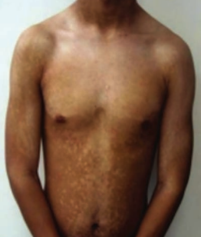
Clinical features
Affects the trunk with ill‐defined nummular hypopigmented non‐scaly macules
Affects areas rich in sebaceous glands
The lesions often converge in and around the midline
Notes:
Affects areas rich in sebaceous glands,most abundant on the face and scalp
Rarely, the proximal extremities, head and neck may be involved.

Slide 38
Progressive macular hypomelanosis
Disease course and prognosis:
May be stable or slowely progressive over time. Spontaneous regression is rare, but possible.
Investigations:
Wood’s light examination: orange‐red fluorescence.

Slide 39
Management
In a study with intra‐person comparison of two treatment strategies 5% benzoyl peroxide hydrogel/1% clindamycin lotion in combination with UVA irradiation versus 0.05% fluticasone propionate cream in combination with UVA irradiation, the antibacterial treatment was found to be superior
PUVA und UVB therapy was reported to achieve improvement
PMH may regress spontaneously within a few years.

Slide 40
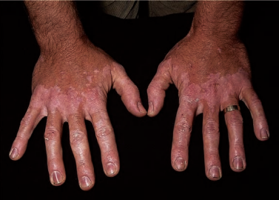
Chemical depigmentation
A number of chemicals can produce cutaneous depigmentation when applied to the skin
Several substituted phenols produce an occupational leukoderma in workers coming into contact with them. Of these, p‐tertiary‐ butylphenol is the most important
Occupational leukoderma occurs in workers in contact with the monobenzylether of hydroquinone
4‐Tertiary‐butylcatechol is also a cause of occupational leukoderma
Notes:
Fig Occupational vitiligo due to tertiary‐butylphenol.
Leukoderma, also called achromoderma, is a clinical sign describing a localised area of white depigmented skin due to total loss of epidermal melanin
The monomethylether of hydroquinone can induce a similar leukoderma
-tert-butylphenol is a formaldehyde resin found in adhesives. Products such as shoes, handbags, belts, watchstraps, glues, varnishes, lacquer resins, motor oil additives, rubber antioxidants, printing inks, masonry sealant, insecticides, deodorants, and commercial disinfectants could contain this substance.
4-tert-butylcatechol (PTBC) is used as an antioxidant in fats, oils, and mineral oils, and as a stabilizer in polyester resins and polystyrene resins

Slide 41
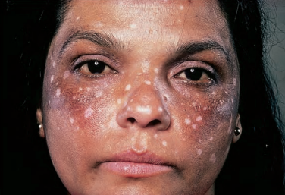
Chemical depigmentation
The areas most likely to be affected in occupational leukoderma are the dorsa of the hands.
The depigmented areas frequently enlarge, and new ones appear even after the patient is no longer in contact.
Treatment with psoralens is usually ineffective
Experimental studies indicate that these substituted phenols have a selective lethal effect on functional melanocytes.
Notes:
Figure Depigmentation on the face following treatment of melasma with monobenzylether of hydroquinone

Slide 42
Idiopathic guttate hypomelanosis
An acquired leukoderma with discrete round to oval porcelain‐white macules approximately 2–5 mm diameter increasing in number with age
Common seen in up to 80% of patients over the age of 70 years.
F > M
Most in people with light skin colour.
Pathology:
Lesions are characterized by slight basket‐ weave hyperkeratosis with epidermal atrophy and flattening of the rete pegs
Histochemical and ultrastructural studies show a decrease in melanocytes and melanin content of the affected epidermis and pigment granules are irregularly distributed
Notes:
Synonyms and inclusions • Disseminate lenticular leukoderma
The lesions in Caucasian people most frequently occur in sun‐ exposed areas of the limbs. Solar damage is a factor in these cases.s

Slide 43
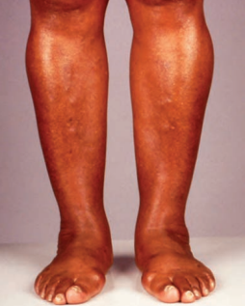
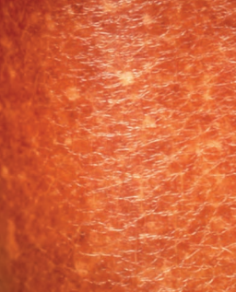
Clinical features
Lesions are porcelain‐white macules, usually 2–6 mm in size but sometimes much larger.
The borders are sharply defined, often angular and irregular.
Susceptible locations include the pretibial side of the legs and the forearms
Other chronic sun‐exposed sites, including the face, neck and shoulders may be affected
The number increases with age. No spontaneous repigmentation occurs
Notes:
Figure Typical appearances on the shins of a 57‐year‐old Afro‐Caribbean woman (a) with close‐up view illustrating discrete guttate hypomelanotic macules (b)

Slide 44
Management
Treatment is not usually required
A variety of therapies have been advocated for IGH, including systemic and topical retinoids,topical steroids, cryotherapy, topical tacrolimus and superficial dermabrasion (e.g. carbon dioxide laser).
None are predictably successful

Slide 45
Punctate leukoderma
It was first described in patients who developed multiple punctiform hypopigmented and achromic spots after several months of PUVA treatment
Later, similar cases were described after UVB therapy for psoriasis and after topical and systemic PUVA for segmental vitiligo
Develops in young adults
Pathology:
Ultrastructurally, punctate leukoderma demonstrates slight to severe damage of keratinocytes and melanocytes not reported in IGH.
Phototoxicity damage to keratinocytes and melanocytes is the aetiological factor.
Notes:
Colorless
Synonyms and inclusions • Leukoderma punctata • Symmetrical progressive leukopathy
Environmental factors Sun exposure, UV therapy

Slide 46
Clinical features
Multiple round or oval small sharply demarcated punctate macules measuring 0.5–1.5 mm in diameter are found symmetrically on the fronts of the shins and on the extensor aspects of the arms
Less often they are also found on the abdomen and interscapular region
Differential diagnosis;
Idiopathic guttate hypomelanosis, the macules are smaller and repigmentation may occur.
Disease course and prognosis:
Persistent although spontaneous repigmentation has been observed

Slide 47
Non‐melanin pigmentation

Slide 48
Endogenous non‐melanin pigmentation
A variety of normal constituents of the body may give rise to alterations in skin colour, if present in excess or in an abnormal form or site
Substances formed as a result of metabolic defects may also produce pigmentary changes
Notes:
Special stains of histological specimens, or techniques such as spectroscopy, may help to identify the nature of exogenous and other non‐melanin pigments.

Slide 49
Cutaneous haemosiderosis
Brownish pigmentation resulting from deposition of the iron‐ containing pigment haemosiderin in the skin
Haemosiderin is a brown iron‐binding pigment which is found predominantly within macrocytes
The deposition of haemosiderin is commonly the result of the local destruction of red blood cells
The accumulation of haemosiderin in the dermis and consequent hypermelanosis results in a brown or coppery discoloration of the skin
Notes:
The most common causes include repetitive minor trauma and venous insufficiency

Slide 50
Cutaneous haemosiderosis
Cutaneous haemosiderosis may arise through a number of different mechanisms of which the most important are as follows:
Trauma: particularly repeated ecchymoses from minor trauma to the lower limbs
Hypostatic haemosiderosis: associated with chronic lower limb venous hypertension
Capillaritis (pigmented purpura)
Congenital haemolytic anaemias
Haemochromatosis: this may also be deposited in the skin as the result of repeated episodes of purpura from any other cause, e.g. following clothing‐ or drug‐induced dermatitis

Slide 51
Clinical variants
Hypostatic haemosiderosis:
In chronic venous hypertension, there is leakage of blood cells from small blood vessels into the tissues.
Extravasated erythrocytes are broken down by tissue macrophages and the iron thus released is incorporated into haemosiderin, which remains predominantly intracellular within the macrocyte
Recently involved areas show grouped points of reddish pigment, but recurrent extravasation of red cells combined with increasing hypermelanosis soon produce a more or less uniform deep brown or coppery colour

Slide 52
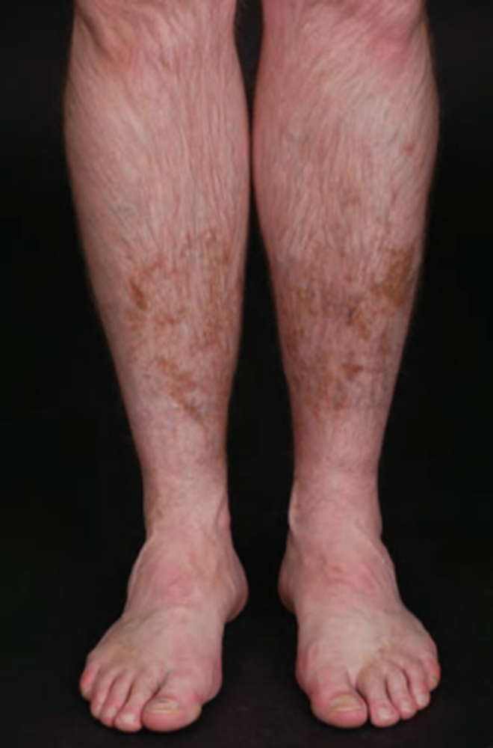
Notes:
Haemosiderin staining on the shins of a 41‐year‐old rugby football player resulting from repeated minor trauma.

Slide 53
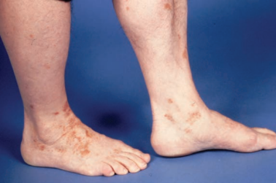
Clinical variants
Capillaritis (pigmented purpura):
Haemosiderosis without clinically evident hypermelanosis is seen in Schamberg capillaritis
Reddish‐brown plaques with cayenne‐pepper points beyond their margins are present on the legs and thighs and sometimes on the arms
Congenital haemolytic anaemia:
Conspicuous pigmentation of the lower leg in the third decade or earlier may develop in patients with sickle cell anaemia.
Notes:
schamberg disease is the most common type of capillaritis. Regular or irregular crops of red-brown flat patches with cayenne pepper spots on their borders appear for no apparent reason. Although most common on the lower legs,
FIGHaemosiderosis secondary to capillaritis which first erupted 6 months previously in a 57‐year‐old male.

Slide 54
Clinical features
The pigmentation is orange‐red at first, later fading through ochre and tawny shades
It is distributed according to the underlying cause
Capillaritis initially presents with punctate bright red purpuric macules which may evolve into irregular plaques of orange or brown pigmentation
Lesions are chronic and persistent
Management
Treatment of the underlying cause if possible.
Notes:
Pale yellow to deep red colour

Slide 55
Jaundice and bronze baby syndrome
Yellowish discoloration of the skin, eyes and mucous membranes due to deposition of bile pigments
Brown‐bronze discoloration of the skin, mucous membranes and urine after phototherapy in children with clinical jaundice

Slide 56
Pathophysiology
Jaundice:
results from the deposition of bilirubin in the tissues
Clinically, it is often first noticed in the sclerae, because bilirubin has affinity for elastic tissue.
Bronzing is the effect of added melanin pigmentation and is often seen in jaundice of long duration
Bronze baby syndrome:
The discoloration may be caused by an abnormal accumulation of a photoisomer of bilirubin, abnormal hepatic function leading to a copper–porphyrin complex which is photodestroyed or accumulation of biliverdin.
Notes:
The range of yellow shades produced by bilirubin may be modified by the presence of biliverdin, which adds a greenish hue

Slide 57
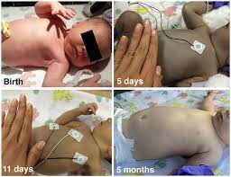
Clinical features
Range of yellow shades with a greenish hue.
Striking grey‐brown discoloration of the skin of neonates follows phototherapy for hyperbilirubinaemia
The serum is also brownish.

Slide 58
Management
Treatment of underlying cause.
Neonatal jaundice is routinely treated with 460–490 nm visible light
Bronze baby syndrome: no treatment is required as pigmentation is reversible after discontinuation of phototherap

Slide 59
Carotenoderma
A benign yellowish coloration of the skin due to elevated blood carotene levels
Predisposing factors
Primary carotenoderma is seen most in food faddists who consume large quantities of oranges or carrots
It is now more commonly seen in young women drastically reducing their weight and eating foodstuffs with high carotene content
Iatrogenic hypercarotenaemia occurs in patients on oral supplements of β‐carotene as a photoprotective agent in erythropoietic protoporphyria with or without canthaxanthine
Notes:
This may be primary due to diet, or secondary due to for example hepatic disease.
Canthaxanthin a keto-carotenoid pigment widely distributed in nature is used to reduce sensitivity to sunlight (photosensitivity) experienced by people who have a rare genetic disease called erythropoietic protoporphyria (EPP)

Slide 60
Carotenoderma
Carotenoderma typically occurs when β‐carotene concentrations exceed 250 μg/dL or when daily ingestion exceeds 30 mg of β‐carotene
In secondary hypercarotenaemia, some increased yellowness is seen in conditions with hyperlipaemia, diabetes, nephritis or hypothyroidism

Slide 61
Pathology
Carotene, a lipochrome, contributes a yellow component to the colour of normal skin
In the presence of excessive blood carotene levels, this yellow component is increased

Slide 62
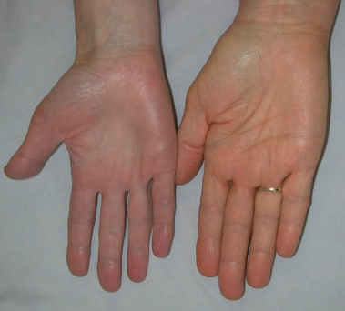
Clinical features
The yellow colour is most conspicuous where the horny layer is thick on the palms and soles
The sclerae are not discoloured
Treatment:
Treatment of underlying cause
Diet low in carotene
Notes:
Figure Carotenoderma: note yellowish hue of the palm on the right compared with the normal palm on the left

Slide 63
Ochronosis
Endogenous ochronosis is the pigmentary changes that occur in connective tissue in patients with alkaptonuria
Exogenous ochronosis: discoloration of the skin after topical use primarily of hydroquinone,
Notes:
but may also be caused by the use of phenol or resorcinol

Slide 64
Epidemiology
Incidence and prevalence:
Endogenous ochronosis is present in about 75% of patients with alkaptonuria
Age:
Alkaptonuria: congenital
Sex:
M = F

Slide 65
Pathophysiology
Predisposing factors:
Exogenous ochronosis: often associated with the use of skin‐ lightening cosmetics.
Most frequently reported in heavily pigmented skin
Pathology:
Characterized by comma‐ or banana‐shaped ochronotic collagen bundles
In alkaptonuria, a deficiency in homogentisic acid oxidase causes accumulation of homogentisic acid throughout the body
In exogenous ochronosis, it may be caused by inhibition of homogentisic oxidase and accumulation of homogentisic acid, which polymerizes to form ochre (brownish‐yellow) pigment in the papillary dermis

Slide 66
Ochronosis
Environmental factors
Exogenous ochronosis: sun exposure
Use of hydroquinone at concentrations higher than 3% for prolonged periods of time (>6 months)

Slide 67
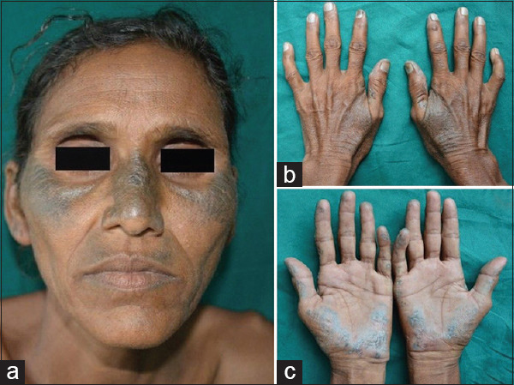
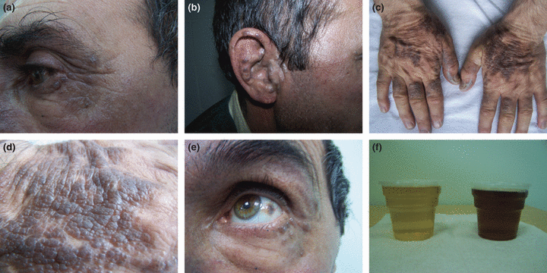
Clinical features
Endogenous ochronosis:
Most frequent is darkening of the ear cartilages and of the sclerae and conjunctivae
There is brown mottled pigmentation of the face (sometimes in a butterfly distribution), neck and trunk
Rarely, pigmentation of the palmar and plantar skin is seen

Slide 68
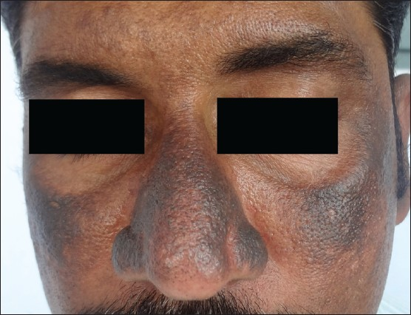
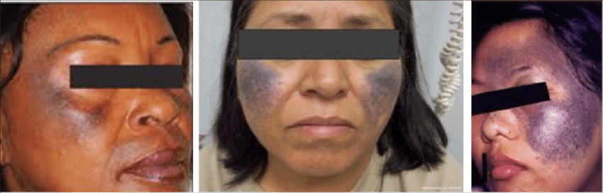
Clinical features
Exogenous ochronosis:
Grey‐brown or blue‐black macules in the skin in contact with hydroquinone, normally the face, neck, back and the extensor surfaces of the limbs
No hyperpigmentation of cartilage, sclerae or conjunctivae occurs

Slide 69
Differential diagnosis
Endocrinopathies: Addison disease, Cushing syndrome, hyperthyroidism.
Metabolic conditions: porphyria cutanea tarda, haemochromatosis.
Poikiloderma of Civatte.
Post‐inflammatory hyperpigmentation.
Toxin‐ and drug‐induced hyperpigmentation or discoloration (e.g. amiodarone, doxycycline).

Slide 70
Investigations
Alkaptonuria may be identified by urine organic acid analysis
Exogenous ochronosis is identified by the patient history

Slide 71
Management
First line
Alkaptonuria:
No definitive treatment exists
Nitisinone, ascorbic acid 1 g/day in divided doses and a protein‐restricted diet (1.3 g/kg/day) may be beneficial
Exogenous ochronosis:
Discontinuation of hydroquinone use
Sun protection/ avoidance
Treatment of discoloration is difficult
Topical low‐potency corticosteroids may be of benefit in combination with photoprotection
Notes:
Nitisinone is used to treat hereditary tyrosinemia type 1, which is too much tyrosine in the blood. It helps to prevent high levels of tyrosine in the blood

Slide 72
Management
Second line:
Although results are not uniform
Superficial dermabrasion using carbon dioxide laser, glycolic acid peelings or Q‐switched laser may improve the skin discoloration

Slide 73
Exogenous pigmentation
A wide variety of chemicals, either from occupational or medicinal exposure, can produce discoloration of the skin
Of importance are the metals silver, gold, mercury and bismuth, which are cumulatively deposited in the dermis and can produce permanent disfiguring pigmentation
A number of drugs can discolour the skin. These include the antimalarials, the phenothiazines, clofazimine and minocycline

Slide 74
Metals
Argyria:
This may develop as a result of systemic absorption or from external contact with silver
The silver may be deposited in the skin either as a result of medication containing silver salts or from industrial exposure
Cases of generalized argyria occur following ingestion of colloidal silver, which is widely marketed as a folk remedy for various conditions, including diabetes, AIDS, cancers and infections
A cumulative dose of 4–5 g is required to produce clinical signs

Slide 75
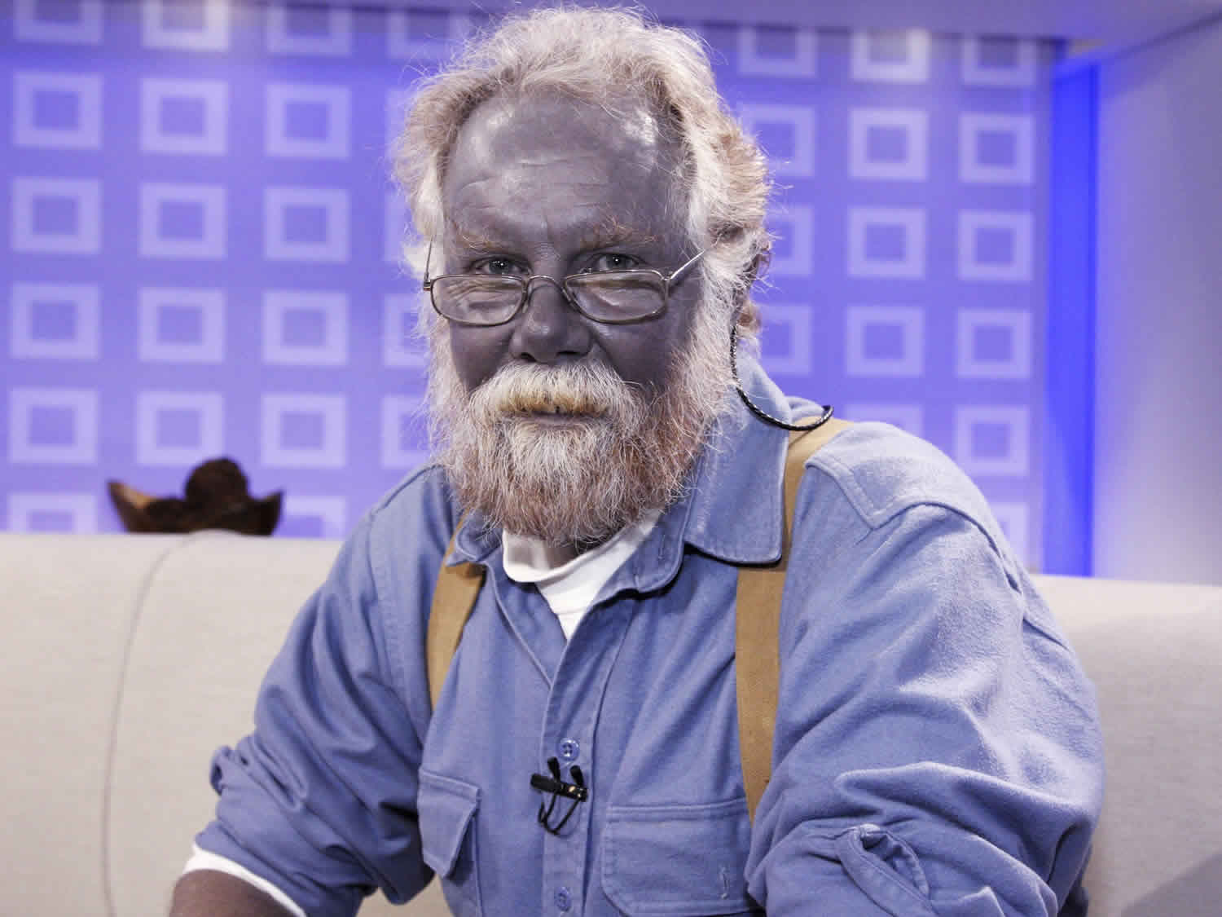
Clinical features
The pigmentation is usually a slate‐grey colour
Usually takes many years to develop and depends on the degree of exposure
The hyperpigmentation is most apparent in sun‐exposed areas of the skin, especially the forehead, nose and hands
In some patients, the entire skin has a slate blue‐grey colour
The sclerae, nails and mucous membranes may additionally become hyperpigmented.
The pigmentation is usually permanent.
Treatment with depigmenting agents is not effective. Sun protection can limit further pigmentary changes

Slide 76
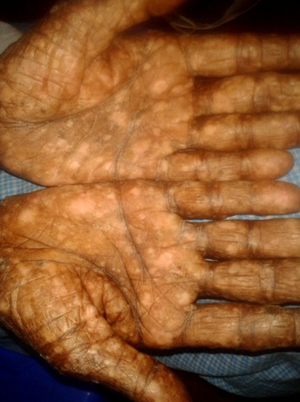
Arsenic
Prolonged ingestion of inorganic arsenic may result in diffuse pigmentation, most intense on the trunk
Hyperpigmentation is characterized by macular areas of depigmentation within areas of hyperpigmentation produce the distinctive ‘raindrop’ appearance
diffuse dark brown spots or diffuse darkening of the skin on the limbs and trunk

Slide 77
Bismuth
The administration of bismuth at regular intervals over a period of years has often been practiced
The diffuse grey pigmentation resembles that of argyria and involves also the sclera and the oral and sometimes the vaginal mucous membrane
A distinctive blue‐black line occurs at the gingival margin
This is due to deposition of bismuth that reacts with hydrogen sulphide formed by bacteria in the mouth

Slide 78
Chrysiasis and chrysoderma
These are terms used to describe permanent pigmentation of the skin due to parenteral administration of gold salts.
Excessive administration of gold leads to its deposition in connective tissue
The diagnosis is confirmed histologically on microscopy with dark‐field illumination and on electron microscopy with electron probe microanalysis

Slide 79
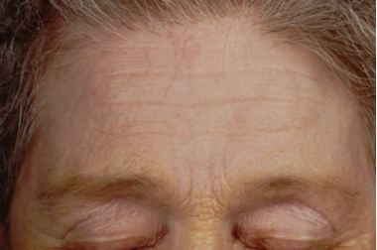
Chrysiasis and chrysoderma
Chrysiasis appears to be inevitable in any patient receiving more than 150 mg/kg
It may develop after a few months or after a longer latent period
The pigmentation is blue‐grey or may show a purplish hue, and is limited to light‐exposed skin and to the sclerae
The oral mucous membrane is not affected
The discoloration is permanent.
Notes:
Chrysiasis: mild lilac discoloration on the forehead and eyelids contrasting with the yellow of the elastotic skin on the bridge of the nose and eyebrows in 64‐year‐old woman with rheumatoid arthritis who 8 years earlier had been treated with parenteral gold for over 2 years.

Slide 80
Mercury
Repeated applications of mercury‐containing compounds can produce localized hyperpigmentation of the treated area
The pigment is observed in the upper dermis around capillaries and associated with collagen and elastic fibres.
Systemic administration of mercury results in gingival hyperpigmentation
Notes:
A case report of homicidal subcutaneous injection of metallic mercury resulted in widespread skin lesions, remote from the radiologically visible mercury; these appeared at 40 days and began to clear at 6 months

Slide 81
Tattoos
Accidental tattoos:
Pigmented particles may be accidentally introduced as contaminants of wounds or may, at high velocity, penetrate previously intact skin producing disfiguring tattoos
Such irregularly spattered pigmentation is quite commonly seen after road accidents and blast injuries
The disfigurement is often permanent
These tattoos often respond well to the Q‐switched Nd : YAG laser
Notes:
Small lesions may also be excised

Slide 82
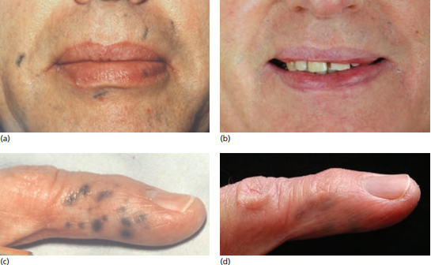
Notes:
(a–d) Traumatic tattoo: accidental tattoo following explosion during school chemistry experiment; excellent response to Nd : YAG laser.

Slide 83
Colliers’ stripes
These are a very distinctive occupational mark in coalminers
The bluish grey, linear or angular stripes develop at the sites of abrasions
Commonest sites are the forehead, bridge of the nose, wrists and elbows
Histologically: particles of coal dust up to 100 μm in diameter are seen at all levels in the dermis. They tend to be grouped around blood vessels

Slide 84
Therapeutic agents
Iron salts:
The use of solutions of ferric sulphate and ferric chloride in the treatment of dermatitis has been followed by a reddish‐ brown tattoo
The pigmentation may disappear after a few months or may persist indefinitely
Occupational contact with iron salts produced red‐brown punctate perifollicular pigmentation of the forearms in a man employed in pickling metal in hydrochloric acid.
Crystal violet: (gentian violet)
Given rise to a tattoo when applied to a wound of the face
Notes:
Crystal violet:(gentian violet; hexamethyl pararosaniline chloride)

Slide 85
Decorative tattoos
Techniques and materials:
The professional tattooist uses an electric needle to introduce particles of pigment into the dermis.The pigments commonly employed include the following:
Blue‐black (carbon).
Red (cinnabar and vegetable dyes).
Light blue (cobaltous aluminate).
Green (chromic oxide or chromium sesquioxide).
Yellow (cadmium sulphide).
Brown (ochre, iron oxides).

Slide 86

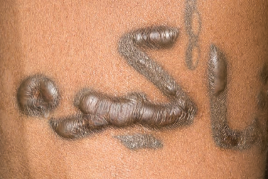
Complications of tattoos
Infection
Allergy to tattoo pigments
koebnerization of other disorders, particularly sarcoidosis
Foreign‐body granulomas of sarcoid type have been reported in ochre tattoos, which have a high silica content
Tattooing may also be complicated by keloids
Notes:
Fig 1)Lichenoid reaction in the red areas of a tattoo. , 2)Keloid reaction to decorative tattoo: flattened areas have responded to the injection of triamcinolone

Slide 87
Removal of tattoos
Small tattoos may be amenable to removal by simple surgical techniques
Pico Lasers are also widely used for tattoo removal

Slide 88


