Slide 1
Acquired DISORDERS OF THE NAILS AND NAIL UNIT
DR KINZA KANWAL
FCPS-II DERMATOLOGY

Slide 2
CONTENTS
DEFINITION
ANATOMY
DEVELOPMENT
GROWTH
CLASSIFICATON OF NAIL DISORDERS

Slide 3
DEFINITION
Nail
“An envelope covering the dorsal aspect of the terminal phalanges of fingers and toes”
Functions
  Aesthetics
  picking up small objects
  protect the distal digit
  fine touch sensation
Notes:
to enhance the asthetic appearance of the hands
to assist in
, to improve the

Slide 4
COMPONENTS
ANATOMY OF NAIL UNIT
Nail matrix
Nail bed
Nail plate
Nail folds
Lunula
Cuticle
NAIL UNIT
Notes:
The components of nail are collectively known as nail unit

Slide 5
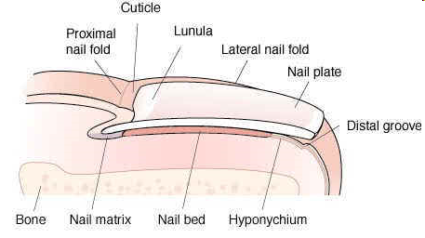
ANATOMY OF NAIL UNIT
Nail Matrix
  production of the cells that become the nail plate.
  No granular layer
  contains blood vessels and nerves
  If the matrix is damaged the nail will grow deformed
Nail Bed
  continuation of the matrix & the the nail plate rests on
Notes:
SO WHAT IS NAIL MATRIX IT IS THAT PORTION OF NAIL THAT IS Responsible for the

Slide 6
Nail Plate
  hard keratin
  Its free edge crosses the finger
  dead, flattened cells
  Pink because of the underlying capillaries
Notes:
nail plate or body of nail (corpus unguis)[3] is the actual nail

Slide 7
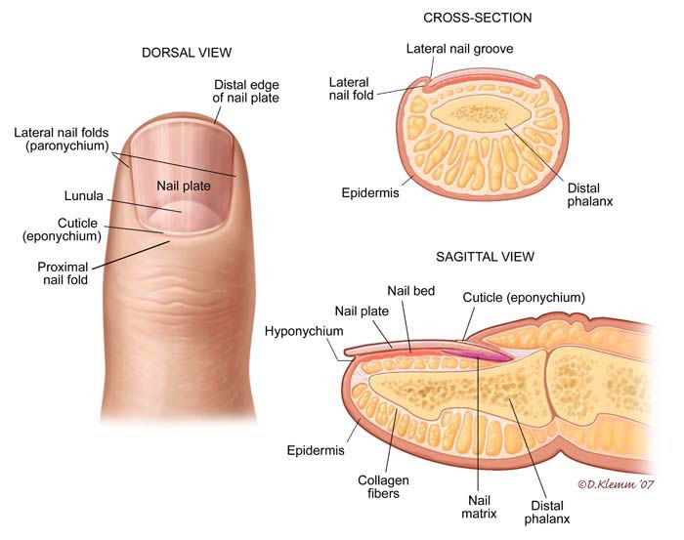
ANATOMY OF NAIL UNIT
Nail Folds
  hard skin overlapping the base(proximal) & sides of the nail (lateral folds),together they comprises paronychium.
Lunula
  visible part of the matrix, the whitish crescent-shape.
Notes:
NAIL FOLD IS AREA of nail that is hard skin
Largest in the thumb and often absent in the little finger.

Slide 8
Cuticle
  skin fold at the proximal end of the nail
  Modifed stratum corneum, protect at base of nail

Slide 9
DEVELOPMENT OF NAIL
ANATOMY OF NAIL UNIT
Develop from primitive epidermis b/w 9th & 20th week
At 20 wk, nail plate begin to form
At 36 wk, nail plate reaches tip of digit

Slide 10
GROWTH OF NAIL
ANATOMY OF NAIL UNIT
Finger nail grow 3 mm/month ,toe nail 1mm/month
Fingernails require 3 to 6 months
Toenails require 12 to 18 months
regrowth
Notes:
at an average rate of
In a month

Slide 11
Growth of nail
Nail growth is quicker:
  Day time
  Right-hand nails
  In the middle,ring and index finger
  During pregnancy
  In the summer than in the winter
  On the hands than the feet

Slide 12
CLASSIFICATION OF NAIL DISORDERS

Slide 13
CLASSIFICATION OF NAIL DISORDERS
ABNORMALITIES OF SHAPE
ABNORMALITIES OF NAIL ATTACHMENT
ABNORMALITIES OF NAIL SURFACE
ABNORMALITY OF NAIL COLOUR
TRAUMATIC NAIL DISORDERS
INFECTIONS OF NAIL APPARATUS
PSYCHOLOGICAL NAIL DISORDERS
DERMATOSIS AFFECTING NAIL
TUMOURS OF NAIL APPARATUS

Slide 14
ABNORMALITIES OF SHAPE
Clubbing
Koilonychia
Pincer nail

Slide 15
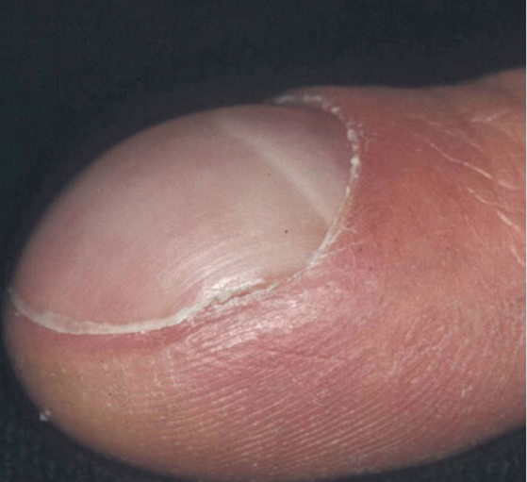
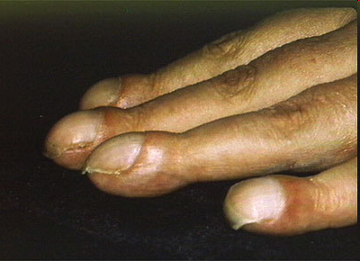
Clubbing
ABNORMALITIES OF SHAPE
Bulbous enlargment of terminal phalanges
increased transverse and longitudinal nail curvature
Caused by
  hypertrophy of the soft-tissue components of the digit pulp
  increased blood flow through the vasodilated plexus of nail unit vasculature
  Increased vagal tone
  Microvascular infarct
Notes:
Clubbing is related more to

Slide 16
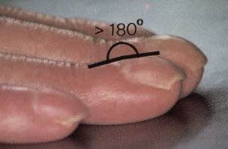
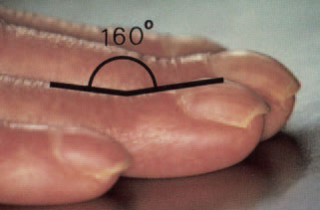
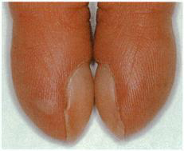
Assesment of clubbing
ABNORMALITIES OF SHAPE
Lovibond’s angle
Curth’s angle
Schamroth’s window
angle at the distal interphalangeal
joint
normally about 180°
diminished to less than 160° in
clubbing
When two fingers are held opposite to
each other
Diamond shape space is seen
Oblitration of this space in clubbing
angle at the junction between the nail plate and the proximal nail
fold
normally less than 160°
exceeds 180° in clubbing
Notes:
There are 3 forms of geomeri assemesmet that can be performed to identify clubbed finger
Shamroths window is seen whwn

Slide 17
Causes of Clubbing
ABNORMALITIES OF SHAPE
Cardiovascular disorders
  Aortic aneurysm
  Infective endocarditis
  Cyanotic congenital heart disease
Bronchopulmonary conditions
  Cystic fibrosis
  Fibrosing alveolitis
  Interstiatial lung disease
  Sarcoidosis/Tuberculosis
  Nasopharyngeal carcinoma
Gastrointestinal disorders
  Inflammatory bowel disease
  Carcinoma of oesophagus
  Hepatic Cirhosis
  Parasitic Infection
Others
  Thyroid disorders
  HIV
  Lupus erythematosus
  Hemiplegia
  Subungual tumour
Notes:
Some common cvs disorders which are implicated in clubbing

Slide 18
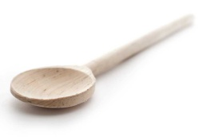
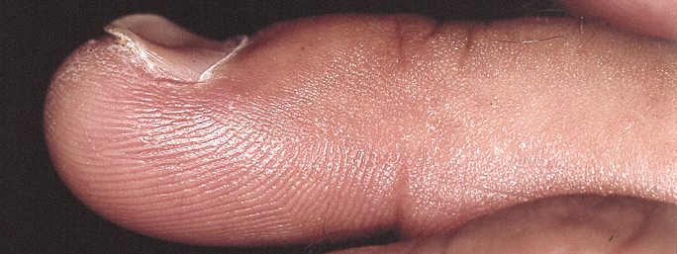
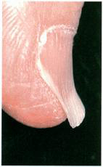
koilonychia
ABNORMALITIES OF SHAPE
Greek: koilos, hollow; onyx, nail
reverse curvature in the transverse and longitudinal axes giving a concave dorsal aspect to the nail
Nails become concave (spoon-shaped)
most prominent in the thumb or great toe
Notes:
Though any nail can be affected

Slide 19
Koilonychia causes
ABNORMALITIES OF SHAPE
PHYSIOLOGICAL | Early childhood
CONGENITAL | Ectodermal dysplasia nail-patella syndrome trichothiodystrophy
METABOLIC | Iron deficiency Haemochromatosis Porphyria Thyroid disease
DERMATOSES | LP Alopecia areata Psoriasis Dariers disease
OCCUPATIONAL | Contact with oils
INFECTIVE | onychomycosis
Notes:
in infancy as a benign feature of the great toenail,
, nail bed hyperkeratosis may push the nail up distally to produce a spoon‐shaped nail.

Slide 20
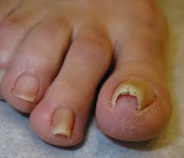
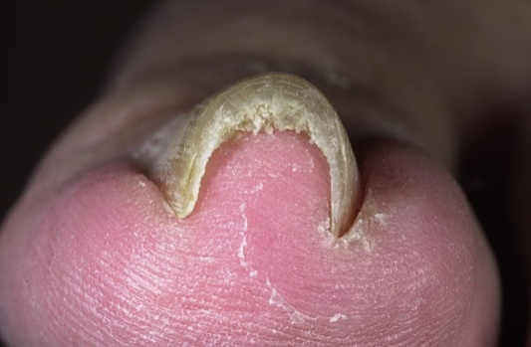
Pincer nail
ABNORMALITIES OF SHAPE
Nail growth is pitched
towards the midline,
combined with increased
transverse curvature.
Painful
Notes:
Pincer nail is described as dystrophy
Pain may arise due to embedding of pincer nail in kaeral nail folds and nail bed

Slide 21
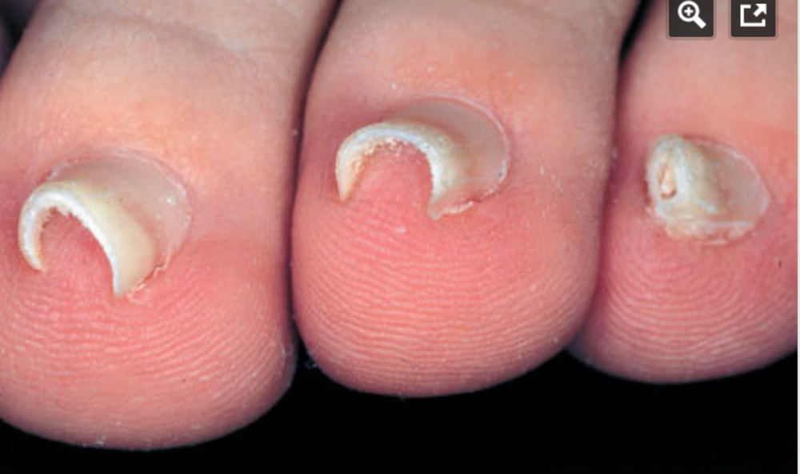
Pincer nail
Causes
  Familial
  Ill fitting shoes
  psoriasis
    Thumbs and big toes
Treatment
  surgery
Notes:
It presents in 3 patterns
Rx:to relieve the pain

Slide 22
ABNORMALITIES OF NAIL ATTACHMENT
Onycholysis
Pterygium
Ventral Pterygium
Subungual hyperkeratosis

Slide 23
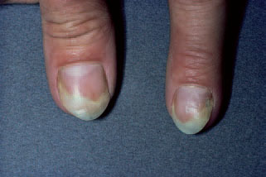
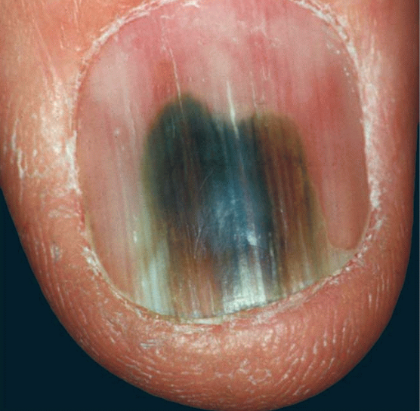
Onycholysis
ABNORMALITIES OF NAIL ATTACHMENT
  Distal and/or lateral separation of the nail from the nail bed
  Creates a subungual space that collects dirt and keratinous debris
  Colonization with P.aeruginosa and candida may produce greenish discoloration
Notes:
Onycholysis with green discoloration due to Pseudomonas colonization

Slide 24
Onycholysis
ABNORMALITIES OF NAIL ATTACHMENT
IDIOPATHIC | SECONDARY ONYCHOLYSIS
Over zealous manicure Frequent wetting Cosmetic solvent Abnormally long nails | Psoriasis Fungal infection Dermatitis Hypothyroidism and Hyperthyroidism Yellow Nail Syndrome Trauma Photoonycholysis due to psoralen, doxycycline, retinoid
Notes:
Idiopathic onycholysis is painless sepaeration of nail from nail bed without apparemt cause
Immersion of the hands in soap and water may be considered traumatic

Slide 25
Onycholysis
Treatment
ABNORMALITIES OF NAIL ATTACHMENT
General measures
  cut away loosened nail
  Keep nail dry
Topical treatment
  topical steroid preparation containing antibiotics and antifungals
  Gentamicin eye drops for Pseudomonas
  Soaking the fingertips in vinegar or sodium hypochlorite solution
Notes:
as much as possible
Several nights in a week for 5min is useful to prevent recurrence
dilution of 4 parts water to 1 part vinegar is likely to avoid risk of irritancy

Slide 26
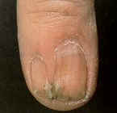
Pterygium
ABNORMALITIES OF NAIL ATTACHMENT
Central fibrotic band divides a nail proximally in two
Causes
  trauma
  lichen planus
  Graft versus- host disease
  leprosy
Notes:
Pterygium refers to winged appearance forms whwne

Slide 27
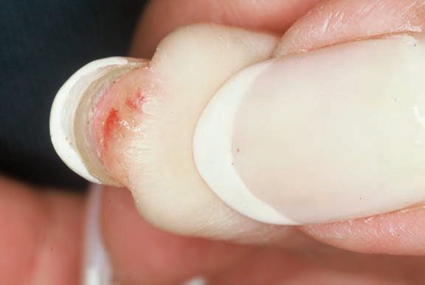
Ventral pterygium (pterygium inversum unguis)
ABNORMALITIES OF NAIL ATTACHMENT
Occurs on the distal undersurface
of the nail
Causes
  Raynaud’s phenomenon
  lupus erythematosus
  familial
  infections
Notes:
with forward extension of the nail bed epithelium dislocating the hyponychium
The overlying nail may be normal, but adjacent soft tissues can be painful.

Slide 28
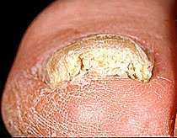
SUBUNGUAL HYPERKERATOSIS
ABNORMALITIES OF NAIL ATTACHMENT
Hyperkeratosis of nail bed and hyponychium
Causes:
  Psoriasis
  Onychomycosis
  Warts
  PRP
  Eczema
  Darier Disease
  Norwegian Scabies
Notes:
Hyperkeratosis is thickening of stratum corneum layer of epideemusAlso seen in sezary syndrome

Slide 29
ABNORMALITIES OF NAIL SURFACE
Longitudinal grooves
Transverse grooves and Beau’s lines
Pitting
Trachyonychia
Onychoschizia

Slide 30
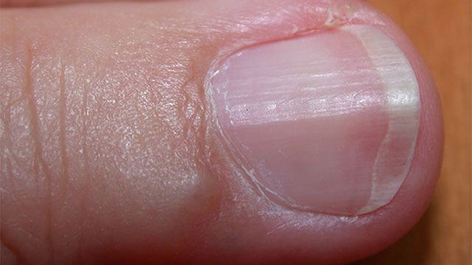
Longitudinal Grooves
  Vertical grooves in longitudinal axes
  Caused by trauma to specific area of nail growth
  Other Causes
    Familial
    Old age
    Oral Retinoid
    Tumours
    proximal nail fold pterygium
Notes:
viral warts, myxoid cysts, periungual fibromas)
Pic=nail is split, usually in the midline, with a firtree‐ like appearance of ridges angled backwards

Slide 31
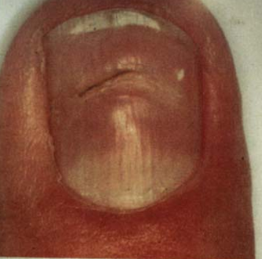
Transverse grooves and Beau’s lines
ABNORMALITIES OF NAIL Surface
Endogenous (Beau’s lines)
  arcuate margin matching the lunula
Exogenous (such as those due to manicure)
  the margin may match the proximal nail fold
Notes:
These are horizontal ridges present on nail When transverse grooves are endogenous due to acute systemic event they have drug reaction mi easls mumps pneumonia

Slide 32
The distance of the groove from the nail fold is related to the time since the onset of growth disturbance
The depth and width of the groove may be related to the severity and duration of disturbance
Notes:
These tranverse grooves or beaus lines arise when there is temporary interference in nail formation

Slide 33
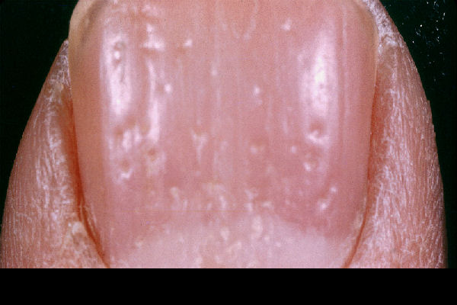
Pitting
ABNORMALITIES OF NAIL Surface
Punctate surface erosions on nail
Shallow or deep
Regular or Irregular outline
Notes:
Hp pits represent foci of parakeratosis retention of nuclei in statum corneum
Theses are small pits present on nail

Slide 34
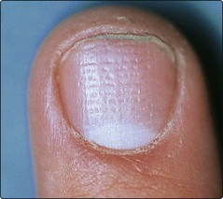
pitting
Causes
  Psoriasis
  Alopecia areata
  Eczema
  Occupational trauma
  Parakeratosis pustulosa
  P.rosea,secondary syphilis,LP,sarcoidosis
Isolated large pit(Elkonyxis)
  Seen in Reiters Disease,Psoriasis,Trauma
Notes:
Main cause of pitting is psoriasis in which it willb less regular
an isolated large pit may produce a localized full‐thickness defect in the nail plate
Fine pitting in alopecia areata

Slide 35
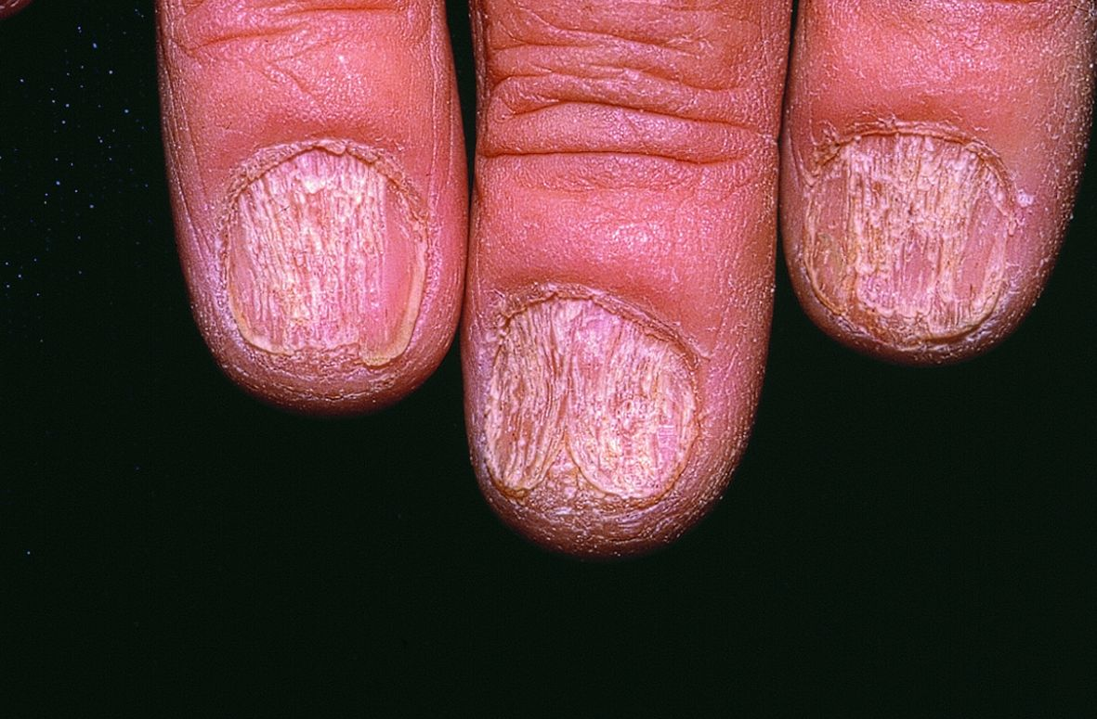
Trachyonychia
(2O NAIL DYSTROPHY)
ABNORMALITIES OF NAIL Surface
Roughened surface of all nail plates
CAUSES:
  Idiopathic 20 nail dystrophy
  Alopecia areata
  Psoriasis
  Lichen planus
  Chemicals
  Pemphigus
  Primary biliary cirrhosis
  Icthyosis vulgaris
  Ectodermal dysplasia
Notes:
As if it had been longitudinaly rubbed with sand paper paper with sand or a rough surface is stick to one sisde
Some response to sterods topical il systemic

Slide 36
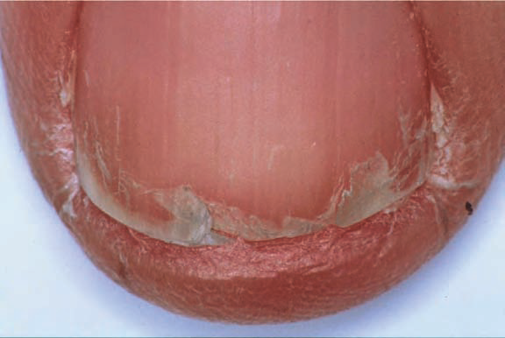
Onychoschizia/lamellar dystrophy
ABNORMALITIES OF NAIL Surface
Transverse splitting into layers at or near the free edge
Notes:
Is characterized by
Transverse splitting of nails into

Slide 37
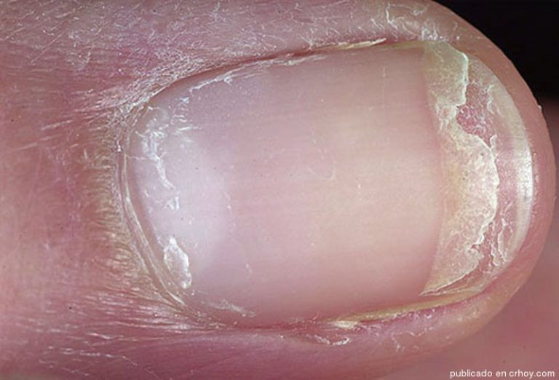
Onychoshizia/lamellar dystrophy
Causes
  Frequent wetting and drying of the hands
  Trauma
  Nail cosmetics
  Polycythemia
  HIV infection
  glucagonoma
Notes:
Sometimes associated with systemc disorder like

Slide 38
Onychoshizia/lamellar dystrophy
Biotin
Retain hydration
    Gloves,emollients,nail varnish

Slide 39
ABNORMALITIES OF NAIL COLOUR
Leukonychia
Colour changes due to drugs
Yellow Nail Syndrome
Splinter Haemorrhages
Red Lunula
Longitudinal erythronychia

Slide 40
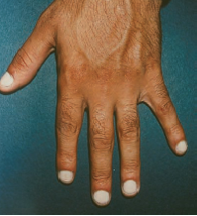
leukonychia
ABNORMALITIES OF NAIL COLOUR
White discoloration of the nail
Due to matrix dysfunction
Total leukonychia
    all nails are milky porcelain white

Slide 41
Subtotal leukonychia
    proximal two-thirds are white, becoming pink distally.
    attributed to a delay in keratin maturation
Apparent leukonychia
  changes in the nail bed are responsible for the white appearance
  anaemia, oedema or vascular impairment

Slide 42
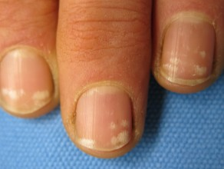
Punctate leukonychia
    white spots of 1–3 mm diameter
    minor trauma (e.g. manicure)
    Alopecia areata.

Slide 43
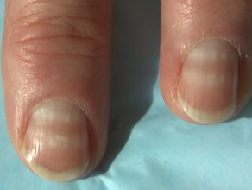
Transverse leukonychia (Mees’ line)
    1–2 mm wide transverse band in the arcuate form of the lunula
    chemotherapy
    poisoning
    systemic infection
Notes:
Truenon blanchable migrate with nail growth

Slide 44
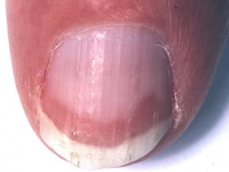
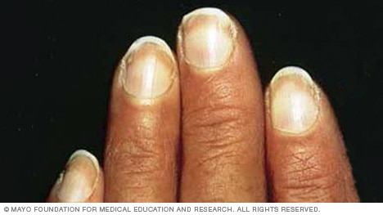
ABNORMALITIES OF NAIL COLOUR
Terry’s nail
  The nail is proximally white and normal distally
  Cirrhosis
  Congestive cardiac failure
  Diabetes

Slide 45
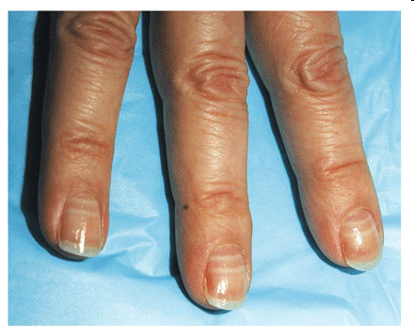
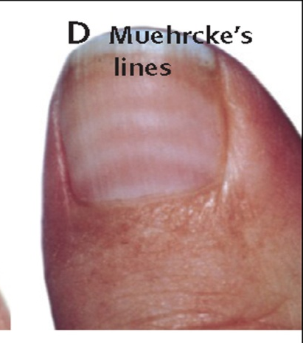
Muehrcke’s paired white bands
  parallel to the lunula
  pink between two white lines
  associated with hypoalbuminaemia
  reversible
Notes:
White bands pesent parallelassociated with hypoalbuminaemia, the correction of which by
albumin infusion can reverse the sign
Apparent leukonychia due to vascular congestion disappear when pressed

Slide 46
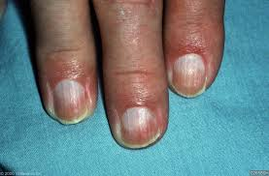
Half‐and‐half nails
  Proximal portion of the nail white and the distal half red, pink or brown with a sharp line of demarcation between the two halves.

Slide 47
Colour changes due to drugs
YELLOW | TETRACYCLINE
BLUE BLACK | CHLOROQUINE
BLUISH COLOUR | MEPACRINE
SLATE BLUE | ARGYRIA
BLUE LUNULAE | HYDROXYUREA
HYPERPIGMENTATIN | DOXORUBICIN
LONGITUDINAL MELANONYCHIA | ZIDOVUDINE

Slide 48
Yellow nail syndrome
Lymphedema
Respiratory features
Nail changes

Slide 49
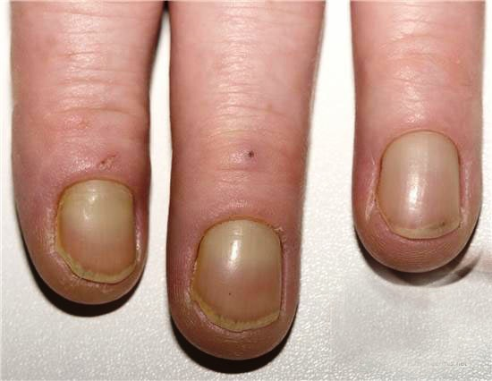
YELLOW NAIL SYNDROME
ABNORMALITIES OF NAIL COLOUR
The nails are yellow due to thickening, sometimes with a tinge of green
Obscured lunula
Increased transverse and longitudinal curvature
Loss of cuticle
Arrested nail growth is diagnostic
Nails grow at 0.1-0.25 mm/week
Notes:
The lunula is obsured
Nails grow at greatly reduced rate as copared to lowe normal rate of 0.5 mm week

Slide 50
YELLOW NAIL SYNDROME
Associations
ABNORMALITIES OF NAIL COLOUR
  Lymphedema
      most frequently affects the legs
      Less often it affects the face or hands
      occasionally it is universal.
  Respiratory or nasal sinus disease
      Recurrent pleural effusions. Chronic bronchitis, bronchiectasis
  Others
      malignant neoplasms, d-penicillamine therapy, nephrotic syndrome

Slide 51
YELLOW NAIL SYNDROME
TREATMENT
ABNORMALITIES OF NAIL COLOUR
oral and Topical vitamin E
oral zinc
Prednisolone
systemic antifungal
  itraconazole, fluconazole
Notes:
Attempted rx which have been tried are
Results are betteer

Slide 52
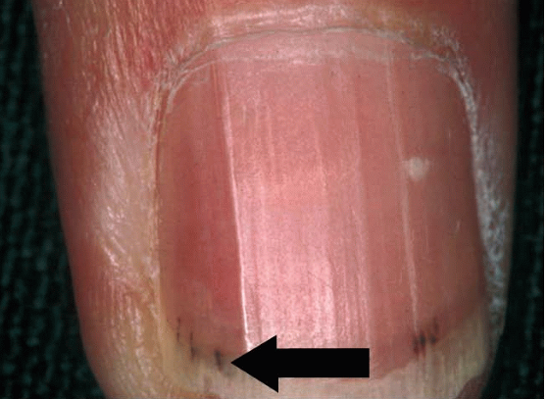
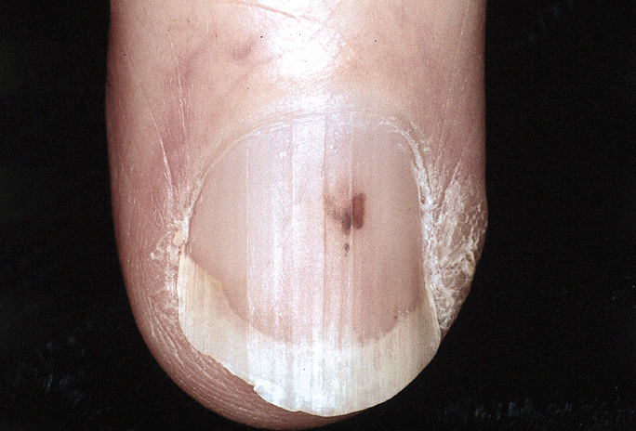
Splinter Haemorrhages
ABNORMALITIES OF NAIL COLOUR
Longitudinal haemorrhages in the nail bed
Trauma
psoriasis
dermatitis
fungal infection of the nails
Bacterial endocarditis
antiphospholipid syndrome
Distal
Proximal

Slide 53
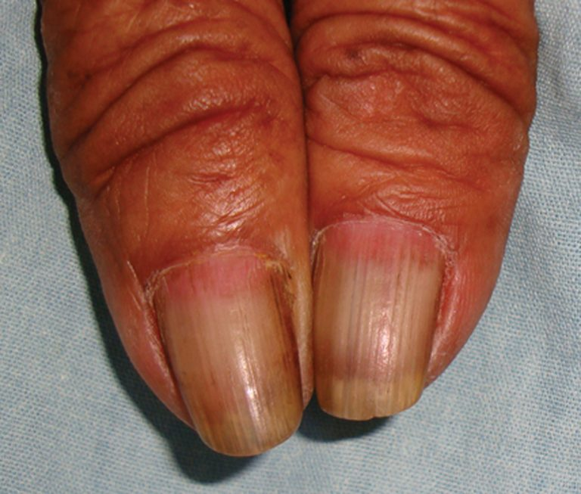
Red Lunula
ABNORMALITIES OF NAIL COLOUR
Erythema of all or part of the lunula
May affect all digits
Most prominent in the thumb
Subungual tumour such as a myxoid cyst or glomus tumour
Dotted red lunula in psoriasis and alopecia areata
Notes:
It will remain until the tumour is removed

Slide 54
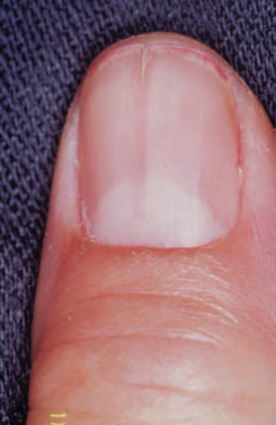
Longitudinal Erythronychia
ABNORMALITIES OF NAIL COLOUR
A longitudinal red streak in the nail
Seen in
  Lichen planus
  Darier disease
  Langerhan cell histiocytosis
  Psoriasis
  Focal tumors
Notes:
Focal tumors can cause this appearnce

Slide 55
TRAUMATIC NAIL DISORDERS
Subungual haematoma
Onychogryphosis.
Ingrowing toenail

Slide 56
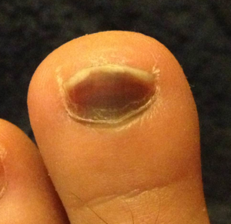
Subungual haematoma
TRAUMATIC NAIL DISORDERS
Collection of blood underneath a nail
Characterized by reddish-black discoloration
May or may not associated with pain

Slide 57
SUBUNGUAL HAEMATOMA
Treatment
  draining haematoma
  Nail removal(if >50% of nail is affected)

Slide 58
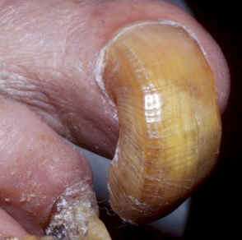
Onychogryphosis
TRAUMATIC NAIL DISORDERS
The nail is thickened, distorted and twisted
Affects great toenail
Predisposing factors
  elderly and neglected individuals
  Trauma and biomechanical foot problems
  chronic untreated onychomycosis
Notes:
It is an acquired dystrophy usually affecting great toe nail
Curved like rams horn

Slide 59
onychogryphosis
Treatment
  Surgical removal (good circulation)
  palliative (regular paring and trimming
Notes:
Rx is either radical or palliative
Radical rx cocsits of surgical removal of nail and matrix and is recomeneded in those with good circulation
Usulay by podiatrist using nail clippers

Slide 60
Ingrowing toenail (Onychocryptosis)
The lateral nail fold of the great toe is penetrated by the edge of the nail plate
Causes
  compression of the toe from the side due to ill-fitting footwear
  cutting the toenails in a half‐circle instead of straight across
  abnormally long great toe and prominent lateral nail folds
  Sport
  crawling, ‘pedalling’ or wearing undersized ‘jumpsuits
Notes:
The nail can ingrow on any of its four margins, although lateral ingrowing is the most common pattern and is usually found on the big toe. The soft tissue at the side of the nail (lateral nail fold) is penetrated by the edge of the nail plate, resulting in pain, inflammation and, later, the formation of granulation
Anatomical features, such as an, are important in some cases. with the toe impacting on the inside of the shoe through kicking or other movements, can be a contributory factor.. T. Proximal nail ingrowing is known as retronychia and is self‐limiting over a matter of several months as eventually the older nail is shed. During that time, nothing effectively relieves the problem and avulsion is the treatment of choice. The replacement nail usually grows back without any problem [5]. In infancy, ingrowing toenail most commonly occurs before shoes are worn and is associated with’ [6]; acute paronychia may be associated. Rarely, it is congenital [7] and even familial [2]. In children, ingrowing is commonly distal rather than lateral. Management is conservative in most instances, with topical steroid and antiseptic preparations. Surgery is occasionally required

Slide 61
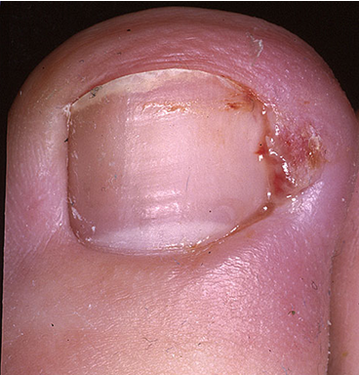
Clinical features
Pain and redness, shortly followed by swelling and pus
Granulation tissue formation
Notes:
Excess nail fold granulation tissue can also be a feature of amelanotic melanoma and reactions to medications such as retinoids, ciclosporin, antiretroviral drugs and chemotherapy

Slide 62
MANAGEMENT
  Wear shoes sufficiently wide, high and pliable to remove lateral pressure
  Correct Any abnormality of foot/toe function
  Cut the nail straight across
  Topical antiseptics and insert a pledget of cotton‐wool under the edge of the nail.
  Twice‐daily warm water baths followed by careful drying and powdering
Notes:
Rx may b difficult and prolonged first essential is to insit the patient

Slide 63
MANAGEMENT
  Potent topical corticosteroids
  Systemic antibiotics (more severe infection with local cellulitis )
  Cauterization with a silver nitrate stick(for granulation tissue)
  Nail removal
  Phenolization of the relevant part of the matrix
Notes:
can help to diminish inflammation and suppress granulation tissue They should always be used only after infection has been ruled out
. It is important that an amelanotic melanoma is not missed [19], and if there are atypical features a biopsy should be performed
If conservative measures fail, operative intervention will be necessary
Removing the nail alone is likely to result in recurrence of ingrowing when the nail returns and so should be combined

Slide 64
INFECTIONS OF NAIL APPARATUS
Paronychia
Subungual abscess
Hang Nail
Onychomycosis

Slide 65
Paronychia
INFECTIONS OF NAIL APPARATUS
Inflammation of the skin around a finger or toenail
  Acute paronychia
  Chronic paronychia
  Herpetic whitlow
  Drug‐induced paronychia

Slide 66
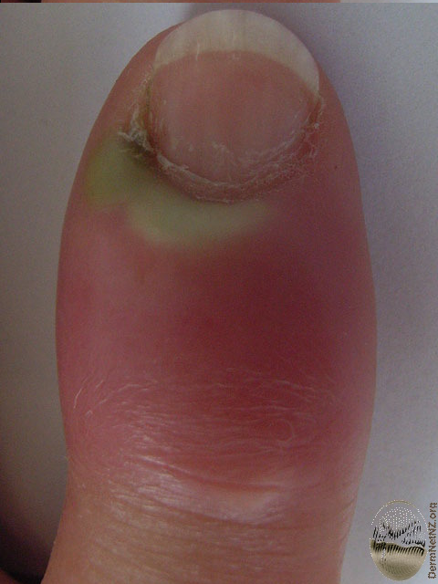
Acute Paronychia
INFECTIONS OF NAIL APPARATUS
  < 6 weeks duration
  Usually staphylococcal infection
  herpes virus ,orf virus,fungi
result from local injuries, splits, splinters or nail biting
  Affects single digit
Pain, redness and swelling
Notes:
Acute paronychia is most commonly caused by
Non infectious causes are
Presents as painful red sweeling of paronychial area

Slide 67
Chronic Paronychia
INFECTIONS OF NAIL APPARATUS
>6weeks duration
Etiological factors
    Wet work or caustic materials
    Domestic workers, bar staff, canteen workers
    Background of atopy or psoriasis
    Thumb sucking
    Organisms
      S.aureus or epidermidis, Proteus vulgaris, E.coli , Pseudomonas aeruginosa,
      Candida albicans
Notes:
Inflammatory dermatoses of nail fold of more than 6 weeks
It is predominantly a disease of
Of patients having a background
Various organisms may b found

Slide 68
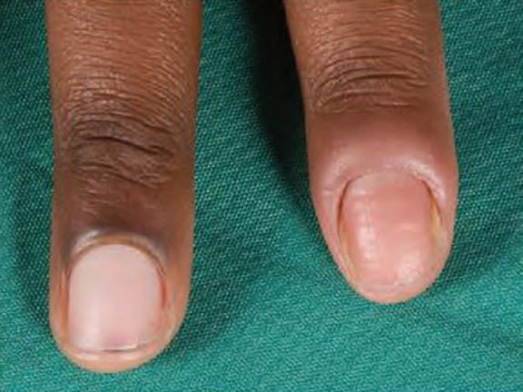
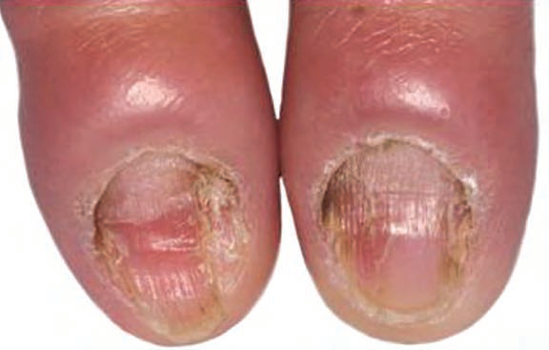
Chronic Paronychia
INFECTIONS OF NAIL APPARATUS
Nail changes:
  Index & Middle finger of right hand
  Middle finger of left hand
  Swelling at base of one or more nail
  Cuticle is lost
  Puss below nail fold
  Nail growth disturbed
  Nail discoloration
  Nail dystrophy
Notes:
Any finger may b involved most frequently Begins as
Resulting in matrix disruption resulting in disruption of nail growth
Discoloration due to candida or pesudomonas
Pic=loss of cuticle, severe nail dystrophy in more advanced disease

Slide 69
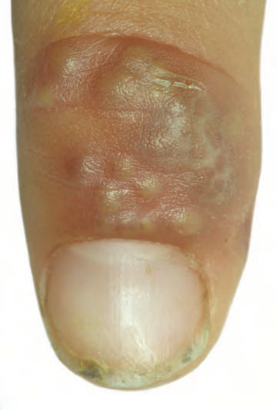
Herpetic whitlow
INFECTIONS OF NAIL APPARATUS
Due to inoculation of the herpes simplex virus from herpes stomatitis or herpes labialis
Presents as single or grouped painful blisters close to the nail
Clear at first,become purulent, rupture and replaced by crusts
Children under 2 years
Takes 3 weeks to resolve

Slide 70
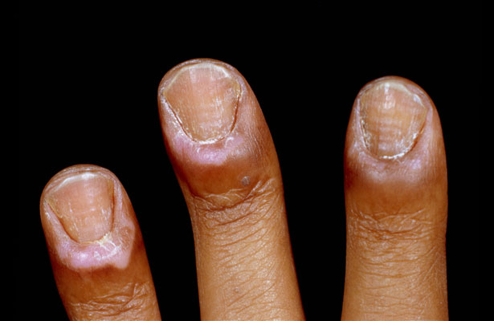
  DRUG‐INDUCED PARONYCHIA
INFECTIONS OF NAIL APPARATUS
Isotretinoin
Methotrexate
ciclosporin
Lamivudine
Capecitabine
Doxorubicin
Docetaxel
Notes:
Medications are also responsible for acute nd chroniv paronychia
Paronychia resolves once medication is discontinued
Paronychia due to retiniods/texans

Slide 71
Diagnosis (Paronychia)
INFECTIONS OF NAIL APPARATUS
Clinical
Gram stain microscopy
Potassium hydroxide
Bacterial culture
Viral swabs
Tzanck smears
Nail clippings for culture

Slide 72
MANAGEMENT(Paronychia)
INFECTIONS OF NAIL APPARATUS
Keep the hands dry and warm
Avoid wet work, or use totally waterproof gloves
Keep fingernails clean
Topical antiseptics .
Oral antibiotics /Antiviral /Antifungals
Topical/intalesional corticosteroids with antimicrobials
Surgical incision and drainage
Nail removal
Notes:
Rx is by combination of avoidance of precipitants hand careand medications
Most imp part of rx is to kep may be prescribed for localised, minor infection
may be necessary for severe or prolonged bacterial infection; often a tetracycline such as doxycycline is prescribed.
In case of severe or recurrent herpis infection
if C albicans is confirmed.If significant nail dystrophy nd medical therapy unsuccesful repeated acvute flares nail removal
Steriods For flare nd in resistant cases
may be required for abscess followed by irrigation and packing with gauze
Steriods For flare nd in resistant cases
may be required for abscess followed by irrigation and packing with gauze
to allow pus to drain

Slide 73
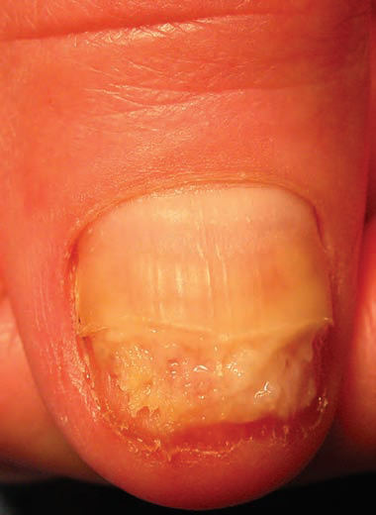
Subungual abscess
INFECTIONS OF NAIL APPARATUS
Pockets of pus directly beneath the nail plate without coexisting paronychia
Throbbing pain
Yellow discoloration of the nail
Distal onycholysis
Treatment
  Pus drainage
  Partial nail avulsion
  Antibiotic therapy
Notes:
Partial avulsion of the abnormal nail area allows the nail bed
to be treated with chlorhexidine, mupirocin or fusidic acid

Slide 74
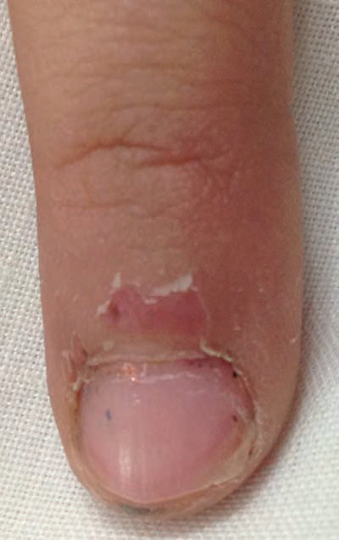
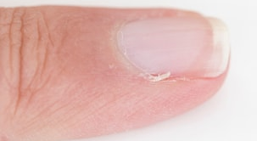
Hangnails
INFECTIONS OF NAIL APPARATUS
Small horny epidermis that have split away from the lateral nail fold.
Due to nail biting/irritants
hard pointed distal end and an adherent base
Pain due to inflammation
May lead to paronychia
Notes:
Hang nails are small portions
Attempts to remove them may be complicated by acute or chronic paronychia.
And I m sure u all have expeience this condition time to time
.

Slide 75
Management(hang nails)
  Snip off
  Mupirocin or fusidic acid ointment
Notes:
They should be snipped offusing sharp‐pointed scissors.
may prevent or clear low‐grade infection

Slide 76
Onychomycosis
INFECTIONS OF NAIL APPARATUS
  Dermatophytes such as Trichophyton rubrum (T rubrum), T. interdigitale
  Yeasts such as Candida albicans.
  Moulds especially Scopulariopsis brevicaulis and Fusarium species
Notes:
RING WORM OF NAILS

Slide 77
Onychomycosis
INFECTIONS OF NAIL APPARATUS
Five distinct patterns
Distal and lateral subungual onychomycosis
Superficial white onychomycosis
Proximal subungual onychomycosis
Endonyx onychomycosis
Totally dystrophic onychomycosis

Slide 78
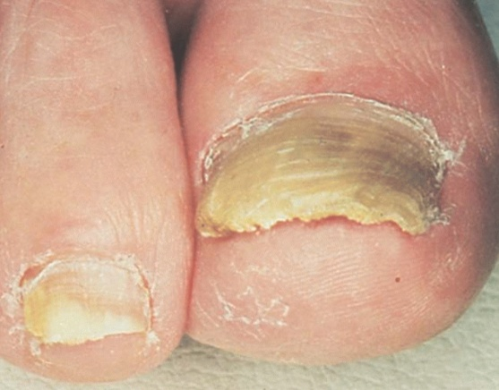
Distal and lateral subungual onychomycosis
INFECTIONS OF NAIL APPARATUS
Most common pattern
White or yellow streak or a patch of discoloration
at the free edge of the nail plate, often near the lateral nail fold
Become darker brown or black
Notes:
Due to thickening

Slide 79

Superficial white onychomycosis
INFECTIONS OF NAIL APPARATUS
Less common
Powdery white patches
Easier to treat

Slide 80

Proximal Subungual Onychomycosis
INFECTIONS OF NAIL APPARATUS
Particularly associated with AIDS patients
T. rubrum-most common cause

Slide 81

Endonyx Onychomycosis
INFECTIONS OF NAIL APPARATUS
pits and lamellar splits on nail
invasion occurs from the top surface, but penetrates deeply into the nail plate
caused by
  dermatophytes that cause endothrix scalp infections, notably T.soudanense
Notes:
No onycholysis or subungual hyperkeartosis

Slide 82

Totally dystrophic onychomycosis
INFECTIONS OF NAIL APPARATUS
Nail plate is completely destroyed.
final common pathway for severe infection

Slide 83
Onychomycosis
Treatment
INFECTIONS OF NAIL APPARATUS
First line
Oral terbinafine 250 mg/day for
6 weeks for fingernails
3 months for toenails
OR
Itraconazole 400 mg/day for 1 week/month
2–3 months for fingernails
3–4 months for toenails
Second line
• Griseofulvin dose 1 g for 4–8 months (longer for toenails)

Slide 84


PSYCHOLOGICAL NAIL DISORDERS
Onychophagia
  biting off the nail plate, soft tissues of the nail bed and the cuticle
Onychotillomania
  habit of picking or otherwise manipulating the nails
Nails are short,ragged free edges,roughened surface, paronychia,pterygium
Treatment
  Trim nails
  Bitter-taste application
  Oral pimozide
Notes:
To discourage nail biting
Antipsychotic drug

Slide 85
DERMATOSIS AFFECTING NAIL
PSORIASIS
DARIERS DISEASE
ECZEMA
LICHEN PLANUS

Slide 86
Psoriasis
DERMATOSIS AFFECTING NAIL
50% patients Nail involvement
NAIL MATRIX | NAIL BED OR HYPONYCHIUM | OTHER
Pits | Onycholysis/oily spots | Nail discoloration
Transverse furrows/grooves | Subungual hyperkeratosis | Acute and chronic paronychia
Crumbling nail plate | Splinter haemorrhages
Notes:
Psoriais is most common dermatosis affecting nails
Over a life time
Nail changes seen in spritic patients are Pits represent punctate surface depressions
Nail matrix disturbace is reflected in

Slide 87



DERMATOSIS AFFECTING NAIL
PSORIASIS
Notes:
Pits=punctate surface depressions arising from proximal matrix disease
onycholysis+=Focal nail bed parakeratosis produces an ‘oil spot’ or ‘salmon
patch’. Extension of this area to the free edge results in onycholysis
Subungual hyperkeratosis=marked distally and extends proximally

Slide 88

Acropustulosis
DERMATOSIS AFFECTING NAIL
Component of:
  pustular psoriasis
  Palmoplantar pustulosis
  acrodermatitis continua of Hallopeau
Sterile pustules in the nail bed and matrix
nail plate may be lifted off
Notes:
This for of psoriasis involves destructive pustualtion of nail unit pic-=plate has been destroyed by intense pustular
inflammation.
Acro localized pustular psoriasis

Slide 89

Parakeratosis Pustulosa
DERMATOSIS AFFECTING NAIL
Usually interpreted as a form of psoriasis
Some consider it a variant of eczema
may affect only part of one digit
  there is pitting and ridging combined with fine scaling erythema of the periunguium
  very rarely pustules.
  usually resolves spontaneously

Slide 90
management Of Nail Psoriasis
DERMATOSIS AFFECTING NAIL
General Hand Care:
Avoid manicure
Avoid solvents
Keep nail short
gloves for wet/greasy work
Use emollients
Notes:
General hand care is important to avoid(Koebner) response, whereby minor trauma may elicit psoriasis. These measures include avoiding..

Slide 91
management Of Nail Psoriasis
DERMATOSIS AFFECTING NAIL
SPECIFIC MEASURES
Steroids:
Clobetasol Propionate topically
Triamcinolone Acetonide Inj
Topical Vitamin-D Analogues
Photo Chemotherapy
Retinoids
Topical 5-Fluorouracil 1% in 20% urea/propylene glycol
Topical Cyclosporin
Systemic therapy (mtx,ciclosporin)
Notes:
Clobetasol propionate ointment without occlusion, rubbed into the nail fold. Duration of treatment is
limited by local atrophy. It is useful for psoriatic paronychia
Injected into Nail fold, bed and matrix response in subungual hyper and nail plate thickening
With or without steroids in alternate basis
Onycholysis more responsive
Tazarotene 0.1% gel under occlusion onycholysis and pitting
5 fu not use if onycholysis
Systemic methotrexate and ciclosporin, Biological agents would not usually be advocated as therapy for nail disease alone

Slide 92


Lichen Planus
DERMATOSIS AFFECTING NAIL
Thinning or thickening
Onychorrhexis
Crumbling or fragmentation
Brittleness
pterygium
Notes:
Nails are involved in 10% cases of lp and in 75% nail changes may b the sole manifestation of lp
Onychorhrexis lobgitudinal ridging of nail plate Classic pterygium formation
thinning of the nail plate and longitudinal ridging

Slide 93


Lichen planus
Longitudinal melanonychia/erythronychia/leukonychia
subungual hyperkeratosis
Onycholysis
Anonychia
Notes:
Lichen planus with longitudinal melanonychia
Anonychia following lichen planus.

Slide 94
Lichen Planus
Treatment
DERMATOSIS AFFECTING NAIL
Topical Steroids for 2-3 months
Triamcinolone Acetonide I/M for 3-6months
Oral Steroids 60mg/day
OTHER : dapsone,acitretin,ciclosporin,azathioprine
Notes:
Treatment needs to be commenced early Once scarring has progressed sufficiently to cause a pterygium,
there will be an irreversible component.
rubbed into the nail folds for 2–3 months
Triamcinolone acetonide can be given intramuscularly at a dose of
0.5–1 mg/kg per month for 3–6 months
ORAL STEROIDS ARREST SEVERE SCARRING NAI LP

Slide 95


Darier Disease
DERMATOSIS AFFECTING NAIL
Red & White Longitudinal Streaks
Distal subungual hyperkeratotic papules
V-Shaped nick----Pathognomic
Other :
  Excess ridging
  Thickening of nail plate
Notes:
Nail involvement is common in dariers
And about 96% pts have acral changes of which nail changes are most common V-shaped nick at the free edge of the nail

Slide 96


Eczema
DERMATOSIS AFFECTING NAIL
Pitting
Thickening
Nail loss
Transverse ridges and furrows
Subungual hyperkeratosis & Onycholysis
Smooth and shiny with severe itching
Associated hand dermatitis shows vesicles,
scaling, erythema, cracks & swollen finger

Slide 97
Eczema
Treatment
DERMATOSIS AFFECTING NAIL
  General hand care
  Topical steroids
  Topical or systemic antimicrobial therapy
  PUVA can be helpful
Notes:
General hand care is important, with the avoidance of soap, irritants,wet work. Protective gloves shoul be used, with copious emollient application.potent topical steroids may b need sometimes with additional topical or systemic ntimicrobial terapy rubbed into nail folds can develop premature epishyseal cloure osteomyelitis
Hand or foot puva can b helpful

Slide 98
TUMOURS OF NAIL APPARATUS
BENIGN
MALIGNANT
Pyogenic Granulomas
Glomus Tumor
Subungual Exostosis
Myxoid Pseudocyst
Onychomatricoma
Periungual Fibrokeratoma
Subungual keratocanthoma
Squamous Cell Carcinoma
Melanoma

Slide 99

Pyogenic granuloma
TUMOURS OF NAIL APPARATUS
Benign vascular tumour
Site:
  proximal nail fold/nail bed
  Hyponychium
Slightly raised red bumps
Bleeds very easily
Erosion of surface may occur

Slide 100
Predisposing factors
TRAUMA | Ingrowing nail friction from footwear self‐induced disorders accidental penetration of foreignbody
DRUGS | Retinoids ,ciclosporin ,cancer chemotherapy and antiretroviral therapy
PERIPHERAL NERVE INJURY | plaster cast immobilisation,Guillain–Barre syndrome,hemiplegia
INFLAMMATORY SYSTEMIC DISEASES | sarcoidosis, psoriasis and seronegative spondyloarthritis

Slide 101

Pyogenic Granulomas
TUMOURS OF NAIL APPARATUS
TREATMENT
  Potent corticosteroid cream under an occlusion
  Curettage under local anaesthesia
  Remove cause (drug, plaster cast)
Notes:
best for drug‐induced PGs) for up to 6 weeks
if feasible
Differential diagnosis
melanoma and squamous carcinoma.

Slide 102

Glomus tumour
TUMOURS OF NAIL APPARATUS
Benign tumor of glomus body
Subungual
Pain--spontaneous or provoked by mild trauma or temperature change
Bony erosions 50%
Notes:
Component of dermis involved in thermoregulation
Pressure of glomus tumour on underlying phalanx
Pain is predominat symptom

Slide 103


CLINICAL PRESENTATION
BLUISH OR RED FOCI BENEATH NAIL
LONGITUDINAL ERYTHRONYCHIA
Notes:
There are 2 main clinical pressnettaions of glomus tumor

Slide 104
Glomus tumour
Investigations
  MRI
  Histopathology
    Clusters of glomus cells surrounding capillaries
Treatment
  Excision
Notes:
Location and extent of tumour

Slide 105
Subungual Exostosis
TUMOURS OF NAIL APPARATUS
Benign osteochondral outgrowth of the terminal phalanx.
Usually found on the great toe
May be painful
Predisposing factors
  Trauma
Notes:
rarely a finger

Slide 106

Clinical presentation
Usually elevates nail plate as it emerges from hyponychium
Porcelain white hue with superficial telangiectasia
Thick hyperkeratotic surface
Notes:
Exophytoc outgrpowth og emerging from under the nail plate surface telengiectasisa

Slide 107
Subungual Exostosis
Investigations:
  X RAY
  HISTOPATHOLOGY
    Bony tumour with hyaline cartilaginous cap
Management:
  SURGICAL EXCISION

Slide 108



Myxoid Pseudocyst
TUMOURS OF NAIL APPARATUS
Semi translucent,smooth shiny papule,contain a clear gelatinous fluid
Result from leakage of synovial fluid through breach in joint capsule
Associated with osteoarthritis
Notes:
Comon benign tumor of digits Called psudocyst coz its not surrounded by a capsule ,unlike a true cyst.
Pathophysio behind this

Slide 109
Type A
Type B
nodule between the distal interphalangeal joint and the proximal nail fold
in the proximal nail fold and presses on the underlying matrix resulting in a longitudinal groove in the nail
under the matrix, giving rise to a reddish or bluish lunula
Type C
Notes:
Clinacal features deepend on their location in relation to nail apparatus
Type a is most common presenation

Slide 110
Myxoid Pseudocyst
TUMOURS OF NAIL APPARATUS
Treatment
  incision and drainage
  Steroid or sclerosant injection
  Cryotherapy
  laser
  surgical removal
Notes:
Multiple rx have been recomnede fo rthis condition an daim is to obliterate leakage oof fluid from joint by inducing fibrosis around capsule For type c

Slide 111


Onychomatricoma
TUMOURS OF NAIL APPARATUS
Tumour of the nail matrix
Single digit 75% ,middle finger
Notes:
Rare benign

Slide 112
Clinical signs
Thickening of the nail plate,sparing a part of normal pinkish nail
Woodworm cavities at the free edge of the thickened nail plate
Longitudinal ridging
Splinter haemorrhages
Transverse and longitudinal overcurvature
Xanthonychia

Slide 113
Notes:
Pigmente d longitudinal thickng of plate
Wood worm cavities in nail plate

Slide 114


onychomatricoma
Investigation
  Dermoscopy
  Nail clipping
  Ultrasound
  MRI
  Nail Avulsion
    Villous tumor,sea anemone appearance
Treatment
  Surgical excision
Notes:
Dermso confrm diagnosis in showng wood worm perforations at distal edge of nail
Mri reveals tumor emerging frm nail matrix

Slide 115


Periungual Fibrokeratoma
TUMOURS OF NAIL APPARATUS
    Solitary benign asymptomatic nodule
    Occurs due to trauma
    Hyperkeratotic tip and narrow base
In the periungual area Or under the nail plate
When present on several digits
(koenen tumours) rule out tuberous sclerosis
Notes:
Garlic clove fibroma
Multipe soft fibrokeratomas I tuberous sclerosi

Slide 116


Subungual keratoacanthoma
TUMOURS OF NAIL APPARATUS
Benign but rapidly growing and aggressive tumour
Painful, dome‐shaped nodule with a central crater plugged by keratinous material
Most commonly over thumb
May lead to destruction of the distal bony phalanx.
Notes:
Standard X‐rays consistently demonstrate a well‐defined cupshaped
erosion of the underlying bone

Slide 117


Squamous Cell Carcinoma
TUMOURS OF NAIL APPARATUS
Most frequent malignant tumour of the nail apparatus
Etiology
  HPV, Ionizing radiation, arsenic and pesticides
In situ squamous cell carcinoma (Bowen disease)
Invasive squamous cell carcinoma
Subungual hyperkeratosis , onycholysis,nail plate destruction
Notes:
Its presenation as in situ
It can cause bowen disease wart lesion of distal ned bed and hypony
Onycholyssis and oozing from great toe nail due to invasi scc

Slide 118


Melanoma
TUMOURS OF NAIL APPARATUS
Involvement of nails is rare
Poor prognosis
Thumb or hallux is most often affected
Longitudinal melanonychia
Amelanotic nodule
Hutchinson’s sign
Notes:
Melanoma of nail apparatus is rare but ass with poor prognosis 3 quartes of cases present as lon in others it arises from nail ed and present as amelanotic
the presence of pigment on the proximal, lateral or distal nail fold
Hutchinson sign highly suggestive of melanms

Slide 119

melanoma
Investigation
  Dermoscopy
    Brown backgound with brown to black lines
    Unevenly pigmented
    Irregularly spaced
    Variable thickness
  biopsy
Notes:
ermoscopy shows a brown background and longitudinal darker lines of irregular thickness, spacing, and coloration (arrows). L

Slide 120
treatment
In situ melanoma
  En bloc removal of nail unit with 5-10mm margins
Invasive melanoma
  Amputation guided by balance between tumour thickness and conservation of function

Slide 121


