Slide 1

Notes:
In the name of Allah , The most beneficent , the most merciful

Slide 2
Blepharochalasis
Laxity of the eyelid skin due to a defect in the elastic tissue.

Slide 3
Synonyms
Ascher syndrome

Slide 4
Epidemiology
Incidence and prevalence
Rare, mostly sporadic.
Age
Usually around the time of puberty.
Ethnicity
Most cases are reported in white people.
Associated diseases
Some cases may be a localized form of post‐inflammatory elastolysis
or follow angio‐oedema .

Slide 5
Pathophysiology
In the early stages, there may be a mild dermal lymphocytic infiltrate,and in the later stages the elastic fibres in the lids fragment and decrease.
Normal elastin gene expression suggests other factors may be involved in elastic fibre loss.
IgA deposition may be detected on fibres, implying an immunopathogenic mechanism may be relevant.
Disintegration of collagen fibres has also been observed in one case.

Slide 6
Predisposing factors
Presumably inflammatory stimulus to elastophagocytosis.

Slide 7
Genetics
Some pedigrees show autosomal dominance, although most cases are sporadic.

Slide 8
Clinical features
History
There may be a history of previous transient episodes of painless eyelid swelling lasting for 2–3 days.

Slide 9
Clinical features
Presentation
Blepharochalasis is an uncommon condition that usually develops insidiously.
Attacks of painless swelling of the eyelids are followed by laxity, atrophy, wrinkling and pigmentation, predominantly of the upper eyelids.
There may be multiple telangiectases. These changes produce an appearance of tiredness, debauchery or premature ageing.
Reduplication of the mucous membrane of the upper eyelid is associated with blepharochalasis in about 10% of cases, and this may make the eyelids appear thick.

Slide 10
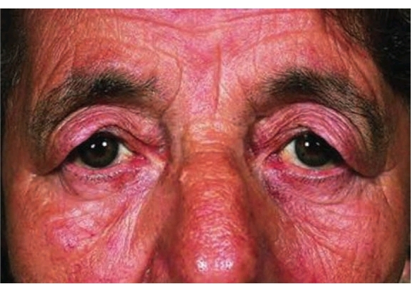
Blepharochalasis.

Slide 11
Clinical variants
Ascher syndrome
Ascher syndrome is the association of blepharochalasis with progressive enlargement of the upper lip due to hypertrophy and inflammation of the labial salivary glands.
The lip feels soft and lobulated and there may be excessive salivation.
In some cases, the accessory lacrimal glands are also affected, with increased thickness of the eyelids.
Goitre (enlargement of the thyroid) has also been reported as part of the syndrome.

Slide 12
Differential diagnosis
Ptosis
Dermatochalasis
Danlos syndrome

Slide 13
Actinic granuloma and annular elastolytic giant cell granuloma
Actinic granuloma is an uncommon condition affecting actinically damaged skin that results from a low‐grade reactive inflammatory process in which degenerate elastic fibres are phagocytosed by multinucleate giant cells and histiocytes.
It is the commonest type of annular elastolytic giant cell granuloma, in which abnormal elastic fibres are progressively destroyed by an expanding ring of elastolysis and granulomatous inflammation.

Slide 14
Synonyms and inclusions
Elastolytic actinic giant cell granuloma
O’Brien granuloma
Miescher granuloma of the face
Atypical annular necrobiosis lipoidica of the face and scalp
Granuloma multiforme

Slide 15
Introduction and general description
Annular elastolytic giant cell granuloma (AEGCG) is an uncommon granulomatous cutaneous reaction pattern in which damaged dermal elastic fibres are slowly eliminated by a process of phagocytosis by multinucleate giant cells and histiocytes.
The commonest form, actinic granuloma, occurs in sun‐exposed skin and manifests as one or more slowly enlarging annular plaques with an elevated erythematous margin, leaving behind a central area of atrophy devoid of elastic fibres.
Actinic granuloma is associated with diabetes in up to 40% of cases: it has been postulated that hyperglycaemia may alter the immunogenicity of elastic fibres.

Slide 16
There are other less common variants of AEGCG including an annular form of sarcoidosis which typically presents around the temples and forehead and was originally described as atypical necrobiosis lipoidica [4,5]; AEGCG in sun‐protected skin and AEGCG occurring in burn scars.
It has also been associated with prolonged doxycycline photosensitivity prolonged sunbed exposure and with the onset and recurrence of acute myeloid leukaemia.
The common theme would appear to be damage to elastic fibres provoking a granulomatous inflammatory response.

Slide 17
Epidemiology
Incidence and prevalence
The condition is more common in sunny countries.
Age
Usually over the age of 30.
Ethnicity
Fitzpatrick skin type I are particularly susceptible.
Associated diseases
Diabetes.

Slide 18
Pathophysiology
Pathology
The histological appearances are characteristic.
A biopsy taken radially across the thickened edge of the lesion and stained with elastic van Gieson stain shows three distinct zones in the dermis.
In the external ‘normal’ skin, there is actinic elastosis.
In the thickened annulus, there is a histiocytic and giant cell
inflammatory reaction in relation to elastotic fibres, and in the centre, within the annulus, little or no elastic tissue remains.
The cellular infiltrate slowly expands outwards, leaving behind a central area from which elastic fibres have been removed by ‘elastoclasis’.
The epidermis may be normal or it may show signs of actinic damage.

Slide 19
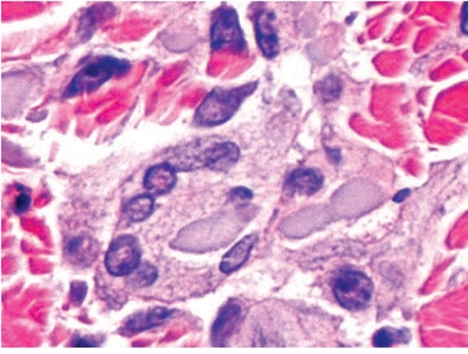
Annular elastolytic giant cell granuloma: high‐power view showing
fragments of degenerate elastic fibres engulfed by multinucleate giant cells.

Slide 20
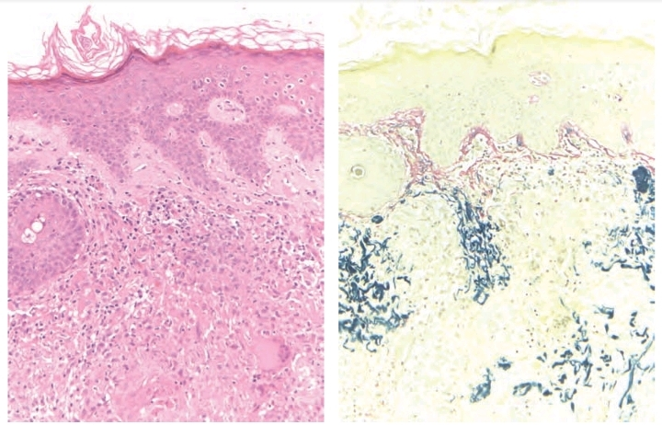
Annular elastolytic giant cell
granuloma:

Slide 21
Clinical features
History
Lesions are typically asymptomatic.
Presentation
Lesions may be single or multiple.
They normally develop in sun‐exposed skin such as the dorsa of the hands and forearms, the vee of the neck or the bald scalp. Fair‐skinned or freckled subjects are particularly susceptible.
The lesions start insidiously as small pink papules, which slowly extend centrifugally to form a ring of firm superficial dermal thickening which is smooth and slightly elevated.
The ring initially measures a few millimetres across but gradually expands,often attaining a diameter of several centimetres.

Slide 22
Clinical features
The centre may become slightly atrophic and variable depigmentation may occur.
The lesions are usually asymptomatic but a sunburn reaction may provoke severe erythema and irritation.
Hair growth is not affected

Slide 23
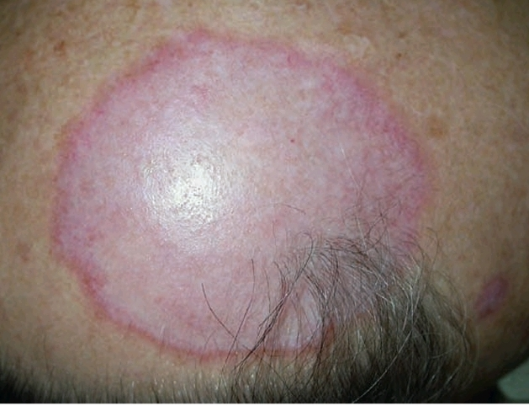
Actinic granuloma on a bald scalp.

Slide 24
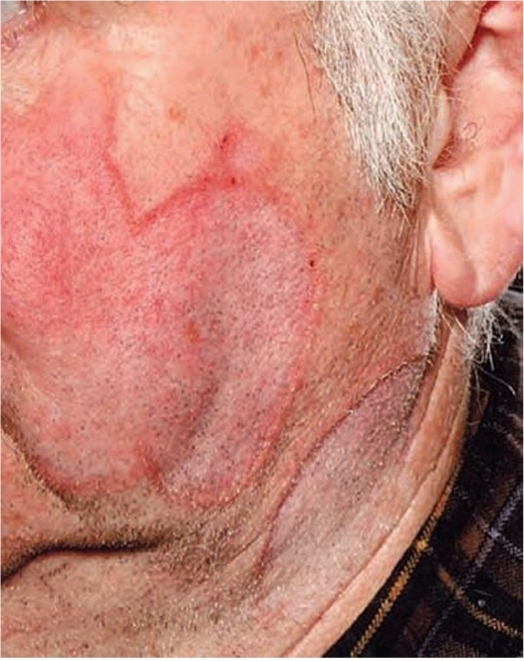
Typical actinic granulomas on the face and neck

Slide 25
Clinical variants
AEGCG
Granuloma multiforme

Slide 26
Differential diagnosis
Granuloma annulare
Necrobiosis lipoidica
Elastosis perforans serpiginosa
Sarcoidosis

Slide 27
Complications and co‐morbidities
Diabetes

Slide 28
Disease course and prognosis
The condition can improve with adequate sun protection.

Slide 29
Investigations
Skin biopsy.

Slide 30
Management
No treatment is of proven benefit.
Topical steroids are generally unhelpful.
Anecdotal reports of successful treatment include
Intralesional triamcinolone.
Oral hydroxychloroquine, isotretinoin (0.5 mg/ kg/day)
Acitretin 25 mg/day,
Dapsone,
Methotrexate and
Ciclosporin and
Topical tacrolimus

Slide 31
Granuloma multiforme
Granuloma multiforme is a dermatosis reported in dark‐skinned people mainly from Africa and India.
It shares many similarities with AEGCG in that it is characterized by annular plaques with giant cell granuloma formation at the periphery and loss of elastic tissue centrally.
As with AEGCG, it presents with papules which enlarge to form annular plaques with raised edges which may attain many centimetres in diameter.
Histologically, the condition is difficult to distinguish from AEGCG except that focal necrobiosis and dermal mucin may be seen, which is not the case in AEGCG.
Many authorities believe that granuloma multiforme should be regarded as a form of AEGCG.

Slide 32
Clinical features
The upper, uncovered parts of the body are predominantly affected.
The initial lesions are small flesh‐coloured papules which become aggregated into plaques or form the elevated rims of annular lesions.
In larger annular lesions, the central area is often hypopigmented.
Pruritus may be prominent.
The condition lasts for many months or years, and may persist indefinitely.

Slide 33
Differential diagnosis
Leprosy

Slide 34
Management
No treatment is known to be effective

Slide 35
Other elastolytic conditions
Granulomatous slack skin is characterized by the slow development of pendulous folds of lax erythematous skin, which on histological examination contain a dense granulomatous dermal infiltrate, with destruction of dermal elastic tissue.
It is now considered to be a type of cutaneous T‐cell lymphoma (mycosis fungoides).

Slide 36
Acquired pseudoxanthoma elasticum‐like syndromes
Perforating pseudoxanthoma elasticum
Synonyms and inclusions
Perforating periumbilical calcific elastosis
Transepithelial elimination (TEE) of altered elastic fibres can occasionally occur in generalized hereditary forms of PXE but it can also occur as a localized acquired defect in patients who do not have the other features of PXE.
These localized lesions usually occur in the periumbilical area in obese, multiparous black or Asian women, and it is possible that this represents a response to repeated cutaneous stretching (e.g. ascites or previous abdominal surgery).
Similar lesions on the breast have been reported in patients undergoing haemodialysis

Slide 37
Clinical features
Clinically, asymptomatic yellow macules and papules coalesce into well‐demarcated hyperpigmented plaques which slowly enlarge.
The surface may be atrophic, grooved, fissured or verrucous, and compression of the edge of the lesion may produce a liquid discharge.

Slide 38
Elastosis perforans serpiginosa in association with PXE were really examples of perforating PXE.
The histology of the two conditions is similar, but in perforating PXE there is transepidermal elimination of altered basophilic, calcified, elastic fibres, which are short, fragmented, curled and predominantly in the mid‐dermis, whereas in elastosis perforans serpiginosa the fibres are abnormally large, non‐calcified, eosinophilic and straight.
The condition is similar to, or identical with, papillary dermal elastolysis.
Spontaneous resolution has been reported

Slide 39
Acquired pseudoxanthoma elasticum
Skin changes which are virtually identical to those of PXE can rarely be produced by penicillamine (e.g. in the treatment of Wilson disease), although the systemic features do not occur.
The skin changes can be explained by the known effect of penicillamine in inhibiting collagen and elastin cross‐linking, with the production of vastly increased amounts of abnormal elastin in the dermis.
Transepidermal extrusion of elastin has been reported in this condition.

Slide 40
Toxic
Lesions clinically resembling PXE are reported in the eosinophilia– myalgia syndrome; dermal calcification is absent on histology.
Eosinophilia myalgia syndrome is defined by:
(i) incapacitating myalgias;
(ii) a blood eosinophil count greater than 1000 cells/μL; and
(iii) no evidence of infection (e.g. trichinosis) or neoplastic conditions that could account for these findings, and related to toxic oil syndrome, caused by ingestion of contaminated l‐tryptophan or other less well characterized toxic substances

Slide 41
Depositions
Yellowish papules and plaques resembling PXE are seen in some patients with amyloidosis; amyloid deposits are seen and, again, dermal calcification is absent.

Slide 42
Haematological disease
PXE–like lesions are described in several haemoglobinopathies, including congenital anaemia, sickle cell disease and thalassaemia.
These patients may develop systemic manifestations such as peripheral vascular occlusive disease and retinal neovascularization and haemorrhage.

Slide 43
Saltpetre disease
A condition which resembles the skin changes of PXE clinically, histologically and ultrastructurally has been described in a group of elderly farmers, who decades earlier had spread a fertilizer containing calcium‐ammonium nitrate (Norwegian saltpetre).
The patients developed cutaneous ulcers at sites of exposure (including antecubital fossae).
These quickly healed to leave yellowishwhite papules and plaques.
None of the patients had a positive family history or other signs of PXE.

Slide 44
Acrokeratoelastoidosis
Acrokeratoelastoidosis is an uncommon asymptomatic disorder which manifests as multiple tiny crateriform keratotic papules along the margins of the hands and feet, particularly in people of
African descent.
The name derives from the histological appearances which include not only epidermal acanthosis and hyperkeratosis but also fragmentation of underlying dermal elastic fibres.
The mechanisms involved are not understood.

Slide 45
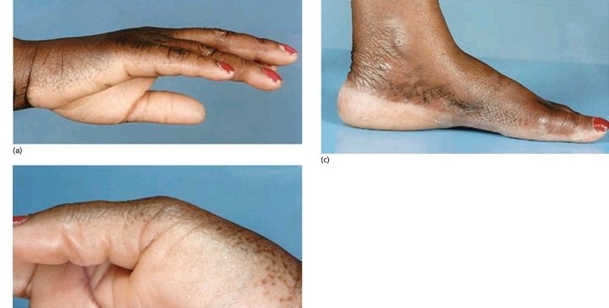
Acrokeratoelastoidosis.

Slide 46
It is inherited in an autosomal dominant fashion but does not usually present until after puberty;
sporadic cases also occur.
As elastorrhexis cannot always be demonstrated, alternative names for clinically indistinguishable cases have been proposed: these include focal acral hyperkeratosis and marginal papular acrokeratoderma.
There is still controversy as to whether these should be regarded as separate entities.

Slide 47
THANK YOU

