Slide 1
Acquired Disorders Of Epidermal Keratinization
Dr Misbah Hafeez
Resident Dermatology
CMH Bahawalpur

Slide 2
Acquired Ichthyosis
It usually arises in adult life and clinically resembles hereditary ichthyosis
However, it is not inherited but associated with a systemic disorder,
Particularly malignancy [hodgkin disease,MF,MM], endocrinopathy [DM,Thyroid disease],some infections [leprosy, Tb,HIV] autoimmune conditions [dermatomyositis,SLE,Scleroderma]

Slide 3
Pathophysiology
Pathogenesis differs according to the entity with which it is associated
Living in a hot and humid climate may hide the clinical manifestations of filaggerin deficiency
Histologically,epidermis shows compact hyperkeratosis with a thinned or absent granular layer

Slide 4
Clinical Features
Onset is typically sudden with initial involvement of lower limbs but then generalize
Symmetrically distributed,dark thick scaling appears on the legs
Arms and trunk can also be involved, but flexures are spared due to the higher humidity in these areas

Slide 5
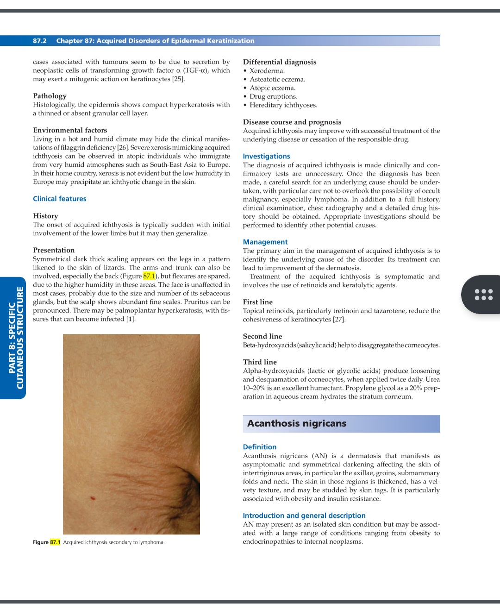
Acquired ichthyosis

Slide 6
Face is unaffected in most cases,due to the size and number of its sebaceous glands, but scalp shows abundant fine scales
Pruritus is pronounced
There is palmoplantar hyperkeratosis, with fissures that can be become infected

Slide 7
DDs
Xeroderma
Asteatotic eczema
Atopic eczema
Drug eruptions
Hereditary ichthyosis

Slide 8
Investigations
Diagnosis is mainly clinical
Detailed history including drug history and clinical examination should be performed
Appropriate investigations and chest radiography to identify other potential causes

Slide 9
Management
Primary aim is to identify the cause of the disorder and its treatment
Treatment of aquired ichtyhosis is symptomatic
FIRST LINE:topical retinoids such as tretinoin and tazarotene to reduce the cohesiveness of keratinocytes

Slide 10
SECOND LINE: Beta-hydroxyacids helps to disaggregate the corneocytes
THIRD LINE: Alpha-hydroxyacids produce loosening and desquamation of corneocytes
Urea 10-20% and Propylene glycol 20% preparations

Slide 11
Acanthosis Nigricans
A dermatosis manifests as asymptomatic and symmetrical darkening affecting the skin of intertriginous areas i.e axilla,groins,submammary folds and neck
Skin is thickened,has a velvety texture and may be studded by skin tags
Familial AN is rare and inherited as autosomal dominant fashion

Slide 12
Epidemiology
Benign AN is very common,and mainly affects adults- upto 20% and 7% of children(also obese children)
Malignant AN is rare,usually arises in older age groups and children with wilms tumours ans osteogenic sarcomas
AN can occur at any age, and has an equal sex ratio,more common in pt with darker skins

Slide 13
Pathophysiology
Obesity and insulin resistance is the most common association with AN
IGF-1 Receptors are overexpressed in obese pts ans IGF-1 can stimulate proliferation of keratinocytes and dermal fibroblast
Epidermal growth factor receptors and fibroblast growth factor receptors are also implicated

Slide 14
Histology shows hyperkeratosis and papillomatosis with finger-like upward projections of dermal papillae
AN shows no or minimal acanthosis or hyperpigmentation microscopically
Pseudo-horn cyst may be present
In mucosal lesions,parakeratosis may be observed

Slide 15
Clinical Features
AN presents as symmetrical velvety dark patches which are most commonly seen in axilla and groins and on the back and sides of neck
Back of neck is most common site in children.
AN may become widespread and involve eyelids and conjuctivae
Nail changes include leukonychia and subungual hyperkeratosis

Slide 16
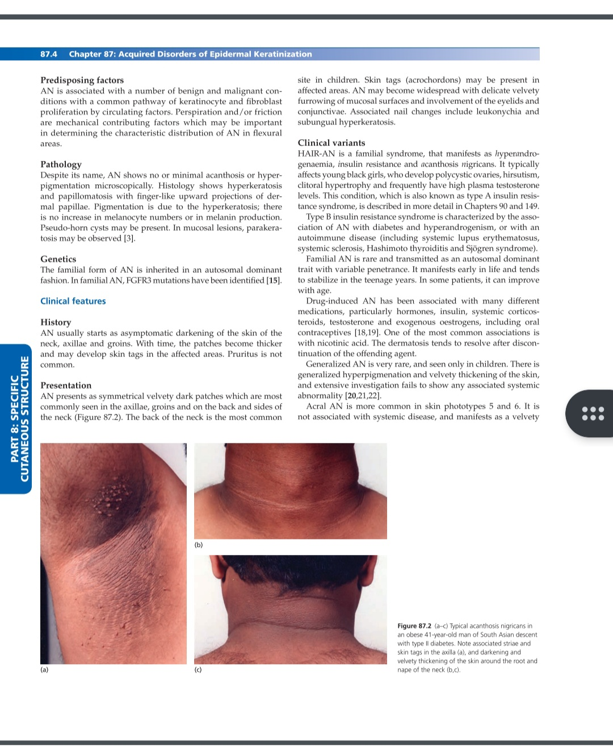
Acanthosis nigricans

Slide 17
Clinical variants
HAIR-AN: aka type A insulin resistance syndrome, a familial syndrome that manifests as hyperandrogenaemia,insulin resistance and AN
Typically affects young black girls
Type B insulin resistance syndrome:charac-terized by association of AN with diabetes and hyperandrogenism or with an autoimmune disease(SLE,SS,Hashimoto thyroiditis)

Slide 18
Drug-induced AN: associated With hormones,insulin,corticosteroids,testosterone,and exo estrogens(OCPs)
One of the most common associations is with nicotinic acid
Unilateral AN: very rare,arise from a somatic mutation.Appear in infancy but onset can be in child/adulthood
Clinically,a pigmented plaque,solitary or along a line of Blaschko,and resembles an epidermal naevus

Slide 19
Malignant AN : associated with an internal cancers but over 90% in pts with GIT cancers, of which two-thirds are gastric cancer
Acral AN
Generalized AN

Slide 20
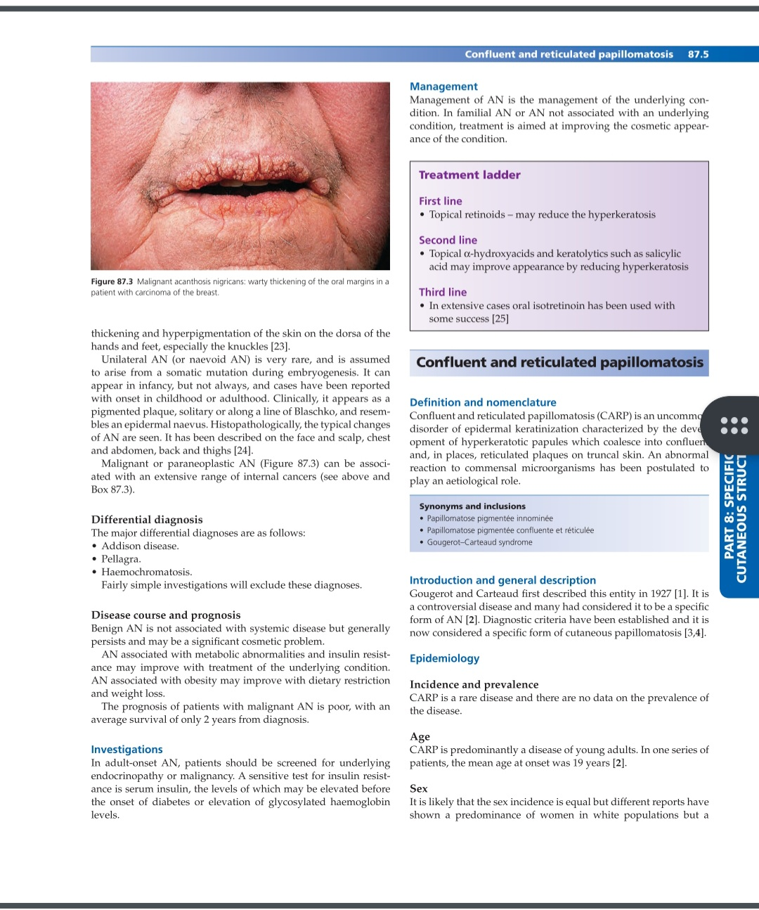
Malignant AN

Slide 21
DDs
Addison disease
Pellagra
Haemochromatosis

Slide 22
Investigations
In adult-onset AN, pts should be screened for endocrinopathy or malignancy
Serum insulin or elevation of glycosylatd haemoglobin levels in insulin resistance

Slide 23
Treatment
First line:Topical retinoids-may reduce hyperkeratosis
Second line:Topical alpha-hydroxyacids and keratolytics such as SA
Third line:Oral isotretinoin in extensive cases

Slide 24
Confluent and Reticulated Papillomatosis(CARP)
An uncommon disorder of epidermal keratinization characterized by the development of hyperkeratotic papules which coalesce into confluent and,in places, reticulated plaques mainly on the trunk.
Affects young adults, mean age at onset is 19 years
Equal sex incidence

Slide 25
Pathophysiology
Pathogenesis of CARP is poorly understood
Thought that it is due to an abnormal host reaction to Malassezia organisms or actinomycete bacteria
Abnormal keratinocyte differentiation which shows an increased expression of involucrin,keratin 16 and Ki-67

Slide 26
Clinical Features
Presents as asymptomatic,pigmented,1-2mm hyperkeratotic papules on the trunk
These coalesce to form greyish-blue plaques which are confluent at centre but become reticular towrads periphery of plaques
Plaques spread to involve face,limbs, lower abdomen and pubic areas
Mucous membranes are not involved

Slide 27
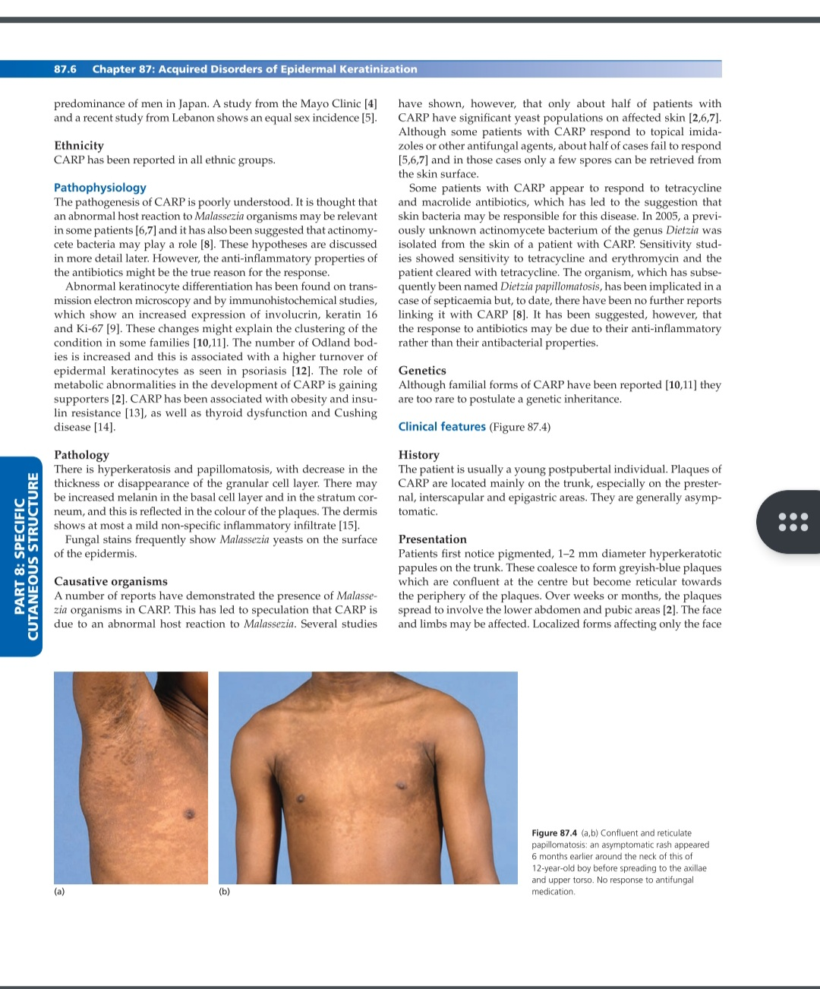
Confluent & reticulate papillomatosis

Slide 28
DDs
Acanthosis nigricans
Macular amyloid
Darier disease
Epidermal naevus
Plane warts
Pityriasis versicolor
Seborrhoeic keratosis

Slide 29
Treatment
First line:oral antibiotics-the most effective is minocycline
Topical mupirocin ointment in some cases
Second line:topical and systemic antifungals,including selenium sulphide shampoo
Topical retinoids and vitamin D analogues
Third line:both high and low-dose isotretinoin used with varying results

Slide 30
Pityriasis Rotunda
PR is a rare dermatosis of unkown cause that presents as perfectly round,slightly erythematous or hyperpigmented plaques,with fine scaling,located on trunk or buttocks,arms and legs
It has an equal sex incidence

Slide 31
Types
The most common form of PR is type 1 typically seen in older Asian or African individuals in their 60s
Associated with underlying systemic disease or malignancy
Type 2 PR is usually familial and presents in white patients in their 40s,not associated with underlying disease

Slide 32
Histological changes are restricted to the epidermis with hyperkeratosis and loss of granular cell layer
Type 2 PR is inherited as an autosomal dominant trait

Slide 33
Associated diseases
HCC
CML
CRF
TB
Cardiac disease
SCC of hard palate
Chronic diarrhoea
Systemic sclerosis

Slide 34
Clinical Features
Presents as asymptomatic thin finely scaling plaques ranging from 0.5 t 20cm in diameter located on trunk,buttocks,arms,and legs
Plaques, from a few to more than 100 ,are sharply demarcated and can coalesce.forming polycyclic plaques
Vary in colour from pink to dark brown

Slide 35
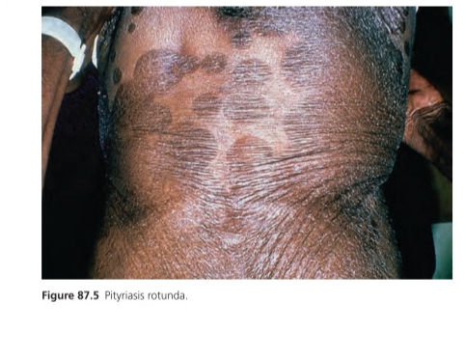
Pityriasis rotunda

Slide 36
DDs
PIH following FDE
Erythrasma
Tinea corporis
Psoriasis
PV

Slide 37
Investigations
Skin biopsy to exclude other condition
Skin scraping and mycological examination to exclude dermatophytosis and pityriasis versicolor

Slide 38
Managemet
First line:topical retinoids such as tretinoin,isotretinoin or tazarotene
Second line:topical 10% lactic acid
Third line:5% salicylic acid ointment

Slide 39
Keratosis Pilaris
KP is an inherited abnormality of keratinization affecting the follicular orifices with varying degrees of keratotic follicular plugging,perifollicular erythema and follicular atrophy
Very common condition affecting 50-80% of adolescents and 40% of adults-more frequent in females
In first decade of life

Slide 40
Associated diseases
Ichthyosis vulgaris
Atopic eczema
IDDM(type 1 and 2)
Noonan syndrome
Cardio-facio-cutaneous synd
Down syndrom
Renal failure
hypervitaminosis

Slide 41
Pathophysiology
A plug of excess keratin is formed due to defect of corneocyte adhesion at follicular orifice and this impedes the hair from emerging
Hair can become ingrown and result in an inflammatory response

Slide 42
Autosomal dominant trait with variable penetrance
May show seasonal variation,improving in summer
Histology shows hyperkeratosis and hypergranulosis with plugging of hair follicle
Mild perivascular lymphocytic infiltrate in dermis

Slide 43
Clinical Features
Generally starts in children, and can worsen around puberty
Small,keratotic papules appear on extensor surface of limbs (arms,thighs),buttocks and lumbar areas
These affected areas acquire a Goose-bump appearance and rough texture

Slide 44
Lesions can become pustular with superficial pustules developing in affected follicles,precipitated by rubbing or clothing
On buttocks,deeper inflammatory lesions and nodules may develop

Slide 45
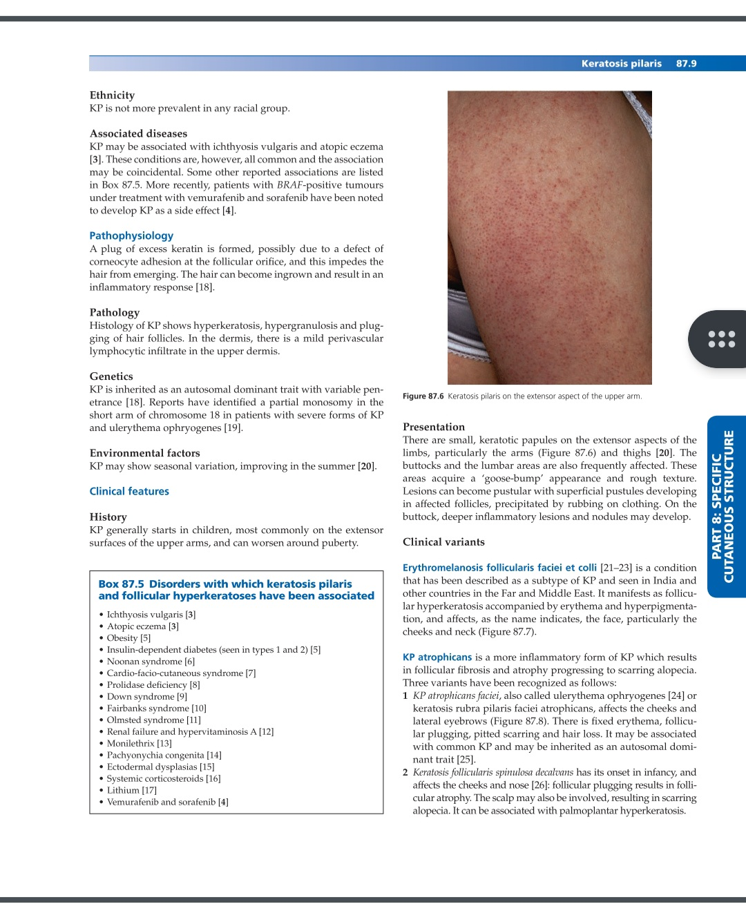
Keratosis pilaris

Slide 46
Clinical Variants
Erythromelanosis follicularis faciei et colli: manifests as follicular hyperkeratosis accompanied by erythema and hyperpigmentation, and affects the face
KP atrophicans:more inflammatory form of KP which results in follicular fibrosis and atrophy progressing to scarring alopecia

Slide 47
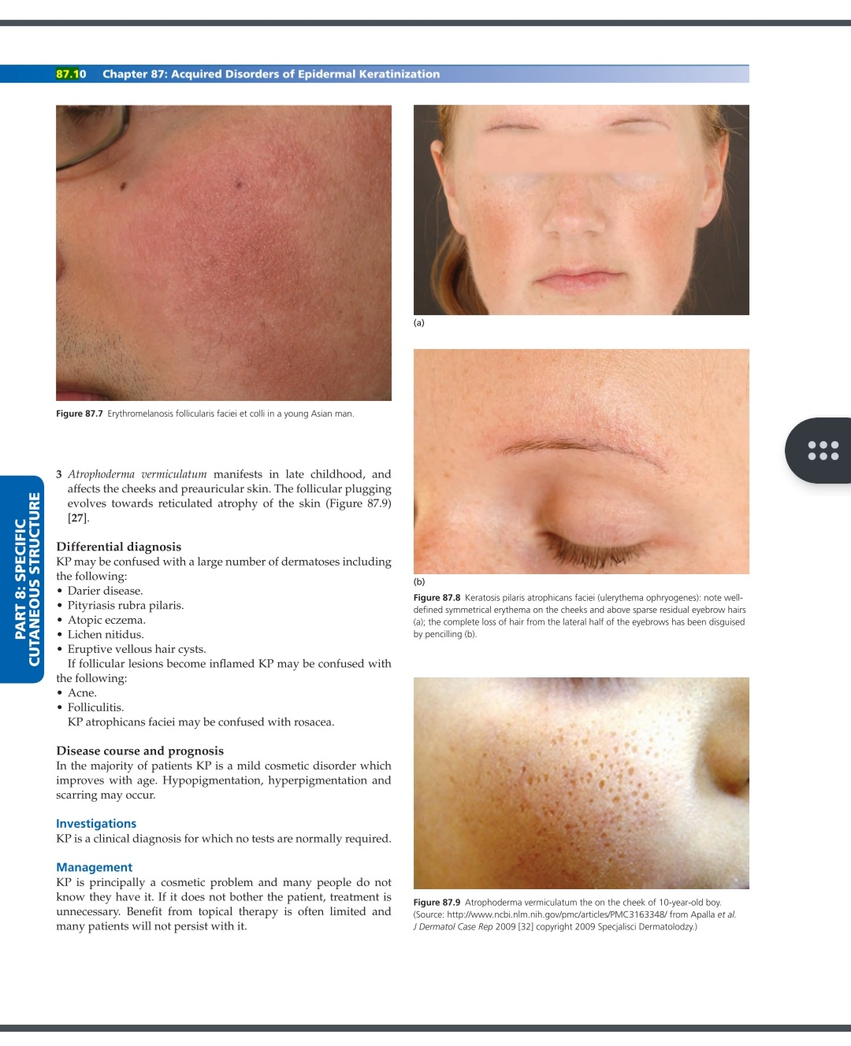
Erythromelanosis follicularis faciei et colli

Slide 48
DDs
Darier disease
Pityriasis rubra pilaris
Atopic eczema
Lichen nitidus
Eruptive vellous hair cyst

Slide 49
Treatment
First line: keratolytics,lactic acid and glycolic acid preparations to reduce the roughness of skin
Second line:topical retinoids with 10% urea containing moisturisers
Third line:oral isotretinoin in severe KP
Fourth line:pulsed dye laser for severe erythema in KP atrophicans faciei

Slide 50
Lichen spinulosus
A rare idiopathic condition,characterized by appearance of hyperkeratotic follicular papules arranged into large plaques
Affects children and young adults
Equal distribution in males and females

Slide 51
Hair follicles are dilated by a thick keratinous plug and surrounded by mild to moderate chronic inflammatory infiltrate
There are case reports of LS in HIV infection,crohn disease and alcoholism,hodgkin disease and syphilis.
Cause of LS is unkown

Slide 52
Clinical features
Individual papules are follicular,2-3mm in diameter and 1mm raised with a pointed keratotic spine
Papules coalesce into plaques,symmetrical and distributed on trunk,buttocks,neck,knees and elbows
Face,hands,and feet usually spared
LS is a chronic disease,erupts acutely and asymptomatic

Slide 53
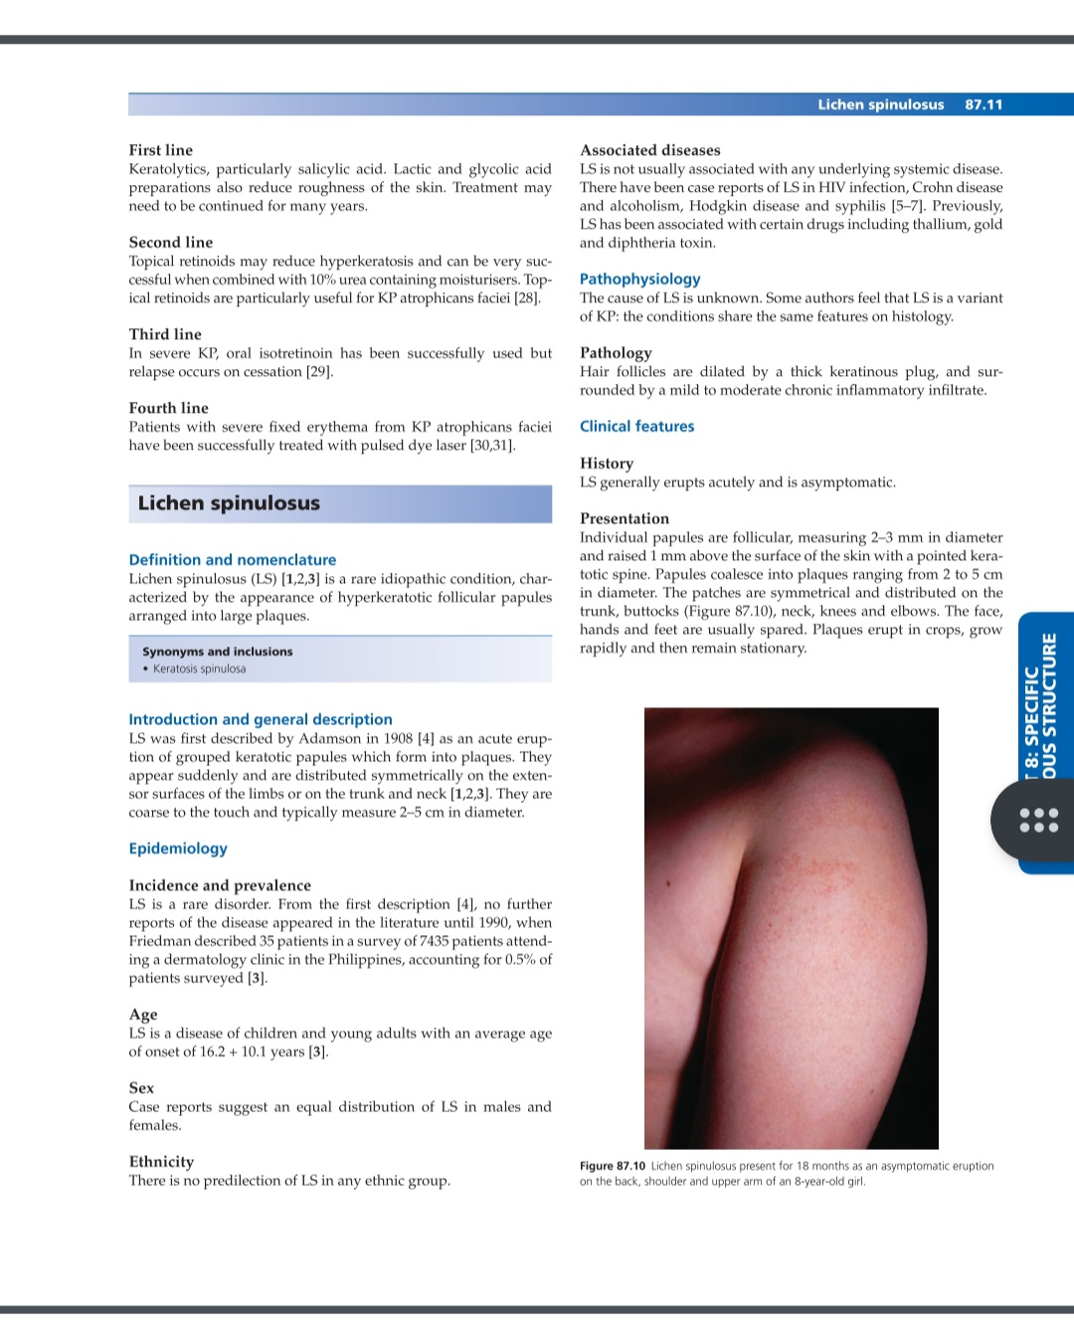
Lichen spinulosus

Slide 54
DDs
Keratosis pilaris
Lichen nitidus
Phrynoderma
Pityriasis rubra pilaris
Diagnosis of LS is made clinically and supported by histology

Slide 55
Treatment
First line:keratolytic agent including lactic acid,SA and urea can be used
Second line:topical retinoids
Third line:topical tacalcitol

Slide 56
Keratosis circumscripta
Rare condition characterized by circumscribed areas of follicular hyperkeratosis
KC first develops in childhood at the age of 3-5 years and then persist thereafter
Cause is unknown

Slide 57
Histology shows follicular plugging and moderate hyperkeratosis.No involvement of dermis
KC first described in African tribe and more common in phototype 6 skin

Slide 58
Clinical features
Lesions are well-defined areas of diffuse and follicular hyperkeratosis affecting the extensor surfaces of arms,legs and trunk
Dorsa of hands and feet occasionally involved but palms, soles rarely affected
Lesions may become thickened and hyperpigmented or violaceous in colour

Slide 59
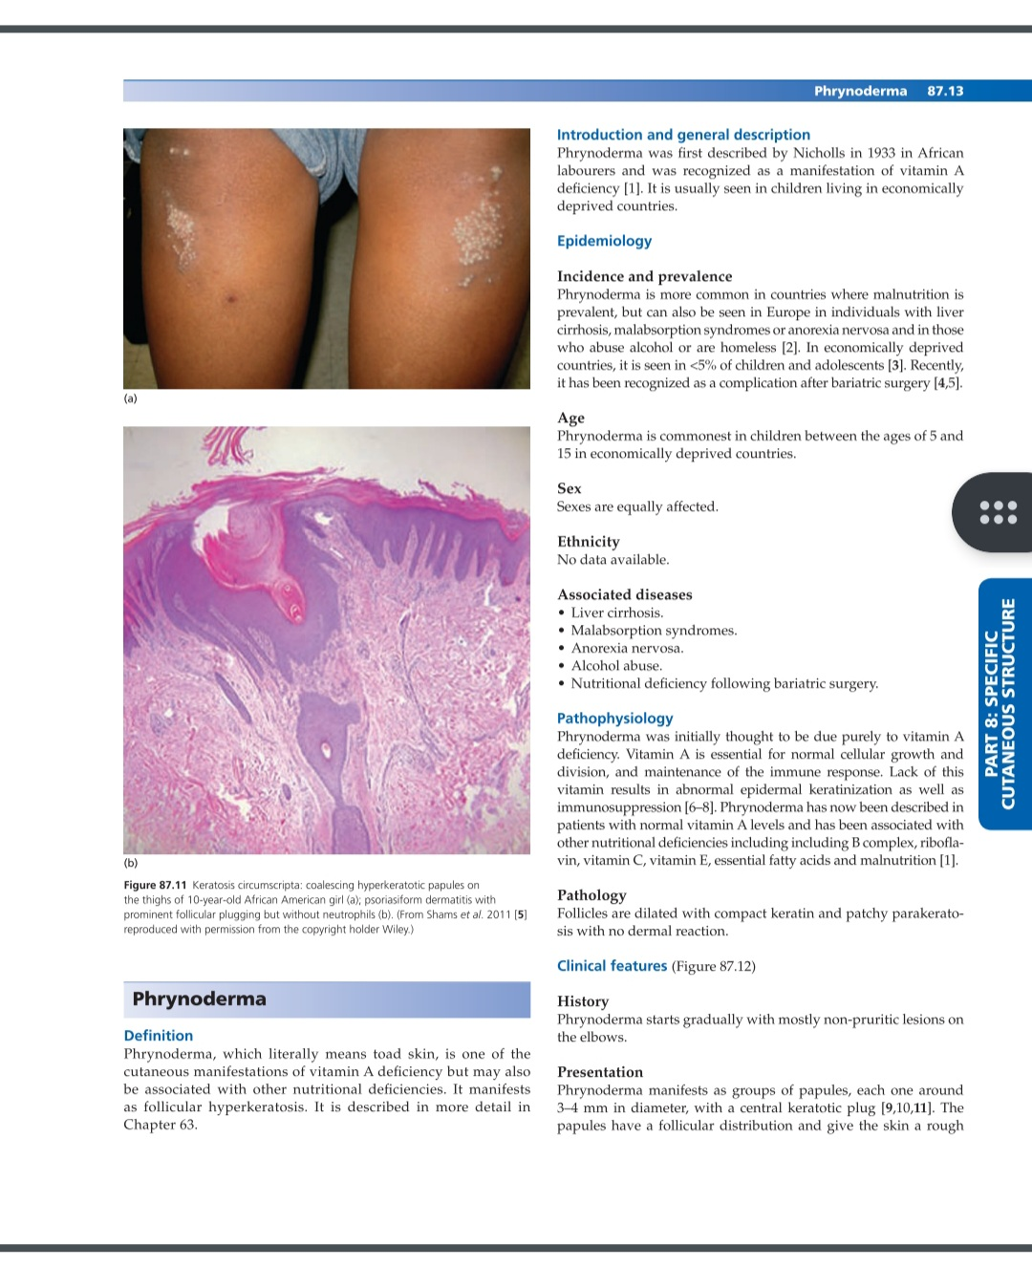
Keratosis circumscripta

Slide 60
DDs
Type 4 circumscribed juvenile PRP
Lichen spinulosus
Psoriasis

Slide 61
Treatment
Poorly responsive to Rx
It does not improve with topical corticosteroids,topical retinoids or keratolytics
40% urea in white soft paraffin to improve the appearance of KC

Slide 62
Phrynoderma
Literally means toad skin,is one of the cutaneous manifestations of vitamin A deficiency but may also be associated with other nutritional deficiencies(B complex,vitamin C,vitamin E etc.)
It manifests as follicular hyperkeratosis

Slide 63
Usually seen in children at the age of 5 to 15yrs living in economically deprived countries but can also be associated with liver cirrhosis,malabsorption syndromes,anorexia nervosa,alcohol abuse or following bariatric surgery
Both genders are equally affected

Slide 64
Pathophysiology
Lack of vitamin A results in abnormal epidermal keratinization as well as immunosuppression
Histology shows follicles are dilated with compact keratin and patchy parakeratosis with no dermal reaction

Slide 65
Clinical features
It manifests as groups of papules,each one around 3-4mm, with a central keratotic plug and give the skin a rough texture
Mostly non-pruritic lesions,papules are skin-coloured or hyperpigmented
Elbows and knees are most commonly affected but buttocks and extensor surfaces of limbs may be involved
Associated with ocular signs

Slide 66
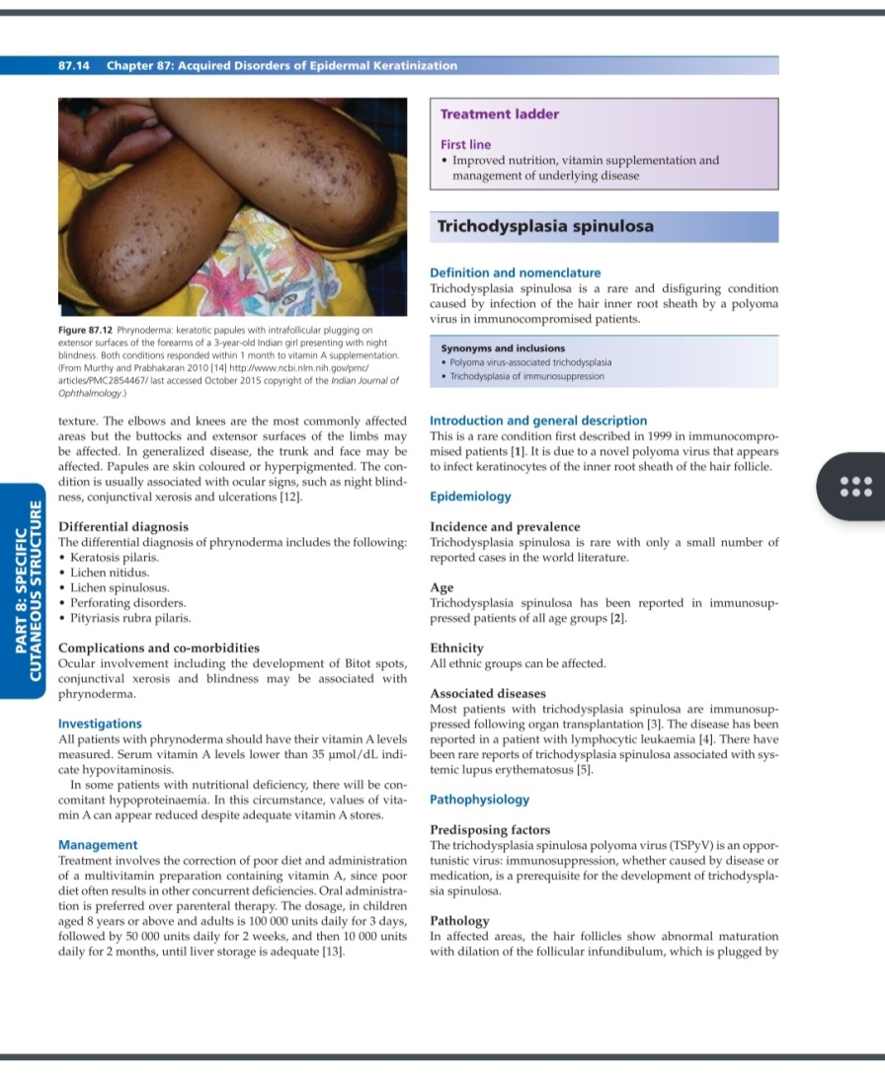
Phrynoderma

Slide 67
DDs
Keratosis pilaris
Lichen nitidus
Lichen spinulosus
Perforating disorders
PRP

Slide 68
Investigations
Serum vitamin A levels should be measured(levels lower than 35umol/dl indicates hypovitaminosis)
In some pts,there will be concomitant hypoproteinemia

Slide 69
Treatment
Improved nutrition,vitamin supplementation and management of underlying disease
Vitamin A dosage in children aged 8 years or above and adults is 100 000 units daily for 3 days followed by 50 000 units daily for 2 weeks and then 10 000 units daily for 2 months, until liver storage is adequate

Slide 70
Trichodysplasia spinulosa
A rare and disfiguring condition caused by infection of keratinocytes of the hair inner root sheath due to a novel polyoma virus in immunocomprised patients of all age groups
It is reported in a pts with lymphocytic leukaemia and SLE or following organ transplantation

Slide 71
Hair follicles show abnormal maturation with dilation of follicular infundibulum,which is plugged by cornified eosinophilic keratinocytes containing large trichohyalin granules
Immunofluorescence studies have shown that polyoma virus is restricted to the nuclei of inner root sheath cells

Slide 72
Clinical features
Shiny follicular papules with central spiny keratotic spikes form on facial skin, which then rapidly coalesced to form a Leonine facies
Alopecia Of eyebrows and scalp may occur
Usually asymptomatic but may be mildly pruritic

Slide 73
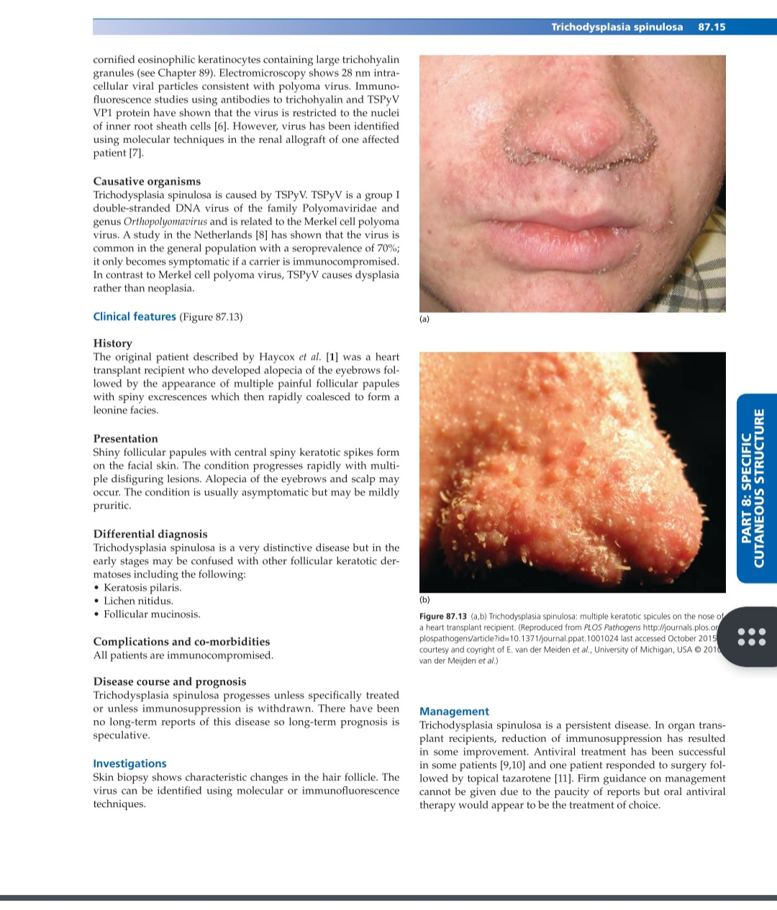
Trichodysplasia spinulosa

Slide 74
DDs
Keratosis pilaris
Lichen nitidus
Follicular mucinosis

Slide 75
Investigations
Virus identified using molecular or immunoflourescence techniques
Skin biopsy shows characteristic changes in hair follicle

Slide 76
Treatment
First line:reduction of immunosuppression, oral valganciclovir,topical cidofovir
Second line:topical tazarotene
Third line:topical aciclovir,2-deoxy-D-glucose,epigallocatechin

Slide 77
Flegel disease
A rare dermatosis,characterized by flat keratotic papules on lower legs and dorsa of feet
It is a disease of older adults, but can be seen in younger pts
A few reports suggested association with endocrinopathies,particularly DM

Slide 78
Pathophysiology
Cause is unknown,some authors suggest that UV light may play a role.Electron microscopy showed a lack or paucity of Odland bodies in stratum granulosum-a possible mechanism for localized hyperkeratosis
On microscopy,stratum corneum is thickened,eosinophilic and compact,stratum spinosum is compressed, patchy parakeratosis,granular layer is thinned or absent.

Slide 79
Epidermis can show papillomatosis
And lymphocytic dermal infiltrate in a band-like distribution.

Slide 80
Clinical features
Lesions are asymptomatic red/brown non-follicular keratotic papules develop on lower legs and slowly spread up the legs in middle-aged to elderly patients
Each papule measures 1-5 mm and is topped by a horny keratotic scale,the removal of which causes bleeding

Slide 81
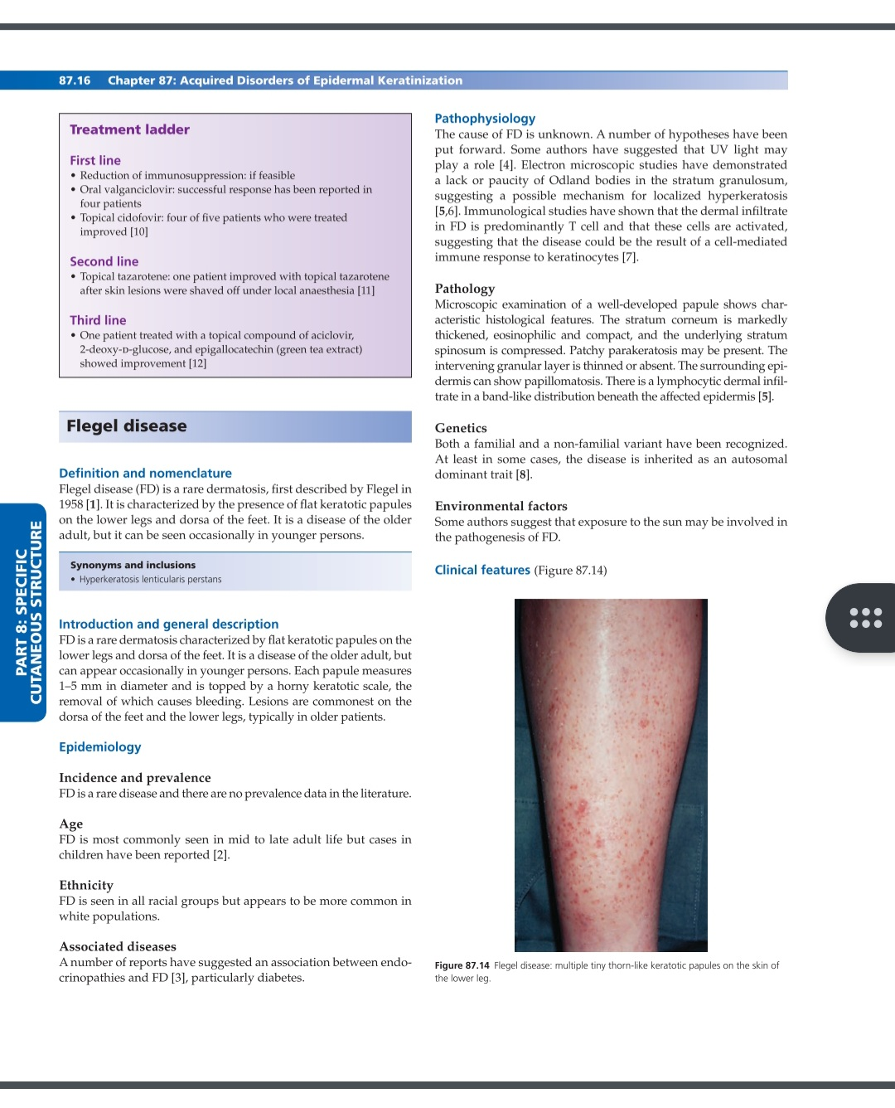
Flegel disease

Slide 82
DDs
Actinic keratosis
Arsenial keratosis
Darier disease
Acquired reactive perforating dermatosis
Porokeratosis
Stucco keratosis

Slide 83
Treatment
FD is difficult to treat and Rx need to be continued for prolonged periods
First line:5% fluorouracil,dermabrasion,local excision
Second line:systemic retinoids
Third line:topical vitamin D analogues,topical retinoids,keratolytics-inconsistent results

Slide 84
Porokeratoses
A clonal expansion of keratinocytes which differentiate abnormally but are not truly neoplastic
All forms show a thin column of parakeratosis,the cornoid lamella, representing the active border
Cut. malignancies,particularly SCCs may occur
A rare disease,DSAP is the most common form

Slide 85
Clinical classification of porokeratoses
Localized forms
Porokeratosis of Mibelli
Linear porokeratosis
Punctate palmoplantar
Genital porokeratosis
Perianal porokeratosis

Slide 86
Disseminated forms
Superficial actinic porokeratosis
Superficial porokeratosis
Systematized linear porokeratosis
Palmoplantar porokeratosis

Slide 87
Associated diseases
HIV infection
Crohn disease
Diabetes
Liver disease
Renal failure
Hemotological and solid tumours

Slide 88
Pathophysiology
Cornoid lamella,the hallmark of porokeratosis,is composed of parakeratotic keratinocytes which result from either faulty maturation or an acceleration of epidermopoiesis
Also abnormal DNA ploidy in keratinocytes has been shown
In DSAP,mutations in SART3 and MVK genes have been found

Slide 89
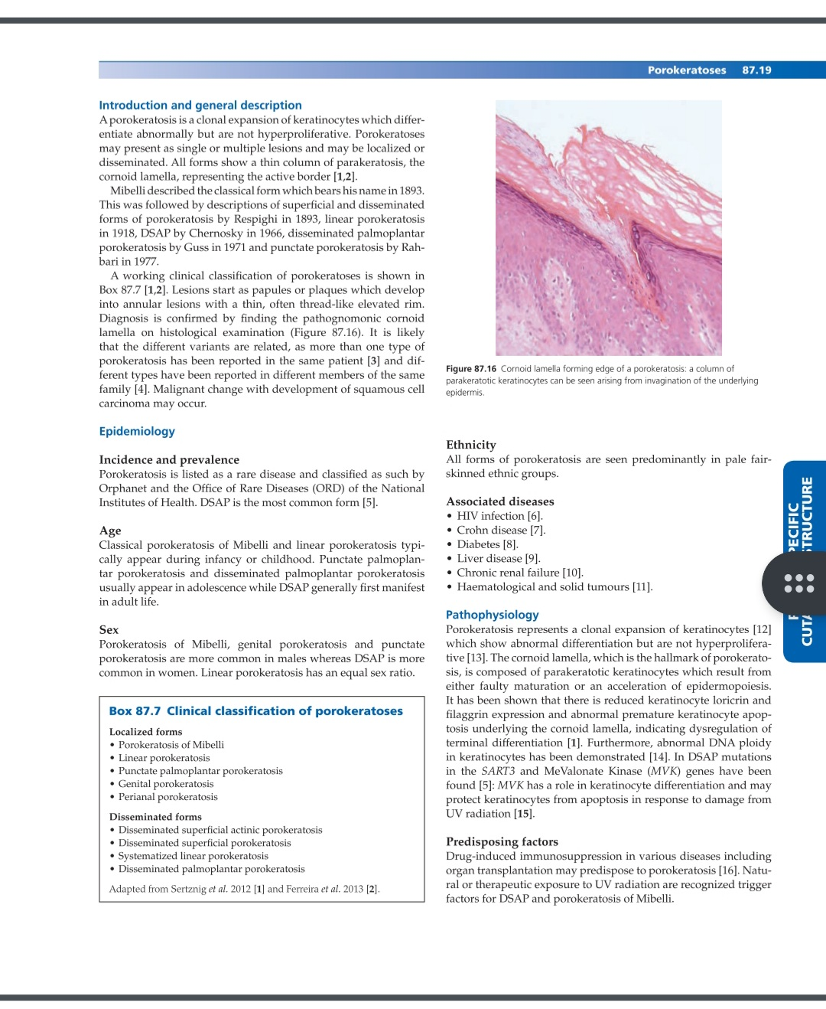
Cornoid lamella

Slide 90
Histologically,cornoid lamella is a thin column of tightly packed parakeratotic keratinocytes within a keratin-filled invagination of epidrmis through the stratum corneum
Str. Granulosum may be absent or weak
Perivascular or lichenoid lymphocytic infiltrate

Slide 91
All forms have autosomal dominant patterns of inheritance with a variable penetrance
Drug-induced immunosuppression and natural or therapeutic UV radiation exposure may predispose to porokeratosis

Slide 92
Clinical features
Asymptomatic single or multiple papules or plaques which develop into annular lesions with a thin raised border
Typically appear during infancy or childhood (porokeratosis of Mibelli & linear form) or in adolescence(punctate palmoplantar & disseminated palmoplantar) while DSAP in adult life

Slide 93
Localized forms
Porokeratosis of Mibelli:single or small group of keratotic papules,may be pigmented, gradually grow to form irregular plaques, with a thin keratotic & well-demarcated border on the extremities
Central area may be atrophic,hypo or hyperpigmented,hairless and anhidrotic

Slide 94
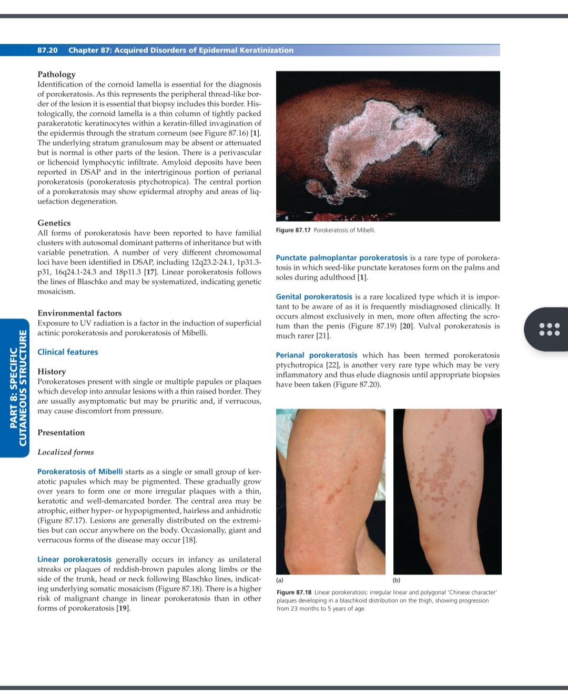
Porokeratosis of Mibelli

Slide 95
Linear porokeratosis:occurs in infancy as unilateral streaks or plaques of reddish-brown papules along limbs or side of trunk,head or neck following Blaschko lines
It has a higher risk of malignant change than in other forms

Slide 96
Linear porokeratosis

Slide 97
Punctate palmoplantar porokeratosis:a rare type in which seed-like punctate keratoses form on palms and soles during adulthood
Genital porokeratosis:a rare form,frequently misdiagnosed clinically.Occurs exclusively in men,more often affecting the scrotum than the penis.vulval porokeratosis is much rare

Slide 98
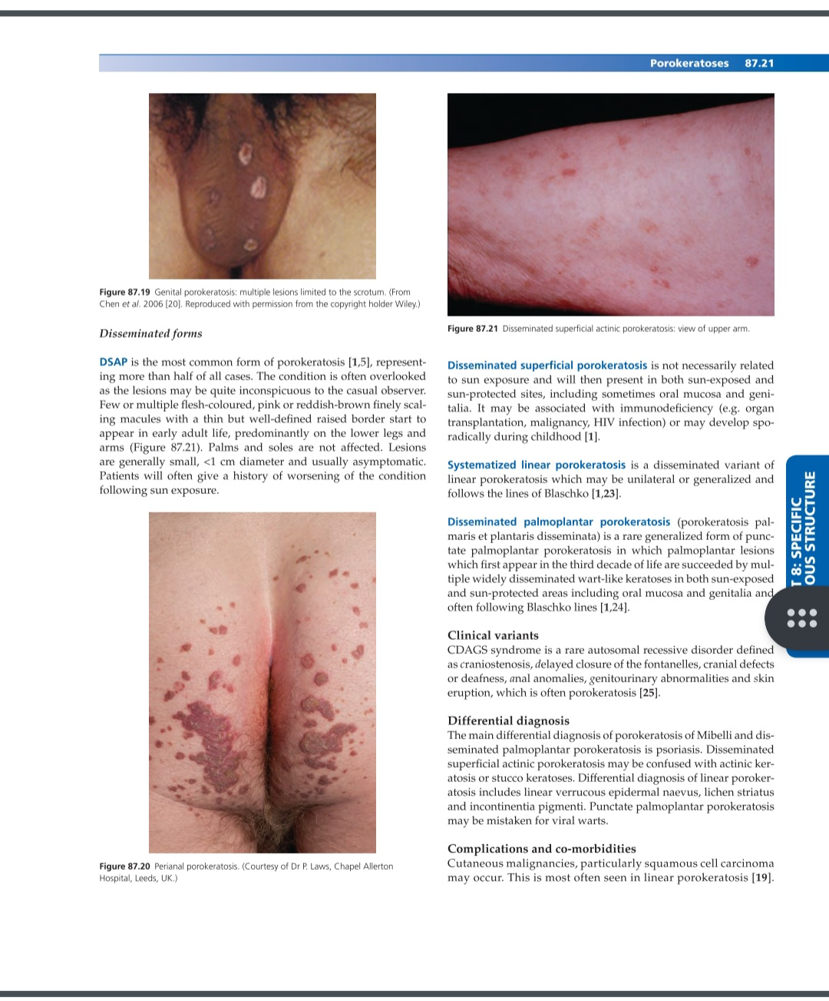
Genital porokeratosis

Slide 99
Perianal porokeratosis

Slide 100
Disseminated forms
Disseminated superficial actinic porokeratosis:the most common form.Few or multiple flesh-coloured,pink or reddish-brown finely scaling macules with a thin but well-defined raised border
Appear in early adult life,mainly on lower legs and arms.Palms and soles are not affected
Pt give history of worsening cond. following sun-exposure

Slide 101
Disseminated superficial actinic porokeratosis

Slide 102
Disseminated palmoplantar porokeratosis: a rare generalized form,in which multiple widely disseminated wart-like keratoses in both sun-exposed and sun-protected areas including oral mucosa,genitalia and often follow Blaschko lines

Slide 103
Clinical variants
CDAGS syndrome is a rare autosomal recessive disorder
Defined as craniostenosis,delayed closure of fontanelles,cranial defects,or deafness,anal anomalies,genitourinary abnormalities and porokeratosis

Slide 104
Investigations
Pts presenting with sudden onset porokeratosis should be investigated for causes of immunosuppression including HIV and haemotological malignancies

Slide 105
Treatment
Principally two approaches:
Target the underlying abnormal clone of cells
Target the abnormal keratinization with topical or systemic retinoids

Slide 106
First line:cryotherapy,5-fluorouracil, imiquimod,curettage & cautery,photodynamic therapy,carbon dioxide laser,topical diclofenac, and topical vit D analogues
Second line:oral retinoids including isotretinoin & acitretin to reduce the risk of malignant change

Slide 107
Transient acantholytic dermatosis
TAD is a common transient or persistent monomorphous,papulovesicular eruption mainly affecting the trunk which may be pruritic or asymptomatic
Mean age at diagnosis is 61 years
Disease has a male predominance and commonest in white population

Slide 108
Associated disease
Psoriasis
Asteatotic eczema
Contact allergic dermatitis
Contact irritant dermatitis
Skin cancer
Haemotological malignancies

Slide 109
Pathophysiology
Cause is unknown.A recent study showed autoantibodies against a number of proteins involved in keratinocyte development, activation,adhesion & motility using proteomic microarrays to analyse IgA & IgG autoantibodies
TAD is reported to be more common in winter but may be exacerbated by UV exposure,heat,sweating

Slide 110
Primary histological feature is the presence of small foci of acantholysis with dyskeratosis, intraepidermal clefting and sometimes vesicle formation
Five histological patterns of TAD:
Pemphigus vulgaris-like
Darier-like
Spongiotic
Pemphigus foliaceus-like
Hailey-hailey like

Slide 111
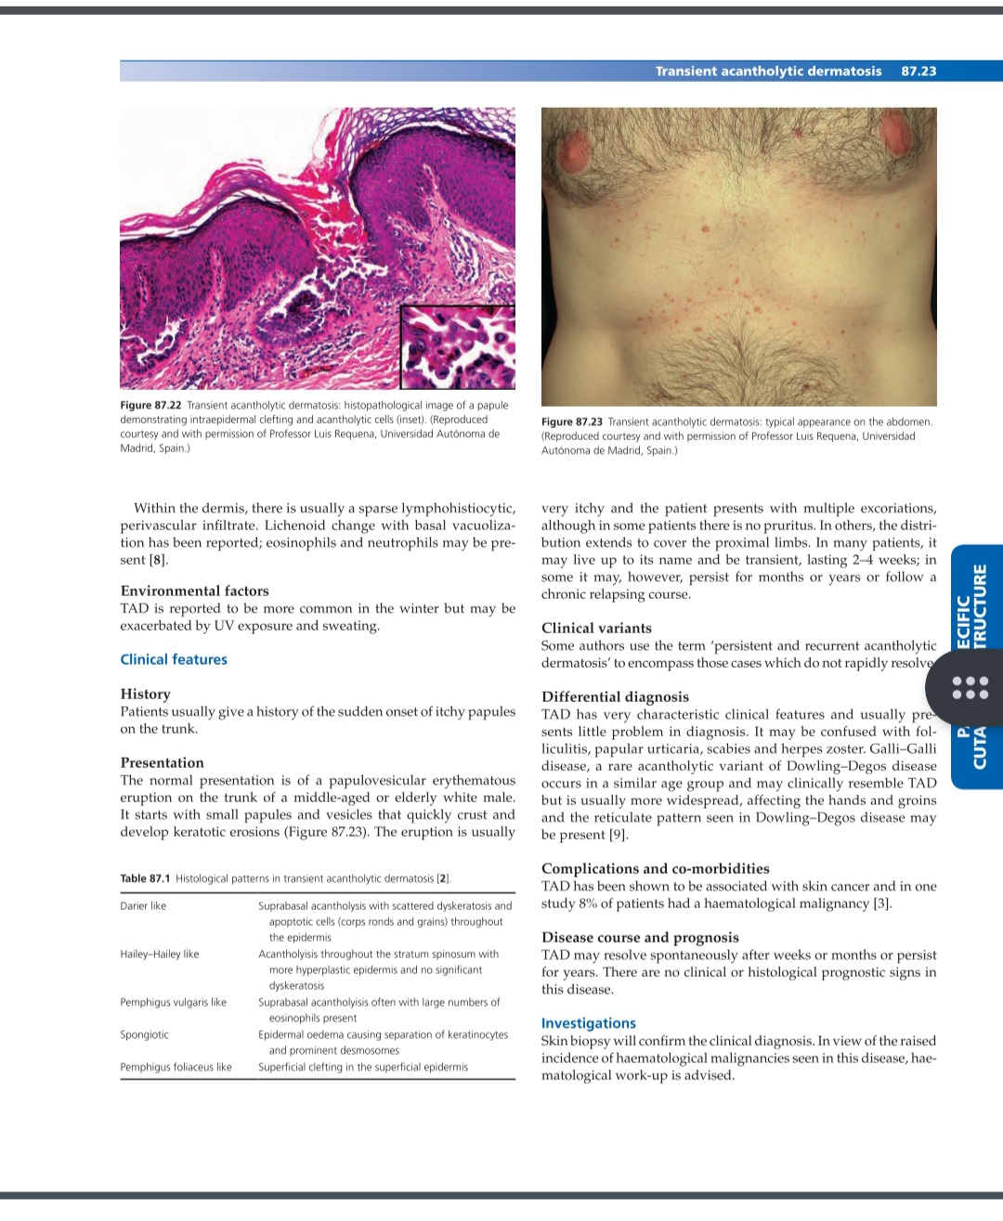
Transient acantholytic dermatosis

Slide 112
Clinical features
Sudden onset Papulovesicular erythematous eruption on trunk of a middle-aged or elderly white male
It starts with small papules and vesicles that quickly crust and develop keratotic erosions that are very itchy
In many pts,it is transient and lasting for 2-4 weeks, in some however persist for months or years

Slide 113
TAD

Slide 114
DDs
Folliculitis
Papular urticaria
Scabies
Herpes zoster
Galli-Galli disease

Slide 115
Investigations
Skin biopsy will confirm the clinical diagnosis
Haemotological work-up to rule out malignancies

Slide 116
Treatment
First line:potent topical corticosteroids,topical vit D analogues,calcineurin inhibitors,oral antihistamine
Second line:systemic corticosteroids. Systemic retinoids,phototherapy and methotrexate(in refractory cases)
Third line:etanercept,recalcitrant TAD,photodynamic therapy

Slide 117
Keratolysis exfoliativa
A common disease of young adults in which discrete areas of superficial skin peeling occur on palms,starting as air-filled blisters leading to a circinate or irregular annular pattern of scaling
Acquired form of non-inflammatory skin peeling
Associated with localized hyperhidrosis as in summer,agg. by detergents & irritants

Slide 118
Pathophysiology
Premature corneodesmolysis is the main pathological mechanism
Histology and electron microscopy show cleavage and partially degraded corneodesmosomes within stratum corneum.
No inflammatory infiltrate

Slide 119
Clinical features
Presents initially as small superficial blister-like air filled pockets on palms,palmar aspects of fingers or occasionally feet
Roofs of pockets rupture centrally as they expand centrifugally,leaving a ragged rim of residual scale surrounding an irregular superficial dry erosion

Slide 120
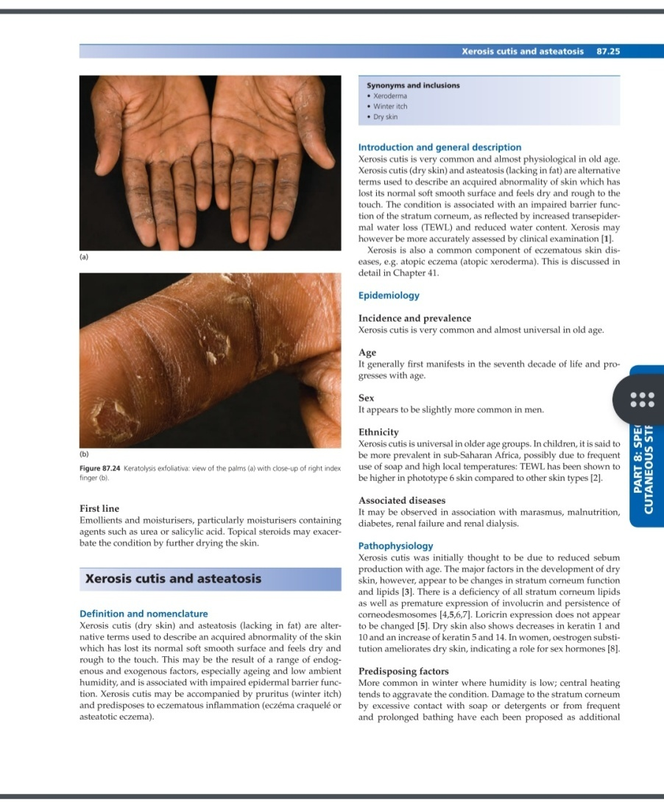
Keratolysis exfoliativa

Slide 121
DDs
Pompholyx
Psoriasis
Tinea manuum
Epidermolysis bullosa simplex
Acral skin peeling syndrome

Slide 122
Treatment
A self-limiting condition and treatment may not be needed
Pts advised to avoid contact with detergents and other irritants
First line:emollients and moisturisers containing agents such as urea or salicylic acid

Slide 123
Xerosis cutis and Asteatosis
Both above are alternative terms used to describe an aquired abnormality of skin which has lost its normal soft smooth surface and feels dry & rough
Xerosis cutis is very common & almost physiological in old age. It may be accompanied by pruritus and predispose to eczematous inflammation

Slide 124
First manifests in seventh decade of life and progresses with age
Slightly more common in men
It may be observed in association with marasmus,malnutrition,diabetes,renal failure and renal dialysis
Low humidity in winter & drying effects of central heating exacerbate XC.

Slide 125
Pathophysiology
Deficiency of all stratum corneum lipids as well as premature expression of involucrin and persistence of corneodesmosomes.
Dry skin also shows decrease in keratin 1&10 and an increase of keratin 5 &14
In women,estrogen substitution ameliorates dry skin,indicating a role for sex hormones
No histological abnormality apart from slight irregularity in str. corneum

Slide 126
Clinical features of XC
Dryness & scaliness of skin is first manifestation, followed by itching
Affect shins but may become widespread but spares face,neck,palms,and soles.
In elderly hospitalized pts,it will affect abdomen and,in women,the anterior surface of breasts,but spares back & undersurface of breasts.
Affected skin shows criss-cross superficial cracks in str.corneum

Slide 127
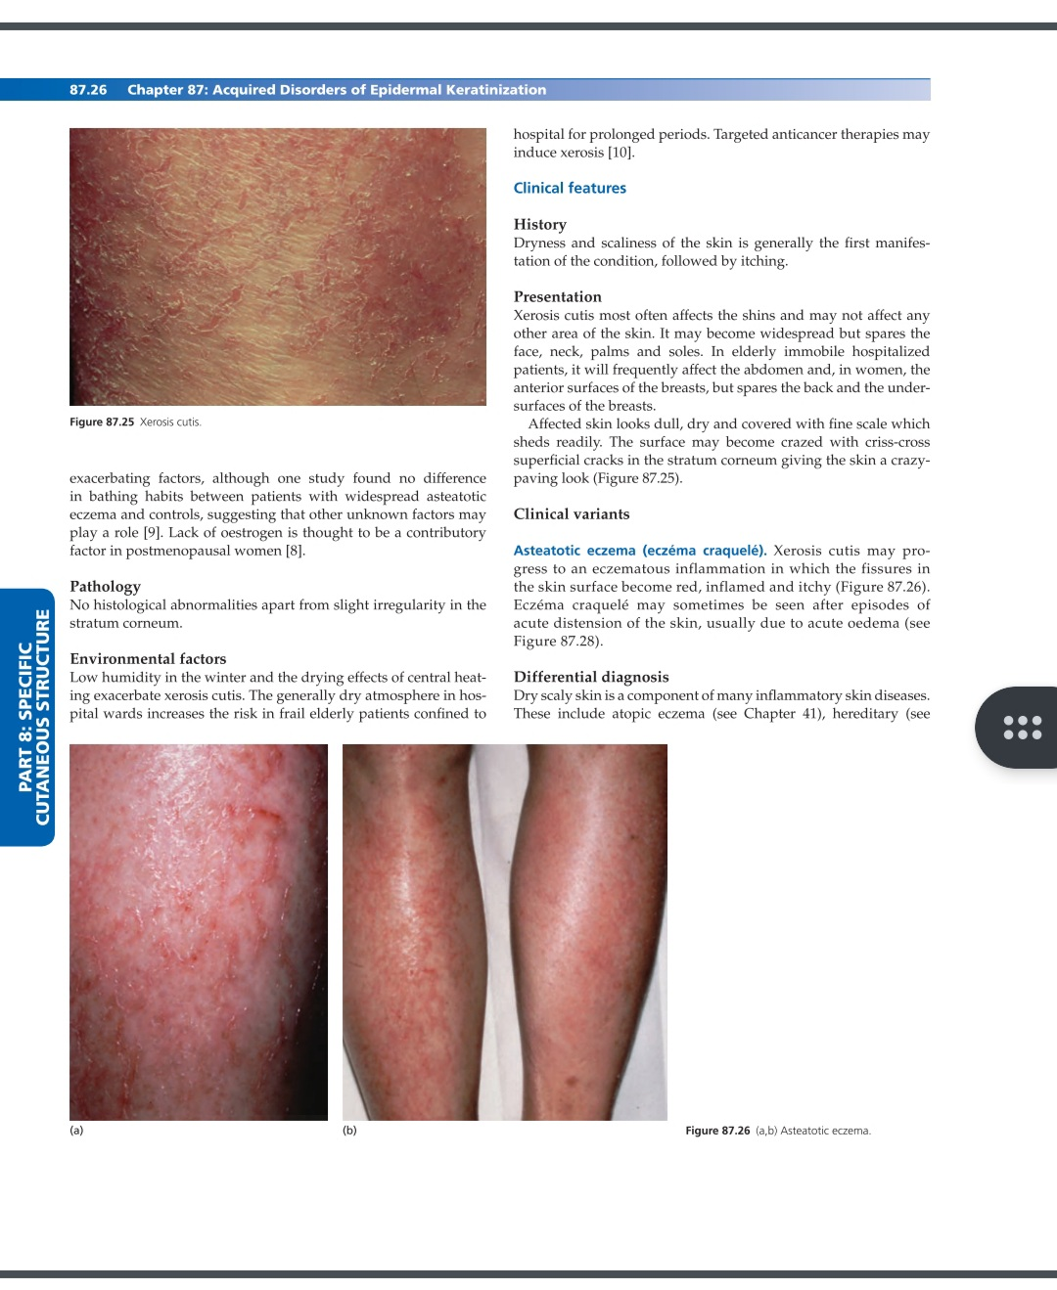
Xerosis cutis

Slide 128
Clinical variants
Asteatotic eczema: XC may progress to an eczematous inflammation in which fissures in skin surface become red,inflamed and itchy.
Asteatotic eczema sometimes seen after episodes of acute distension of skin due to acute oedema

Slide 129
Asteatotic eczema

Slide 130
Treatment
Removal of precipitating factors such as irritants
First line:emollients and moisturisers usually result in rapid improvement
Second line:if asteatotic eczema,then mild corticosteroid ointment is necessary but long-term topical steroids should be avoided, as it can damage skin barrier.Topical tacrolimus.

Slide 131
Acute epidermal distension & acute oedema blisters
Acute distension of uninflamed skin in the absence of disordered epidermal integrity may at times result in epidermal separation or disruption.
Most commonly, due to acute dependent oedema,and result in large bullae which may be mistaken for BP
Blisters respond rapidly to reduction of oedema

Slide 132
Pathophysiology
USG studies of acute oedema suggests that fluids accumulate more superficially in dermis than following lymphoedema or chronic stasis, which may be a contributory factor
Biopsies showed epidermal spongiosis,and a slight lymphohistiocytic inflammatory infiltrate

Slide 133
Clinical features
Acute onset of oedema without itching
Tense unilocular non-pruritic bullae appearing in areas of acute oedema
Lesions resolve rapidly as oedema resolves,leaving no scars

Slide 134
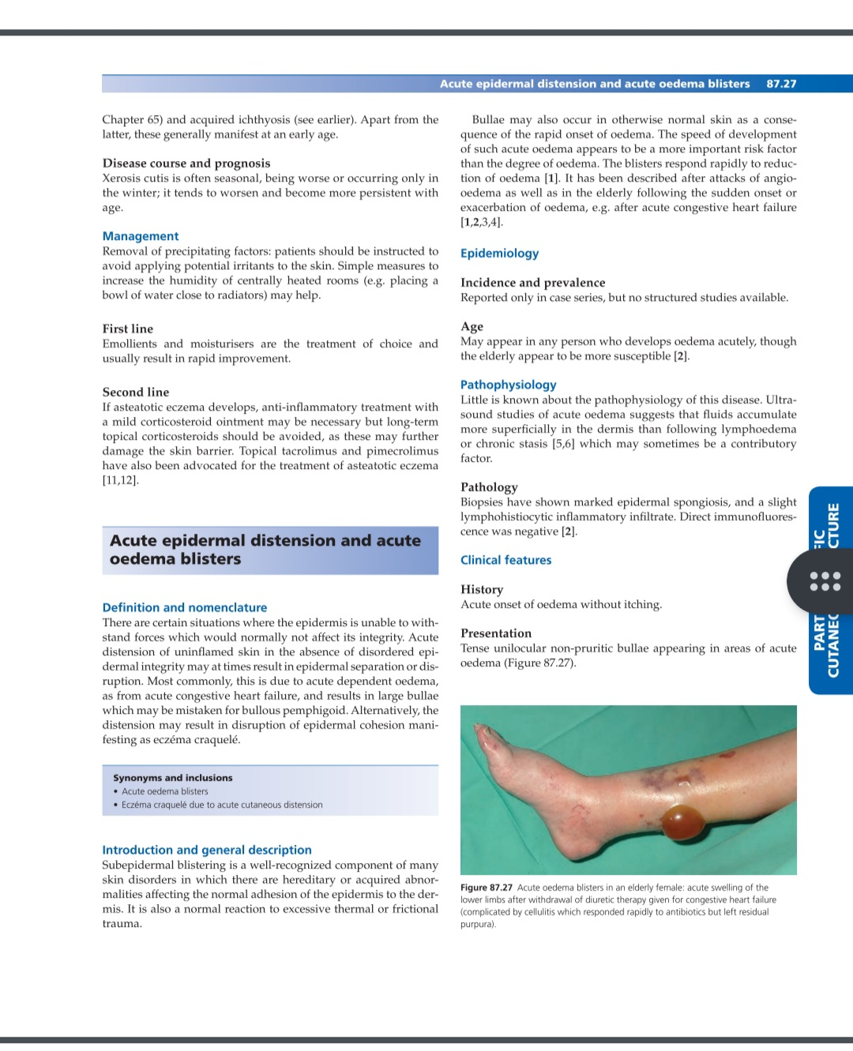
Acute oedema blisters

Slide 135
Clinical variants
Eczema craquele: acute cutaneous distension may result in disruption of epidermis as seen in asteatotic eczema with crazing and fissuring of epidermis and leakage of oedema fluid to the surface

Slide 136
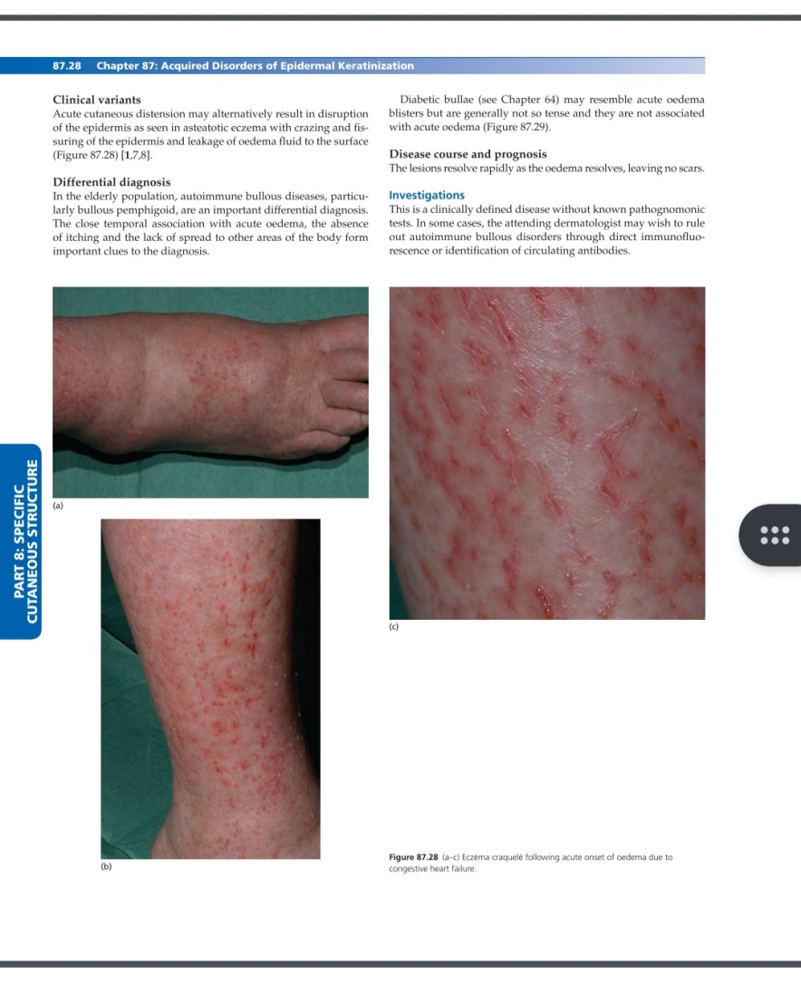
Eczema craquele

Slide 137
DDs
Bullous pemphigoid,in elderly population,is an important dd. Close temporal association with acute edema,absence of itching and lack of spread to other areas of body,are imp clues to diagnosis
Diabetic bullae may resemble acute edema blisters but generally not so tense and not associated with acute edema

Slide 138
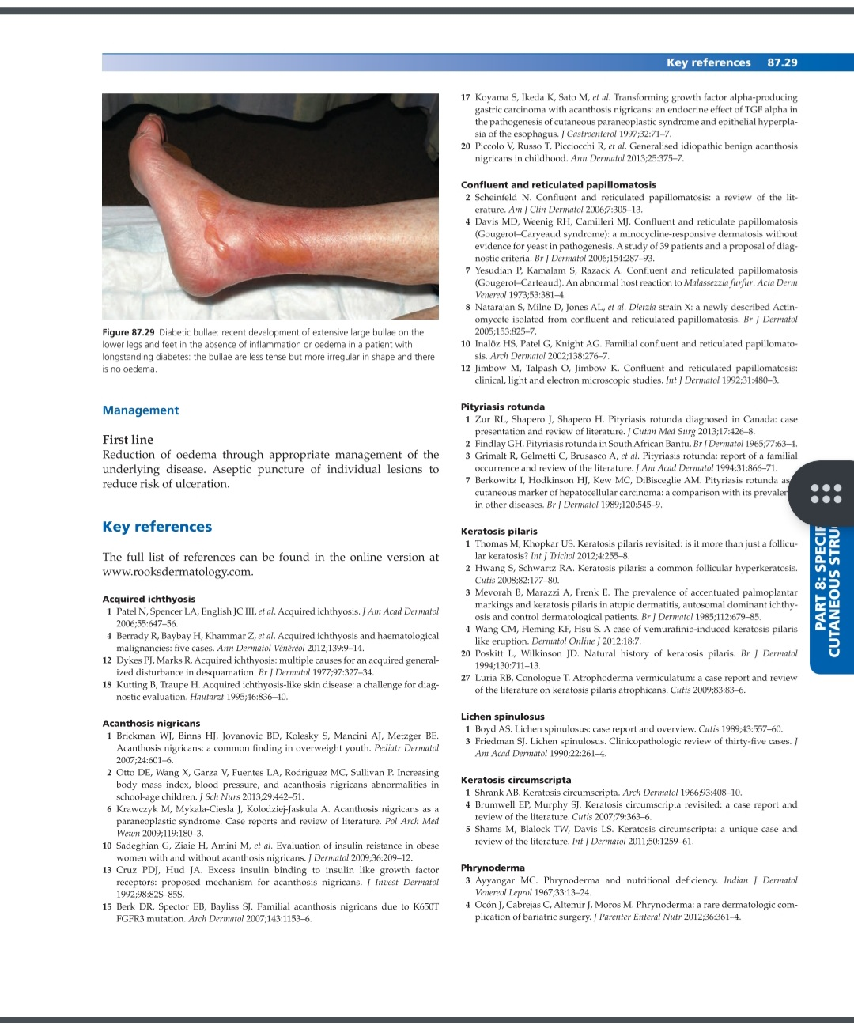
Diabetic bullae

Slide 139
Investigation
Clinical diagnosis
In some cases,autoimmune bullous disorders may be rule out through direct immunofluorescence or identification of circulating antibodies

Slide 140
Treatment
Reduction of edema through appropriate management of underlying disease
Aseptic puncture of individual lesions to reduce risk of ulceration

Slide 141
THANK YOU

