Slide 1
Benign keratinocytic acanthomas

Slide 2
introduction
Benign keratinocytic keratoses and acanthomas are a group of benign discrete epidermal proliferative disorders

Slide 3
Seborrheoic keratosis
A benign tumour composed of epidermal keratinocytes, frequently pigmented and more common in the elderly.
Seborrhoeic keratoses (SK) are usually asymptomatic and can have pleomorphic features varying from pale superficial patches to darkly pigmented verrucous plaques.

Slide 4
Epidermiology
  Age- Seborrhoeic keratoses usually appear in the fifth decade of life in patients living in temperate climates but the age of onset may be earlier in those residing in tropical regions.

Slide 5
Associated diseases
The rapid development of large numbers of SKs can occur in patients with an inflammatory dermatosis, e.g. eczema or in association with underlying malignancies where it is known as the sign of Leser–Trélat .
The neoplasms most commonly associated with this rare sign of Leser–Trélat include gastric and colon cancer.
In some patients, it may be associated with the development of acanthosis nigricans

Slide 6
Pre-disposing factors
Genetics FGFR3 mutations have been identified in 39–85% of human SK . Additionally, age has been identified as a major risk factor for the occurrence of somatic FGFR3 mutations in the skin, in line with the appearance of SK in mid to old age.
Environmental factors Cumulative UV exposure has been implicated

Slide 7
Pathology
There is an accumulation of normal but immature keratinocytes between the basal layer and the keratinizing surface of the epidermis.
Melanocyte proliferation may be present.
Horn cysts are produced by immature keratinocytes.

Slide 8
The surface may be verrucous and dermal papillae may be elongated.
Marked papillomatosis will also cause an irregular ‘church steeple’ outer border which retains keratin.
Conversely, the surface can be smooth and rounded, and the melanocyte population and degree of pigmentation might vary, so that the lesions may be deeply pigmented.

Slide 9
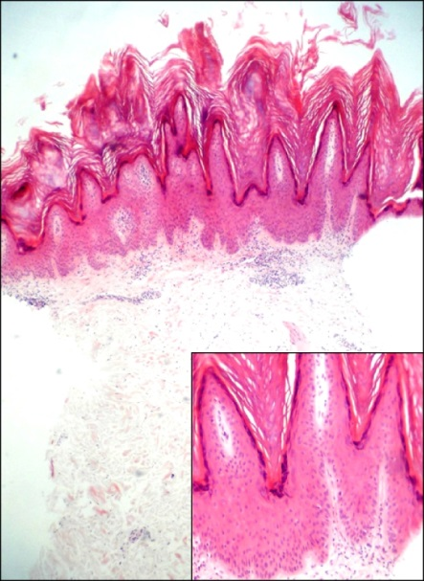
The parenchymal cells are rather small and polygonal, possessing tonofibrils and intercellular bridges, and they are arranged in an orderly fashion.

Slide 10
Pathologiocal variant
The three pathological variants are the solid,hyperkeratotic and reticular variants.
The solid SK is the most common and displays a mass of immature keratinocytes seen mainly above the level of the surrounding epidermis . Occasional cystic areas containing fragments of stratum corneum are seen at these sites.
The hyperkeratotic variety is rare and may be clinically mistaken for an actinic keratosis.

Slide 11
The reticular form is a third variant, composed of strands of keratinocytes; this type is frequently seen as a flat lesion on the face.
The most important differential diagnosis for an irritated SK is an early invasive squamous cell carcinoma (SCC). Despite the presence of focal areas of whorls of keratinocytes in squamous eddies, mitotic figures are rare, and the base of the lesion shows a clear separation from dermal tissue, with no single‐cell CA.

Slide 12
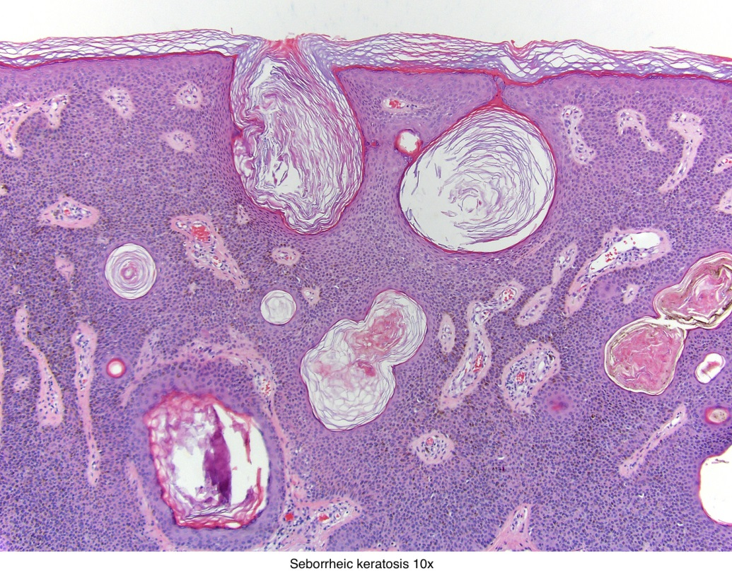
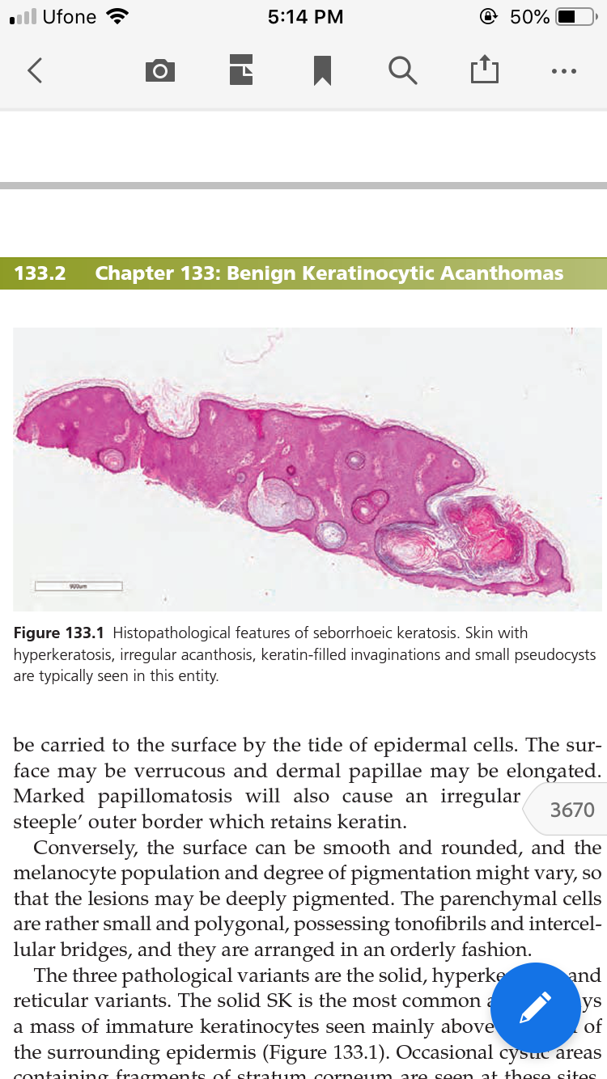

Slide 13
Clinical features
Seborrhoeic keratoses are usually asymptomatic but may be pruritic.
Site They can occur on any body site but most frequently on the face and upper trunk.
The first evidence is slight hyperpigmentation and differentiation from melanocytic lesions such as lentigo simplex, lentigo maligna and pigmented actinic keratosis can be difficult.
SKs can be pedunculated or acanthotic, smooth surfaced, domed and heavily pigmented. The surface of these SKs has numerous plugged follicular orifices, giving an almost cerebriform appearance

Slide 14
Moreover, these do not reflect light, differentiating them from naevi.
Additionally, SKs have fewer hairs than the skin they arise from. The superficial verrucous plaques vary from dirty yellow to black in colour and may have a typical ‘stuck‐on’ appearance with a loosely adherent greasy keratin on the surface.
SKs are commonly round or oval and their size varies from 1 mm to several centimetres. On the eyelids and major flexures, SKs may be pedunculated and less keratotic. Irritation or infection causes swelling, sometimes bleeding, oozing and crusting, and a deepening of the colour due to inflammation, signs that may indicate subsequent spontaneous resolution

Slide 15
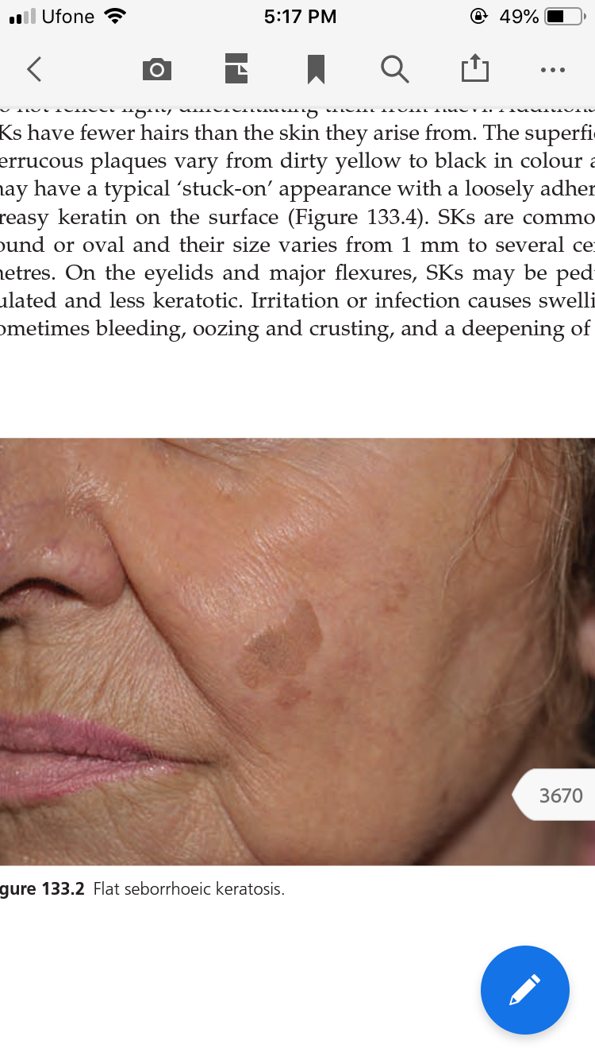
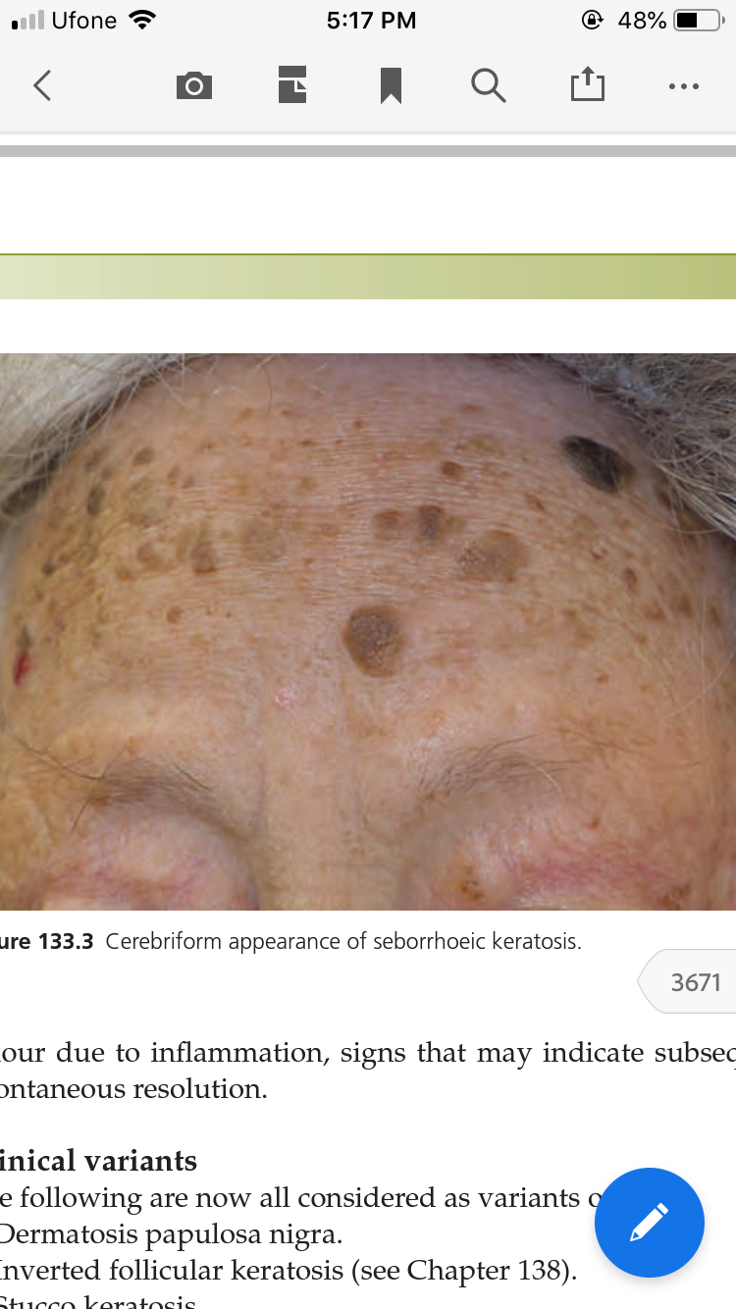
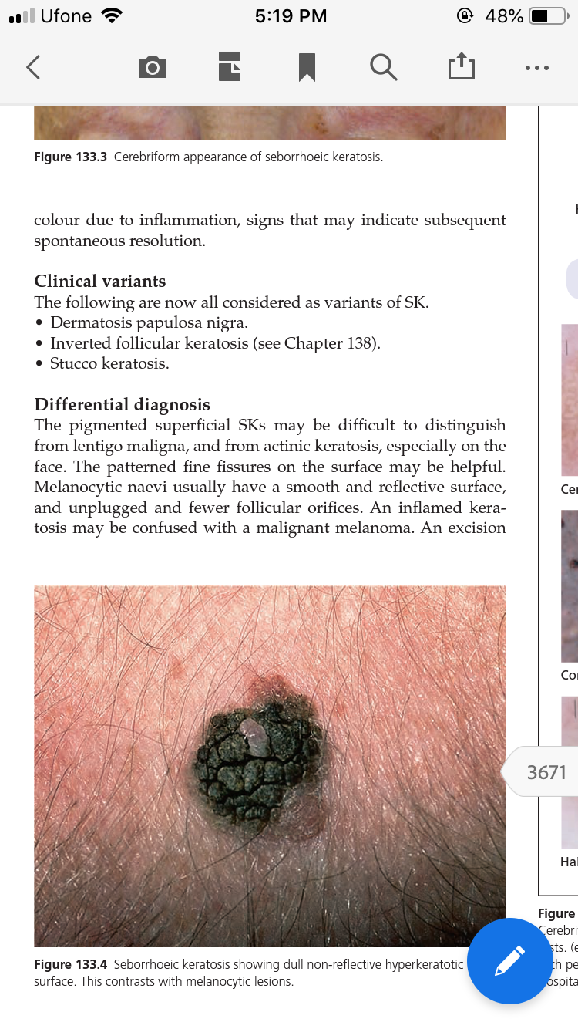

Slide 16
Differential diagnosis
The pigmented superficial SKs may be difficult to distinguish from lentigo maligna, and from actinic keratosis.
The patterned fine fissures on the surface may be helpful. Melanocytic naevi usually have a smooth and reflective surface, and unplugged and fewer follicular orifices.
An inflamed keratosis may be confused with a malignant melanoma.
Pigmented basal cell carcinomas are usually irregular with a rolled edge, have a thin shiny epidermis with telangiectases and a depressed or ulcerated centre.

Slide 17
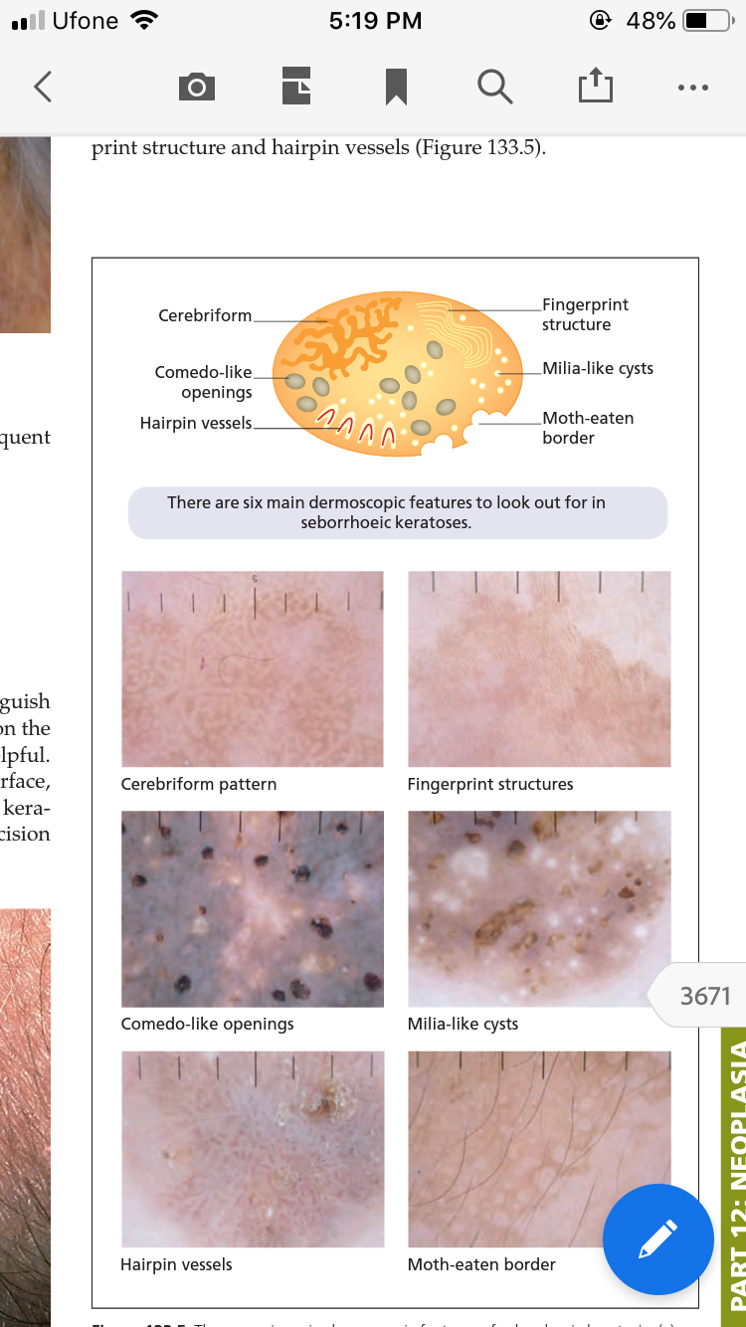
Investigations

Slide 18
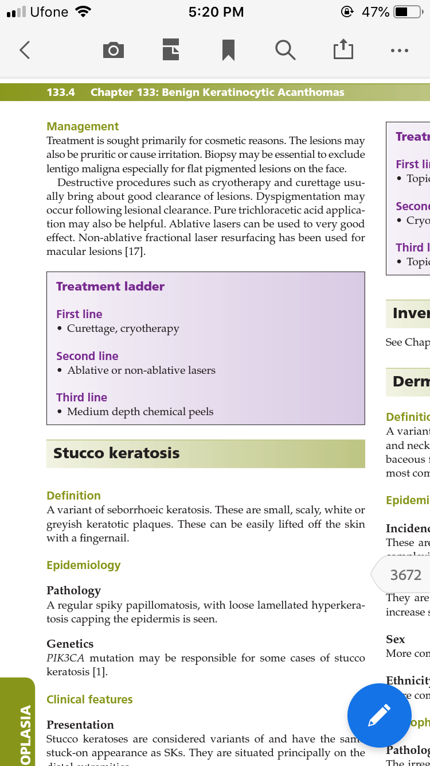
management

Slide 19
Stucco keratosis
A variant of seborrhoeic keratosis.
These are small, scaly, white or greyish keratotic plaques. These can be easily lifted off the skin with a fingernail.
Pathology A regular spiky papillomatosis, with loose lamellated hyperkeratosis capping the epidermis is seen.

Slide 20
Clinical features
Stucco keratoses are considered variants of and have the same stuck‐on appearance as SKs. They are situated principally on the distal extremities.
Differential diagnosis Ichthyosis and porokeratosis may occasionally pose a diagnostic challenge.

Slide 21
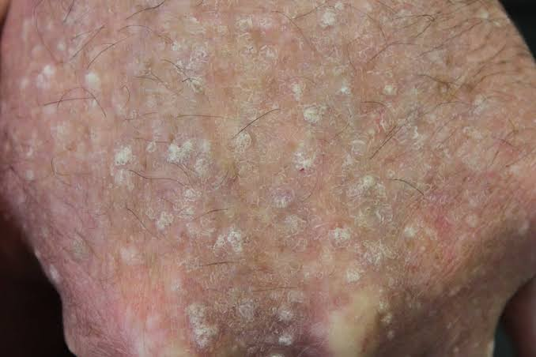

Slide 22
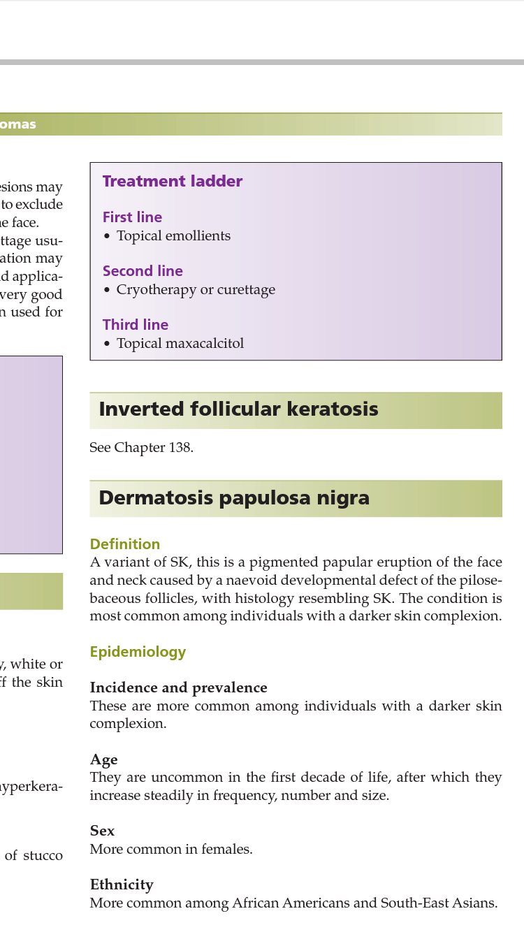
management

Slide 23
Dermatosis papulosa nigra
A variant of SK, this is a pigmented papular eruption of the face and neck caused by a naevoid developmental defect of the pilosebaceous follicles, with histology resembling SK.
Ethnicity the condition is most common among individuals with a darker skin complexion.
Age They are uncommon in the first decade of life, after which they increase steadily in frequency, number and size.
Sex More common in females.

Slide 24
Pathophysiology
The irregular acanthosis and hyperkeratosis resembles the histopathological features of SK.
Clinical features Lesions may be black or dark brown, flat or cupuliform papules.
Size They measure 1–5 mm in diameter.
Site The cheeks and forehead are most commonly affected. Although rare, lower parts of the face and chin, neck, chest, abdomen and back may all be affected.

Slide 25
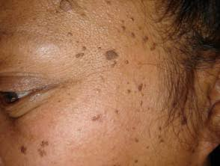

Slide 26
Management
Destructive techniques such as electrocautery and curettage may be effective. As the lesions are usually seen in dark-skinned patients, the risk of dyspigmentation exists. Laser ablation achieves good results, but non-ablative laser treatments may also be effective

Slide 27
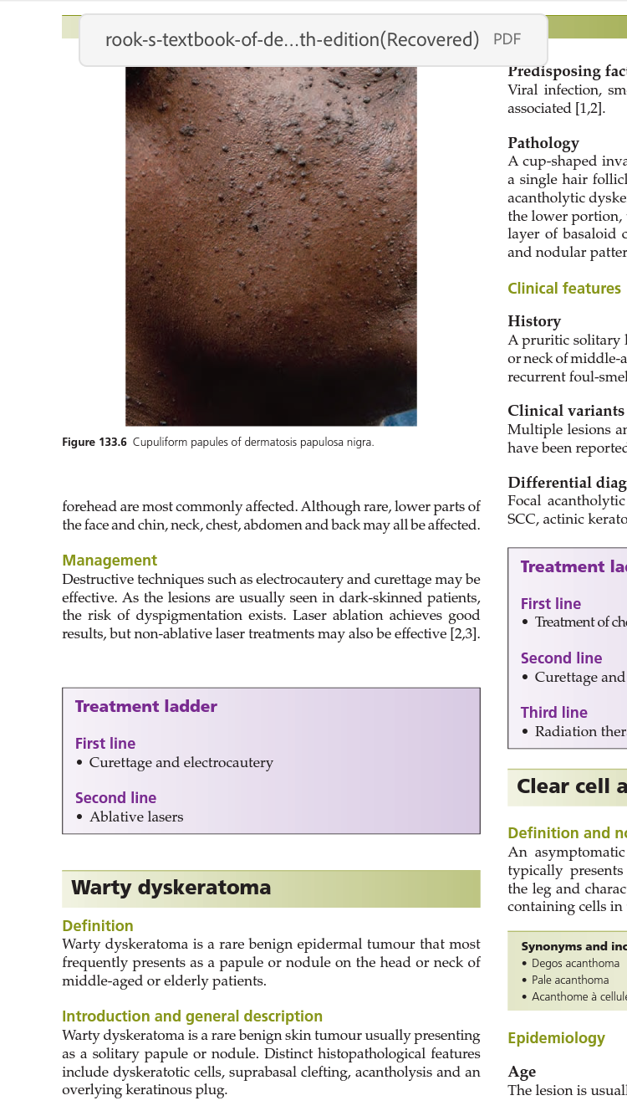

Slide 28
Warty dyskeratoma
is a rare benign epidermal tumour that most frequently presents as a papule or nodule on the head or neck of middle‐aged or elderly patients.
Pre disposing factors Viral infection, smoking, autoimmunity and UV light have been associated

Slide 29
Pathology
A cup‐shaped invagination filled with a keratotic plug involving a single hair follicle.
Within the invagination entrance numerous acantholytic dyskeratotic cells and typical corps ronds are seen. In the lower portion, there are many villi that are covered by a single layer of basaloid cells with the villi protruding upwards.
Cystic and nodular patterns have also been reported

Slide 30
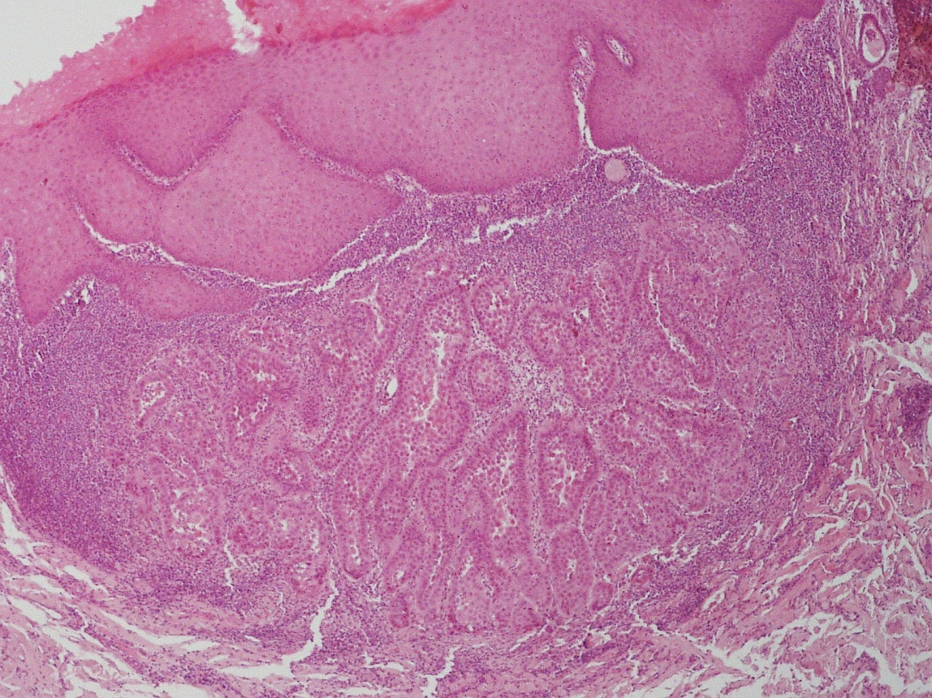

Slide 31
Clinical features
A pruritic solitary lesion with a central keratotic plug, on the head or neck of middle‐aged or elderly persons.
Other symptoms include recurrent foul‐smelling cheesy discharge or bleeding on trauma.
Clinical variants Multiple lesions and involvement of the oral and genital mucosa have been reported.
Differential diagnosis Focal acantholytic dyskeratosis is also observed in acantholytic SCC, actinic keratosis, basal cell carcinoma and Darier disease.

Slide 32
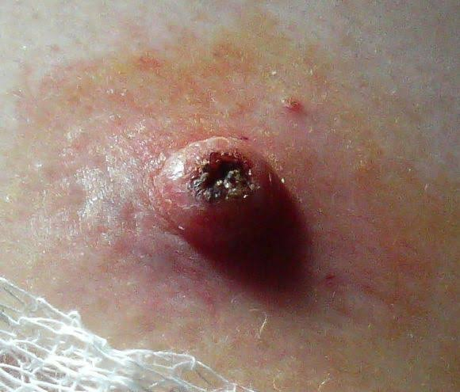

Slide 33
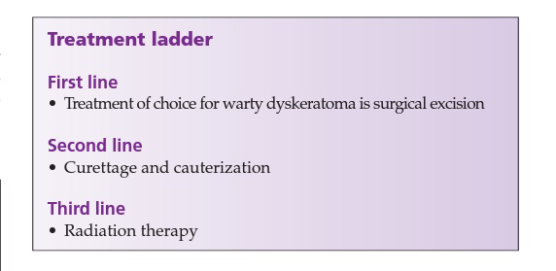
management

Slide 34
Clear cell acanthoma
An asymptomatic benign lesion of unknown aetiology, which typically presents as a red to brown, dome‐shaped papule on the leg and characterized by the accumulation of clear glycogen‐ containing cells in the epidermis.

Slide 35
Pathophysiology
The histopathological features are characteristic. These include psoriasiform acanthosis with pale periodic acid–Schiff (PAS) positive glycogen‐rich keratinocytes (clear cells) . The cytoplasm of the clear cells contains an abundance of glycogen, which on electron microscopy is seen to displace tonofibrils. There is intercellular oedema and an infiltrate often containing many polymorphonuclear leukocytes forming parakeratotic microabscesses.
The papillary dermis is oedematous and the superficial capillaries and veins are increased in number.

Slide 36
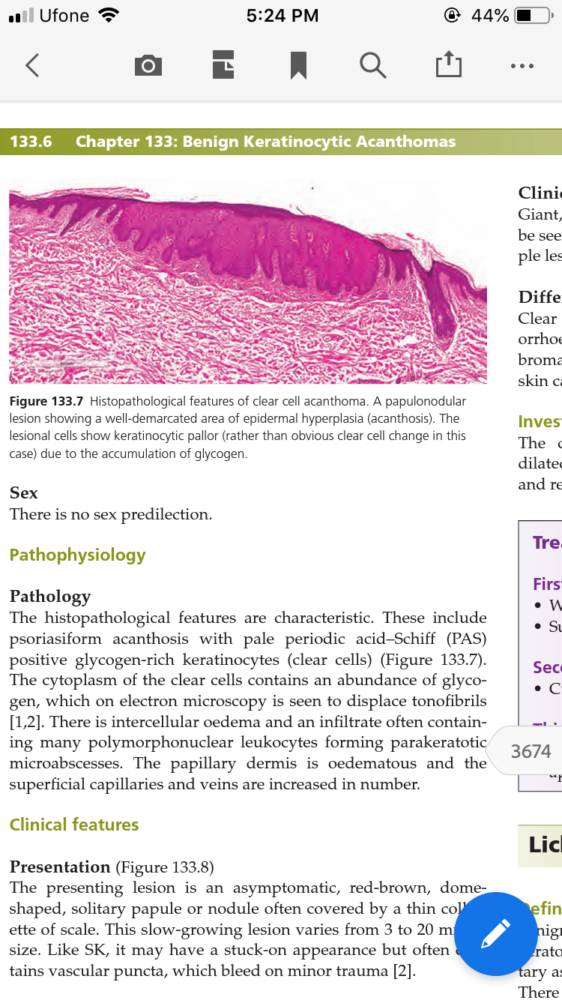

Slide 37
Clinical features
The presenting lesion is an asymptomatic, red‐brown, dome shaped, solitary papule or nodule often covered by a thin collarette of scale. This slow‐growing lesion varies from 3 to 20 mm in size. Like SK, it may have a stuck‐on appearance but often contains vascular puncta, which bleed on minor trauma

Slide 38
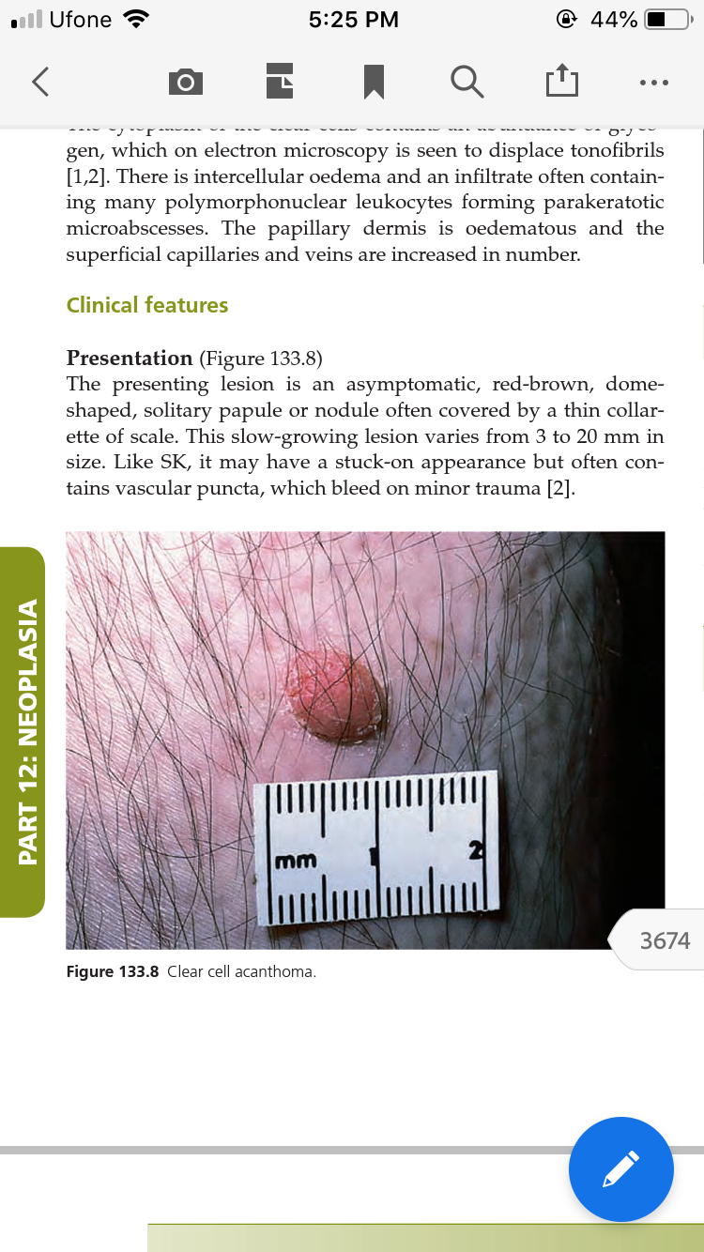

Slide 39
Clinical variants
Giant, pedunculated, atypical, cystic and pigmented patterns may be seen.
The term eruptive clear cell acanthomas is given to multiple lesions presenting over a period of months.
Differential diagnosis Clear cell acanthomas must be differentiated from actinic or seborrhoeic keratoses, viral warts, pyogenic granulomas, dermatofibromas, eccrine poromas, clear cell hidradenoma, non‐melanoma skin cancers and metastatic cancer .

Slide 40
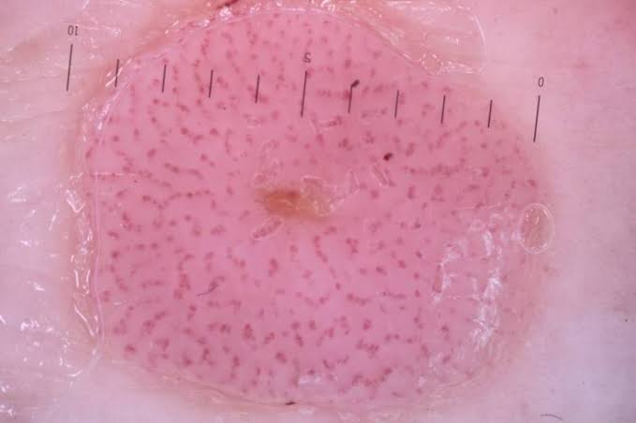
Investigations The characteristic findings on dermoscopy are prominently dilated pinpoint capillary loops (‘bunch of grapes’ appearance), and reticular or linear patterns

Slide 41
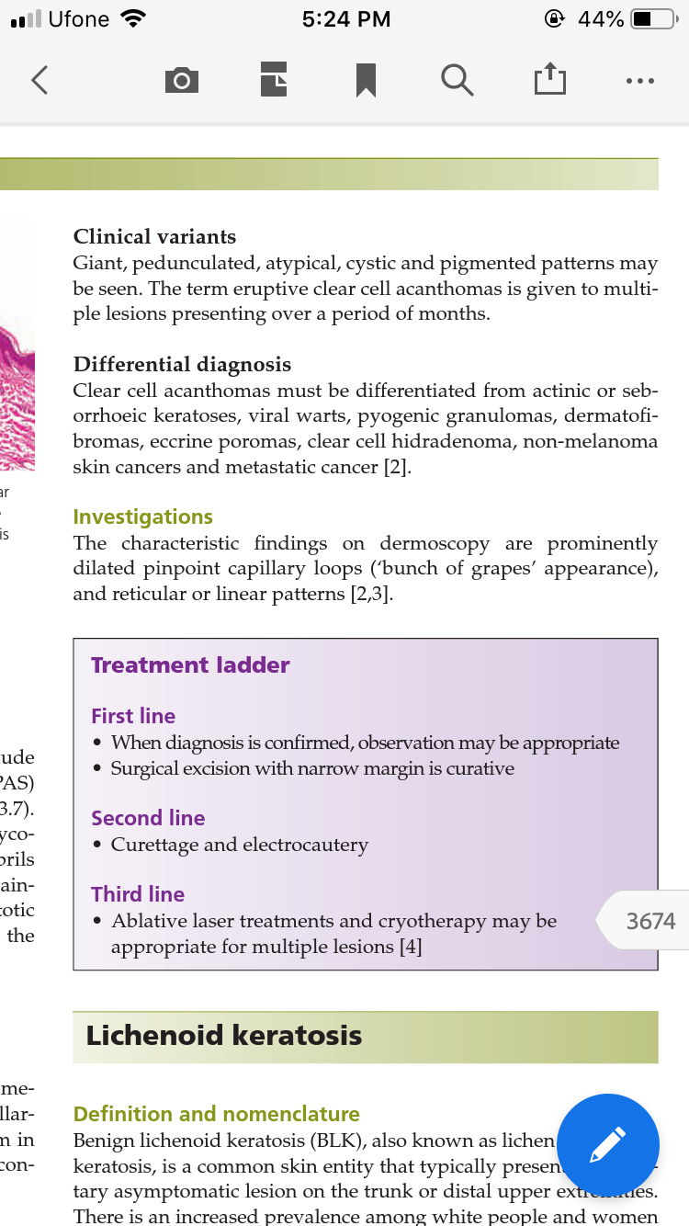
managment

Slide 42
Lichenoid keratosis
also known as lichen planus‐like keratosis, is a common skin entity that typically presents as a solitary asymptomatic lesion on the trunk or distal upper extremities.
There is an increased prevalence among white people and women . It may be rough or scaly in texture and can transition from pink to violaceous to hyperpigmented as its regresses. Multiple regression phases may be simultaneously present within a lesion

Slide 43
Benign lichenoid keratosis presents as a solitary asymptomatic lesion on the trunk or distal upper extremities and may arise from a regressing SK or solar lentigo.
Pathophysiology Epidermal acanthosis, parakeratosis and a band‐like lichenoid lymphocyte infi ltrate are the key histological features.

Slide 44
histologically
Variable numbers of neutrophils, plasma cells, eosinophils and epidermal parakeratosis distinguish this from typical lichen planus .
Subtypes can include classic type, an early or interface type, bullous type, atypical type with cytologically atypical lymphocytes and a late regressed or atrophic type.
Clinical features Benign lichenoid keratosis can present as a pink to violaceous to hyperpigmented scaly patch on the head and neck, trunk or distal upper extremities. On the face, BLK may present as a solitary asymptomatic brown lesion.
Differential diagnosis Basal cell carcinoma, Bowen disease, lentigo simplex, SK, actinic keratosis and melanoma.

Slide 45
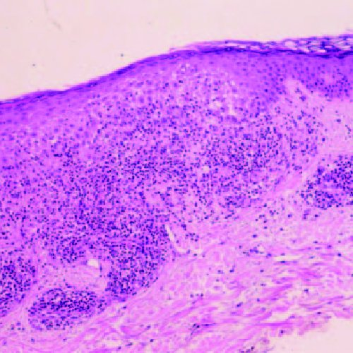
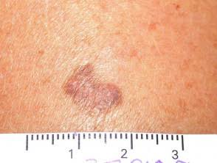
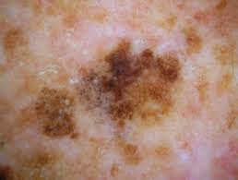

Slide 46
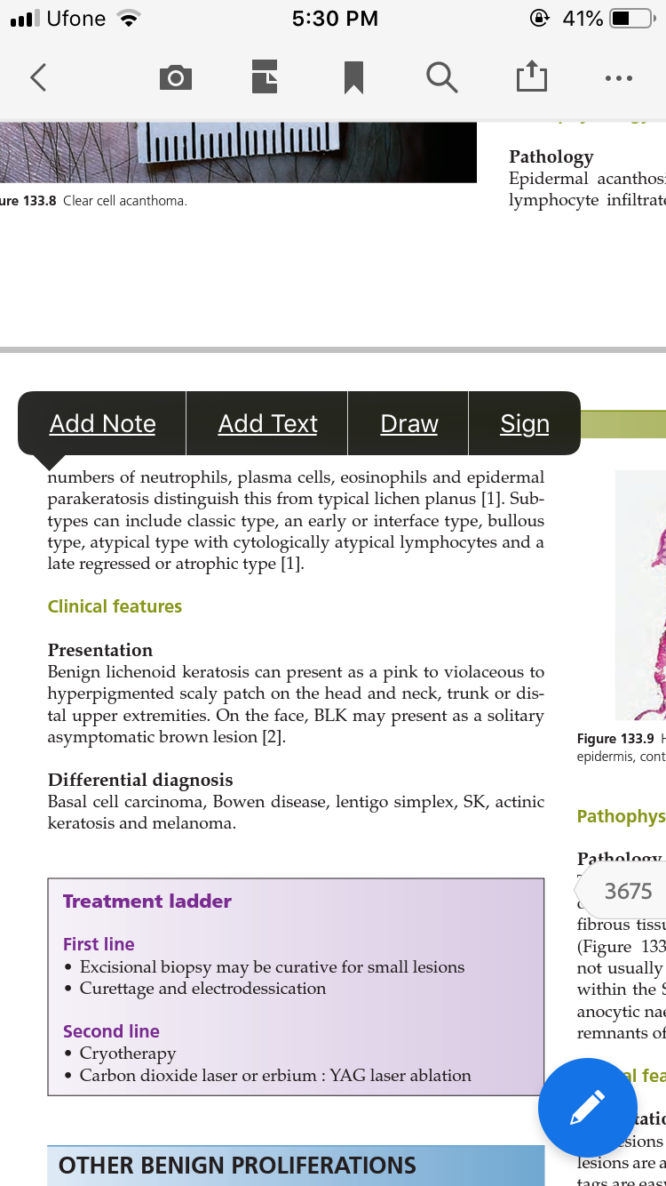
management

Slide 47
Skin tags
A common benign lesion composed of loose fibrous tissue and occurring mainly on the neck and major flexures as a small soft pedunculated protrusion
Associated diseases There may be an association with abnormal lipid profile, type 2 diabetes, cardiovascular disease and obesity

Slide 48
Pathology The epidermis is attenuated, and the basal cell layer is flat and often hyperpigmented. The protruding mass is composed of loose fibrous tissue. This is connected to the skin by a narrow pedicle.
There is an overlap with melanocytic naevi and neurofibromas. Some skin tags may be the last remnants of a pre‐existing melanocytic naevus.

Slide 49
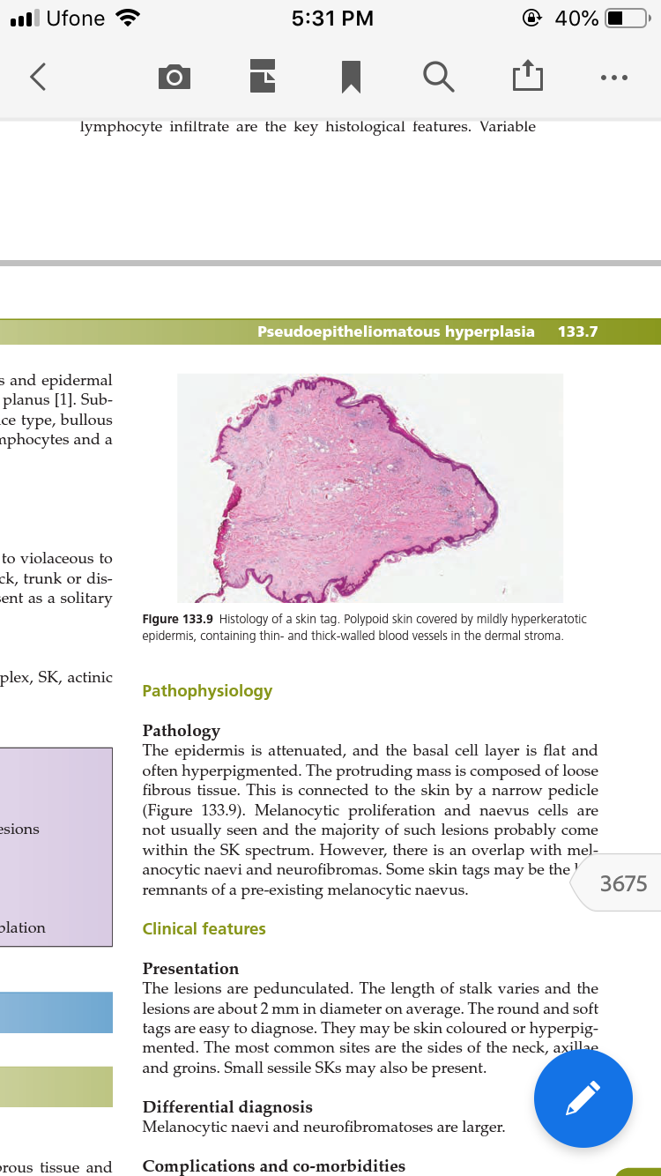

Slide 50
Clinical features The lesions are pedunculated. The length of stalk varies and the lesions are about 2 mm in diameter on average. The round and soft tags are easy to diagnose. They may be skin coloured or hyperpigmented. The most common sites are the sides of the neck, axillae and groins. Small sessile SKs may also be present.
Differential diagnosis Melanocytic naevi and neurofi bromatoses are larger.
Complications and co‐morbidities A skin tag may twist on its pedicle and become inflamed

Slide 51
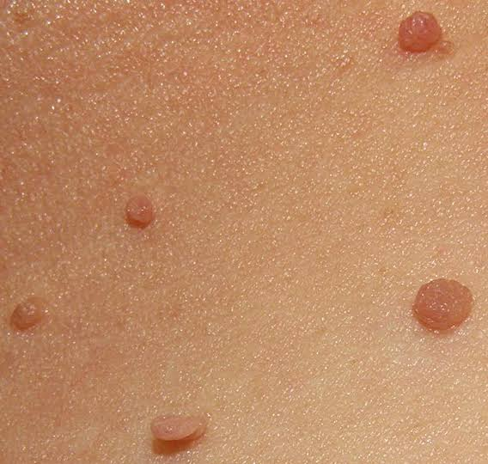

Slide 52
Pseudoepitheliomatous hyperplasia
A florid proliferation of the epidermis that may occur in the setting of chronic skin ulcers, abscesses, burns and infections, and that may simulate SCC.

Slide 53
Predisposing factors/associations
Pseudoepitheliomatous hyperplasia may occur in the setting of chronic leg ulcers, chronic cutaneous granulomatous disorders, e.g. lupus vulgaris, tuberculosis verrucosa cutis, insect‐bite granulomas, pemphigus vegetans, chronic lupus erythematosus, hypertrophic lichen planus, halogenodermas, infections such as chromomycosis and blastomycosis, granuloma inguinale and leishmaniasis. It may occur as a reaction to tattoo pigments and in association with tumours, particularly granular cell myoblastoma and malignant melanoma.

Slide 54
Pathology
In ulcers and inflammatory lesions – by far the most common causes – there is disturbance of the upper part of the dermis, often with young fibroblasts and a rather myxomatous connective tissue stroma replacing the normal dermal collagen.
Columns of prickle cells grow down into the dermis in an irregular fashion. In some areas, there is maturation of the central parts of the columns to produce horny pearls. The general appearance is that of invasive proliferation of the epithelium.

Slide 55
Clinical features
The clinical features vary with the primary disorder. Thickened, warty or heaped‐up epidermis is seen in pseudoepitheliomatous hyperplasia due to complicating granulomatous disorders such as chromomycosis.
In chronic ulcers, the margin is heaped up, often giving the appearance of a rolled border, and has an irregular surface. The edge is not usually indurated to the extent that occurs in SCC. It is characteristic that the hyperplasia will subside as the ulcer is treated and heals.

Slide 56
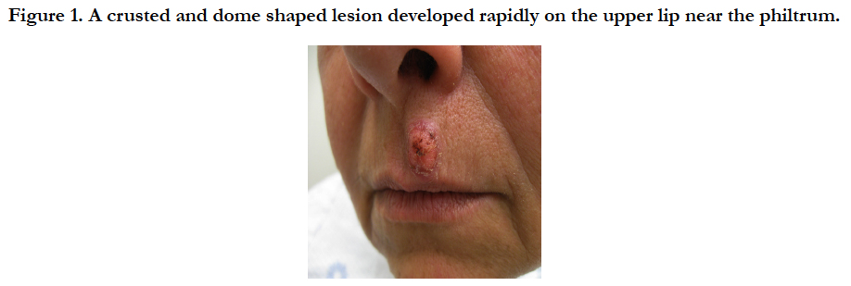

Slide 57
An ulcer whose margin has been affected by pseudoepitheliomatous hyperplasia in the past may eventually be the cause of metastasizing SCC.
Differential diagnosis Clinical differentiation from SCC can be difficult. Histology may be helpful.
Investigations DNA microarray studies show a distinct gene expression pattern which may help in distinguishing SCC from pseudoepitheliomatous hyperplasia.

Slide 58
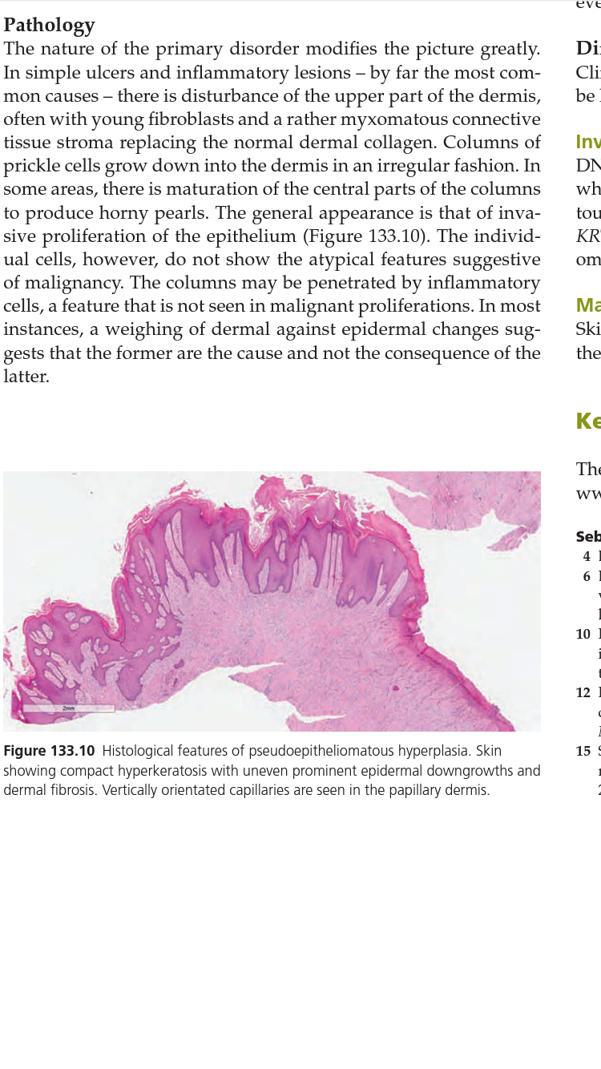
Management Skin biopsy should be undertaken to rule out SCC. Treatment of the associated disorders should be sufficient.

Slide 59
Inverted follicular keratosis
A localized area of hyperkeratosis found in association with the pilosebaceous orifi ce, considered as a variant of seborrheic keratosis

Slide 60
Pathophysiology
A number of these lesions arise as a result of infection of the infundibulum of the hair follicle by human papillomavirus (HPV). It is likely that a majority of these lesions may be regarded as the most superficial tumour of the follicular infundibulum , arising as the result of irritation.
Pathology The pathological features show an endophytic lesion connected to the infundibulum of the hair follicle. Irritated keratinocytes form whorls of cells, so‐called ‘squamous eddies’, and keratin cysts. At higher power, mitotic figures may be seen, but they are not abnormal mitoses. The appearances are identical to an irritated seborrhoeic keratosis, but the latter is exophytic

Slide 61
Clinical features
lesion presents as a solitary papule on the head and neck area. It may reach a considerable size, and be inflamed and pruritic.
Management Local surgical excision is generally needed, for both diagnostic and therapeutic purposes.

Slide 62
