Slide 1
ATOPIC ECZEMA

Slide 2
DEFINATION
AE is an itchy, chronic or chronically relapsing inflammatory skin condition that often starts in early childhood (usually before 2 years of age)

Slide 3
UK DIAGNOSTIC CRITERIA
An itchy skin condition (or parental report of scratching or rubbing in a child)
Plus three or more of the following:
Onset below age of 2 years (not used if child is under 4years)
History of skin crease involvement (including cheeks in children under 10 years)
History of a generally dry skin
Personal history of other atopic disease (or history of any atopic disease in a first‐degree relative in children under 4 years)
Visible flexural dermatitis (or dermatitis of cheeks/forehead and outer limbs in children under 4 years)

Slide 4
ATOPY
’Atopy is a personal or familial tendency to produce IgE antibodies in response to low doses of allergens, usually proteins, and to develop typical symptoms of asthma, rhinoconjunctivitis or eczema/dermatitis.

Slide 5
TYPES OF ATOPIC ECZEMA
INTRINSIC ATOPIC ECZEMA;
Dermatitis with normal IGE levels
EXTRINSIC ATOPIC ECZEMA;
Dermatitis with raised levels of IGE

Slide 6
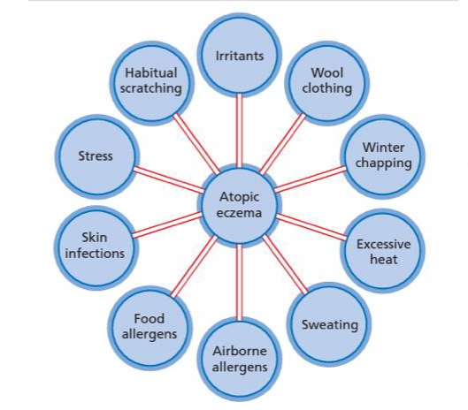
TRIGGERING FACTORS

Slide 7
PATHPHYSIOLOGY
In individuals without a skin barrier defect, there is full integrity of the epidermis, marked by minimal transepidermal water loss (TEWL) and adequate protection against microbes and environmental allergens. Environmental influences on skin barrier integrity, such as frequent use of detergents and water hardness are associated with an increase in AE risk, probably through induction of skin barrier impairment by reduction in natural moisturizing factor, increase in skin pH and a subsequent upregulationin protease activity .

Slide 8
Filaggrin is encoded within the epidermal differentiation complex (EDC) on 1q21.
Profilaggrin, made up of numerous repeats of filaggrin monomers, is expressed in keratinocytes, where it makes up the dominant component part of keratohyalin granules in the stratum granulosum.
Keratinocytes undergo terminal differentiation to form the stratum corneum, during which dephosphorylation of profilaggrin is followed by cleavage with matriptase and other proteases.

Slide 9
Metabolism of filaggrin monomers, higher in the stratum corneum, releases component amino acids which have been reported to contribute to epidermal water retention through their hygrospoic properties.

Slide 10
CLINICAL PRESENTATION
Itching
Macular erythema
Papules or papulovesicles
Eczematous areas with lichenifications
Lichenifications and excoriations
Hyper and hypo pigmentation
Dryness of skin
Secondary infections

Slide 11
INFANTILE PHASE
The lesions most frequently start on the face .
The napkin area is relatively spared.
When the child begins to crawl, the exposed surfaces , especially the extensor aspect of the knees and elbows are most involved.
The lesions consist of erythema and discrete or confluent oedematous papules. The papules are intensely itchy, and may become exudative and crusted as a result of rubbing.
Secondary infection and lymphadenopathy are common.

Slide 12
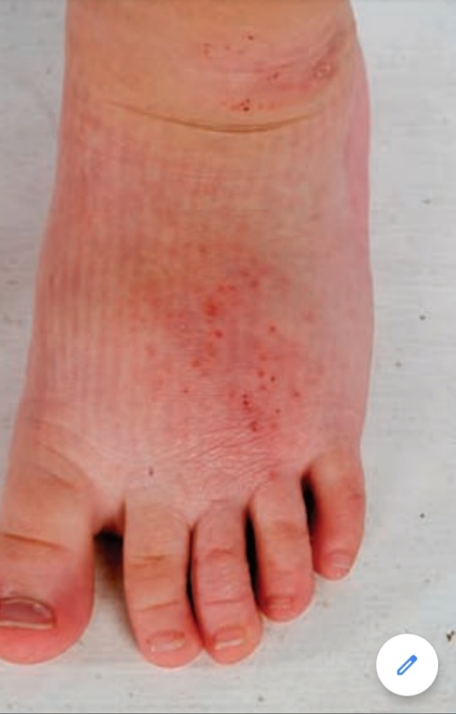

Slide 13
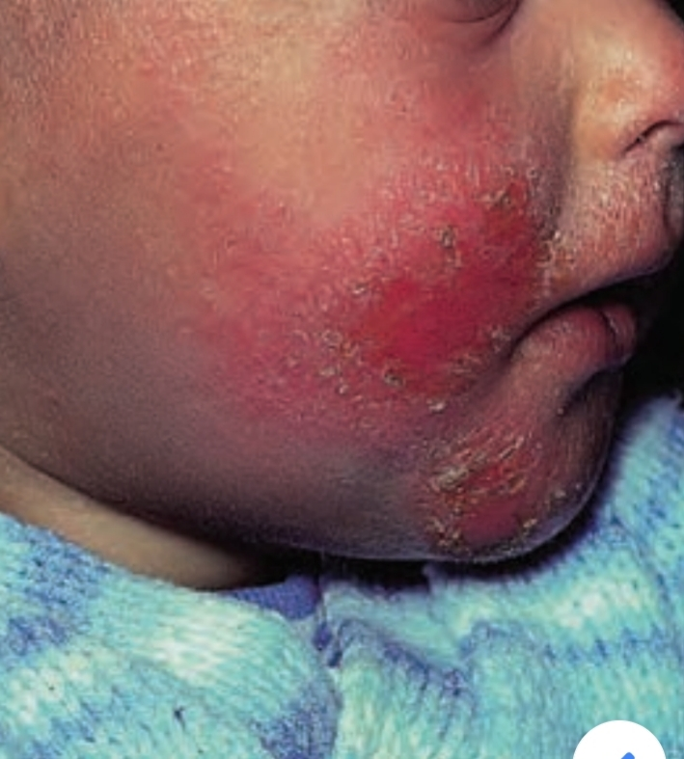

Slide 14
CHILDHOOD PHASE
From 18 to 24 months onwards, the sites most characteristically involved are the elbow and knee flexures
A mixture of erythema, crusting, excoriation, hyper‐ and hypopigmentation, and warty lichenification may be seen depending on the skin type on the sides of the neck, wrists and ankles .
The sides of the neck may show a striking reticulate pigmentation, sometimes referred to as ’atopic dirty neck). Sometimes only one site is involved.

Slide 15
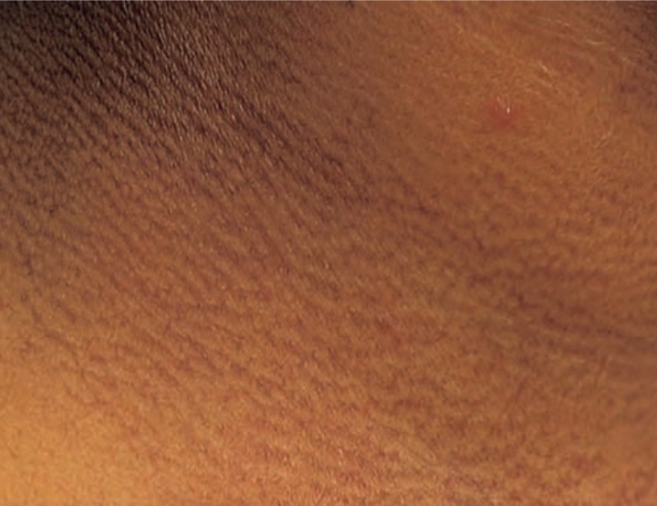

Slide 16
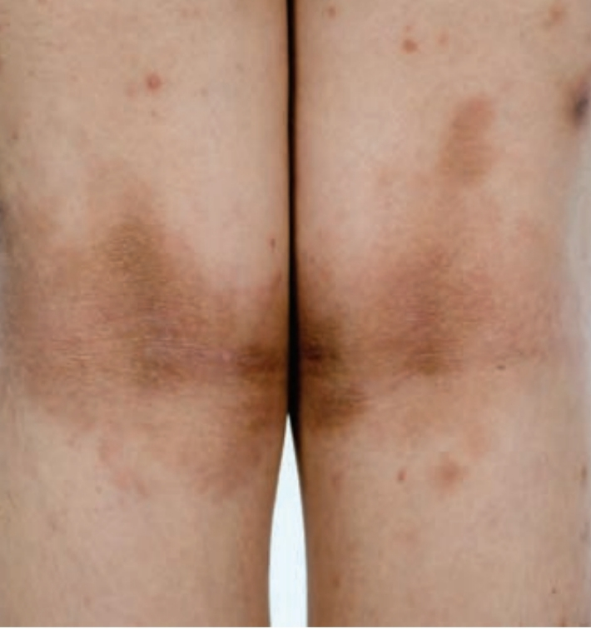

Slide 17
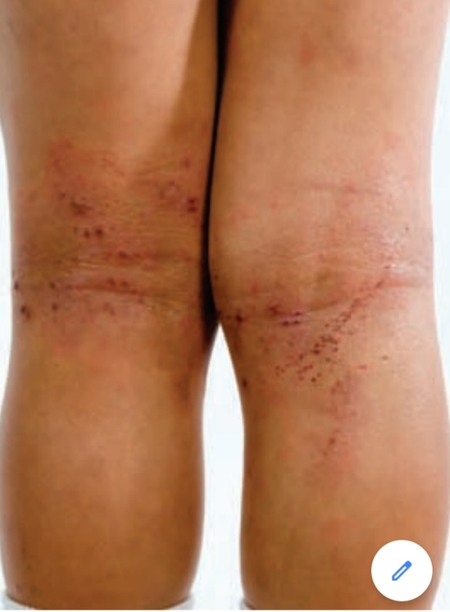

Slide 18
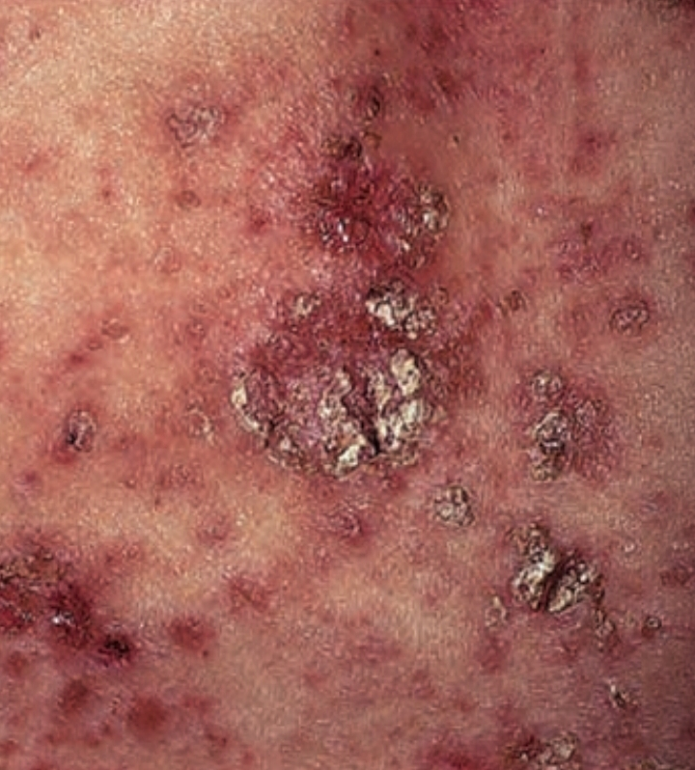

Slide 19
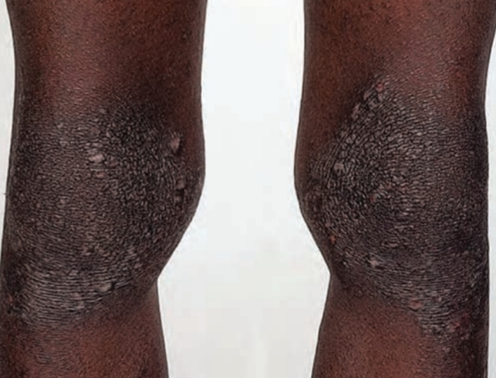

Slide 20
Adult phase
The picture is essentially similar to that in later childhood , with lichenification, especially of the flexures and hands.
Frequently,facial and hand involvement is more problematic in adulthood.
Localized patches of atopic eczema is found on nipples of young women.

Slide 21
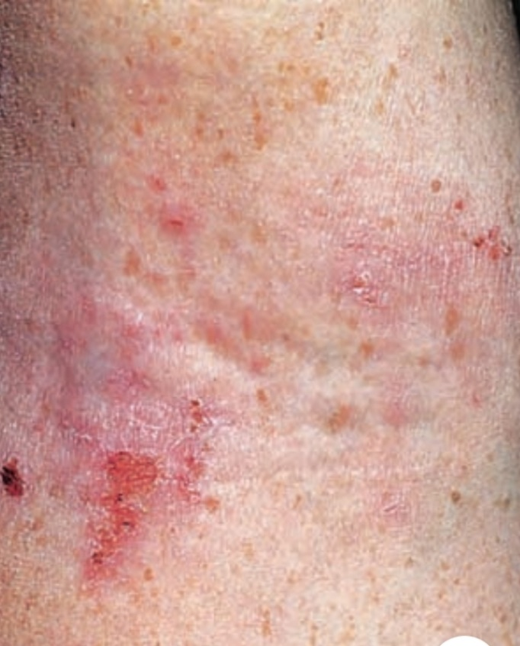

Slide 22
ATOPIC HAND ECZEMA
The hands may be affected in more than 50% of patients with active AE .
A patchy, somewhat vesicular and lichenified eczema is a common manifestation of AE in childhood.
The nails are often involved, resulting in coarse pitting and ridging.
Involvement of the feet is also common.

Slide 23
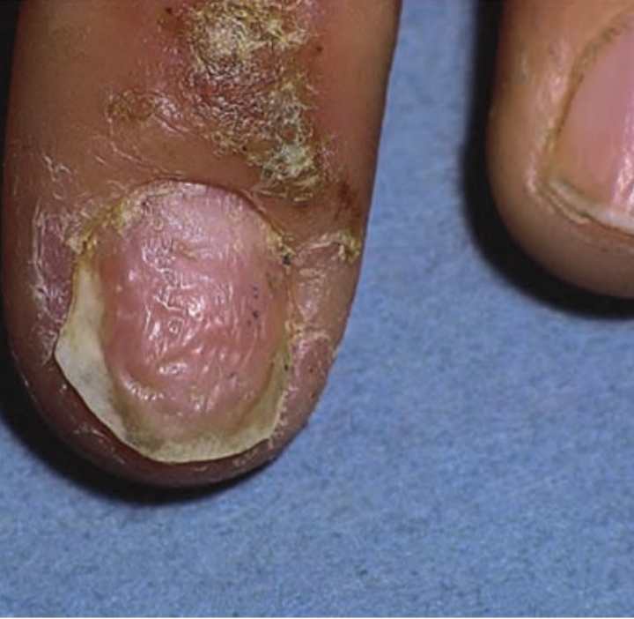

Slide 24
DIFFERENTIAL DIAGNOSIS
Scabies
Seborrhoeic eczema
Contact dermatitis
Rare disorders that may have an atopic eczema like rash
Hyper‐IgE syndrome
Hypereosinophilic syndrome
Agammaglobulinaemia
Anhidrotic ectodermal dysplasia
Ataxia telangiectasia
Netherton syndrome (ichthyosis, bamboo hairs)
Phenylketonuria
Wiskott–Aldrich syndrome (infections and thrombocytopenia)

Slide 25
COMPLICATIONS AND CO MORBIDITIES
Psychosocial aspects
Itching, scratching and sleep disturbance in moderate to severe AE results in impairment in quality of life to an equivalent degree as rheumatoid arthritis or multiple sclerosis.
Severe eczema promotes family
dysfunction, causing exhaustion, sleep deprivation and emotional distress and may predispose to later problems with mental health .
Anxiety and stress vulnerability are also recognized in AE patients .

Slide 26
GROWTH DELAY
Growth delay may be associated with AE but it is usually only in severely affected children .

Slide 27
BACTERIAL INFECTION
Secondary bacterial infection with staphylococci or streptococci is virtually an integral part of the clinical picture .

Slide 28
VIRAL INFECTION
Patients with AE, both active and quiescent, are liable to develop acute generalized infections with herpes simplex virus (eczema herpeticum).

Slide 29
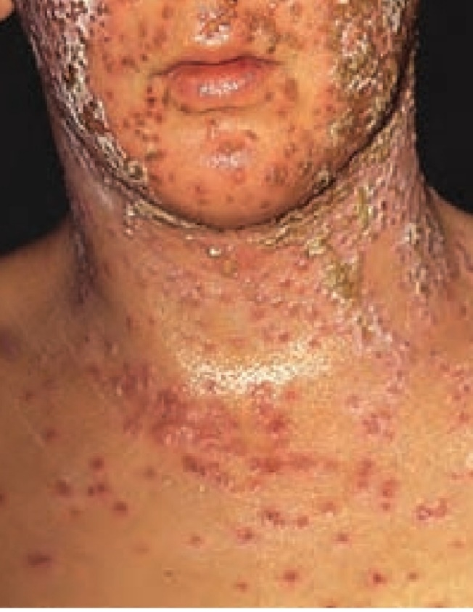

Slide 30
OCULAR ABNORMALITIES
The Dennie–Morgan fold is often present as a fold of skin under the lower eyelids.
Conjunctival irritation is a common syndrome in atopic eczema.
Keratoconjunctivitis has been recorded.
Cataract is also ass with AE.
Retinal detachment is also reported with AE.

Slide 31
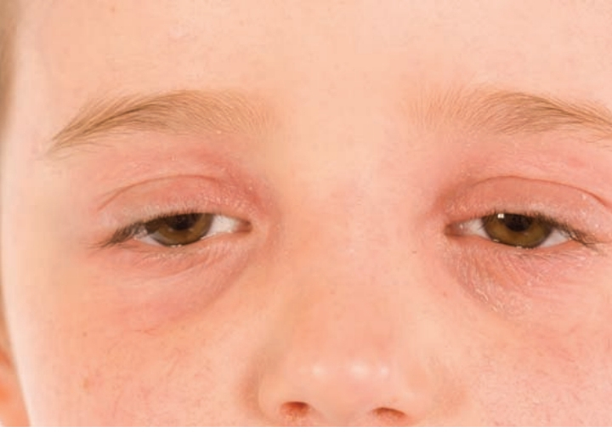

Slide 32
DRY SKIN
This is a common feature of AE .
It is likely that it occurs because of increased TEWL through an abnormal stratum corneum,.
The dry skin may be a consequence of abnormal ceramide and sphingosine synthesis and have an important role in the development of inflammation.

Slide 33
INVESTIGATIONS
The diagnosis of eczema is based on patient history and physical examination.
Total serum IgE
Specific IgE
Prick test

Slide 34
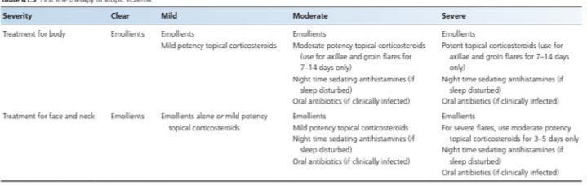
FIRST LINE MANAGEMENT

Slide 35
SECOND LINE
WET WRAP THERAPYR
Two layers of absorbent tubular bandage are applied to the skin. The inner layer is pre soaked in warm water and the outer layer is dry. A generous quantity of a low‐potency topical corticosteroid is applied to the skin before the dressings. The dressings can be used overnight or changed every 12 h.
Localized areas of severe lichenification can be treated with occlusive colloid dressings or paste banding that is left on for several days.

Slide 36
THIRD LINE
Ciclosporin
Azathioprin
Methotrexate
Myclophenolate
Alitretinoin

