Slide 1


Slide 2

ACNE
DR.RABIA FCPS RESIDENT DERMATOLOGY
H.O.D.COL.AAMIR HABIB
Notes:
And today I will be presenting to you a case

Slide 3
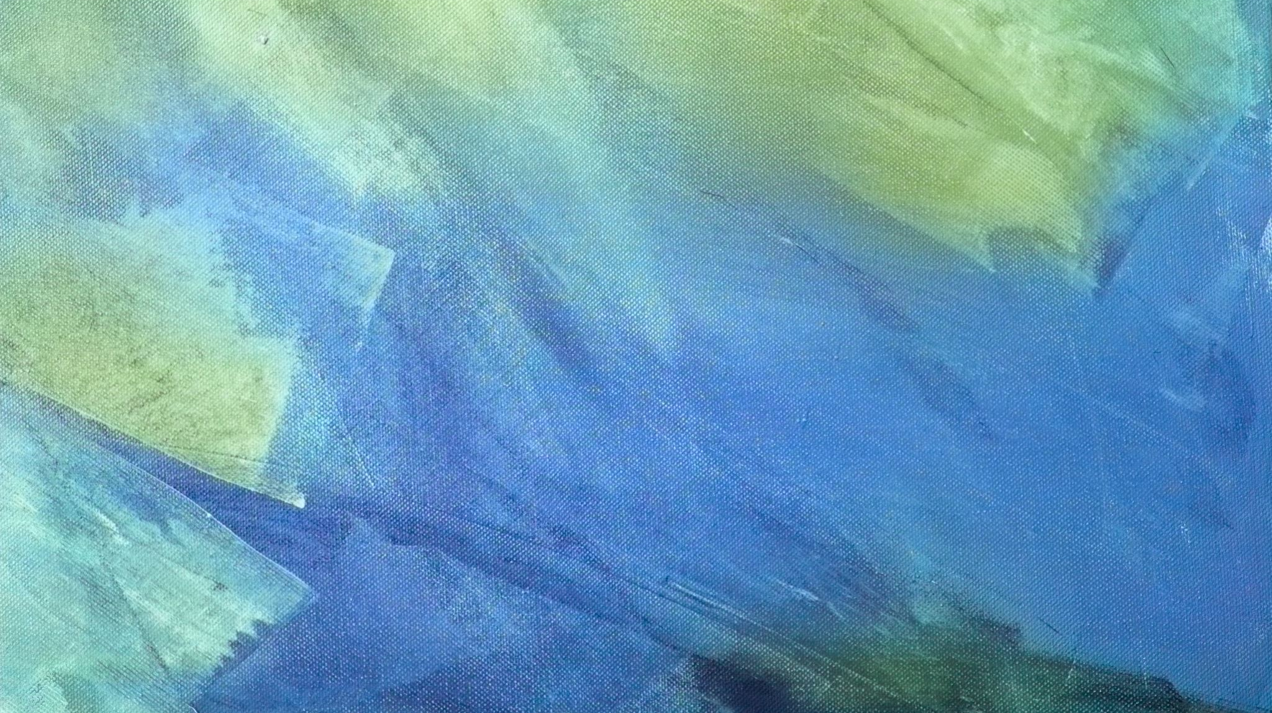
Case Presentation
Name: ABC
Gender: Male
Occupation: Army soldier
Maritial Status: Unmarried
Age: 23 years
MOA: OPD
DOA: 25-Sept-2022
Notes:
A 23 yr old unmarried army soldier

Slide 4
Presenting Complaints
Skin lesions on the face for 6 months

Slide 5
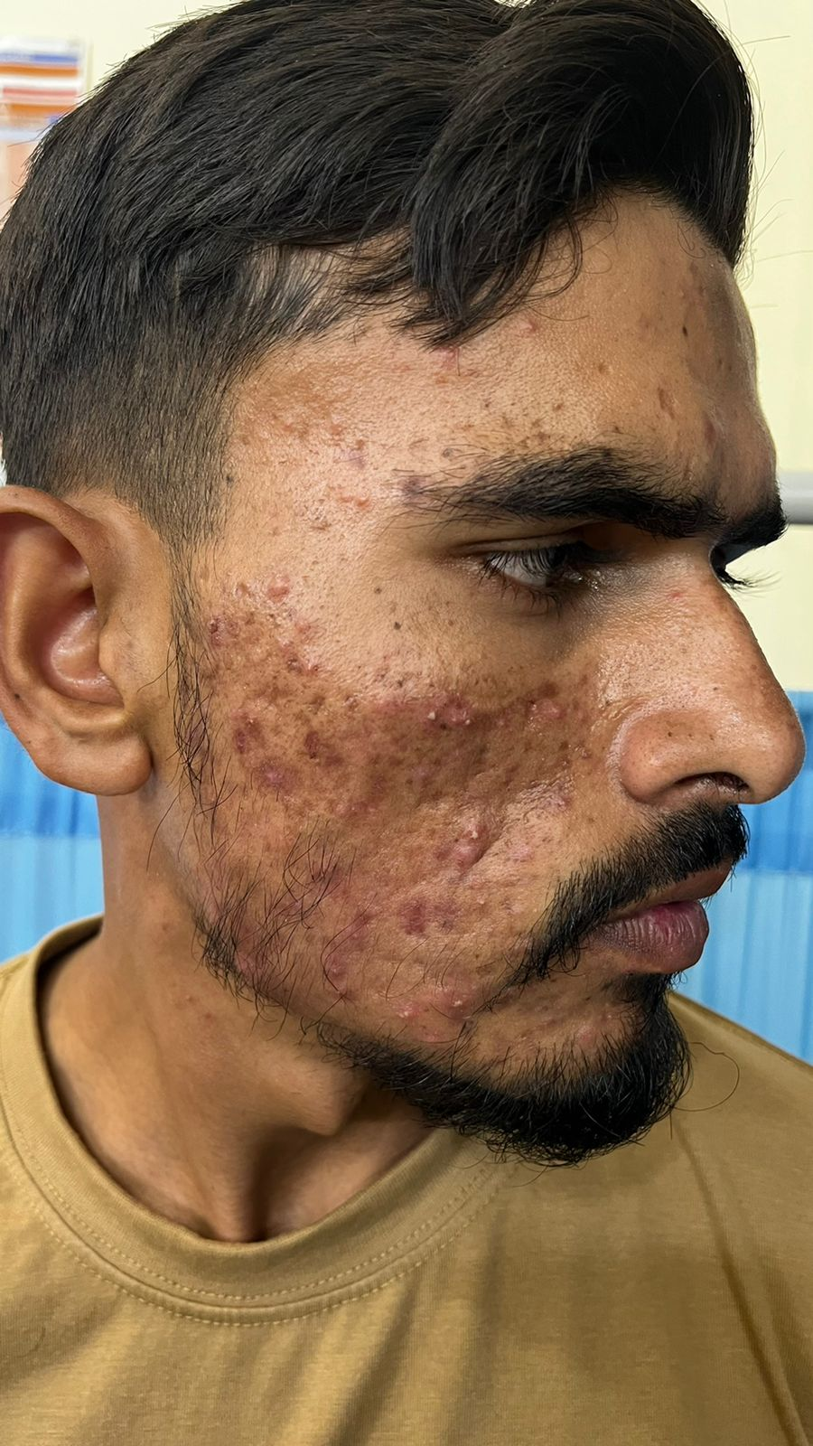
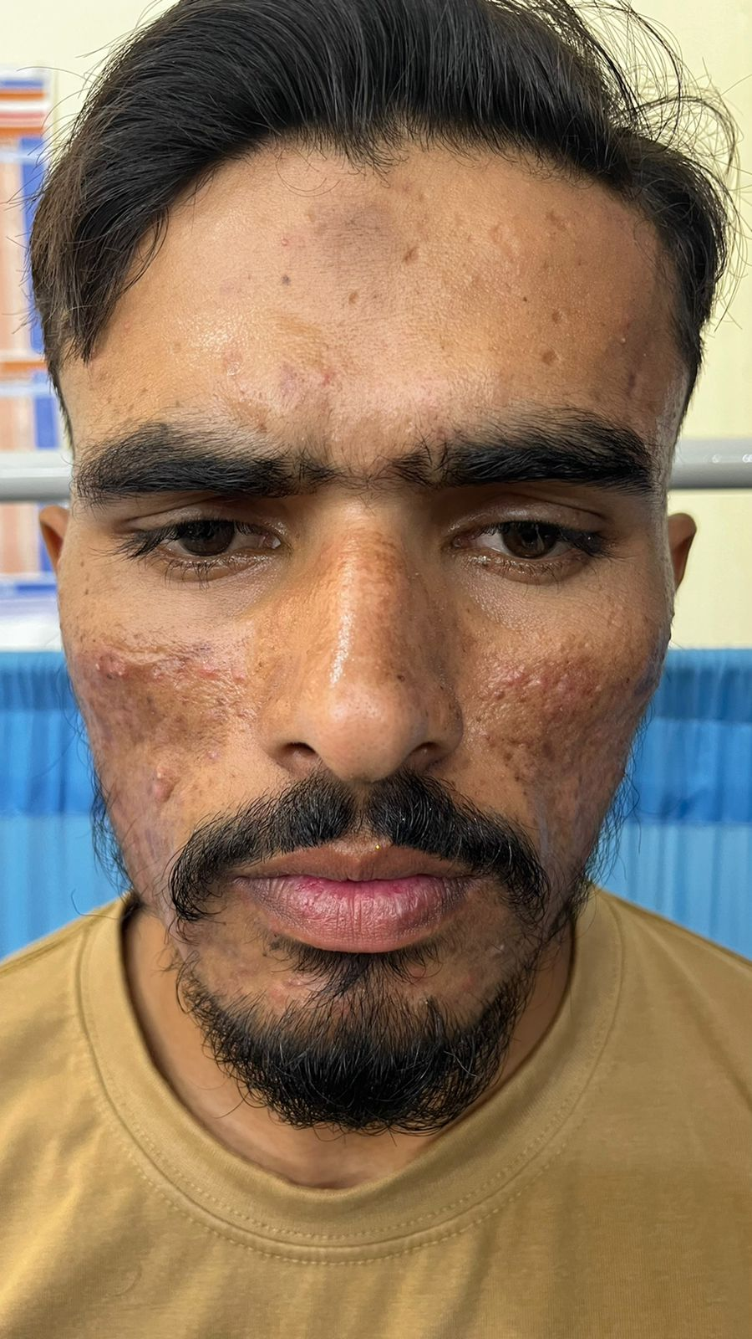
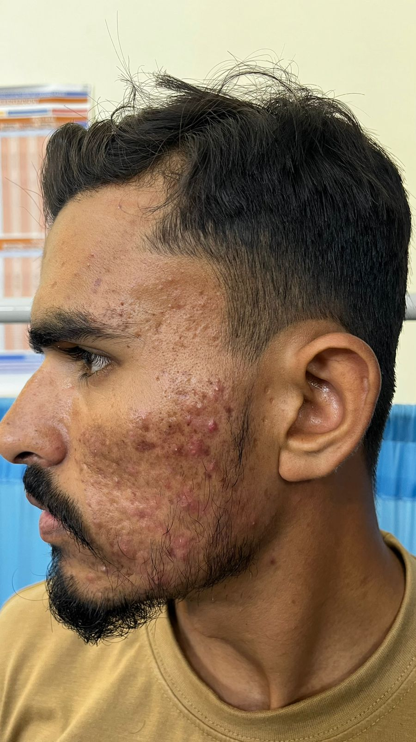
Notes:
The patient had a clear but an oily skin since puberty with occasion of of few skin colored papules and pustules which use to resolve on their own and had not seeked medical attention for them. But for the past .6 months back he started developing a large number of pustules on an erythematous base extending from the malar areas bilaterally to the bitemporal areas.some of the lesions regressed spontaneously leaving post inf hyperpigmentation and ice pick atrophic scarring.

Slide 6
Past Medical history
Past Surgical history
Personal history
Not significant
Not significant
Not significant

Slide 7
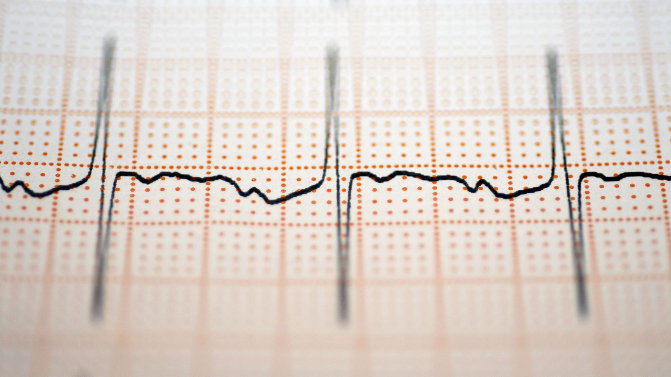
General Physical Examination
Alert, conscious and well oriented
Vitals
Blood pressure : 130/80 mmHg
Pulse : 82 beats/min
Respiratory Rate: 12 breaths/min
Temperature : 98.6 F

Slide 8
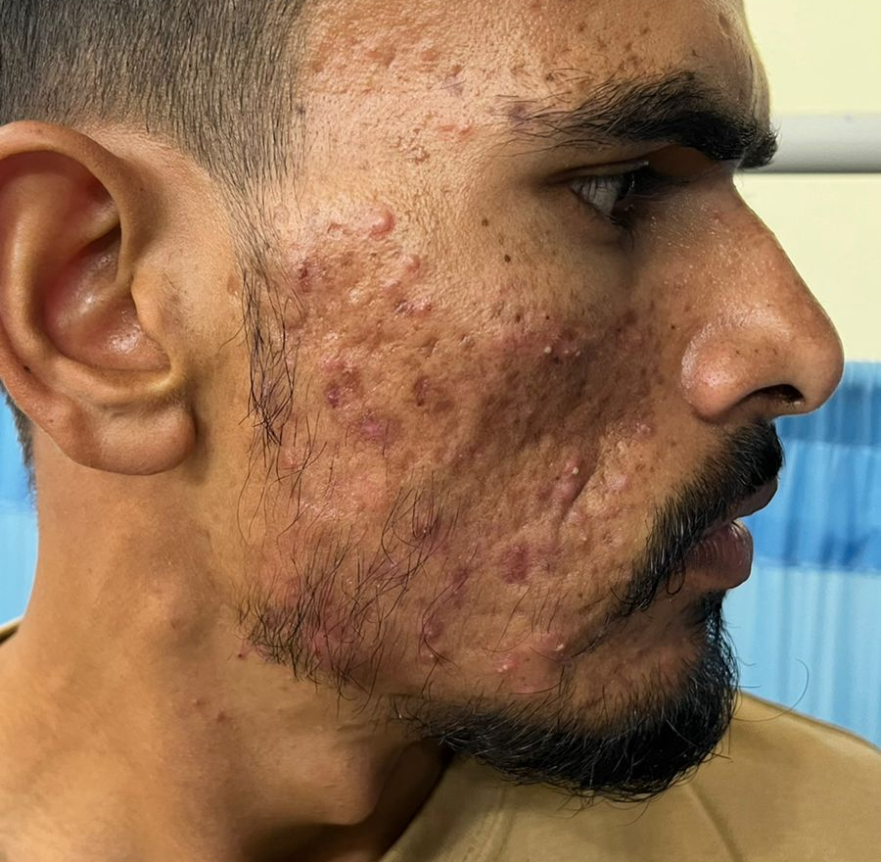
Cutaneous examination
Multiple erythematous papules
Pustules
Atrophic scarring
Hyperpigmentation

Slide 9
SYSTEMIC EXAMINATION
CVS
CNS
GI
Respiratory
Genitourinary
No significant findings

Slide 10

Provisional Diagnosis
Based on history and clinical examination the provisional diagnosis of this case was established as
ACNE VULGARIS
Moderate.Grade II

Slide 11
Management
The patient was prescribed:
  Topical clindamycin +
  Topical benzyl peroxide {Duac}
Oral Isotretinoin 20mg BD was also prescribed after baseline laboratory investigations came out to be normal
follow up at 1 month
Notes:
Which comes under the brand name of gel

Slide 12
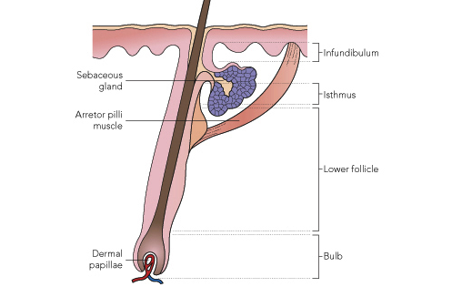
Acne Vulgaris
ACNE is a chronic disorder of the pilosebaceous unit
predominantly affecting pubertal children
Notes:
Coming to the literature acne is a chronic disorder of pilosebaceous unit.pilosebac unit is composed of three things the hair follicle,hair shft n sebaceous gland all of which form a compact structure with the hair shaft opening in to the epidermis. Has a prolonged course with frequent relapse and recurrence

Slide 13
Epidemiology
Approximately 85% of the young adults between ages 12 to 24 experience some form of acne, making it the eighth most prevalent disease worldwide
Severe Acne is more common in males
Notes:
Acne vulgaris remains one of the most common diseases afflicting all races and ethinicites lasting an average of 7 years

Slide 14
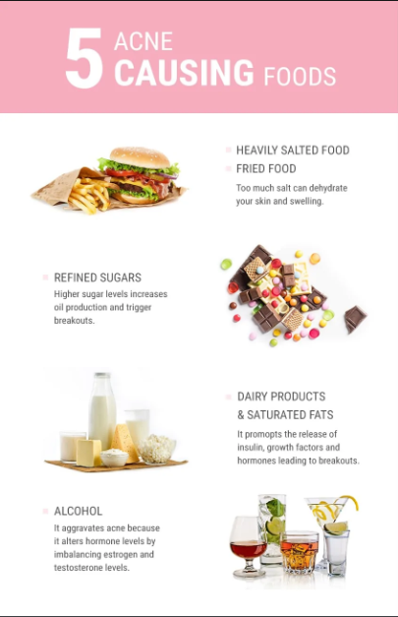
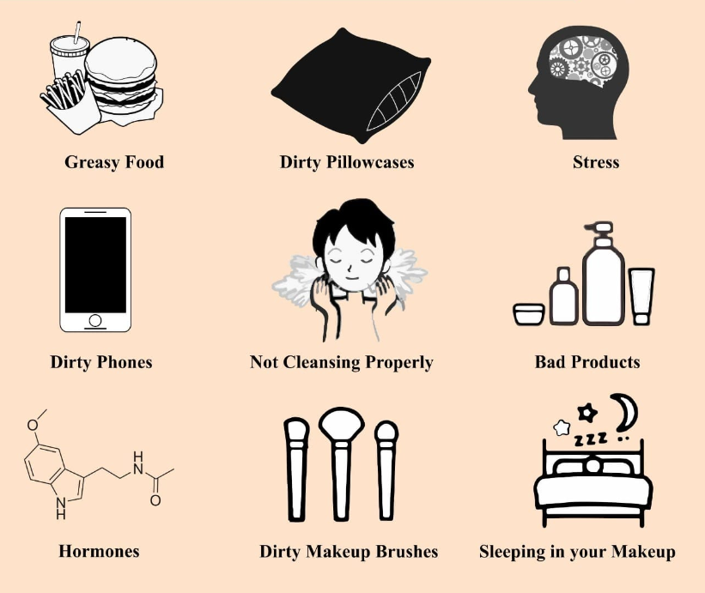
Triggers
Notes:
Acne can be triggered by many factors which can be grouped into our dietary habits specially intake of junk,greasy,oily or processed foods or foods with high glycemic index.or our lifestyle habits like application of make up for prolonged periods.coming in contact with dirty pillows and phones.prolonged exposure to hot and humid conditions.hormonal imbalances,stress,alcohol etc

Slide 15
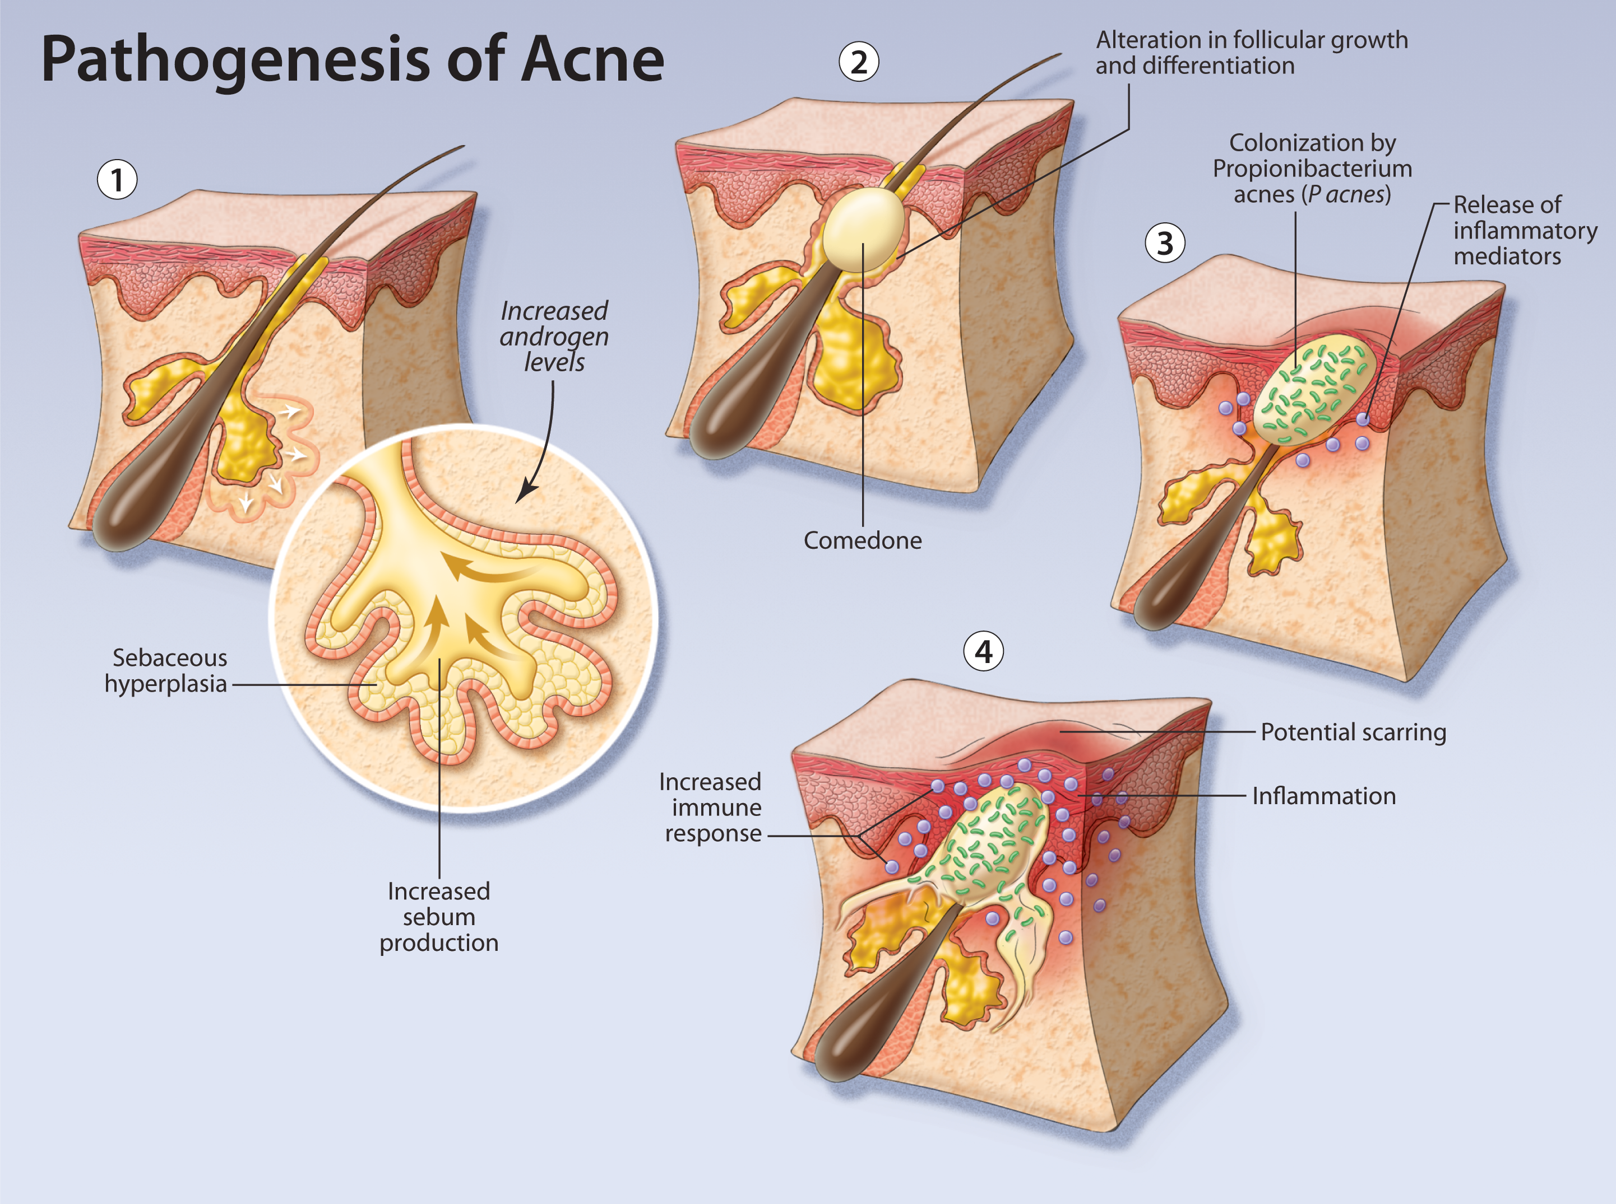
Notes:
Initially there is overactivity of the sebaceous glands causing inc sebum prod that can not only block the pilosebceous ducts resulting incomedo formation but also encourage bact p.acnes which is the primary bacteria respon for causing acne,leading to hypercornification of the pilosebaceous duct and inflammation.this all leads to the formation of

Slide 16
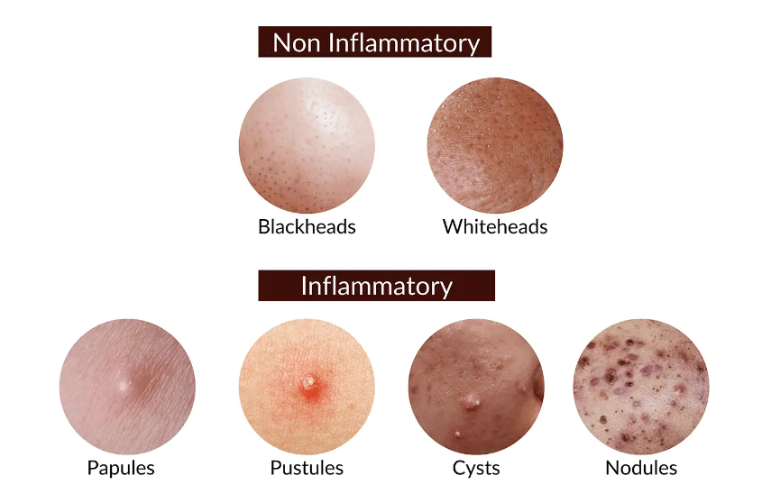
Clinical Features
Notes:
Comedones and inflammatory lesions
Comedones are actually the plugging of the hair follicles due to epithelial debris and keratin which if opened onto the skin form open comedones or black head or if trapped within the hair shaft form white heads or closed comedones.

Slide 17
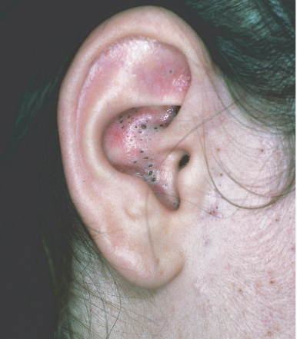
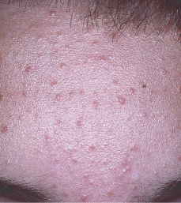

Slide 18
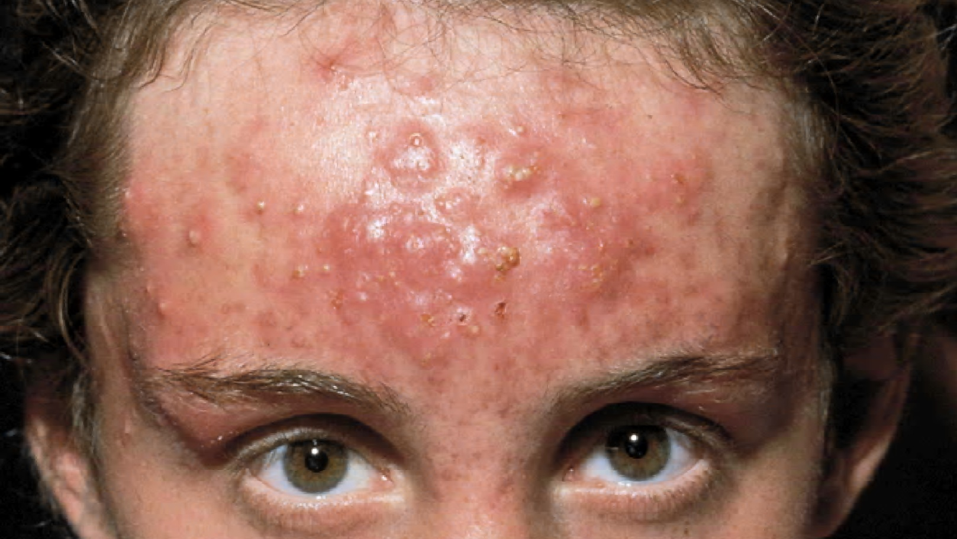
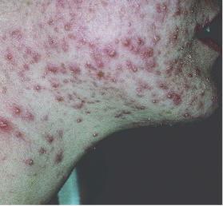
Inflammatory acne

Slide 19
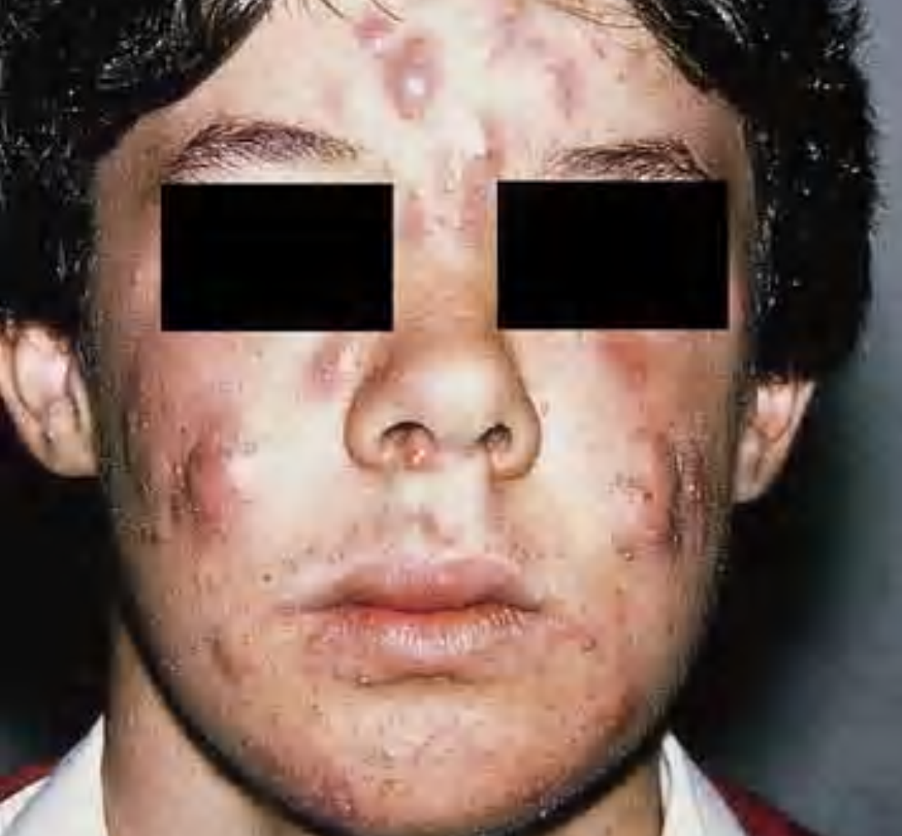
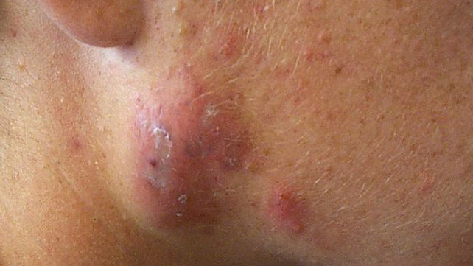
Notes:
Nodules more frequently occur in males and are particularly disfiguring
Sinus track acne is
due to sinus formation between nodules and/or deep pustules and leads to devastating cosmetic effects and
scarring

Slide 20
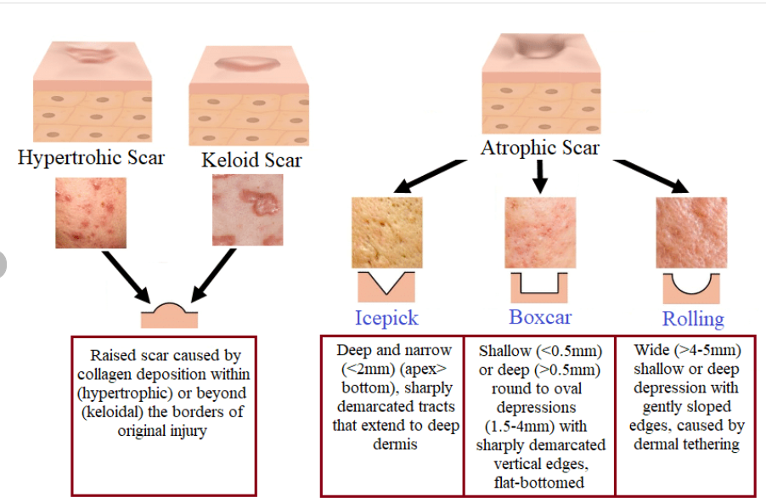
Scarring
Notes:
Coming to the sequlee of acne scarring is a common in chronic acne.can be of three typesTechnically,
hypertrophic scars do not extend beyond the extent
of the original inflammation, but keloids do. Some scars
are difficult to classify in their earlier phases of development
and should be classified as intermediate scars; with
time they may then become more obviously hypertrophic
or keloid scars, or perhaps in some instances become
atrophic and hardly noticeable.

Slide 21
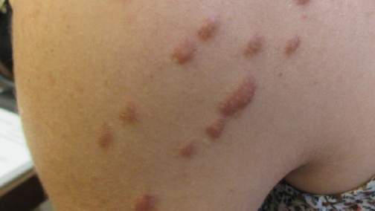
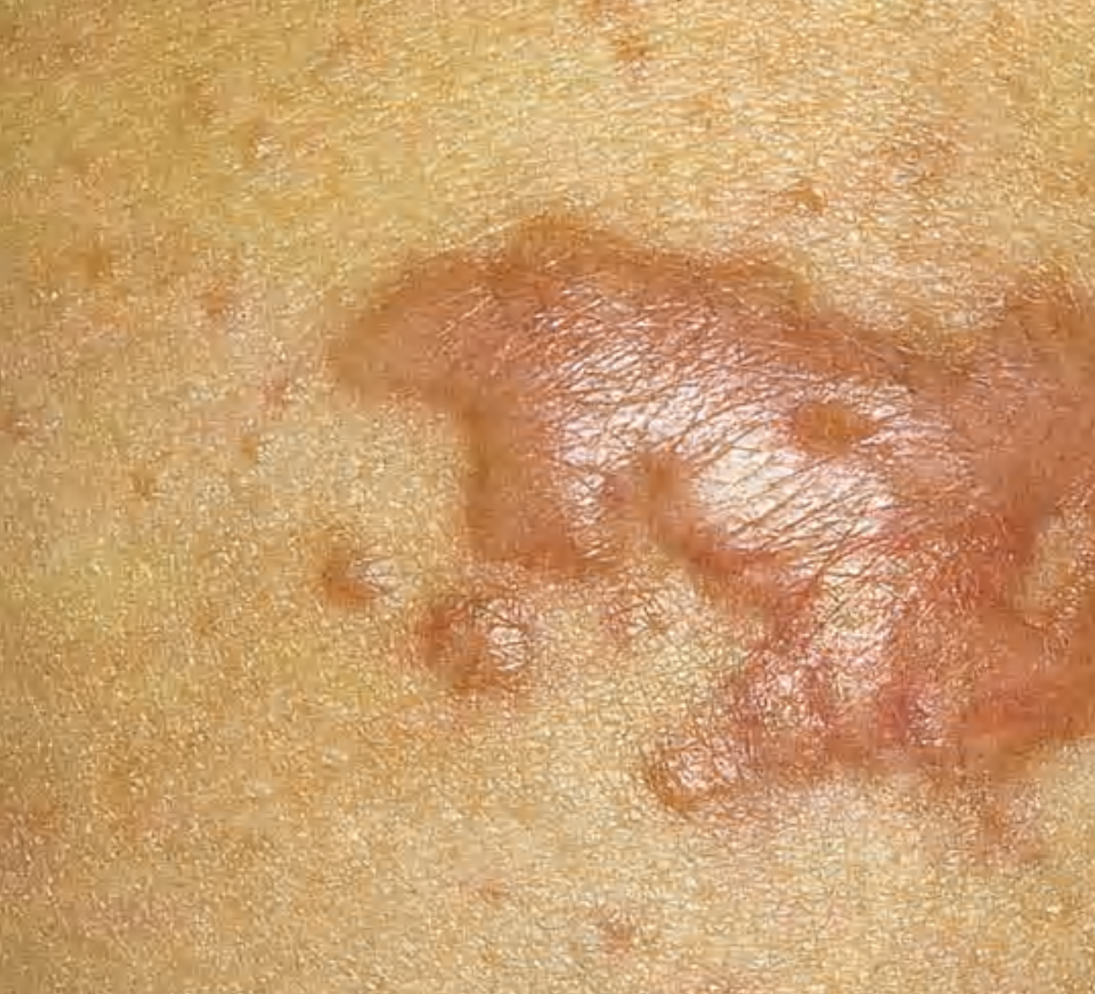
hypertrophic/Keliodal acne

Slide 22
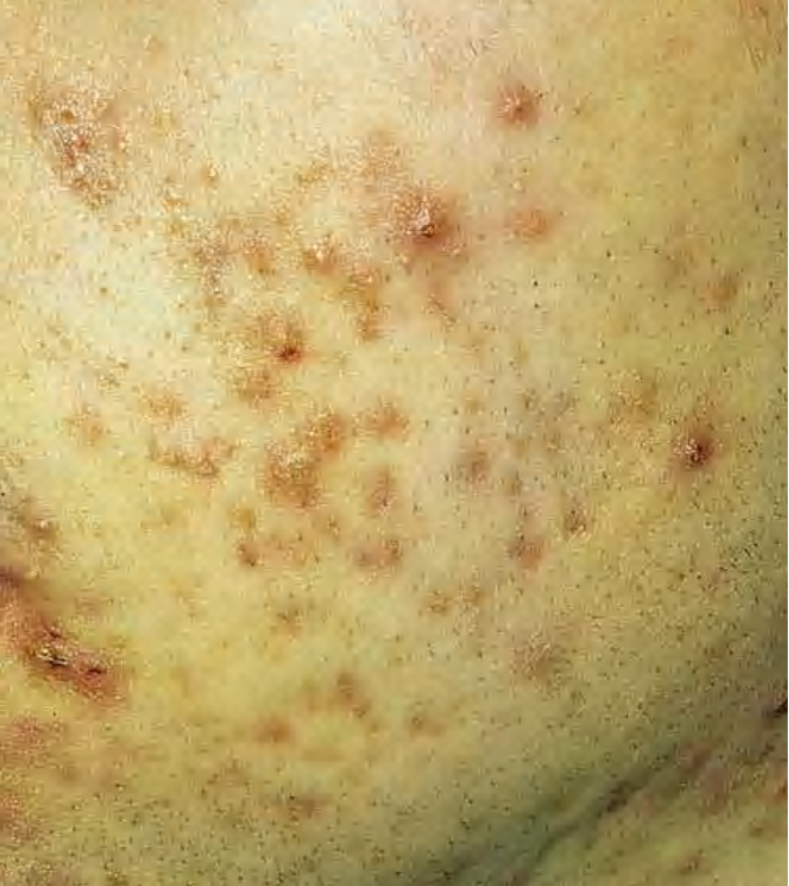
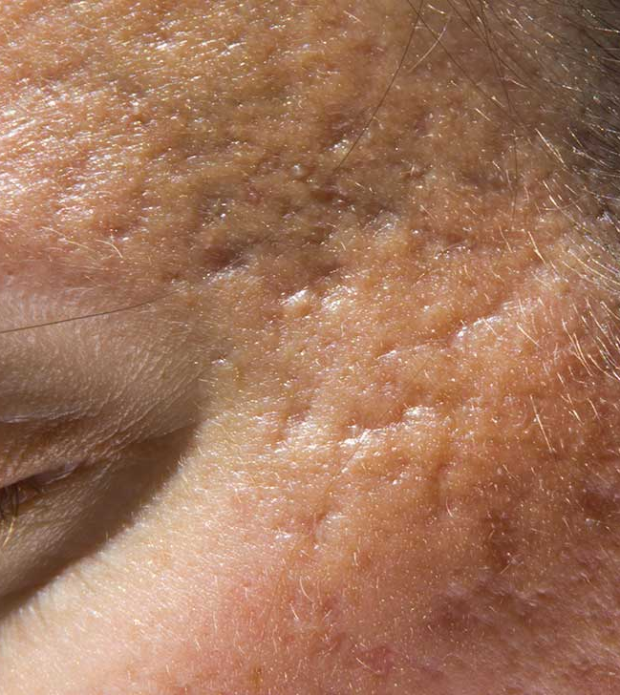

Slide 23
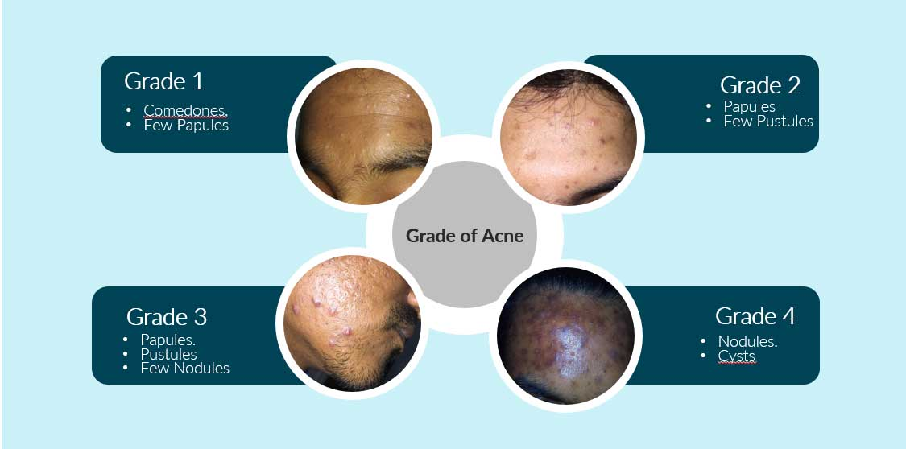
Grading

Slide 24
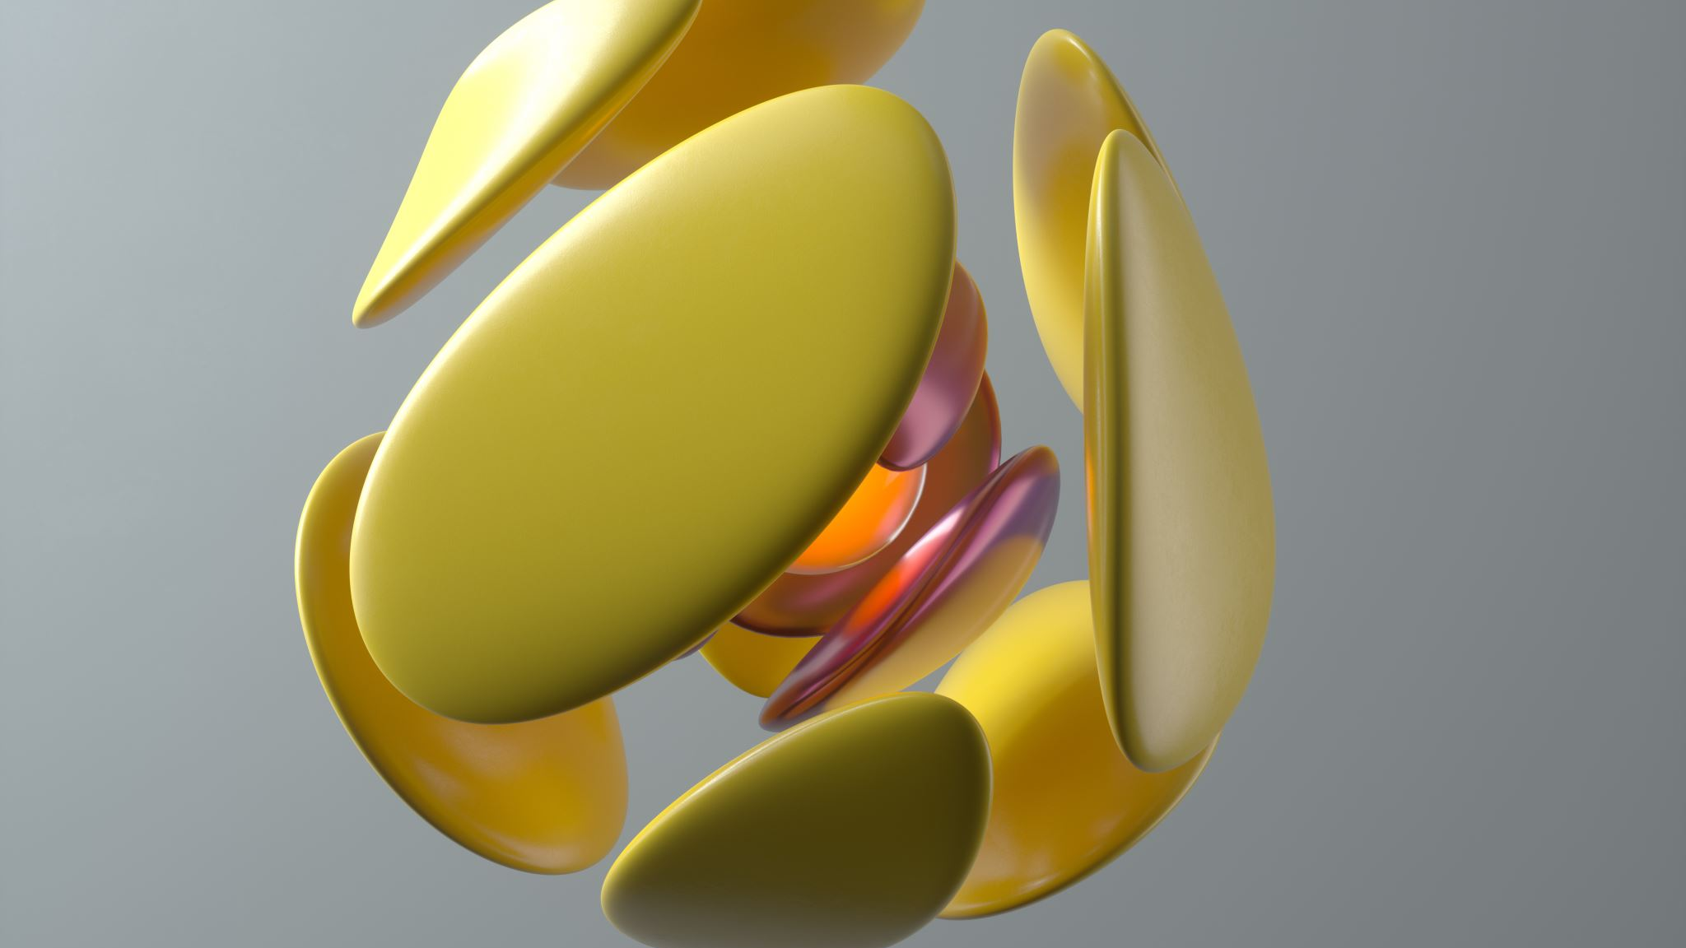
Variants

Slide 25
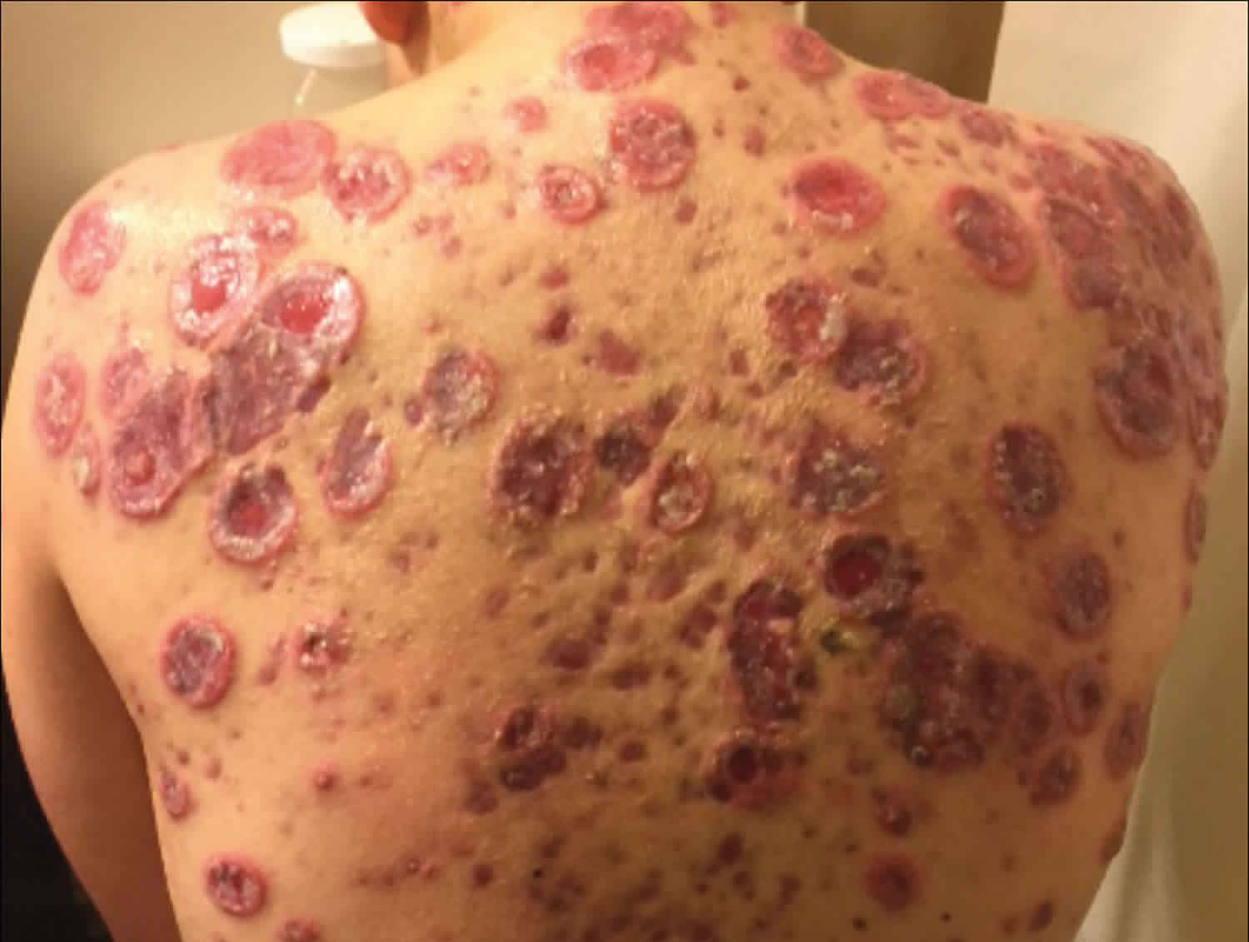
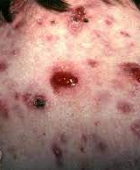
Acne fulminans
Patients present with numerous, inflammatory tender and ulcerative nodules covered with haemorrhagic crusts
Notes:
A very severe form of acne which is sudden in onset of febrile ulcerative necrotic acne lesions alongside arthralgia, fever and various systemic inflammatory signs and symptoms along osteolytic bone lesions.
Oral prednisolone therapy should be commenced first line (0.5–1.0 mg/kg/day) and decreased slowly over 2–3 months. Low‐ dose oral isotretinoin (0.25–0.5 mg/kg/day) should be cautiously introduced either after 3–4 weeks of systemic steroid therapy

Slide 26
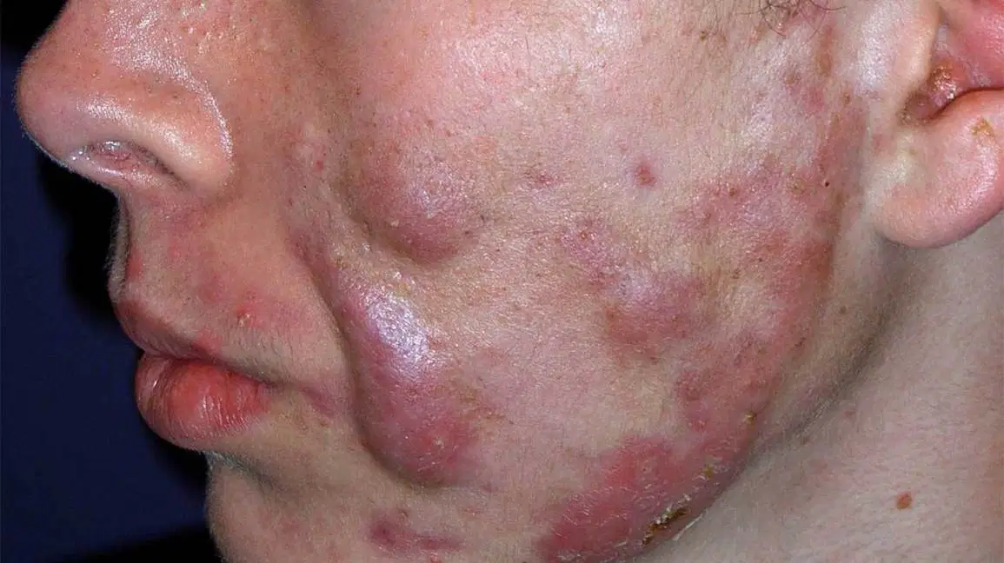
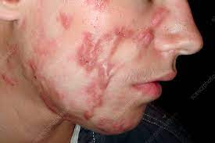
Acne conglobata
Notes:
Insidious onset-more common in boys Severe form of acne characterized by multiple and extensive inflammatory papules, tender nodules and abscesses which commonly coalesce to form malodorous draining sinus tracts. Multiple polyporous, grouped comedones are typical and extensive disfiguring hypertrophic and atrophic scars are also common features

Slide 27
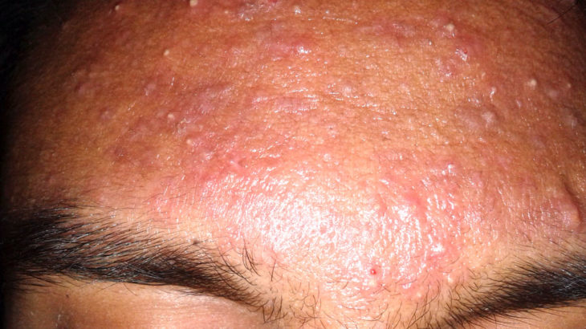
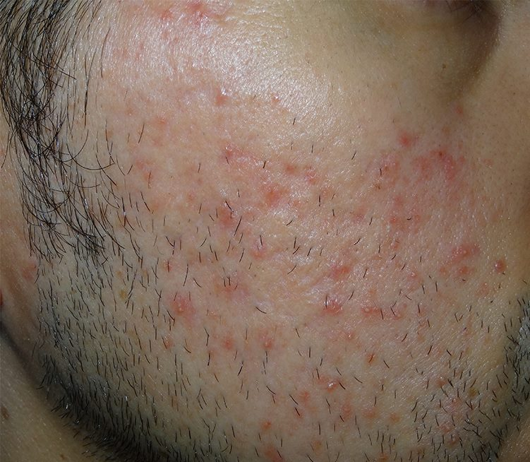
Pomade/cosmetic acne
Notes:
. Pomades are greasy preparations used to defrizz curly hair. They can trigger non‐inflammatory acne

Slide 28
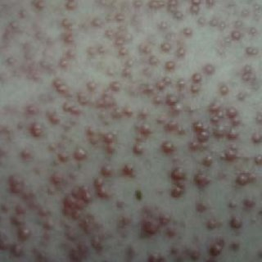
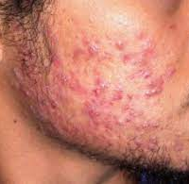
Drug induced acne
Notes:
corticosteroids,anti TB lithium, anticonvulsants, barbiturates, androgenic steroids, DHEA, and medications that contain bromides or iodides

Slide 29
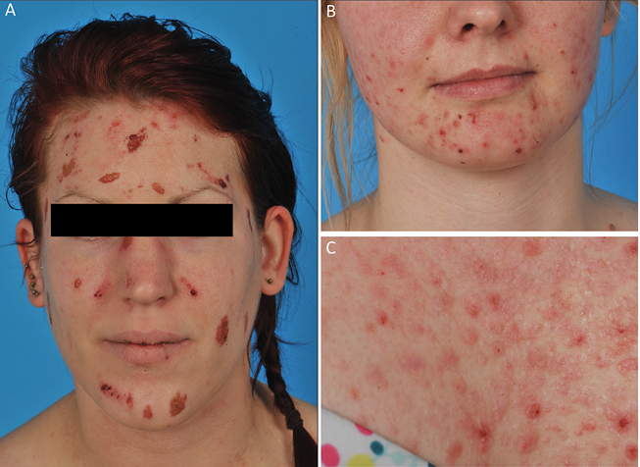
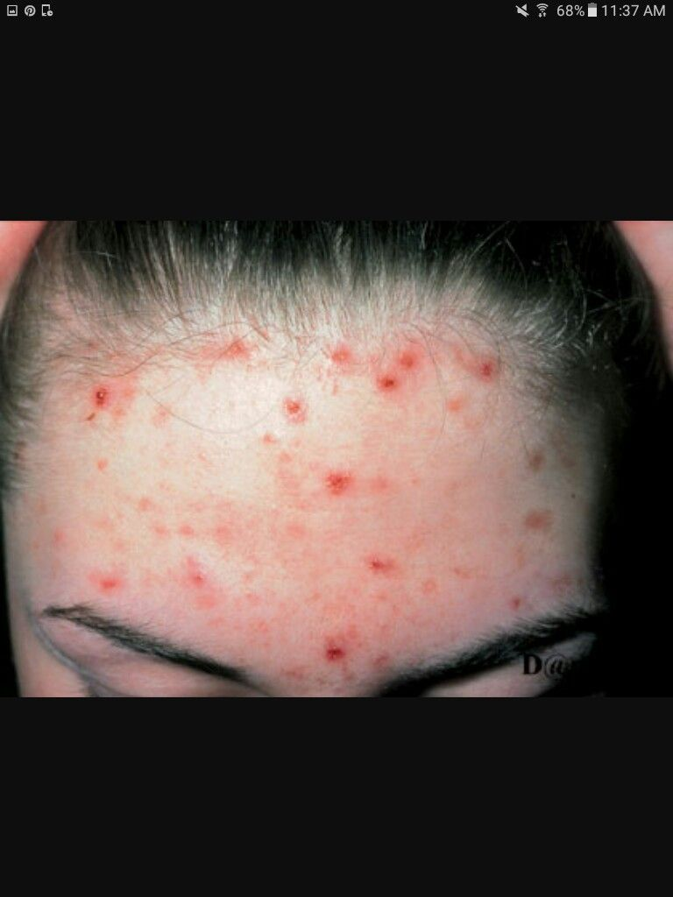
ACNe excoriee
Notes:
results when acne lesions are compulsively squeezed and scratched, resulting in scabs and scars
Seen in young women who have an obsession of picking their skin leading to excoriations or pih

Slide 30
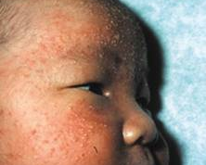
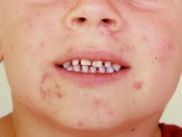
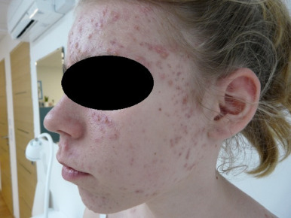
Pre pubertal Acne
Notes:
Acne before the onset of puberty is uncommon. Includes neonatal, infantile, mid‐childhood and prepubertal or pre‐adolescent acne]
A neonate is defined as a newborn up to 35 days
Infantile presents between 3 and 12 monthg
Mid‐childhood acne occurs from age 1 to 7 year Prepubertal acne presents before true puberty-endocrinopathies and virilizing tumours Maternal androgens are thought to be transferred transpalcentally

Slide 31
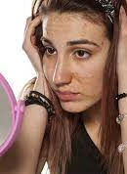
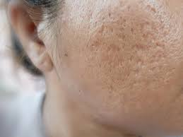
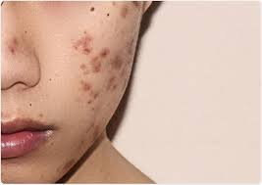

Complications
Notes:
EMBARASSMENT
LACK OF CONFIDENCE,toll on mental health all can affect people suffering from acne.social reluctance,body dysmophism is also seen.other than that chronic acne can leave behind scarring n hyperpigmentation which in turn adds to the social anxiety.

Slide 32
Treatment Modality
Decreasing Sebum Production
Decreasing Bacteria
Normalizing Duct Keratinazation
Decreasing Inflammation
Regular washing with Soaps/Cleanses/Lotions
Picking Should be discouraged
Notes:
Dec sebum prod dec follicular plugging which in turn leads to a dec in activity of priopiona bacterium causing a cumulative affect of dec inflammation.

Slide 33
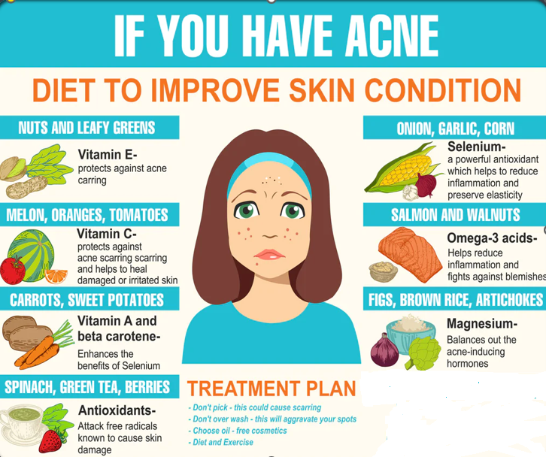
Management
Notes:
The gen management includes inc uptake of healthy,fresh fruits n veg whih act as a nti oxidant as well.dirty pillows,greasy make up issues shud also be addressed.atleast an average of 2.5-3 liters of water shud be taken daily.

Slide 34
Topical therapy
Topical Antibiotics (Erythomycin or Clindamycin 1%) Benzoyl Peroxide 2.5-5%
Keratolytics –Salicyclic Acid
Azeliac Acid 20%
Topical Retinoids
Notes:
There are vario
us tx modailities of acne.first n foremost for mild to mod cases topical tx hud be prescribed.including topical antibiotics,keratolytics,azaelic acid and topical vit A derivatives.
BP anti bacterial

Slide 35
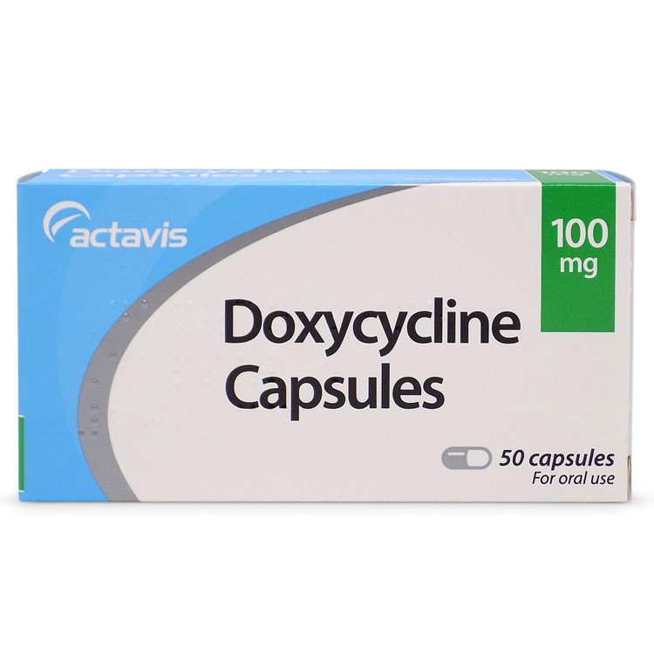
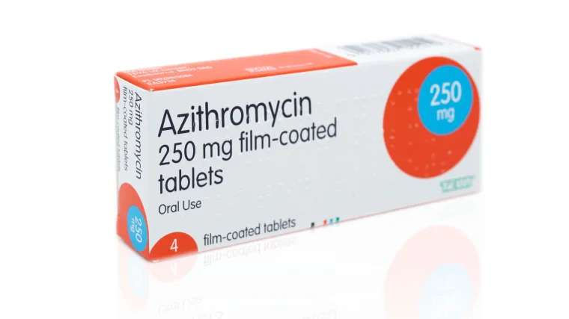
Second line therapy
Low doses oral antibiotic therapy for 4 – 6 months
Along with Topical Retinoids
Notes:
Oral azithromycin using intermittent dosing schedules (250 mg three times a week
Clindamycin is highly lipophilic required and very effective in acne but adverse effects, including diarrhoea seen in 5–20% of casesi
n pregnancy, oral erythromycin is thought to be safec

Slide 36

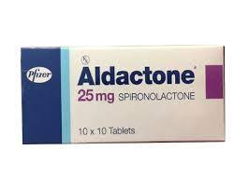
Hormonal Therapy
inhibitors of androgen production by the ovary (oral contraceptives) or adrenal gland (low‐dose corticosteroids),
androgen receptor blockers
antiandrogens that block the effect of androgens on the sebaceous gland.
Notes:
Dec serum dihydroandesterdione whichis benefial in females

Slide 37
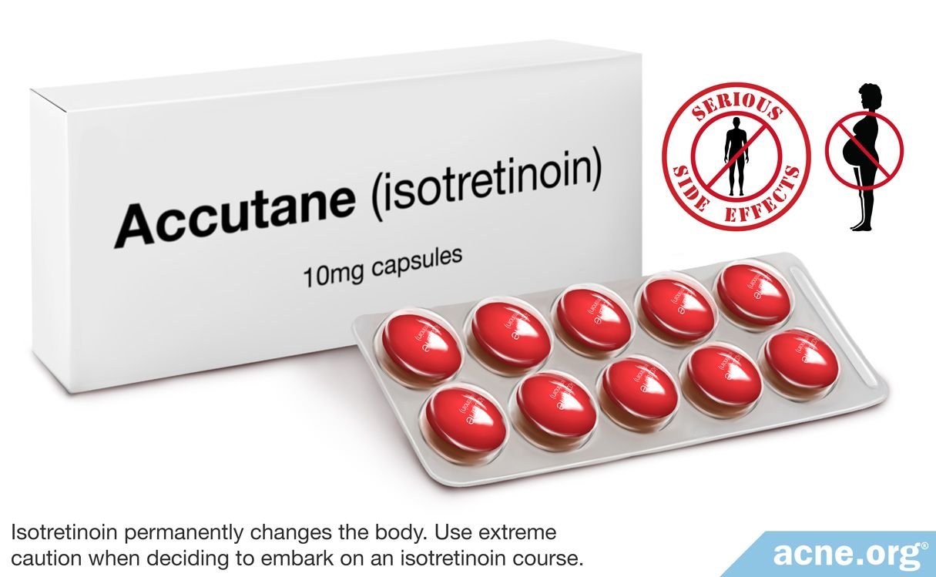
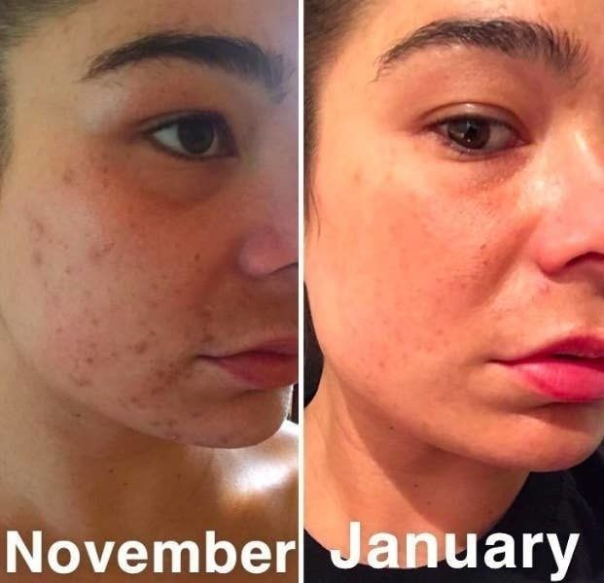
Oral Retinoids
Isotretinoin, 0.5-1mg/kg/day
Total dose of 120-150mg/kg
Notes:
Are miracle drugs for severe acne,but are a double edge sword.very effective in treating comedonal acne, resistant acne,nodulecytic acne,hyperpigmentation and superficial scarring also responds to it.They dec corneal proliferation and unclog our pores but they come with a lot of side effects
Highly teratogenic,double contraception in child bearing age pregnancy test pre and 5 weeks after -double contraception married
Can alsi cause dry skin,dry eyes,retionoid dermatitis,deranged lfts,rft,hyperlipidemia and hyperglycemia.
Needs to be monitored every month for 3 months then 3 monthly

Slide 38
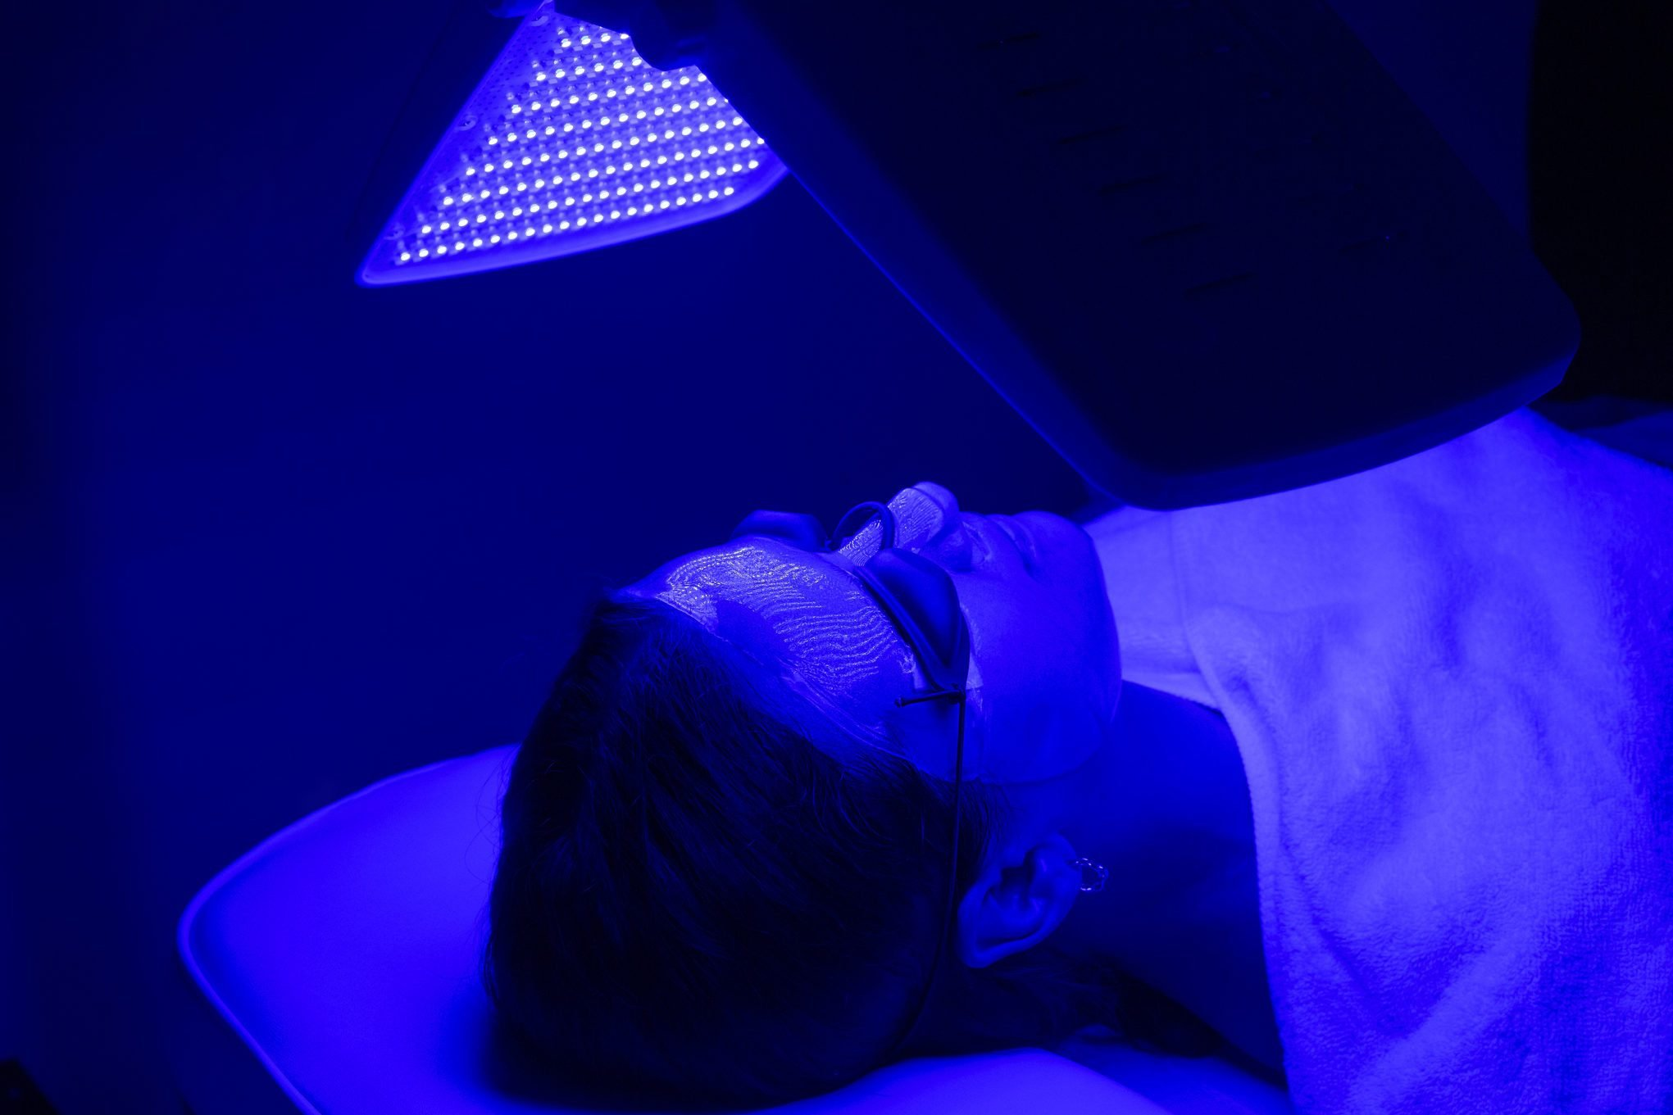
Blue red light therapy
The bacteria in acne release porphyrins
a narrow-band, high-intensity blue light source
readily absorbed by porphyrins released by the bacteria causing acne

Slide 39
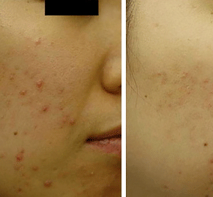
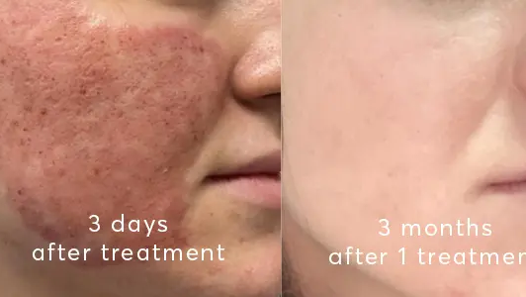
Laser therapy

Slide 40
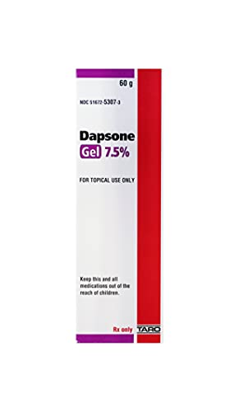
Other therapies
Topical dapsone 5% gel
Topical nicotinamide 4% has anti‐inflammatory actions and does not induce P. acnes resistance
Salicylic acid 2%

Slide 41

CHEMICAL PEELING & DERMABRASION

Slide 42



Notes:
Peeling with SA,Glycolic acid,TCA-burn erythema down time

Slide 43
Newer therapies
Topical minocycline foam, which works in inflammatory acne.
Topical clascoterone, a androgen blocker.
Encapsulated BP + tretinoin
Topical trifarotene, a new fourth-generation retinoid approved for face and trunk.

Slide 44


