Slide 1


Slide 2
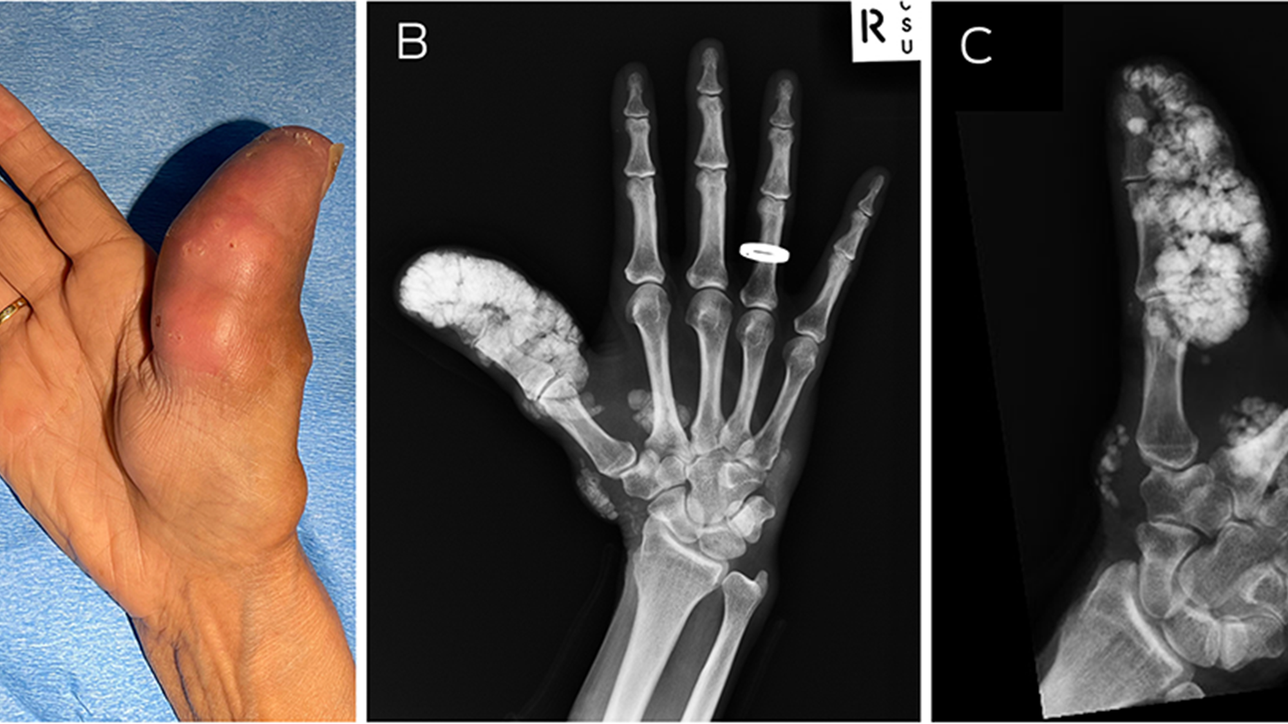
alcinosis
C
C
UTIS
Dr zainab
Mcps PGR-II
Dermatology, sph,
Qta

Slide 3
topics
Physiology of calcification
Pathology of calcification
calcinosis cutis
Types of calcinosis cutis
calciphylaxis

Slide 4
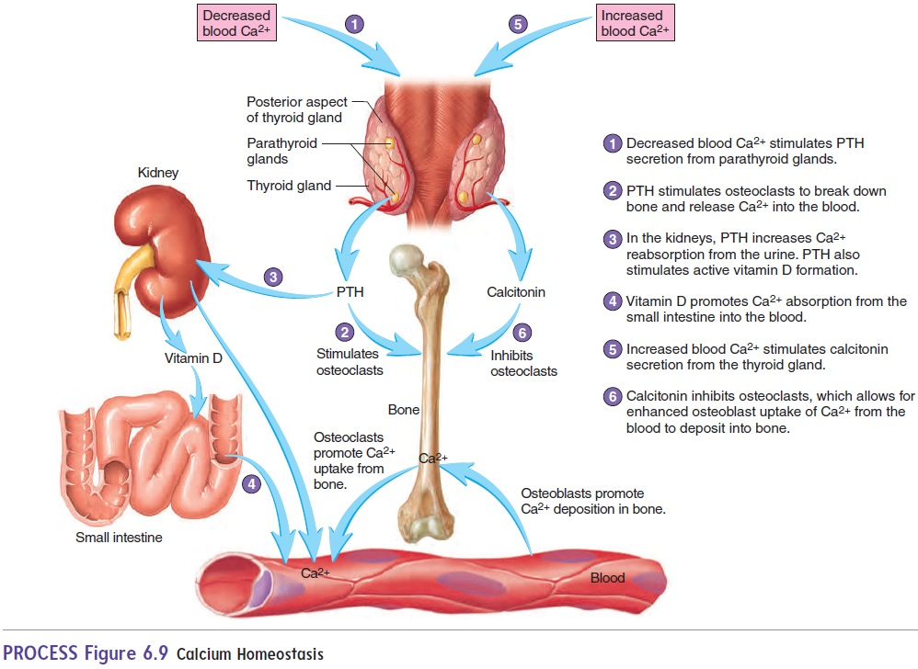

Slide 5
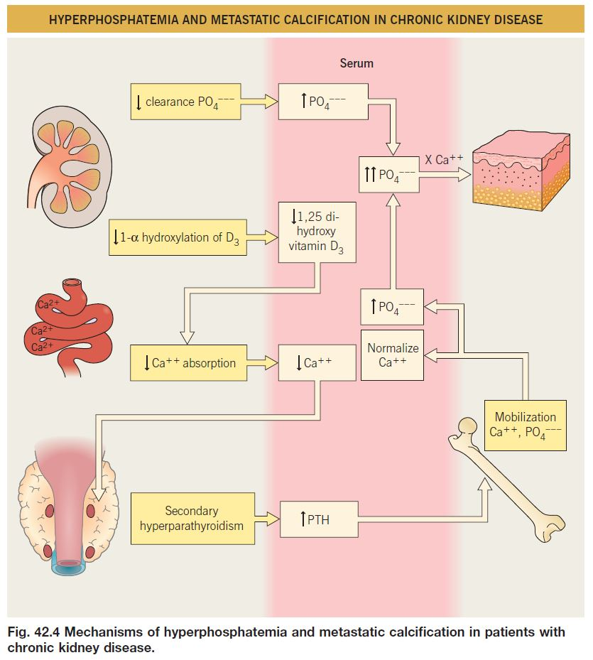
Pathologic Calcification
Abnormal tissue deposition of Calcium salts with smaller amount of iron, magnesium and other mineral salts.
Normally calcification in osteoids, teeth enamel in form of Hydroxyapatite

Slide 6
Causes of pathological calcification
Renal failure
Destruction of bones
Vitamin-D related disorders
Increased PTH-causing bone resorption
Phosphate retention → raised PTH
Myeloma
Leukemia
Intoxication; increase absorption of Ca
Primary hypepararthyroidism (adenoma)
Secondary hyperparathyroidism (paraneoplastic syndrome)
Notes:
Primary hyperp → raised Ca and PTH (or normal), dec PO4
Sec hyperp → dec or normal Ca, raised PTH, raised or dec PO4

Slide 7
Causes of pathological calcificaton
Renal failure
Vitamin-D related disorders
Increased PTH-causing bone resorption
Destruction of bones
Phosphate retention → raised PTH
Intoxication; increase absorption of Ca
Myeloma
Leukemia
Primary hyperthyroidism (adenoma)
Secondary hyperthyroidism (paraneoplastic syndrome)
Notes:
Any bone defect causing bone destruction

Slide 8
Causes of pathological calcificaton
Renal failure
Increased PTH-causing bone resorption
Destruction of bones
Vitamin-D related disorders
Phosphate retention → raised PTH
Myeloma
Leukemia
Intoxication; increase absorption of Ca
Primary hyperthyroidism (adenoma)
Secondary hyperthyroidism (paraneoplastic syndrome)
Notes:
Vitamin D intoxication which acts on GI mucosa and causes Ca absorption

Slide 9
Causes of pathological calcificaton
Increased PTH-causing bone resorption
Destruction of bones
Vitamin-D related disorders
Renal failure
Myeloma
Leukemia
Intoxication; increase absorption of Ca
Phosphate retention → raised PTH
Primary hyperthyroidism (adenoma)
Secondary hyperthyroidism (paraneoplastic syndrome)
Notes:
Renal failure = Hyperphosphatemia and hypocalcemia…… Low vit-D activation so low GI Ca absorption

Slide 10
Pathologic calcification
dystrophic
metastatic
Ocuurs locally in dead and degenerated tissues
Ca metabolism = normal
Serum Ca = normal
Secondary to inflammation, infections, trauma, injection /infusion of calcium containing materials, tumors, genetic diseases.
Deposition in normal tissues
Ca metabolism = deranged
Serum Ca = raised
Seen in cases of hyperthyroidism, hypervitaminosis D, milk alkali syndrome
Normal phenomena in old age

Slide 11
CALCINOSIS CUTIS SUBTYPES
Categories | Serum calcium | Serum phosphate | Causes | Associated conditions
Dystrophic | Normal | Normal | Local tissue injury | CTD Panniculitis Cutaneous neoplasms Infections
Metastatic | Elevated/normal | Elevated/normal | Precipitation of calcium salts in normal tissue due to underlying defect in Ca/PO4 metabolism | CRF Hypervitaminosis-D Milk alkali syndrome Tumoral calcinosis
Idiopathic | Normal | Normal | Unknown
Iatrogenic | Normal | Normal | Local injury | IV calcium chloride IV calcium gluconate
Notes:
Milk alkali syndrome = characterized by excessive ingestion of calcium containing foods or antacids leading to hypercalcemia, causes irreversible renal failure, nephrocalcinosis, subcutaneous calcification predominantly in peri-articular tissue
Tumoral calcinosis = deposition of calcific masses around major joints (hips, shoulders, elbows, knees). Overlying skin is normal, ulceration and calcinosis cutis occur

Slide 12
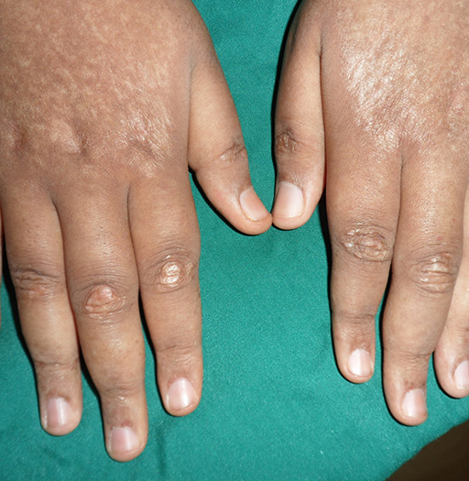
Dystrophic calcification
Inflammatory diseases and infections
Male : female = 1:4
Adults with dermatomyositis (30%)
Children with dermatomyositis(70%)
Associations
CTDs ; Dermatomyositis, scleroderma, lupus erythematosus
PCT, morphea, lichen sclerosus
Infections ; onchocerciasis, cysticercosis, taenia solium, herpetic infections

Slide 13
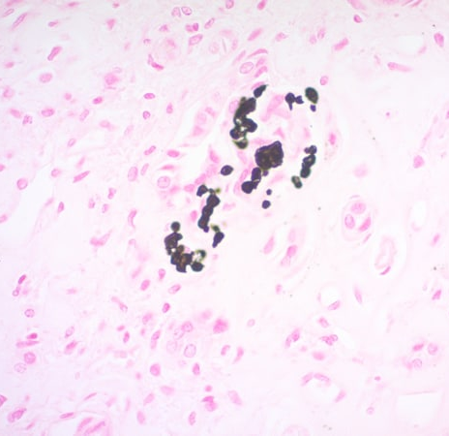
histopathology
Stains = H&E (blue), Von kossa (black)
Dermis = Fine granules
Subcutis = large irregular masses
Chronic lymphohistiocytic infiltrate
Transelimination of calcium

Slide 14
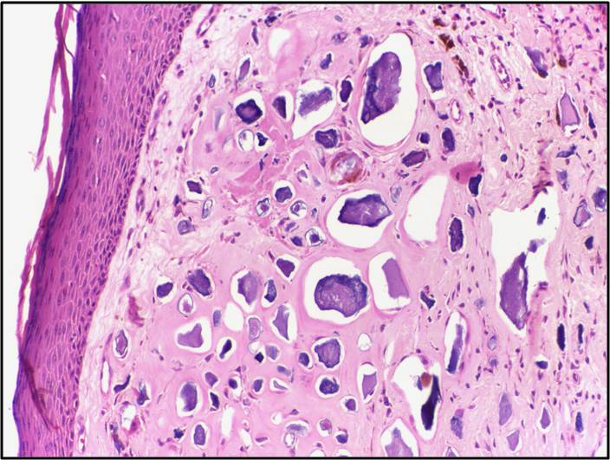

Slide 15
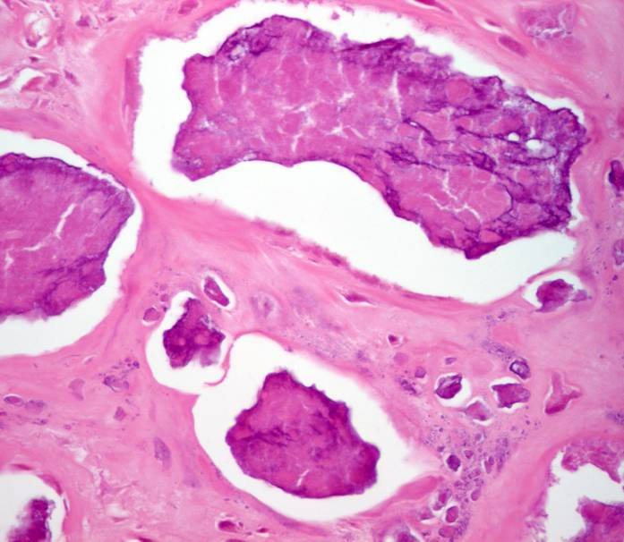

Slide 16
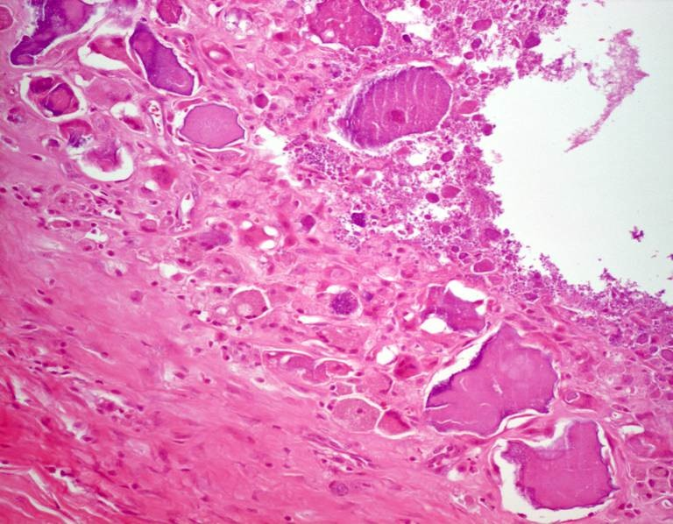

Slide 17
presentation
Dermatomyositis
CREST syndrome
PCT
LE (SLE, panniculitis, DLE, SCLE)
On trunk, limbs
Yellow white nodules and plaques
Ulcerate, transelimination of chalk like white material
Calcification of muscles, contractures, deformity
Site of trauma (elbows, knuckles, volar aspect of fingers)
Nodules/plaques → ulcerate → extrude chalky white material
When associated with pseudoscleroderma
Ulcerating plaque with transelimination of chalky material
Head, neck, dorsum of hand
Heals with scarring
Scarring alopecia of scalp
Asymptomatic
Nodules in subcutaneous tissue and buttocks
Notes:
Cutaneous manifestation presents after many years of onset of the underlying disease

Slide 18
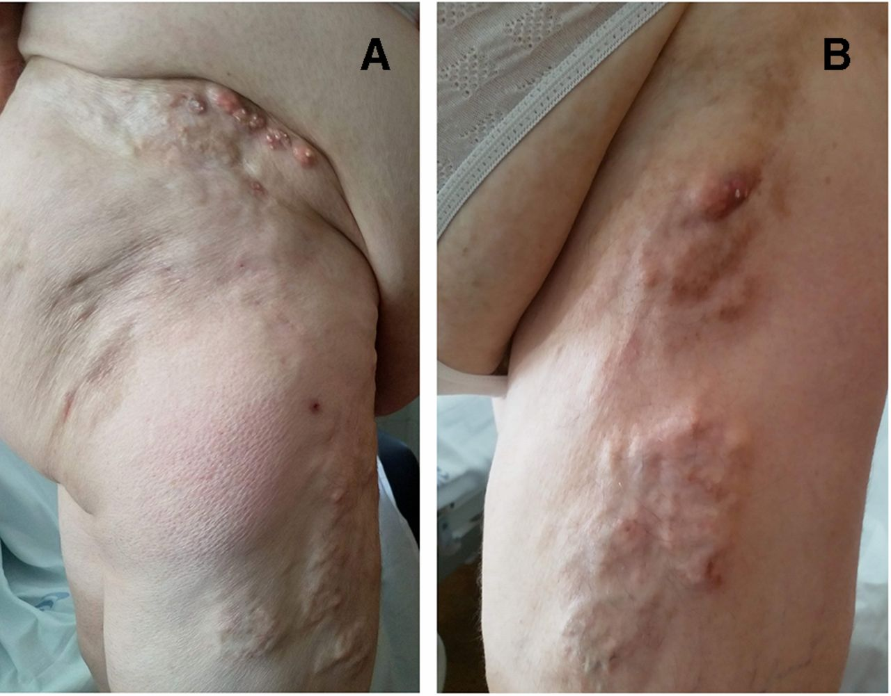
presentation
Dermatomyositis
CREST syndrome
PCT
LE (SLE, panniculitis, DLE, SCLE)
On trunk, limbs
Yellow white nodules and plaques
Ulcerate, transelimination of chalk like white material
Calcification of muscles, contractures, deformity
Site of trauma (elbows, knuckles, volar aspect of fingers)
Nodules/plaques → ulcerate → extrude chalky white material
When associated with pseudoscleroderma
Ulcerating plaque with transelimination of chalky material
Head, neck, dorsum of hand
Heals with scarring
Scarring alopecia of scalp
Asymptomatic
Nodules in subcutis
Buttocks

Slide 19
presentation
Dermatomyositis
CREST syndrome
PCT
LE (SLE, panniculitis, DLE, SCLE)
On trunk, limbs
Yellow white nodules and plaques
Ulcerate, transelimination of chalk like white material
Calcification of muscles, contractures, deformity
Site of trauma (elbows, knuckles, volar aspect of fingers)
Nodules/plaques → ulcerate → extrude chalky white material
When associated with pseudoscleroderma
Ulcerating plaque with transelimination of chalky material
Head, neck, dorsum of hand
Heals with scarring
Scarring alopecia of scalp
Asymptomatic
Nodules in subcutaneous tissue and buttocks

Slide 20
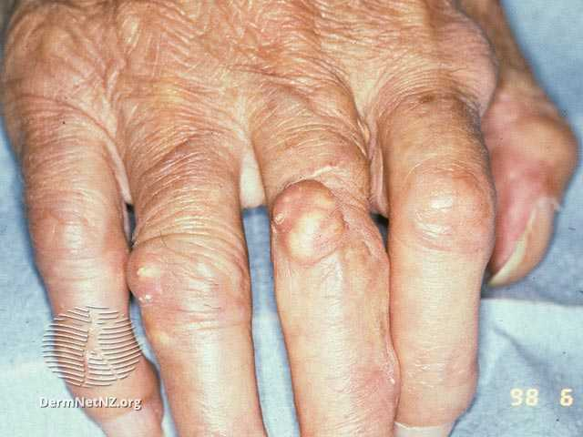
presentation
Dermatomyositis
CREST syndrome
PCT
LE (SLE, panniculitis, DLE, SCLE)
On trunk, limbs
Yellow white nodules and plaques
Ulcerate, transelimination of chalk like white material
Calcification of muscles, contractures, deformity
Site of trauma (elbows, knuckles, volar aspect of fingers)
Nodules/plaques → ulcerate → extrude chalky white material
When associated with pseudoscleroderma
Ulcerating plaque with transelimination of chalky material
Head, neck, dorsum of hand
Heals with scarring
Scarring alopecia of scalp
Asymptomatic
Nodules in subcutis
Buttocks

Slide 21
presentation
Dermatomyositis
CREST syndrome
PCT
LE (SLE, panniculitis, DLE, SCLE)
On trunk, limbs
Yellow white nodules and plaques
Ulcerate, transelimination of chalk like white material
Calcification of muscles, contractures, deformity
Site of trauma (elbows, knuckles, volar aspect of fingers)
Nodules/plaques → ulcerate → extrude chalky white material
When associated with pseudoscleroderma
Ulcerating plaque with transelimination of chalky material
Head, neck, dorsum of hand
Heals with scarring
Scarring alopecia of scalp
Asymptomatic
Nodules in subcutaneous tissue and buttocks

Slide 22
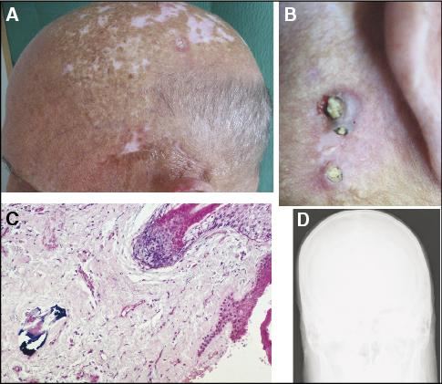
presentation
Dermatomyositis
CREST syndrome
PCT
LE (SLE, panniculitis, DLE, SCLE)
On trunk, limbs
Yellow white nodules and plaques
Ulcerate, transelimination of chalk like white material
Calcification of muscles, contractures, deformity
Site of trauma (elbows, knuckles, volar aspect of fingers)
Nodules/plaques → ulcerate → extrude chalky white material
When associated with pseudoscleroderma
Ulcerating plaque with transelimination of chalky material
Head, neck, dorsum of hand
Heals with scarring
Scarring alopecia of scalp
Asymptomatic
Nodules in subcutaneous tissue and buttocks

Slide 23
presentation
Dermatomyositis
CREST syndrome
PCT
LE (SLE, panniculitis, DLE, SCLE)
On trunk, limbs
Yellow white nodules and plaques
Ulcerate, transelimination of chalk like white material
Calcification of muscles, contractures, deformity
Site of trauma (elbows, knuckles, volar aspect of fingers)
Nodules/plaques → ulcerate → extrude chalky white material
When associated with pseudoscleroderma
Ulcerating plaque with transelimination of chalky material
Head, neck, dorsum of hand
Heals with scarring
Scarring alopecia of scalp
Asymptomatic
Nodules in subcutaneous tissue and buttocks
Notes:
Rarely calcification is seen as a complication of SLE

Slide 24
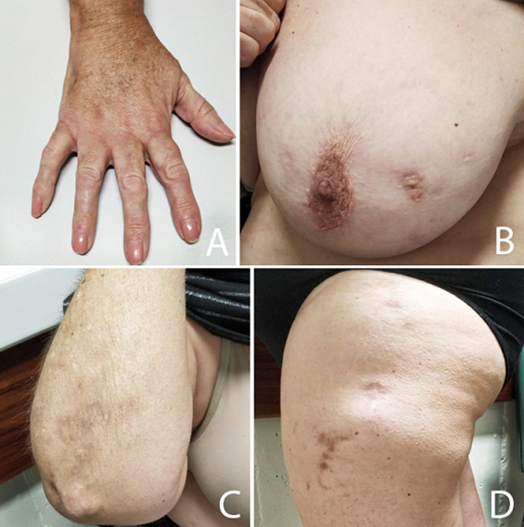
presentation
Dermatomyositis
CREST syndrome
PCT
LE (SLE, panniculitis, DLE, SCLE)
On trunk, limbs
Yellow white nodules and plaques
Ulcerate, transelimination of chalk like white material
Calcification of muscles, contractures, deformity
Site of trauma (elbows, knuckles, volar aspect of fingers)
Nodules/plaques → ulcerate → extrude chalky white material
When associated with pseudoscleroderma
Ulcerating plaque with transelimination of chalky material
Head, neck, dorsum of hand
Heals with scarring
Scarring alopecia of scalp
Asymptomatic
Nodules in subcutaneous tissue and buttocks

Slide 25
Subcutaneous fat necrosis of newborn
infection
Premature infants
Erythematous, well defined nodules/plaques
Cheeks, back, buttocks
May calcify
Associated with hyercalcemia
Calcified nodules
Head, pelvic or pectoral area
Intrauterine herpetic infection

Slide 26
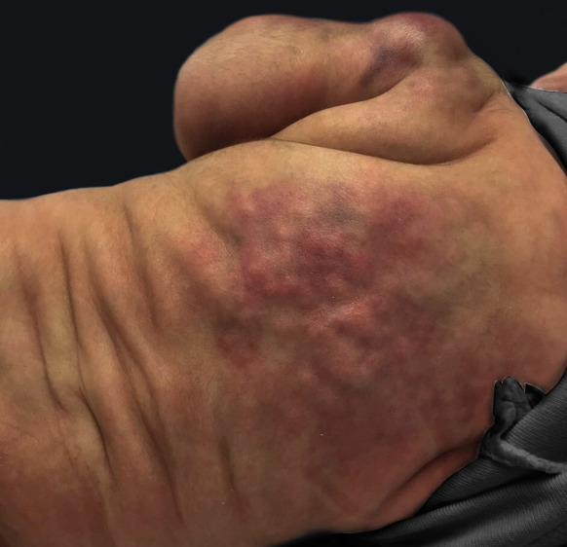
Subcutaneous fat necrosis of newborn
infection
Premature infants
Erythematous, well defined nodules/plaques
Cheeks, back, buttocks
May calcify
Associated with hyercalcemia
Calcified nodules
Head, pelvic or pectoral area
Intrauterine herpetic infection

Slide 27
Subcutaneous fat necrosis of newborn
infection
Premature infants
Erythematous, well defined nodules/plaques
Cheeks, back, buttocks
May calcify
Associated with hyercalcemia
Calcified nodules
Head, pelvic or pectoral area
Intrauterine herpetic infection
Notes:
Infection = onchocerciasis, cysticercosis
Intrauterine herpetic infection may also cause calcification

Slide 28
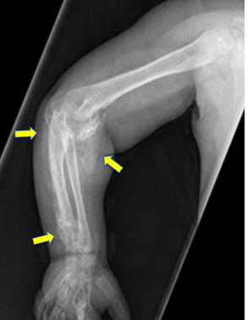
complications
Ulceration with secondary calcification
1
2
Contractures
3
Deformity

Slide 29



investigations
Serology assessment
Full biochemical assessment
Confirm the dx
X-ray
Skin biopsy
For CTD
Serum Ca
Serum phosphate
Alkaline phosphatase
Vitamin D
Parathormone (PTH)

Slide 30
treatment
1st line
Surgical excision/wound care/debridement
CO2laser
Intralesional steroid
Topical thiosulphate
Intralesional thiosulphate

Slide 31
treatment
1st line
Surgical excision/wound care/debridement
CO2laser
Intralesional steroid
Topical thiosulphate
Intralesional thiosulphate
20 mg/ml
Every 4-8 weeks
Notes:
Intralesional steroid 20 mg/ml every 4-8 wks

Slide 32
treatment
1st line
Surgical excision/wound care/debridement
CO2laser
Intralesional steroid
Topical thiosulphate
Intralesional thiosulphate
10% soln
Twice weekly

Slide 33
treatment
1st line
Surgical excision/wound care/debridement
CO2laser
Intralesional steroid
Topical thiosulphate
Intralesional thiosulphate
0.1 ml of 25% soln

Slide 34
2nd line
3rd line
Up to 480 mg per day
Colchicine
Ceftriaxone
Probenecid
Warfarin
IVIG
Diltiazem
Bisphosphonate
Aluminium hydroxide
Minocycline
Stem cell transplant
Notes:
Second line treatment for extensive disease

Slide 35
2nd line
3rd line
Up to 480 mg per day
Colchicine
Ceftriaxone
Probenecid
Warfarin
IVIG
Diltiazem
Bisphosphonate
Aluminium hydroxide
Minocycline
Stem cell transplant
Oral alendronate 10mg/day
Oral Etidronate 800mg/day
IV palmidronate 1mg/kg/day for 3 days every 3 months

Slide 36
2nd line
3rd line
Up to 480 mg per day
Colchicine
Ceftriaxone
Probenecid
Warfarin
IVIG
Diltiazem
Bisphosphonate
Aluminium hydroxide
Minocycline
Stem cell transplant
Up to 2.4 g/day

Slide 37
2nd line
3rd line
Up to 480 mg per day
Colchicine
Ceftriaxone
Probenecid
Warfarin
IVIG
Diltiazem
Bisphosphonate
Aluminium hydroxide
Minocycline
Stem cell transplant
Up to 200mg per day

Slide 38
2nd line
3rd line
Up to 480 mg per day
Colchicine
Ceftriaxone
Probenecid
Warfarin
IVIG
Diltiazem
Bisphosphonate
Aluminium hydroxide
Minocycline
Stem cell transplant

Slide 39
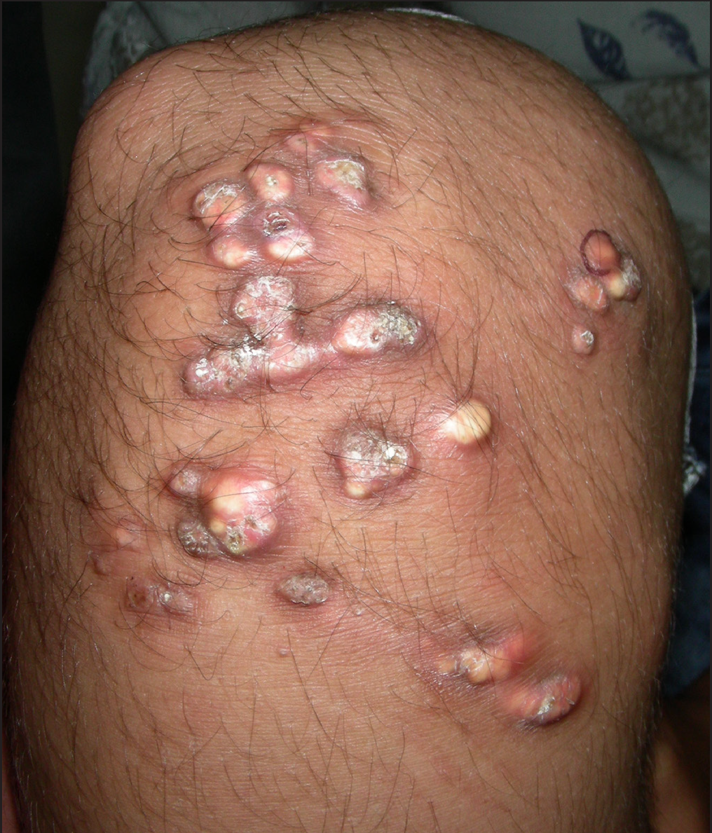
Dystrophic calcification
Trauma/calcium containing injections
At site of trauma
Burns, keloid, heel prick testing
Heparin injections (commonly in renal patients)

Slide 40
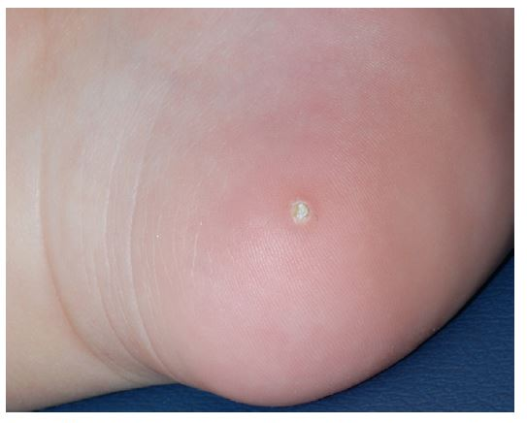
presentaton
POST-INFUSION OR INJECTION
Warm, tender swelling at site of injection Ulceration, necrosis
At site of electroencephalography
HEEL PRICK CALCINOSIS
Firm papule on heels

Slide 41
investigations
Full biochemical assessment
Confirm the dx
Serum Ca
Serum phosphate
Alkaline phosphatase
Vitamin D
Parathormone (PTH)
X-ray
Skin biopsy

Slide 42
treatment
prognosis
Conservative
Excision
Resolve without treatment
Resolves when culprit is removed

Slide 43
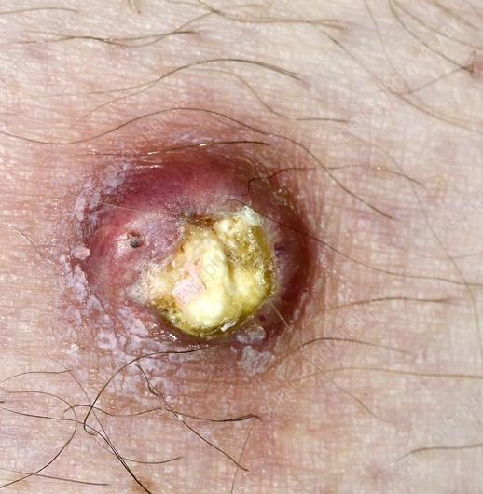
Dystrophic calcification
Tumors and genetic diseases
Benign and malignant tumors of skin
Pilomatricoma (75% of cases), BCC, epidermoid cyst
Genetic (PXE, Ehler Danlos syndrome, Werner syndrome, Rothmund-Thomson syndrome)

Slide 44
presentation
Pilar cyst
epidermoid cyst
Pilomatricoma
Melanocytic naevi
Mobile, hard, subcutaneous papule or nodule
Become inflamed and tender
May perforate, exuding chalky white material
Foci of calcification
Calcify and ossify
PXE
Ehler Danlos syndrome
Werner syndrome
Yellow papules on neck, flexures and abdomen
At sites of scar, calcified subcutaneous spheroids
Progeria with sclerodermoid changes

Slide 45
investigation
treatment
Biopsy (confirmatory)
Excision

Slide 46
Idiopathic calcification
Subepidermal calcified nodules
Scrotal calcinosis
Tumoral calcinosis
Males
White subcutaneous firm, multiple nodules
Childhood
Extremities and head
Solitary hard yellow-white papules or nodules
Twice common in females, adolescent
Large subcutaneous masses
Around major joints
Idiopathic calcinosis universalis
Miliary calcinosis
Rare
Child with Down syndrome
Dermatomyositis

Slide 47
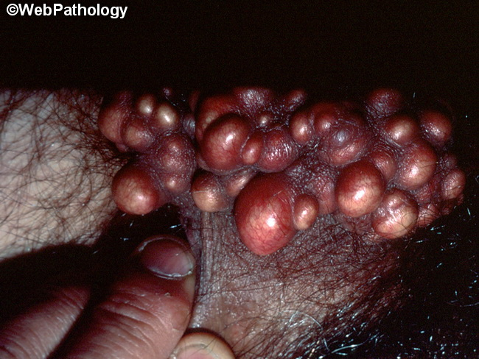
Idiopathic calcification
Subepidermal calcified nodules
Scrotal calcinosis
Tumoral calcinosis
Males
White subcutaneous firm, multiple nodules
Childhood
Extremities and head
Solitary hard yellow-white papules or nodules
Twice common in females, adolescent
Large subcutaneous masses
Around major joints
Idiopathic calcinosis universalis
Miliary calcinosis
Rare
Child with Down syndrome
Dermatomyositis

Slide 48
Idiopathic calcification
Subepidermal calcified nodules
Scrotal calcinosis
Tumoral calcinosis
Males
White subcutaneous firm, multiple nodules
Childhood
Extremities and head
Solitary hard yellow-white papules or nodules
Twice common in females, adolescent
Large subcutaneous masses
Around major joints
Idiopathic calcinosis universalis
Miliary calcinosis
Rare
Child with Down syndrome
Dermatomyositis

Slide 49
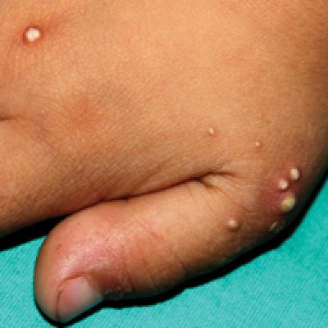
Idiopathic calcification
Subepidermal calcified nodules
Scrotal calcinosis
Tumoral calcinosis
Males
White subcutaneous firm, multiple nodules
Childhood
Extremities and head
Solitary hard yellow-white papules or nodules
Twice common in females, adolescent
Large subcutaneous masses
Around major joints
Idiopathic calcinosis universalis
Miliary calcinosis
Rare
Child with Down syndrome
Dermatomyositis

Slide 50
Idiopathic calcification
Subepidermal calcified nodules
Scrotal calcinosis
Tumoral calcinosis
Males
White subcutaneous firm, multiple nodules
Childhood
Extremities and head
Solitary hard yellow-white papules or nodules
Twice common in females, adolescent
Large subcutaneous masses
Around major joints
Idiopathic calcinosis universalis
Miliary calcinosis
Rare
Child with Down syndrome
Dermatomyositis

Slide 51
investigation
treatment
Biopsy (confirmatory)
Radiology
Serum Ca and PO4
Excision
Spontaneous resolution (miliary)

Slide 52
Metastatic calcification
Abnormality in systemic Ca homeostasis → high Ca deposits
Associations
Hyperparathyroidism
Milk alkali syndrome
Hypervitaminosis-D
Hyperphosphatemia
Sarcoidosis
Bone metastases
Vit D deficiency
(rare)

Slide 53
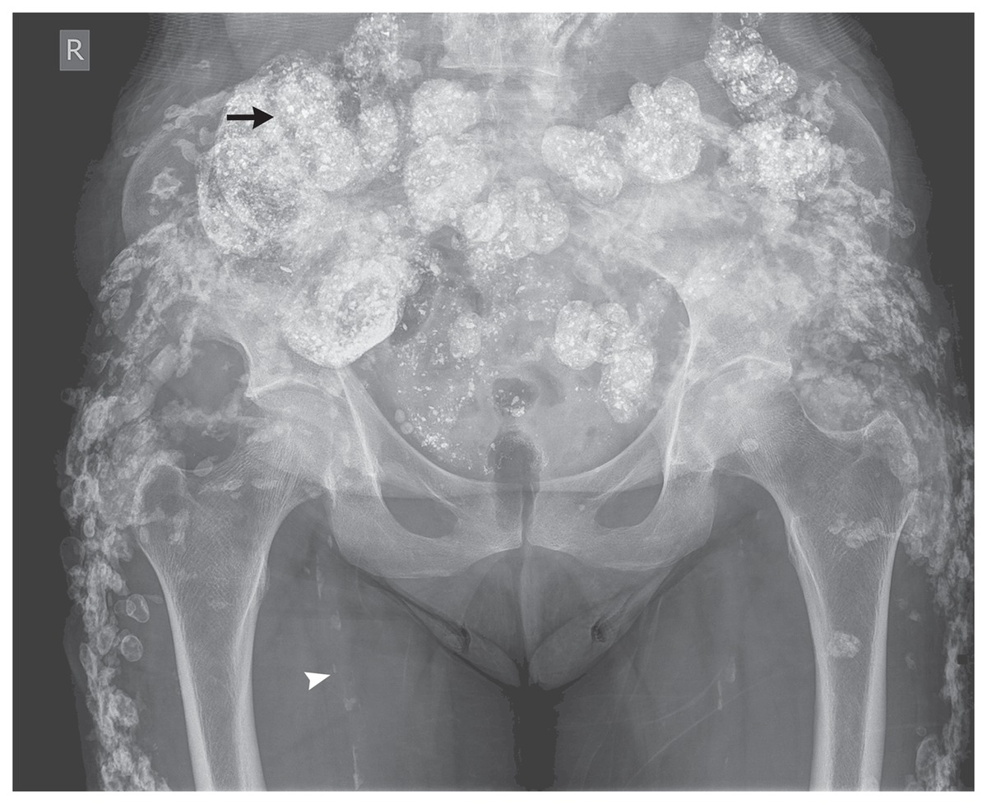
Clinical features
Asymptomatic
Periarticular calcification
Signs of hypercalcemia
Extensive miliary calcification

Slide 54
Complications:
Renal impairment
prognosis
investigation
treatment
Resolves with correction of underlying cause
Biochemical workup
Radiology
Biopsy
Correction of underlying cause
Surgical excision
Notes:
Resolves when hypercalcemia/hyperphosphatemia has been corrected

Slide 55
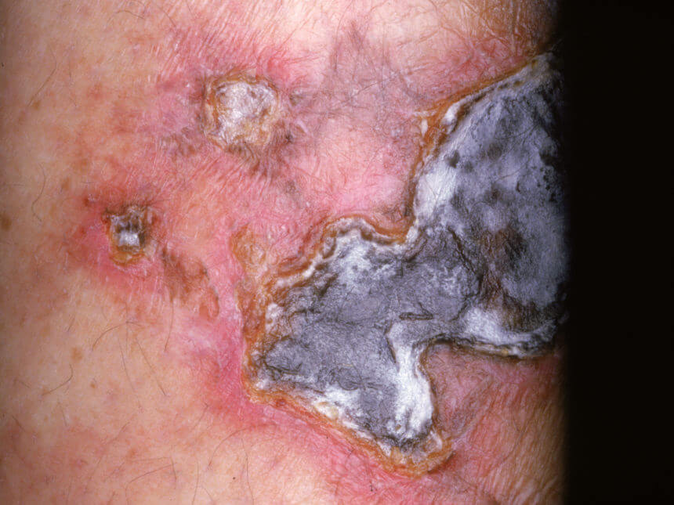
CALCIPHYLAXIS
CALCIPHYLAXIS
Notes:
Also known as calcific uremic arteriopathy or calcifying panniculitis

Slide 56
introduction
Life threatening thrombo-occlusive vasculopathy
Calcium deposits in skin and subcutis, within vessels, in surrounding tissues
Seen in setting of renal failure
Middle age
Female predominance (4:1)
Notes:
Abnormality in systemic Ca homeostasis → high Ca deposits

Slide 57
ASSOCIATIONS
Renal failure
Hepatic failure
Hyperparathy-roidism
Malignancy
Obesity, DM,CTDs
Protein S, Protein C deficiency
Warfarin, steroid use

Slide 58
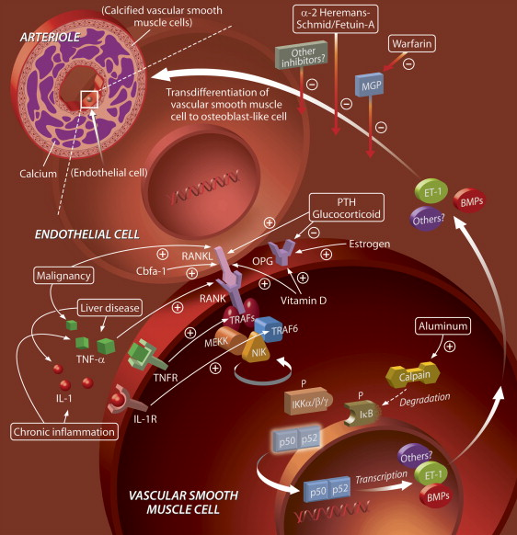
pathophysiology
Multifactorial
Abnormalities in systemic Ca metabolism
Coagulation abnormalities
Receptor activator of nuclear factor kB (RANK), RANK ligand and osteoprotogenerin
Parathyroid hormone, corticosteroid, aluminium, liver disease, inflammations (activate RANK system)
Matrix G1a protein and Fetuin A (inhibit extraosseous calcification)
Warfarin → inhibition of vit K dependent gamma-carboxylation of matrix G1a protein

Slide 59
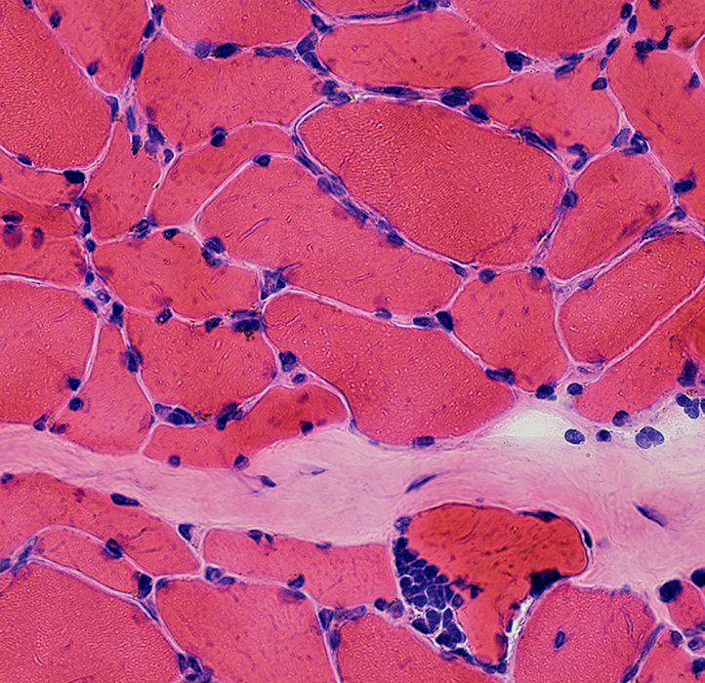
histopathology
Medial calcification
Intimal fibroplasia
Thrombosis of pannicular arterioles with cutaneous necrosis
Extravascular calcium deposits
Notes:
Medial calcification of small and medium sized arteries with intimal hyperplasia in dermal and subcut tissues

Slide 60
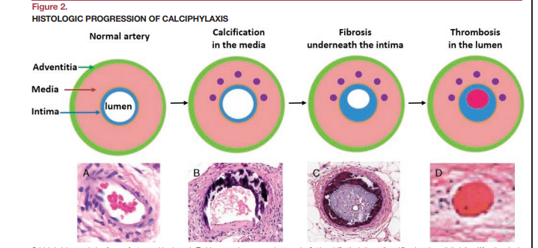

Slide 61
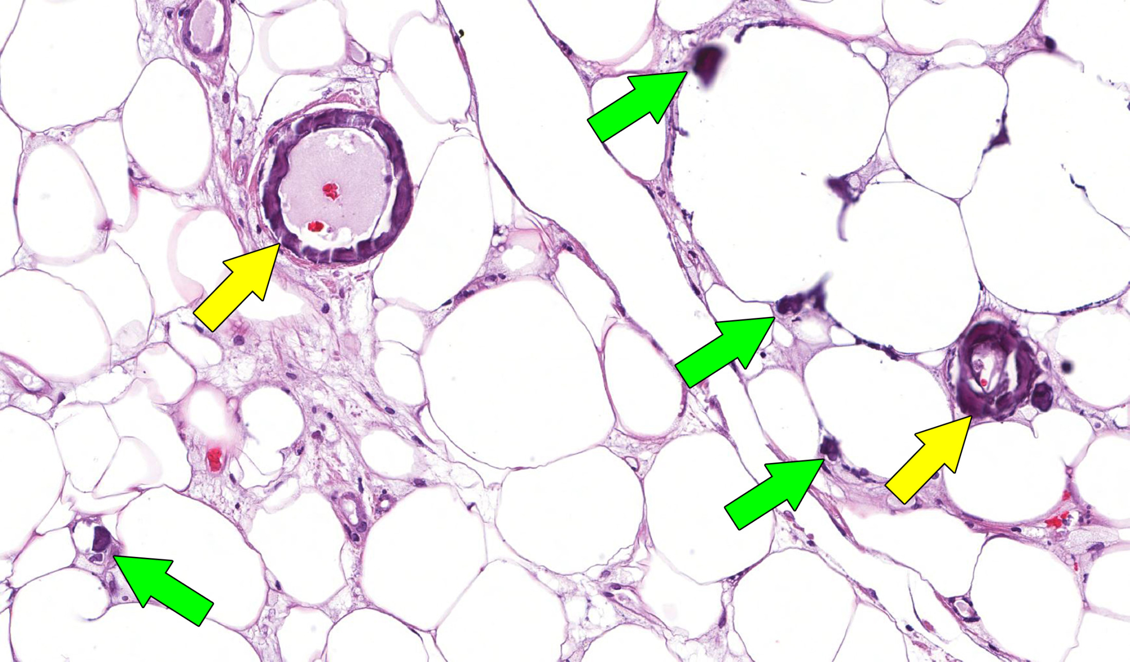
Notes:
Yellow arrows showing blood vessels with calcification
Green arrows showing small foci of calcification

Slide 62
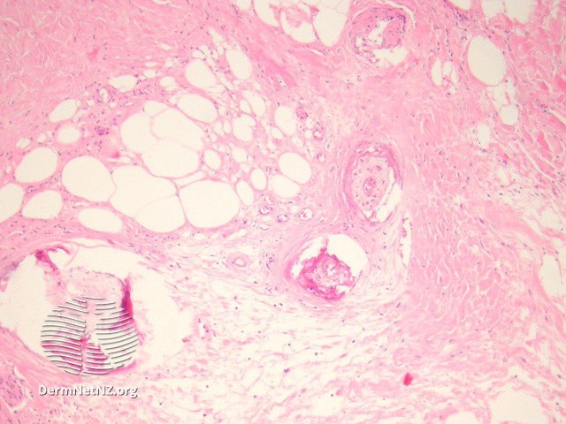

Slide 63
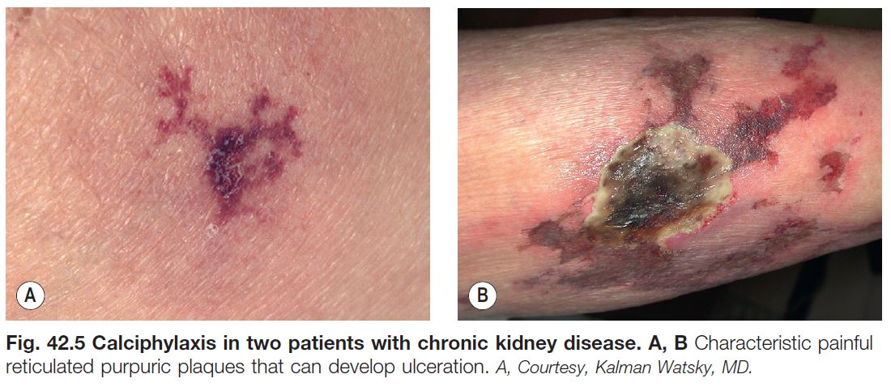
Clinical features
Painful often purpuric
Reticulate, violaceous, ulcerating, necrotic, calcified plaque, and livedo
Ulcers are irregular, stellate and deep
Lower abdomen, thighs
Good prognosis = little cutaneous involvement, more diffuse subcutaneous calcification

Slide 64
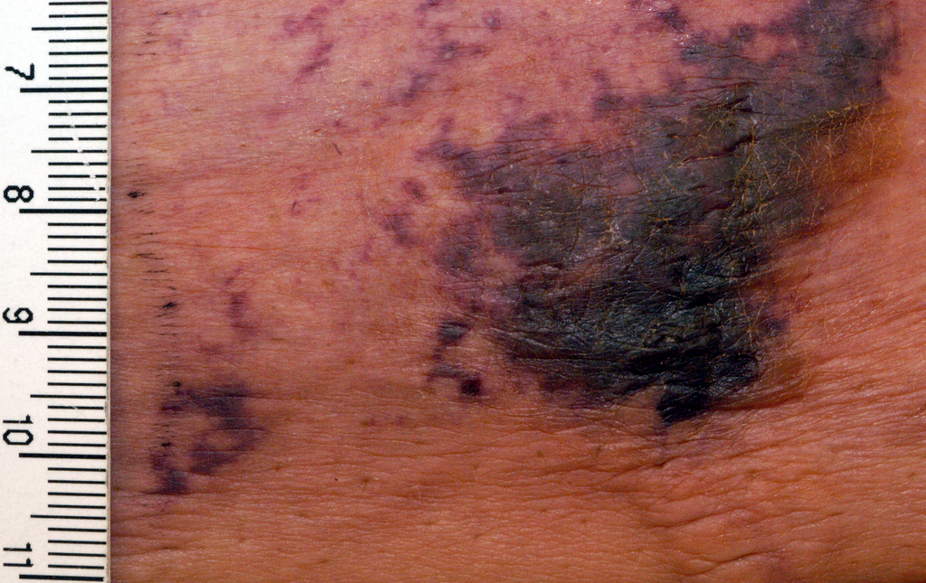

Slide 66
Differential diagnosis
Vasculitis
Hypertensive ulcer of Martorell
Warfarin and heparin necrosis
Pyoderma gangrenosum
Necrotizing fasciitis
Notes:
In more severe form necrotizing fasciitis

Slide 67
 | Calciphylaxis | Pyoderma gangrenosum | Warfarin necrosis | Hypertensive ulcer (Martorell)
M:F | 1:4 | 4:6 | 1:4 | 1:4
Age | >40 | Any age | >50 | >55
Site | Abdomen, thighs, lower leg | Legs (commonly) | Breast, hips, buttocks, thighs | Lower leg
Pain | Severe | Severe | Moderate | Severe
Edge | Purpuric, livedoid | Purpuric, raised, inflamed | Erythema | Purpuric, livedoid
Surrounding tissues | Livedo and firm, S/c, calcified nodules/plaques | Inflamed | --- | Livedo
Ca homeostasis | Often normal | --- | --- | ---
Associated diseases | Chronic renal failure, dialysis, hepatic failure, DM | IBD, RA, heme malignancies | Protein C deficiency | HTN
Histology | Medial calcification, extravascular Ca deposition | Non-specific inflammation, necrosis, ulceration | Fibrin, thrombi, small vein and venules | Hyaline arteriosclerosis, intimal thickening, luminal narrowing

Slide 68
Classification of severity
complications
Patients with more obvious subcutaneous calcification without livedo or necrosis have a benign course
Septicemia
Renal impairment

Slide 69
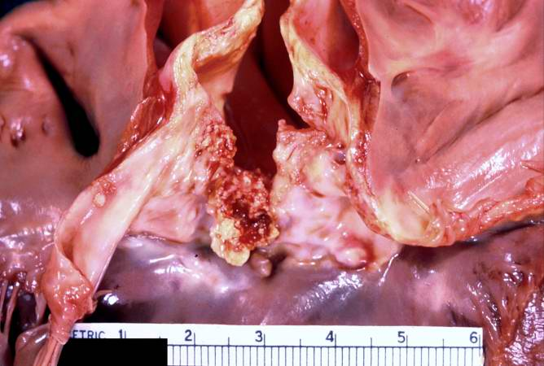
prognosis
Cardiac, gastrointestinal, systemic arteries involvement
Mortality up to 80%
Median survival rate < 3 months
Mortality > 60% with treatment

Slide 70
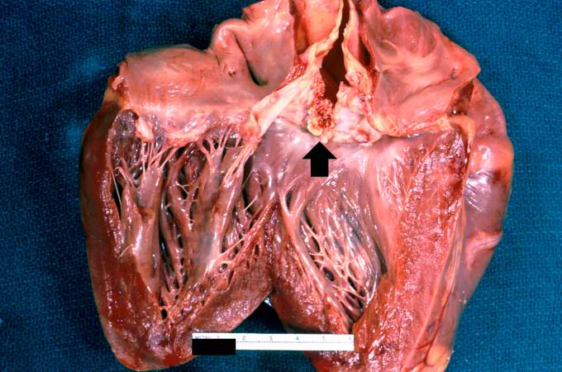
prognosis
Cardiac, gastrointestinal, systemic arteries involvement
Mortality up to 80%
Median survival rate < 3 months
Mortality > 60% with treatment

Slide 71
investigations
Full biochemical assessment
serology
Confirm the dx
Serum Ca
Serum phosphate
Alkaline phosphatase
Vitamin D
Parathormone (PTH)
Blood sugar, HbA1c
LFTs
Coagulation screen
Culture
X-ray
Skin biopsy

Slide 72
treatment
Correct Ca levels
Debridement
Treatment of underlying renal disease
Treat septicemia
IV sodium thiosulphate
Thrombolysis
Anticoagulants
Parathyroidectomy

